Slide 1
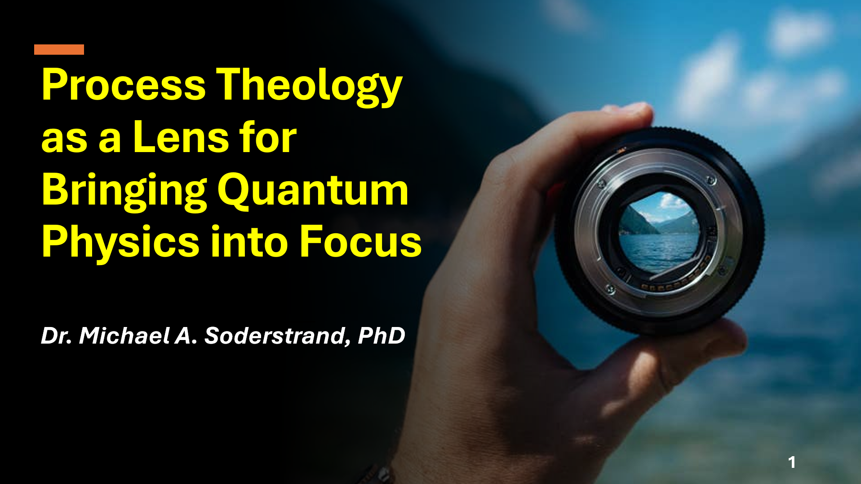

Process Theology as a Lens for Bringing Quantum Physics into Focus
Dr. Michael A. Soderstrand, PhD

Slide 2
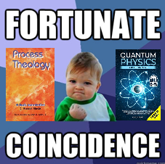
A Fortunate Coincidence
I want to begin with a personal story
As a graduate student in the late 1960s I took two courses at the same time:
  Process Theology
  Quantum Physics
I had no idea how important that coincidence would be

Slide 3
A Fortunate Coincidence
Something surprising happened
The Process Theology course
made quantum physics feel:
  Natural
  Intuitive
  Even… straightforward
Not strange
Not mysterious

Slide 4
A Fortunate Coincidence
Most people experience quantum physics very differently:
  Confusing
  Counterintuitive
  “Weird”
That wasn’t my experience
Question: Why?

Slide 5

What I Realized Later
Much later, I began to understand
  I had learned quantum physics
  with a very different starting intuition
  I didn’t have to “unlearn” anything first

Slide 6
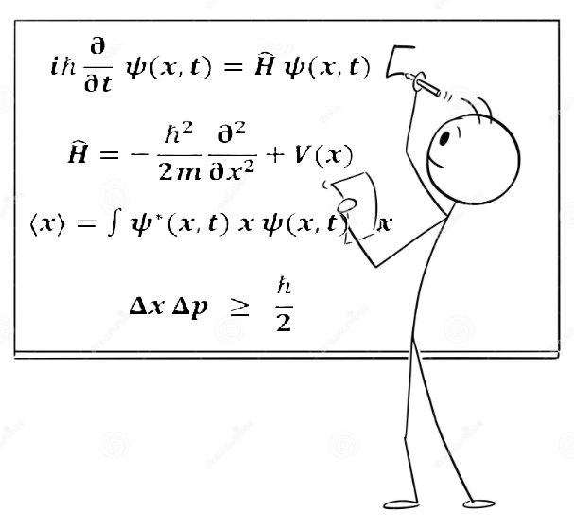
The Usual Approach
Most courses follow this path:
  Build classical physics
  Develop intuition based on objects
  Then introduce quantum physics
Result:
→ Quantum physics feels like a break from reality because classical physics was mistaken for reality

Slide 7
The Usual Approach
The Hidden Cost
Students are left thinking:
  Classical physics = normal
  Quantum physics = strange
And often:
You must unlearn your intuition to understand it

Slide 8

A Different Possibility
What if the problem is not quantum physics…
…but the way we were taught to think?

Slide 9
A Different Possibility
The Alternative Approach
Start with a different intuition
Learn quantum physics first
Use a framework where it feels natural
Then:
→ Classical physics emerges as a limiting case

Slide 10
A Different Possibility
What We Will Do in This Presentation
We will:
  Start with an event-based way of thinking
  Learn quantum physics from that perspective
  Let classical physics emerge naturally

Slide 11

The Role of Process Thought
Process thought (from
Alfred North Whitehead)
Emphasizes:
  Events instead of things
  Becoming instead of static being
This way of thinking:
→ made quantum physics feel intuitive to me

Slide 12
Process Theology
Why Process Theology, Not Just Process Philosophy?
So far we have introduced:
  Events instead of things
  Becoming instead of static being
But this is not yet enough
  The deeper intuition comes from certain conceptual structures used in Process Theology regarding possibility, actuality, and order

Slide 13
Process Theology
What We Are NOT Doing
We are NOT:
  Explaining God
  Arguing theology
  Making religious claims
We are NOT using this to:
  Determine reality
This is not a theology lesson
What We ARE Doing
We are using concepts from Process Theology as:
  A way of thinking
  A source of intuition
Specifically:
→ To understand how the quantum physics model behaves

Slide 14
Process Theology
Why Go This Far?
Quantum physics describes:
  Possibilities
  Probabilities
  Patterns
But it does NOT provide:
  An intuitive picture
Process Theology provides a structured way to think about these ideas

Slide 15
Process Theology
Three Conceptual Roles (God from Process Theology)
  Primordial Nature
  → Structured realm of possibilities (Analogy: Quantum States)
  Consequent Nature
  → Actual events (Analogy: Particle-like detections)
  Superjective Nature
  → Influence toward pattern (Analogy: Probability distributions)

Slide 16
Process Theology
How We Will Use These Concepts
We are NOT using these to describe God
We ARE using them as a model for thinking about quantum physics
Treat them as:
  Conceptual tools
  Intuition builders

Slide 17
Process Theology
From Process Language → Quantum Intuition
Primordial Nature (Possibility)
  → Quantum state: range of possible outcomes
Consequent Nature (Actuality)
  → Measurement events: what actually occurs
Superjective Nature (Patterning Influence)
  → Stable probability distributions: what the model predicts

Slide 18
Process Theology
A New Way to Think About Quantum Physics
Measurement outcomes are not classically deterministic
Yet outcomes are not mere random chaos
Measurement outcomes are:
Structured possibilities
  → actualized in events
  → forming stable patterns

Slide 19
Process Theology
What This Does NOT Mean
We are NOT saying:
  Particles are theological
  Physics depends on God
  This is what reality “is”
This is a way to build intuition
for a predictive model
We are borrowing the structure of Process Theology to develop intuition for how the quantum physics model works

Slide 20

Where We Are Going
We will build this step by step in Sessions 2 through 8:
Lecture 2: The Standard Model → Detected Events (Actual occasions)
Lecture 3: From Particles to Equations → Structured Possibility (Primordial nature)
Lecture 4: Quantization: Building the Quantum State Machine → Ordered Indeterminacy (Creativity under constraint)
Lecture 5: Running the Model: Time Evolution and Becoming → Creative Advance (Ordered process becoming form)
Lecture 6: The Single Slit Experiment → Tendency and Pattern (Lure / aim expressed probabilistically)
Lecture 7: Bound States: The Hydrogen Atom and Stable Matter → Enduring Relations (Societies with inherited order)
Lecture 8: Summary and Conclusions
→ Understanding Physics Through the Process Lens

Slide 21
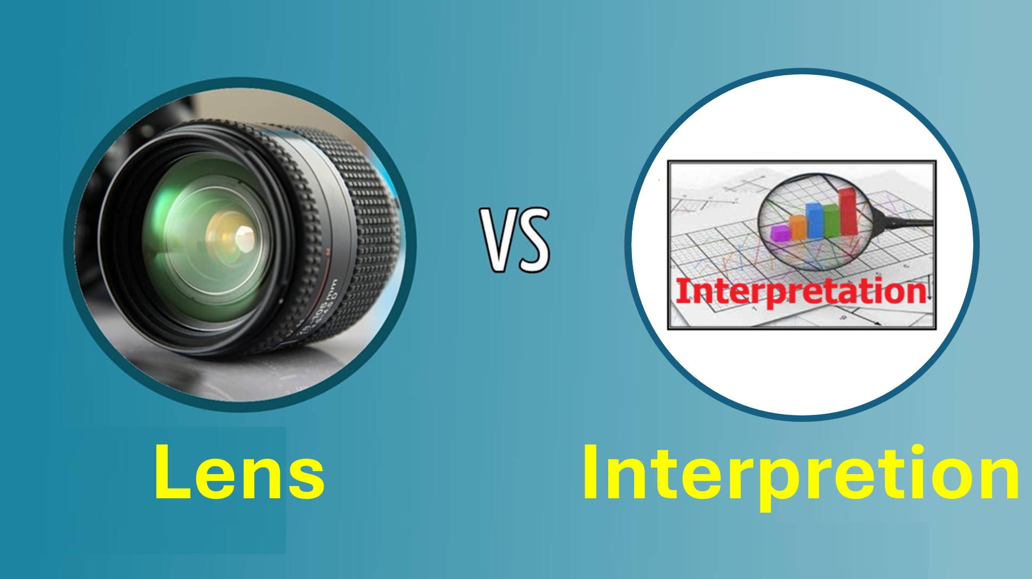
A Potential Confusion
Lens vs Interpretation
At this point, an important question arises:
Are we using Process Theology as an interpretation of quantum physics?

Slide 22
A Potential Confusion
No — This Is Not an Interpretation
We are NOT:
  Explaining what reality is
  Filling in what physics leaves out
We ARE:
  Using a way of thinking
  To better understand the model
This is a lens for understanding, not an interpretation of reality

Slide 23
What is an Interpretation?
What Physics Can—and Cannot—Tell Us
Quantum physics places limits on what can be known
Example:
  Heisenberg Uncertainty Principle
  We cannot simultaneously know:
  Exact position
  Exact momentum

Slide 24
What is an Interpretation?
Between Detection Events
Quantum physics predicts:
  What we will observe
  With what probability
Physics predicts observable outcomes and probabilities, but it does NOT tell us:
  What a particle is doing
  between detection events

Slide 25
What is an Interpretation?
Einstein vs Bohr
Albert Einstein
  → Thought quantum physics was incomplete
  → Wanted a deeper description
Niels Bohr
  → Argued that quantum physics is sufficient for describing observable phenomena
  → What happens between events is not accessible to science

Slide 26
What is an Interpretation?
Interpretation is attempts to fill in the Gap
Several interpretations attempt to clarify what the formalism means, and in some cases what underlying reality may be like:
  Copenhagen interpretation
  Bohmian mechanics
  Many-worlds interpretation

Slide 27
My Approach
INSTRUMENTALISM
Instrumentalism is:
  Closely aligned with
  Copenhagen interpretation
But:
  Even more disciplined
We focus only on prediction —not interpretation!

Slide 28
My Approach
What I Am—and Am Not—Doing
I am NOT:
  Using Process Theology to interpret quantum physics
  Making claims about reality
I AM:
  Using Process Theology
  → as a way to build intuition
  → so the quantum model is easier to understand

Slide 29
Summary
Physics tells us what happens
Interpretations try to say what is real
We focuses only on what happens and use Process Theology to help us understand it

Slide 30
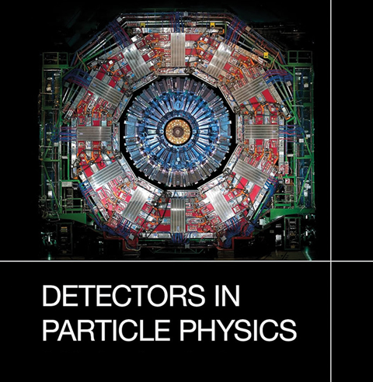
Today’s Focus
We begin with one example:
  A particle-like detection
This is:
  A physical event
  A measurable occurrence
→ Our first “actual occasion”

Slide 31
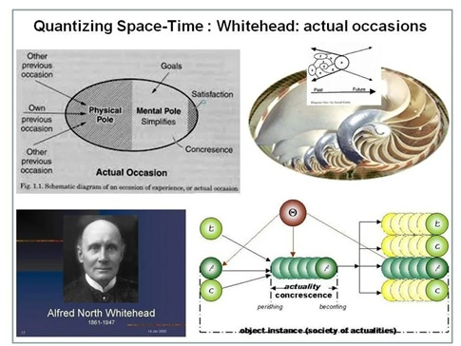
Actual Occasion
In Process Theology an “Actual Occasion” is:
  A concrete event
  Comes into being
  Not a thing
  Not persistent
→ A moment of realization
In physics:
  A detection event
Same structure: a realized event

Slide 32
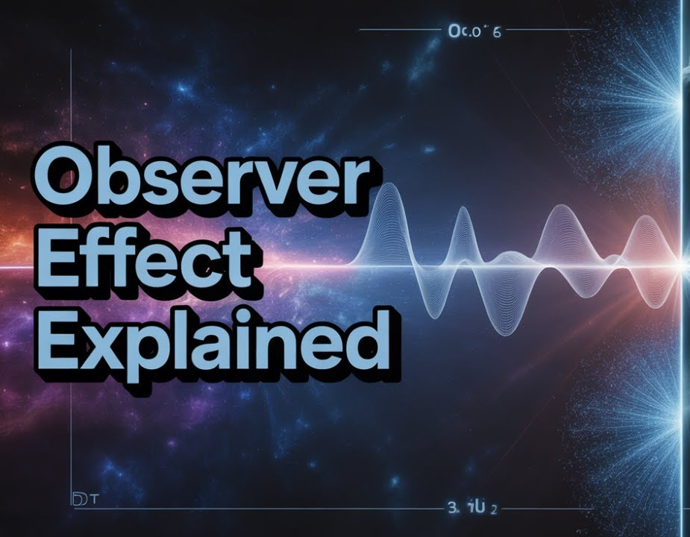
What We Observe in Physics
Particle-Like Detection In physics:
  A detector registers
  A discrete energy transfer
  At a specific place and time
  The energy transfer exhibits identifiable properies like mass, charge and spin
→ What we observe is an event
Connecting the Two
  Detection event
  Actual occasion
→ Same structure: a realized event
Note:
  This is an analogy
  Physics stands on its own
  Process Theolgy helps us understand it

Slide 33
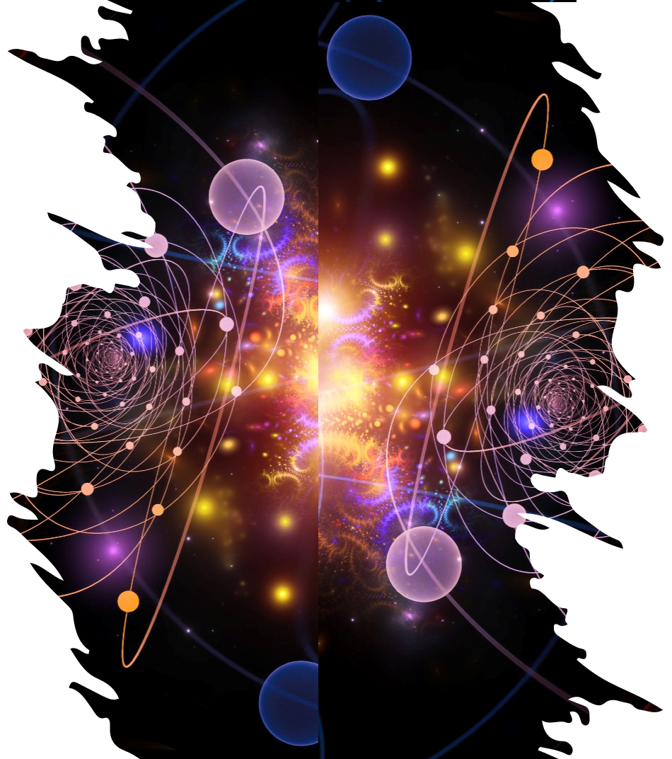
Three Roles: Possibility, Event, Pattern
Process Theology (Used as Intuition)
Primordial Nature
→ Structured realm of possibilities
Consequent Nature
→ Actualized events
Superjective Nature
→ Emergence of pattern and order
Quantum Physics
Model
Quantum State
→ Defines possible outcomes
Detection Event
→ Realized outcome
Probability Pattern
→ Stable statistical distribution

Slide 34
Three Roles: Possibility, Event, Pattern
Process Theology (Used as Intuition)
Primordial Nature
→ Structured realm of possibilities
Consequent Nature
→ Actualized events
Superjective Nature
→ Emergence of pattern and order
Quantum Physics
Model
Quantum State
→ Defines possible outcomes
Detection Event
→ Realized outcome
Probability Pattern
→ Stable statistical distribution
Both frameworks emphasize:
  Not “things”
  But events
  Not static being
  But becoming
A particle is not a thing

Slide 35
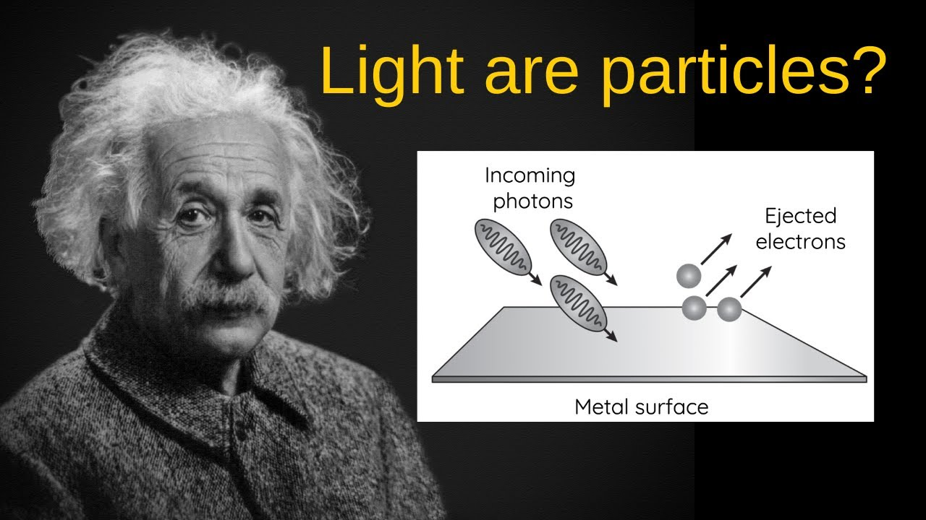
What Is a Particle?
What We Call a Particle
  Not something we see directly
  Not an object traveling
  A name we assign to a particle-like detection event
  A localized quantized energy packet recognized in detection
Based on:
  Mass
  Charge
  Spin
→ A particle is the identified type of a quantized energy-packet detection event

Slide 36
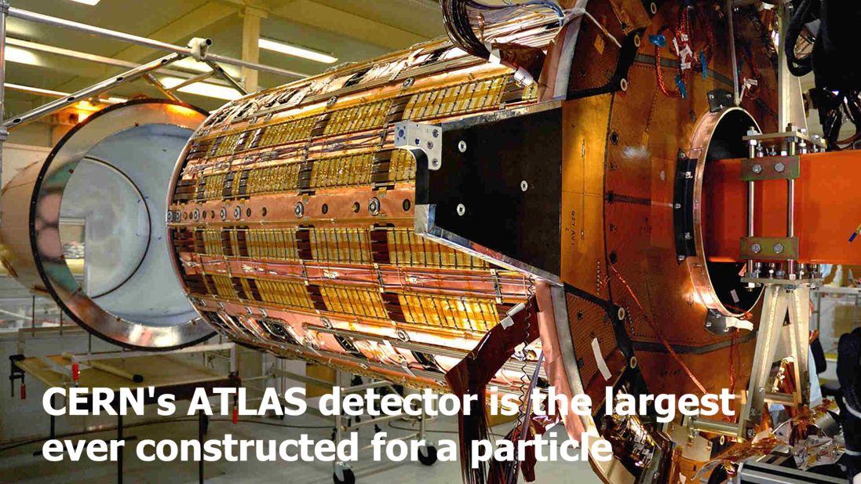
What Happens in Detection
What happens in a particle detector:
  Energy is transferred
  In a discrete amount
  Into the detector
→ Detection = quantized energy transfer
Elementary particle types are identified by characteristic properties such as:
  Mass
  Charge
  Spin
→ These properties identify the type of event observed

Slide 37
What Happens in Detection
A particle-detection event Is not:
  Detection of a tiny object arriving
But:
  A localized energy-transfer event occurring
  A quantized detector response being registered
The quantum model predicts:
  How much energy, momentum, charge, and spin will be transferred
  The statistical laws governing such events
The quantum model does not tell us:
  What underlying “thing” caused the event in transit
The “particle” is the label we assign to a detected quantized energy-transfer event

Slide 38
What Happens in Detection
Types of Detection Events
Physics identifies recurring detection-event categories associated with elementary particles:
Six Leptons
  Electron, muon, tau, neutrinos (3 types)
Six Quarks
  Up/down, charm/strange, top/bottom
Six Bosons
  Photon, W/Z, Higgs, gluons and graviton (still has not been detected)
18 different kinds of detectable events

Slide 39
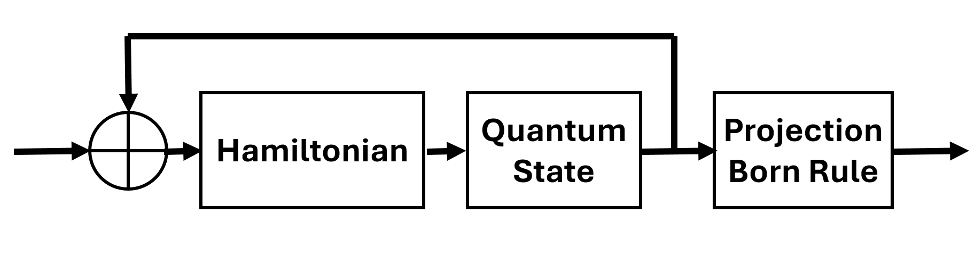
The Quantum State Machine Model Allows Us to Extremely Accurately Predict the Outcome of Physics Experiments
The Quantum Model is a standard state machine model
The model has three parts only:
  A space of possible states (Hilbert Space)
  Rules for evolving the states (Hamiltonian)
  Measurement rule (Born rule)
Nothing else is required for prediction

Slide 40
The Quantum State Machine Model Allows Us to Extremely Accurately Predict the Outcome of Physics Experiments
How the Quantum State Machine Model Is Typically Built
  We do not start directly with the quantum model
  We begin with:
  → A classical Lagrangian
The Lagrangian contains:
  The fields (as variables)
  Their interactions
  The structure of the system
It is the starting blueprint of the theory

Slide 41
The Quantum State Machine Model Allows Us to Extremely Accurately Predict the Outcome of Physics Experiments
What Are “Fields” at This Stage?
  In the Lagrangian:
    Fields are classical variables
  They describe:
      What can exist
      How it can change
Examples:
  Electron field
  Electromagnetic field
These are not yet quantum objects
They are part of the starting description

Slide 42
The Quantum State Machine Model Allows Us to Extremely Accurately Predict the Outcome of Physics Experiments
From Classical to Quantum
Quantization is the mathematical process that turns the classical description into a quantum model
From this process we obtain:
  Quantum states
  A Hamiltonian (energy operator)
This is where the classical framework is converted into a quantum theory

Slide 43
The Quantum State Machine Model Allows Us to Extremely Accurately Predict the Outcome of Physics Experiments
The Final Structure of the Model
Quantum fields are:
  Mathematical operators
  Acting on quantum states
Their effects are already built into:
  The quantum states (Hilbert Space)
  The quantum mathematical operators (Hamiltonian)
So the final model consists of:
  Quantum states
  Hamiltonian
  Born Rule
Fields are not a separate part because they are already encoded in the model

Slide 44
The Quantum State Machine Model Allows Us to Extremely Accurately Predict the Outcome of Physics Experiments
Predicts with extraordinary precision
Explains atoms, chemistry, and the stability of matter
Powers semiconductors, lasers, microchips, MRI, and modern electronics
Correctly models particle interactions and quantum phenomena
Has never failed in its tested domain when properly applied
The most successful predictive frameworks in human history
Quantum Physics Model
Predicts probabilities of detection events
Consists of three parts:
  Quantum states
  Hamiltonian
  Born Rule

Slide 45

From Possibility to Event to Pattern
Conceptual Lens (Process Theology)
  Primordial Nature → Possibility
  Consequent Nature → Actual events
  Superjective Nature → Pattern
Possibility → Event → Pattern
Next Session
  → What is a quantum state?
  → Understanding possibility
  → Primordial Nature

Slide 46


