Slide 1


Process Theology as a Lens for Bringing Quantum Physics into Focus
Dr. Michael A. Soderstrand, PhD
Lecture 2: The Standard Model
→ Detected Events
(Actual occasions)

Slide 2
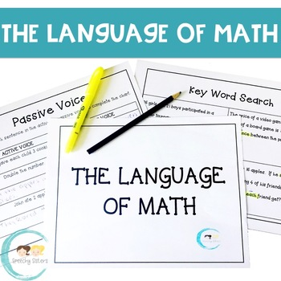
The Language Problem in Quantum Physics
Quantum Physics and Human Understanding
The deepest and most accurate language of quantum physics is mathematics.
But mastering the mathematics of quantum theory requires years of specialized study.
Quantum physics challenges — or “destabilizes” — the classical picture of reality as fundamentally made of stable, independently existing things.
Yet quantum physics does not naturally provide replacement conceptual language for ordinary human understanding.
The Result: We can calculate quantum reality with extraordinary precision, but struggle to describe it conceptually in everyday language.

Slide 3
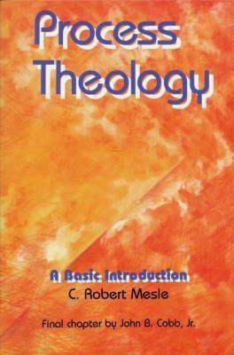
Why Process Theology Matters Here
Process Theology as a Conceptual Bridge
Process Theology provides a highly developed vocabulary of:
  events
  relations
  becoming
  process
This language is far more accessible to a lay audience than advanced quantum mathematics.
Process Theology helps translate event-centered quantum thinking into concepts people can discuss, imagine, and reflect upon.
In this lecture series, Process Theology is being used philosophically and pedagogically rather than as a literal description of reality.
Central Idea
Process Theology does not replace quantum mathematics.
It provides conceptual language that helps make quantum thinking more understandable.

Slide 4
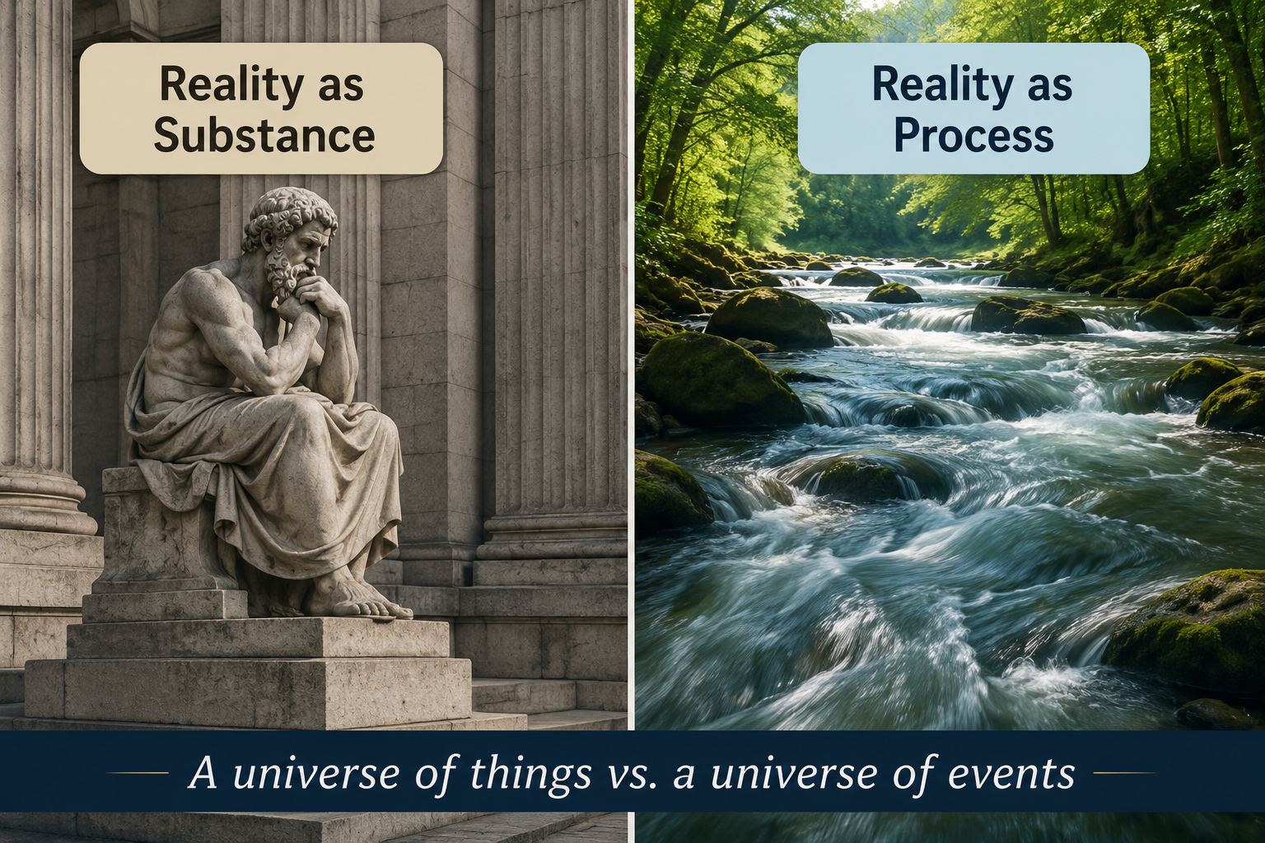
What Is Process Theology?
A Different Way of Understanding Reality
Traditional theology often emphasizes:
  Being over becoming
  Substance over event
  Permanence over change
Process Theology emphasizes:
  Becoming over being
  Events over substances
  Relationship over isolation
  Creativity over determinism
Key Insight
  Reality is not a collection of static things.
  Reality is an ongoing process of becoming.

Slide 5

Core Themes of Process Theology
Reality as Creative Becoming
  Reality consists of interconnected events.
  Every moment contributes something new.
  The future is partly open.
  Creativity is a fundamental feature of existence.
  God continuously offers new possibilities.
Process Theology in One Sentence
  The universe is a creative process unfolding within constraints.

Slide 6

Implications of Process Theology
A God Who Participates in History
Process Theology portrays God as:
  Experiencing the joys and sufferings of creation.
  Working through persuasion rather than coercion.
  Calling creation toward greater beauty, truth, and justice.
  Sharing in the world's ongoing becoming.
Implications
  Human choices matter.
  The future is not predetermined.
  New possibilities can emerge.

Slide 7
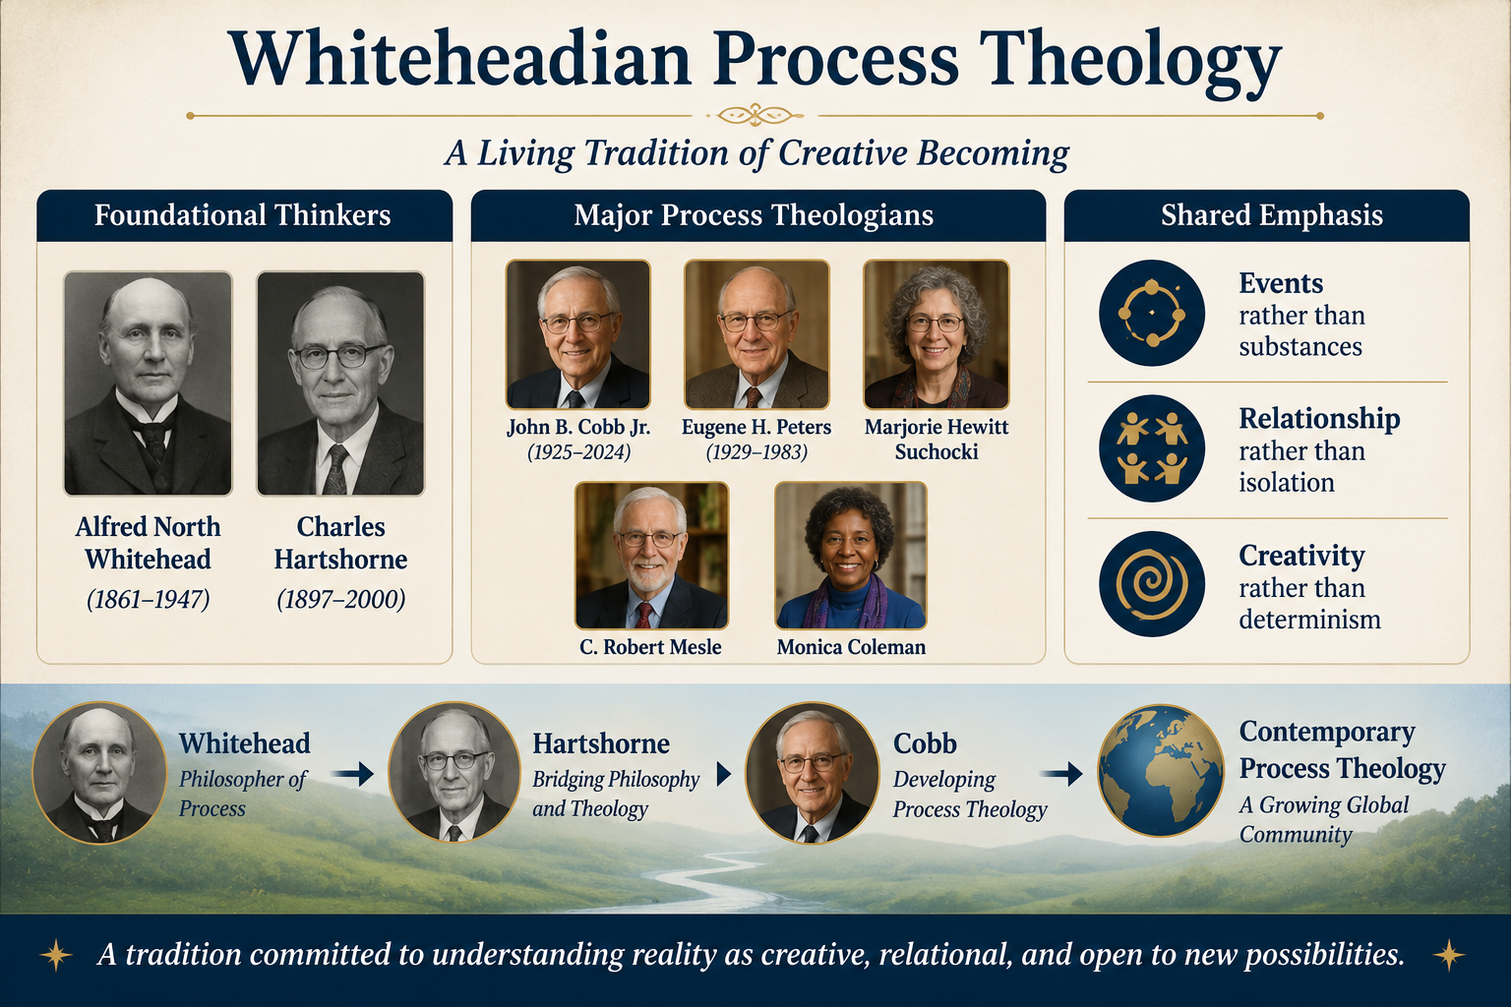
Key Process Thinkers
Whiteheadian Process Theology Foundational Thinkers
  Alfred North Whitehead
  Charles Hartshorne
Major Process Theologians
  John B. Cobb Jr.
  Eugene H. Peters
  Marjorie Hewitt Suchocki
  C. Robert Mesle
  Monica Coleman
Shared Emphasis
  Events rather than substances
  Relationship rather than isolation
  Creativity rather than determinism

Slide 8
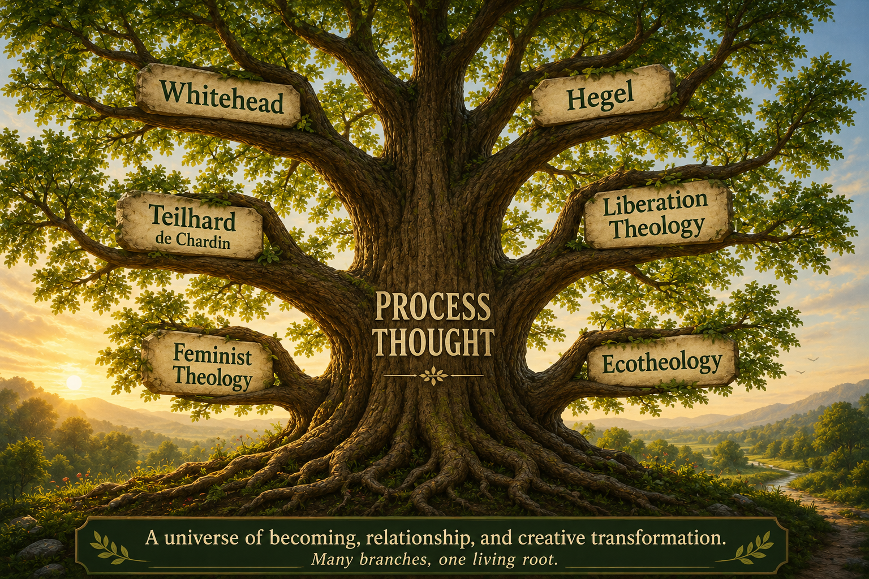
The Broader Family of Process Thought
Beyond Whitehead
John Cobb suggested that "process theology" may include all theologies emphasizing:
  Event over substance
  Becoming over being
  Change over permanence
Related Voices
G. W. F. Hegel
Pierre Teilhard de Chardin
Matthew Fox
Richard Rohr
Sallie McFague
Rosemary Ruether
Catherine Keller
Henry Young
Shared Question
  How does genuine novelty emerge in the universe?

Slide 9
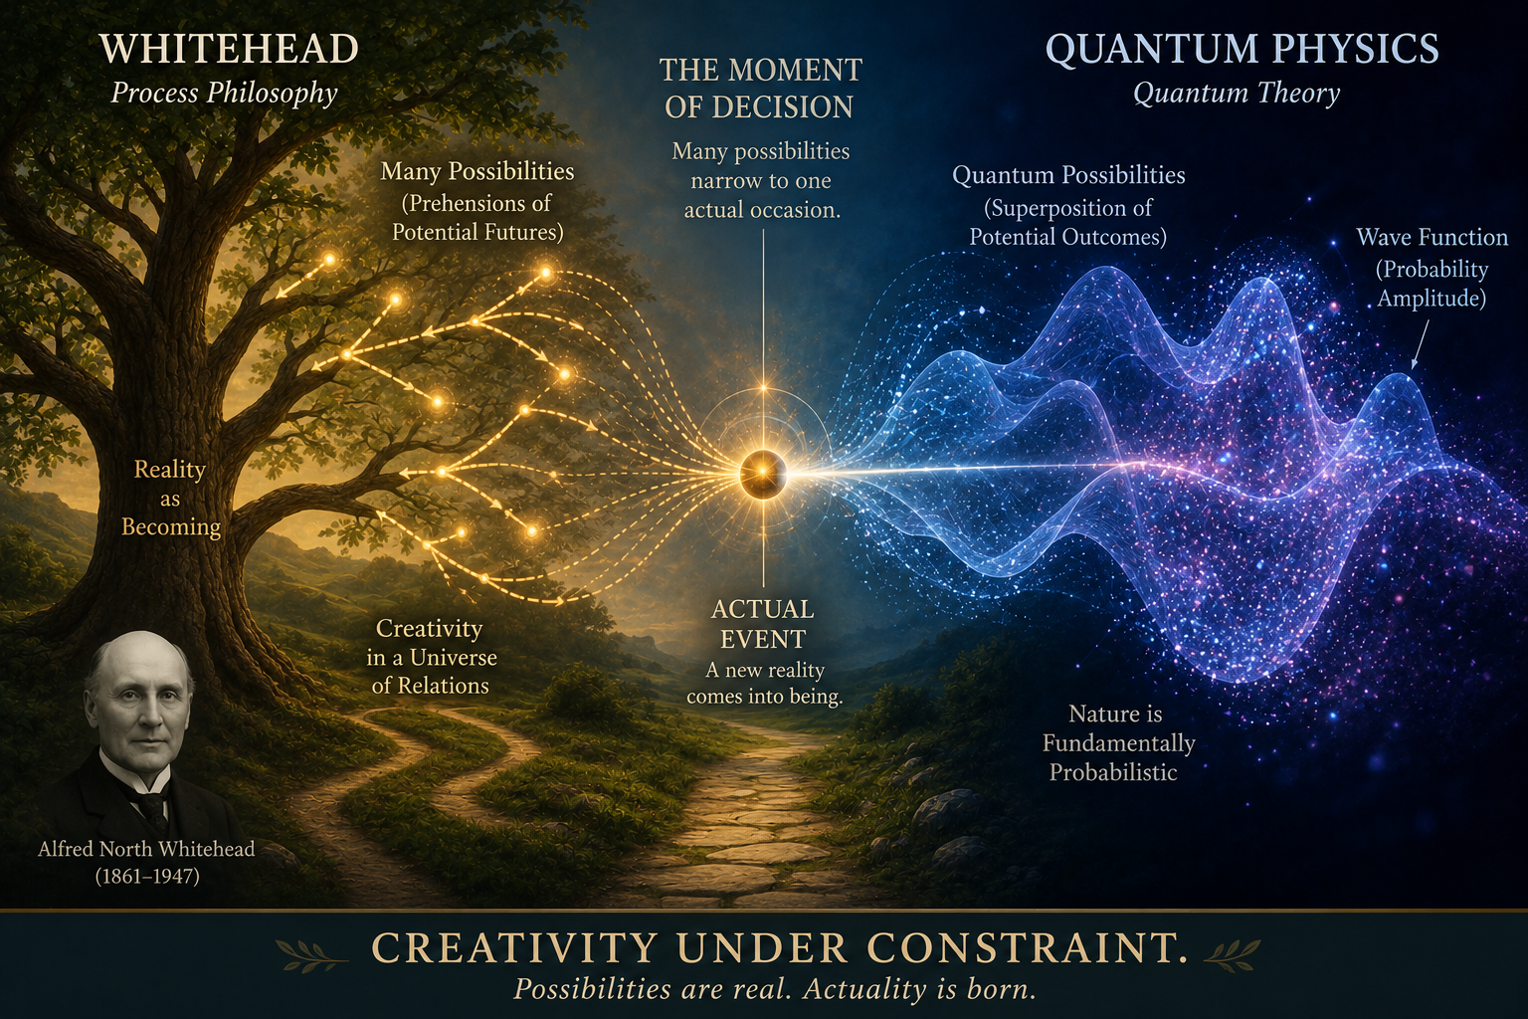
From Process Theology to Quantum Physics
A Remarkable Convergence
Process Theology proposes:
  Reality is fundamentally event-like.
  The future contains real possibilities.
  Creativity is woven into existence.
  Novelty emerges continuously.
Modern Quantum Physics Suggests:
  Nature is built from quantum events.
  Multiple futures are physically possible.
  Outcomes are constrained but not predetermined.
  Reality unfolds through actualized possibilities.
Central Question of This Lecture
  Can the language of Process Theology help us better understand the physical world revealed by quantum physics?

Slide 10
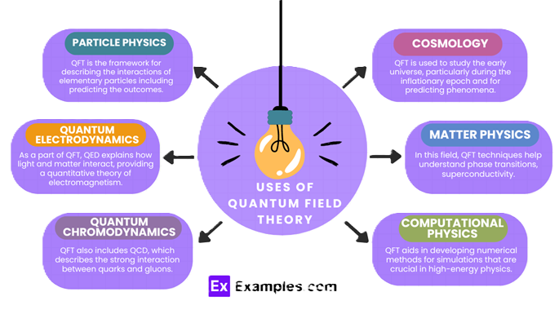
Quantum Physics as a Predictive Framework
Quantum Physics as an Instrumental Framework
The quantum state machine model is fundamentally predictive rather than ontological.
Its purpose is to predict probability distributions of detection events.
The mathematics predicts statistical patterns with extraordinary precision.
But the theory does not specify a classical underlying cause for any individual event.
Instrumental View
Quantum theory is used here primarily as a predictive mathematical framework rather than a literal picture of underlying reality.

Slide 11
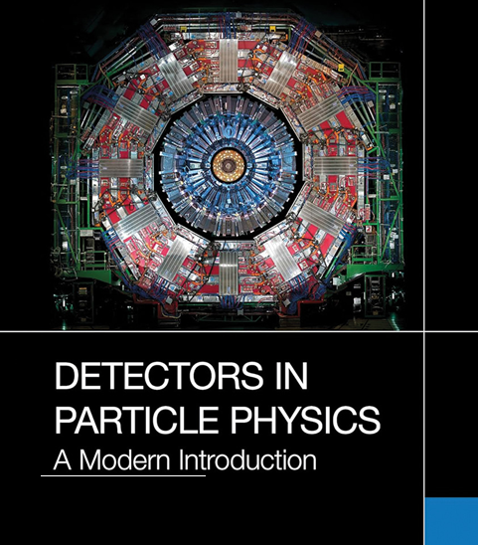
What Quantum Physics
Actually Gives Us
What Physics Directly Observes
Quantum physics experimentally gives us:
  flashes
  clicks
  ionizations
  localized detector events
Conceptual Structures Used in Quantum Theory:
  Quantum fields
  The Hamiltonian
  Hilbert spaces
  Probability amplitudes
  Virtual particles
These mathematical structures need not be treated as literally existing physical objects.

Slide 12
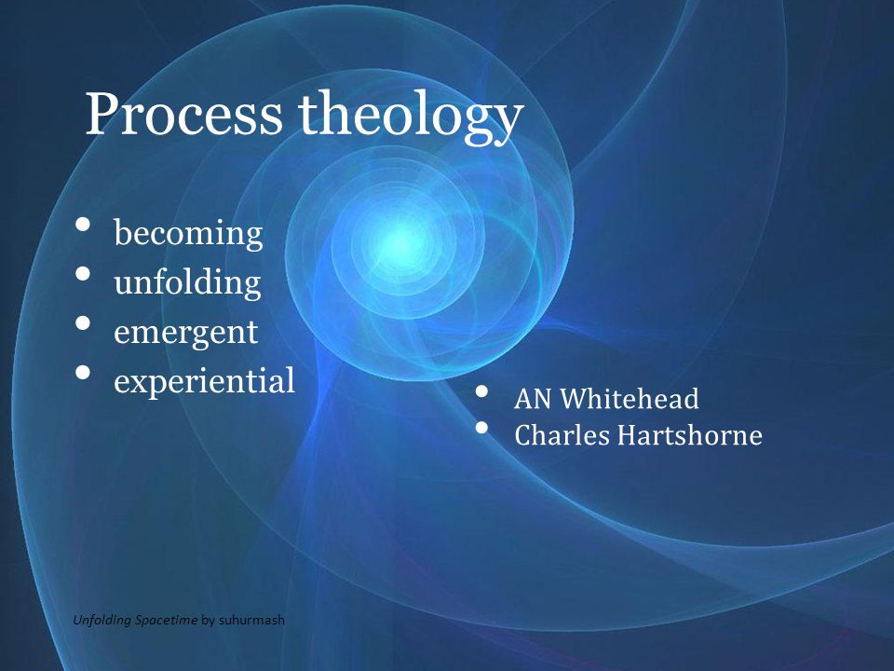
Process Theology as an Interpretive Framework
Process Theology as an Instrumental Framework
Process Theology provides conceptual language centered on:
  events
  relations
  becoming
  process
It helps people think beyond classical substance-centered categories.
It is being used philosophically and pedagogically rather than as a literal description of reality.
Instrumental View: Process Theology is used here primarily as a conceptual interpretive framework rather than a literal picture of underlying reality.

Slide 13

The Conceptual Vocabulary of Process Theology
Conceptual Language in Process Theology
Process Theology uses concepts such as:
  Actual occasion
  Primordial Nature of God
  Superjective Nature of God
  Consequent Nature of God
These concepts are being used here as interpretive tools rather than scientifically established entities.
These conceptual structures need not themselves be treated as literal descriptions of underlying reality.

Slide 14
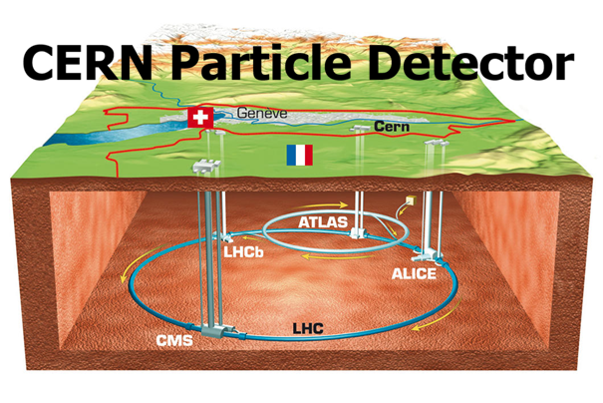
What Do Physicists Actually Detect?
Quantum physics experimentally gives us:
  flashes
  clicks
  ionization tracks
  localized detector events
  quantized energy transfers
Important Point
  Physics does not directly observe tiny visible “particles” moving through space.
  What physics directly observes are localized detection events in measuring instruments.

Slide 15
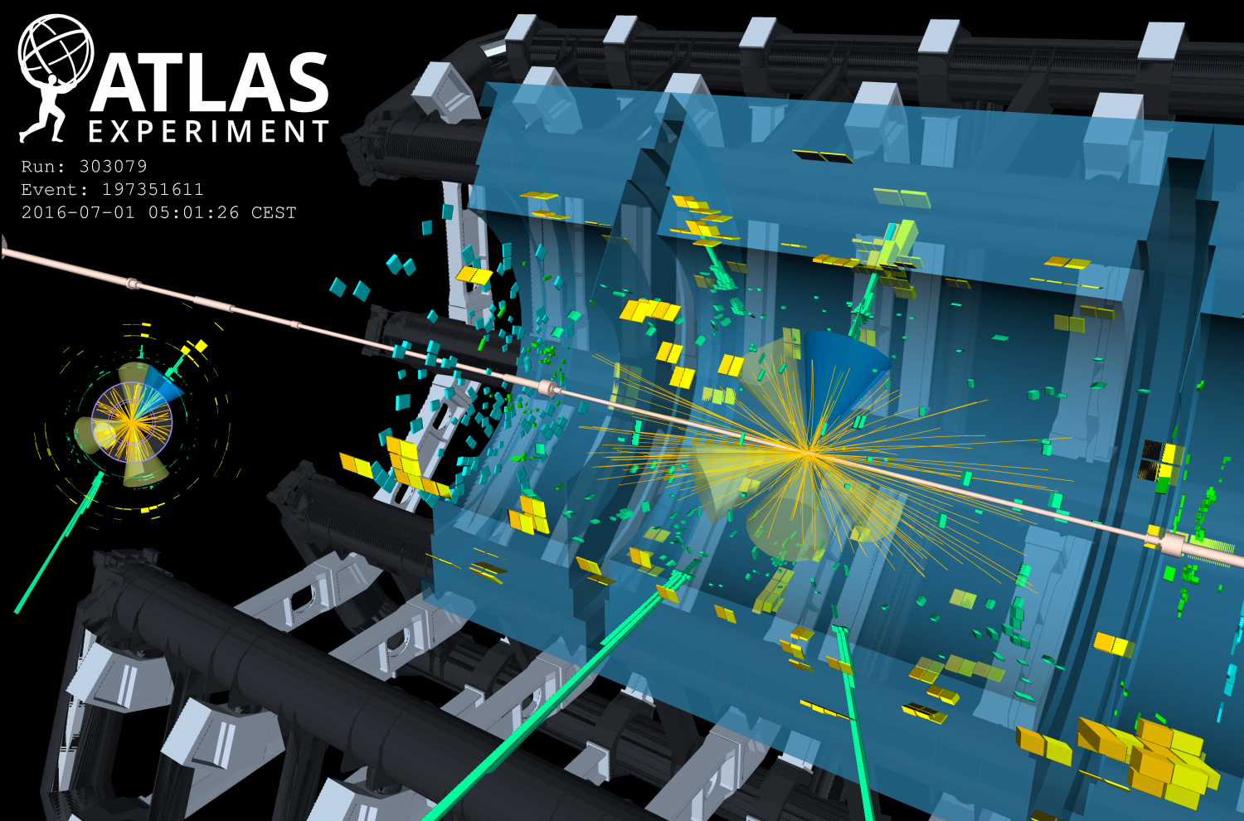
Detection Events and “Actual Occasions”
An Event-Centered Interpretation
In this lecture series, a particle-like detection event may be interpreted through the conceptual lens of an “actual occasion.”
  a localized event
  a momentary interaction
  a transfer of energy
  a quantized occurrence
Important Boundary
  A detector event is a physical observation.
  An actual occasion is part of a philosophical interpretive framework.
Detection of the Higgs Boson by the ATLAS Detector at CERN

Slide 16
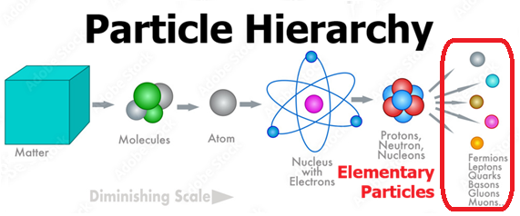
Why “Particle” Is
Instrumental Language
The Operational Meaning of “Particle”
In practice, a “particle” means:
  a recurring pattern of quantized detection events with consistent measurable properties.
Physics predicts:
  where detections are likely to occur
  how much energy is transferred
  what measurable properties appear
But Physics Does NOT Directly Show
  tiny billiard-ball objects
  miniature planets orbiting nuclei
  classical objects moving along exact trajectories
Instrumental View
  “Particle” is therefore being used operationally and instrumentally rather than necessarily as a literal tiny object.
A particle-like detection may be interpreted as an event-centered “actual occasion”.

Slide 17
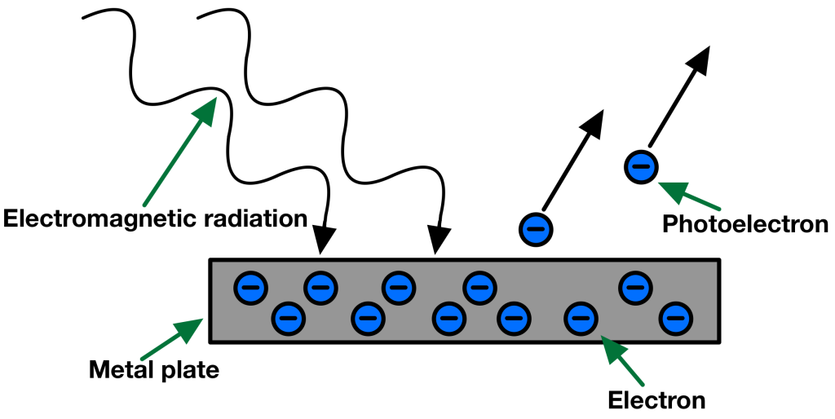
Quantized Energy Transfer
What Happens in a Detection Event?
A detector registers:
  a localized interaction
  involving a discrete transfer of energy
  The energy does not arrive continuously.
  It arrives in quantized packets associated with elementary particle types.
Examples
  an electron ionizes atoms in a detector
  a photon transfers energy to an electron
  a muon leaves a detectable track
  a neutrino occasionally triggers a weak interaction
Central Idea
  Elementary particles are identified through characteristic patterns of quantized interaction.

Slide 18
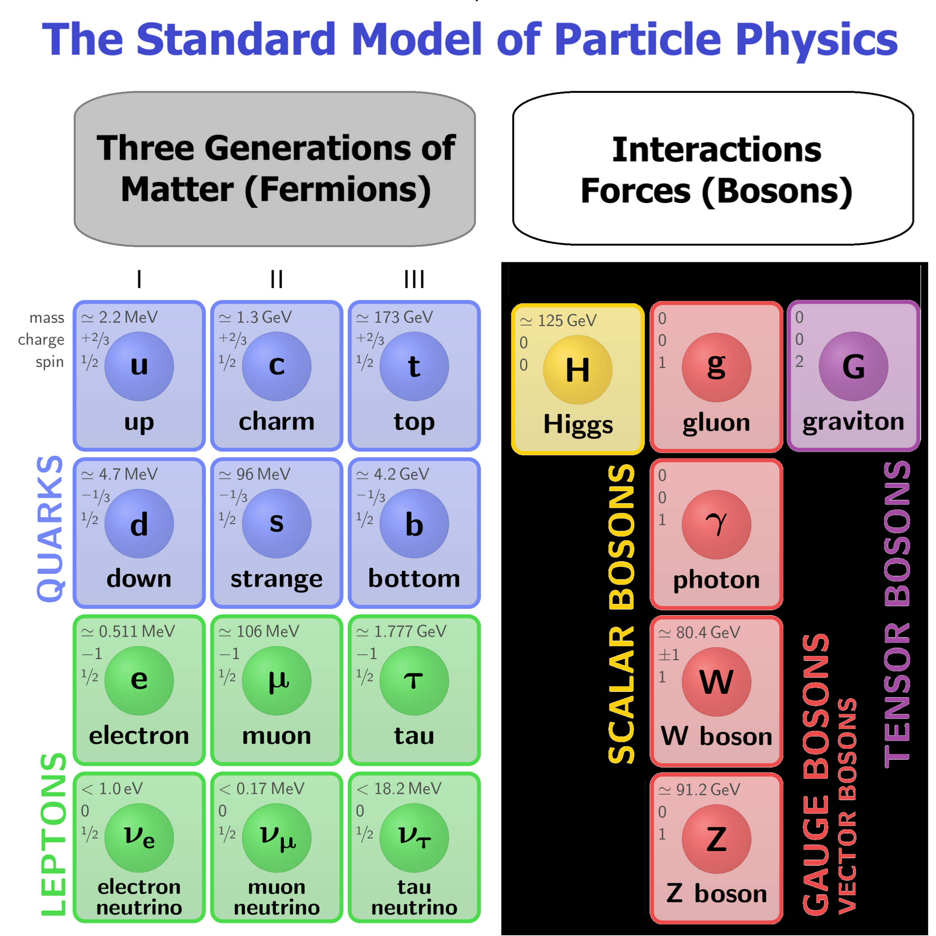
How Are Elementary Particles Identified?
Three Key Properties
Elementary particles are primarily identified by:
  mass
  electric charge
  spin
These measurable properties allow physicists to distinguish one particle type from another.
Examples
Electron:
  0.511 MeV mass
  Negative charge
  spin 1/2
Photon:
  zero mass
  zero charge
  spin 1
Important Note:
In modern physics, mass is treated as an intrinsic invariant property of a particle.

Slide 19
The Goal of
The Standard Model (SM)
What the Standard Model Attempts To Do
  The Standard Model organizes the known elementary particles into a coherent mathematical framework.
It predicts:
  interaction probabilities
  decay patterns
  conservation laws
  measurable detector outcomes
In This Lecture
We will introduce a simplified “666” structure:
  6 quarks
  6 leptons
  6 bosons
along with their associated anti-particles.
Important Simplification
This presentation intentionally simplifies some aspects of modern particle physics in order to build conceptual understanding before technical detail.

Slide 20
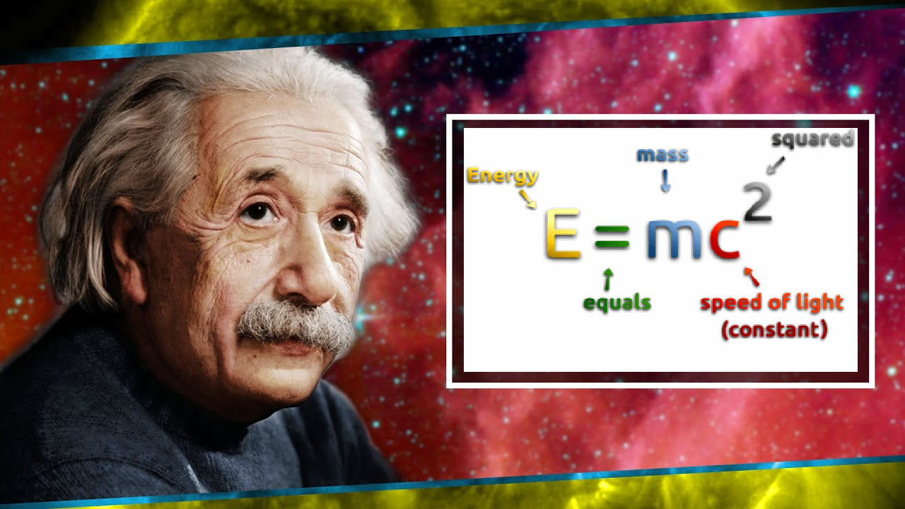

Einstein and Mass–Energy Equivalence
Einstein's Revolutionary Insight
$$E=mc^{2}$$
Mass and energy are different forms of the same underlying physical quantity.
A small amount of mass corresponds to an enormous amount of energy because $c^{2}$is extremely large.
In modern physics, the conserved quantity is total energy, not mass alone.
Important Idea
  Mass is a concentrated form of energy.

Slide 21
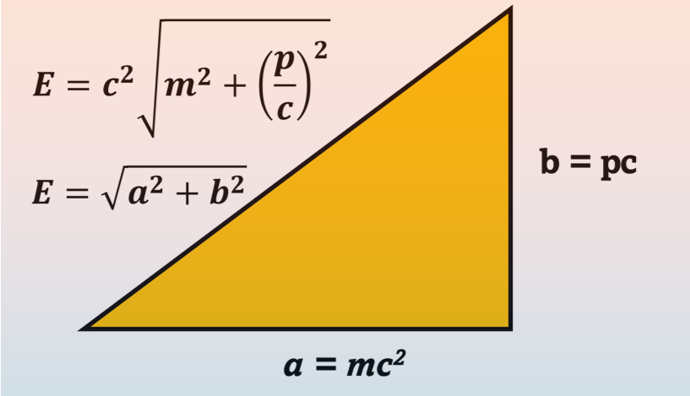

Energy, Momentum, and Mass
The Relativistic Energy Equation
$$E=c^{2}\sqrt{m^{2}+{\left(\frac{p}{c}\right)}^{2}}$$
Where:
  $E$= total energy
  $m$= invariant mass
  $p$= momentum
  $c$= speed of light
Two Important Cases
If $p=0$:
  the particle is at rest
  energy reduces to $E=mc^{2}$
If $m=0$:
  the particle is massless
  Energy reduces to E = pc
Important Point
  Even massless particles can carry energy and momentum.

Slide 22
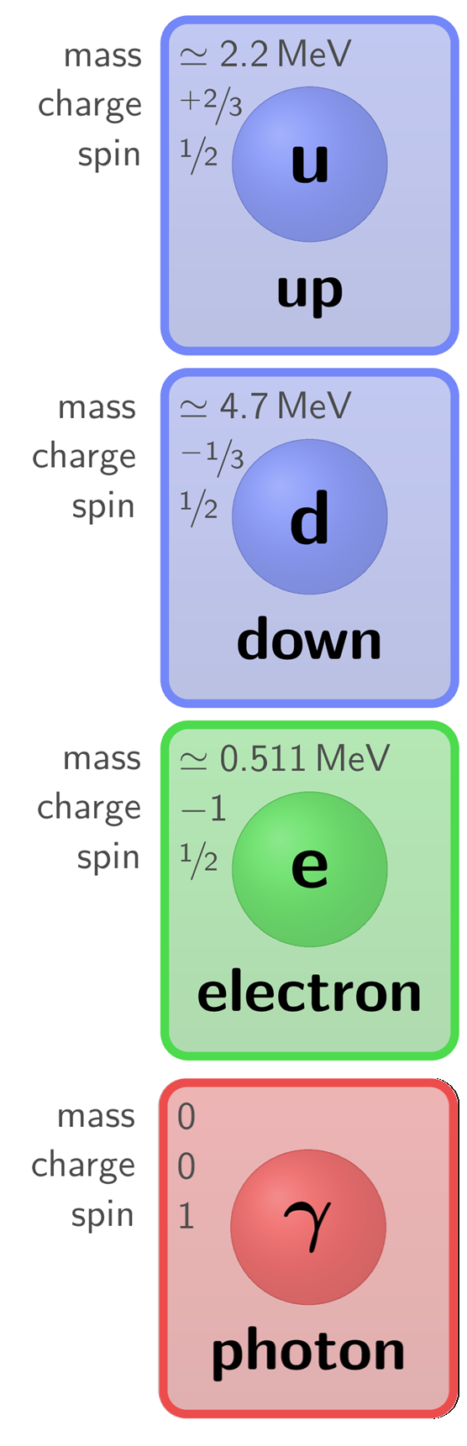
Why Particle Mass Is Listed in eV, MeV, and GeV
Mass Expressed as Energy
Because mass and energy are equivalent, particle masses are commonly expressed using energy units.
Common units include:
  electron volts (eV)
  mega electron volts (MeV)
  giga electron volts (GeV)
Examples:
  Up Quark:
    2.2 MeV
  Down quark:
    4.7 MeV
  Electron:
    0.511 MeV
  Photon:
    0 eV
Important Point
  In particle physics, energy units are often more convenient than kilograms for describing elementary particles.

Slide 23
Electric Charge
Electric Charge as an Identifying Property
Elementary particles may carry:
  positive charge
  negative charge
  or no charge at all
Charge determines how particles interact electromagnetically.
Examples
  Electron:
    charge = −1
  Photon:
    charge = 0
Quarks have fractional charges:
  up quark = +2/3
  down quark = −1/3
These combine to form the integer charges of protons and neutrons.

Slide 24
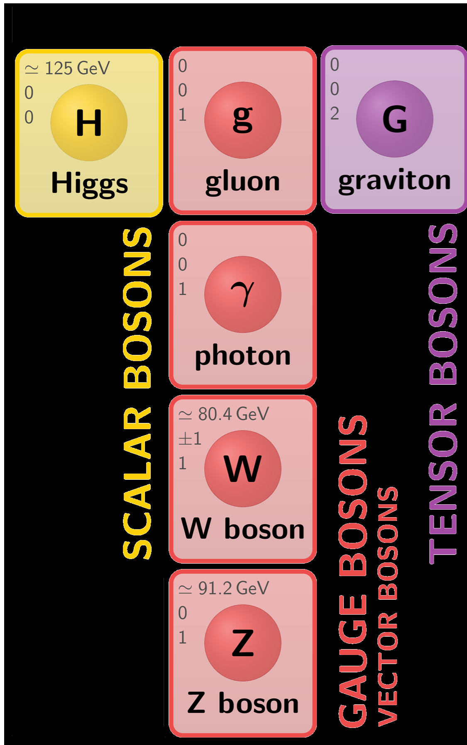
Spin and Rotational Symmetry
Spin Is a Quantum Property Related to Symmetry
  Spin is not best understood as tiny objects physically spinning.
  Instead, spin describes how quantum states behave under rotation.
Integer Spins (Bosons)
Spin 0:
  Completely symmetric under rotation
Spin 1:
  Symmetry somewhat like a globe: the overall pattern remains the same after a 360° rotation
Spin 2:
  Symmetry somewhat like a barbell:the overall pattern repeats after a 180° rotation

Slide 25
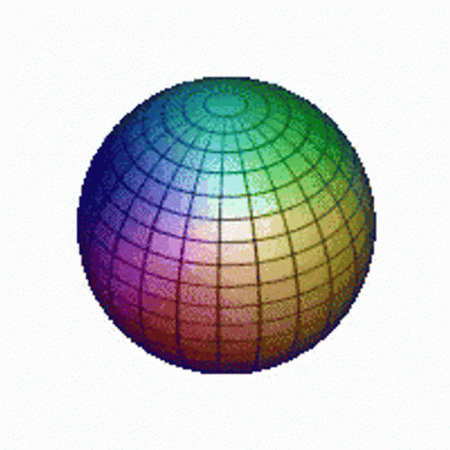
Spin and Rotational Symmetry
Spin Is a Quantum Property Related to Symmetry
  Spin is not best understood as tiny objects physically spinning.
  Instead, spin describes how quantum states behave under rotation.
Integer Spins (Bosons)
Spin 0:
  Completely symmetric under rotation
Spin 1:
  Symmetry somewhat like a globe: the overall pattern remains the same after a 360° rotation
Spin 2:
  Symmetry somewhat like a barbell:the overall pattern repeats after a 180° rotation

Slide 26

Spin and Rotational Symmetry
Spin Is a Quantum Property Related to Symmetry
  Spin is not best understood as tiny objects physically spinning.
  Instead, spin describes how quantum states behave under rotation.
Integer Spins (Bosons)
Spin 0:
  Completely symmetric under rotation
Spin 1:
  Symmetry somewhat like a globe: the overall pattern remains the same after a 360° rotation
Spin 2:
  Symmetry somewhat like a barbell:the overall pattern repeats after a 180° rotation

Slide 27

Spin and Rotational Symmetry
Spin Is a Quantum Property Related to Symmetry
  Spin is not best understood as tiny objects physically spinning.
  Instead, spin describes how quantum states behave under rotation.
Integer Spins (Bosons)
Spin 0:
  Completely symmetric under rotation
Spin 1:
  Symmetry somewhat like a globe: the overall pattern remains the same after a 360° rotation
Spin 2:
  Symmetry somewhat like a barbell:the overall pattern repeats after a 180° rotation
Examples
  Higgs boson
    → spin 0
  Photon, Gluon, W⁺ and Z:
    → spin 1
    Graviton (hypothetical)
    → spin 2
Important Note: The full quantum mathematics of spin is more subtle and mathematically sophisticated.

Slide 28
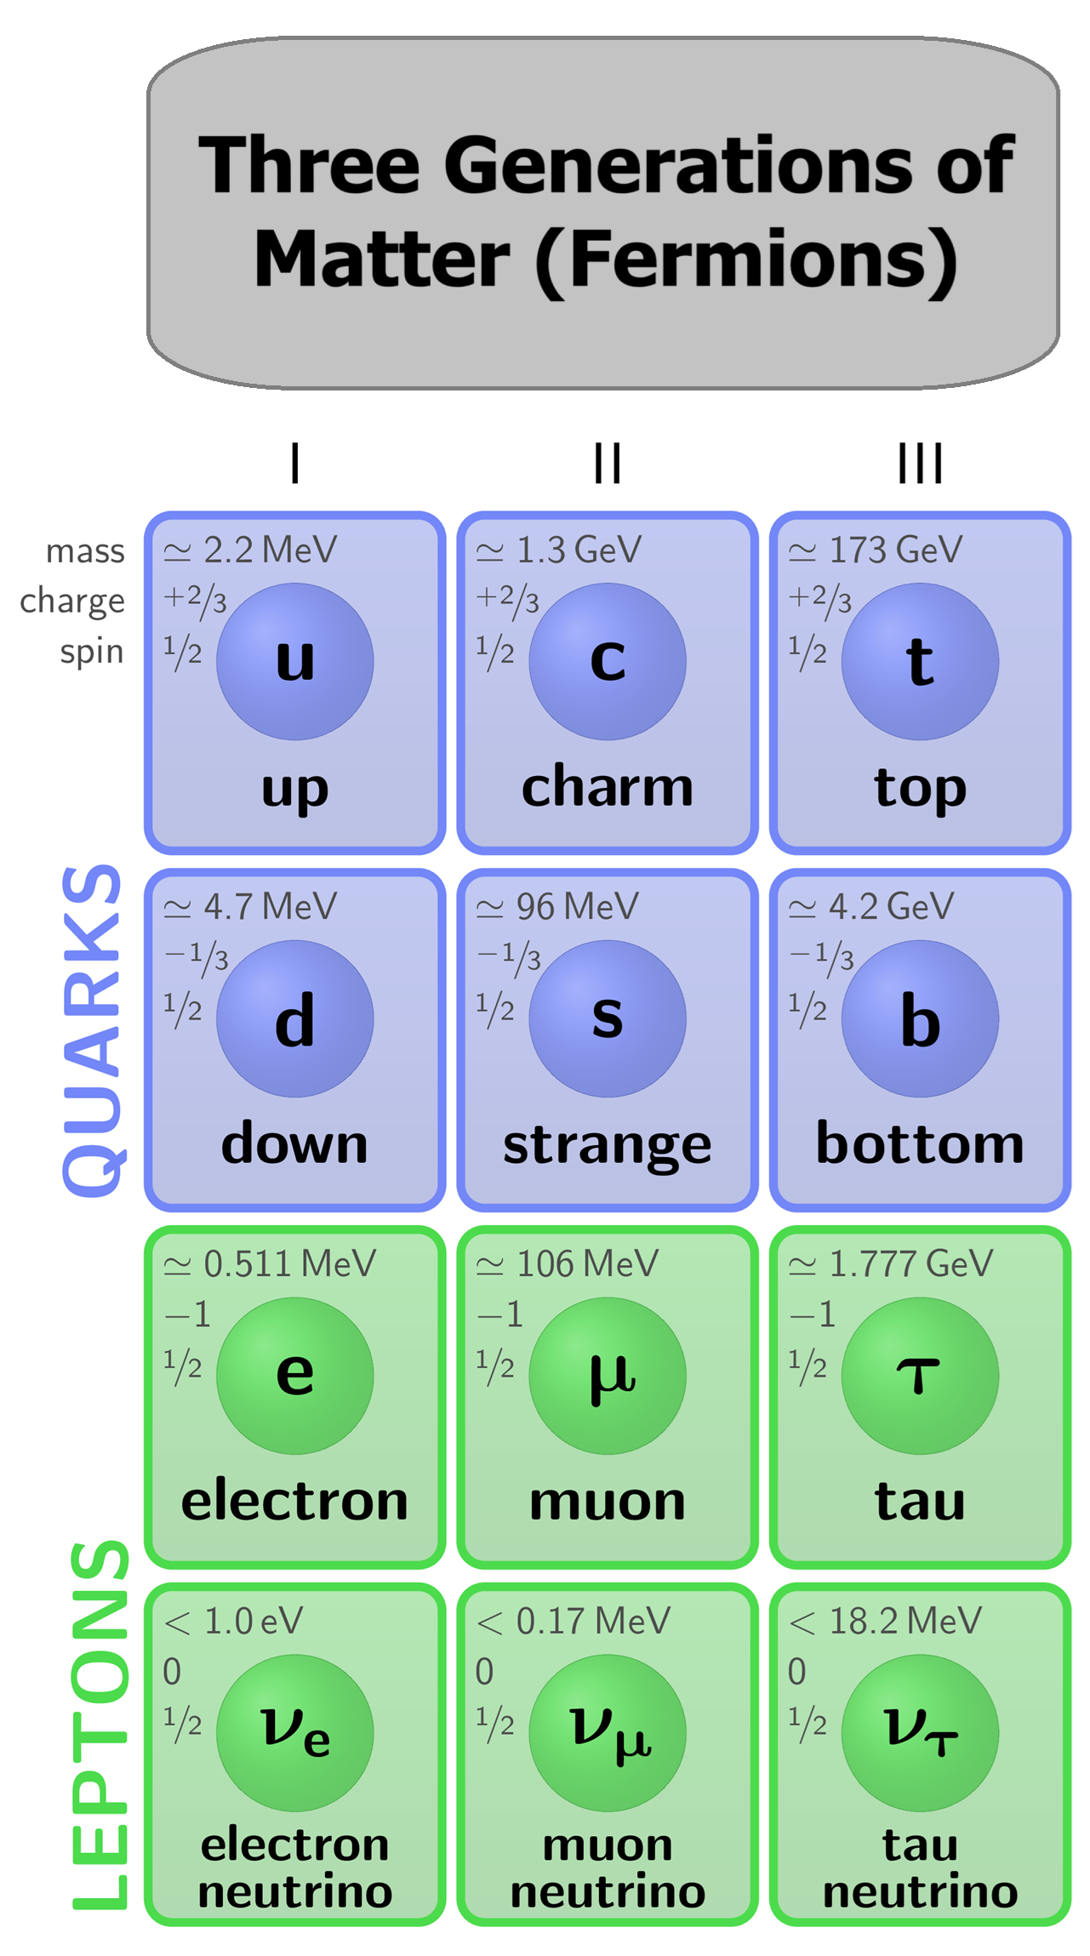
Fermions and the 720° Rotation
Half-Integer Spin Has No Classical Analog
Fermions have half-integer spin:
  spin 1/2
  spin 3/2
  etc.
The electron, quarks, and neutrinos are all spin 1/2 particles.
The Remarkable Property of Spin 1/2
A spin 1/2 particle:
  does NOT return to the same quantum state after a 360° rotation
  requires a full 720° rotation to return to the same state
Important Point
Nothing like this exists in classical physics. This is one of the clearest examples of the fundamentally non-classical nature of quantum theory.

Slide 29

Fermions and Bosons
Two Major Classes of Elementary Particles
Particles are grouped according to their spin.
Fermions
  half-integer spin
  matter particles
  obey Fermi–Dirac statistics
Examples:
  quarks
  electrons
  neutrinos
Bosons
  integer spin
  force-mediating particles
  obey Bose–Einstein statistics
Examples:
  photons
  gluons
  Higgs bosons
Important Idea: Fermions build matter. Bosons mediate interactions.

Slide 30
Spin Orientation
All elementary particles with nonzero spin possess spin orientation states.
For spin-1/2 fermions, these are commonly described as:
  spin up
  spin down
This is important in:
  atomic structure
  magnetism
  the Pauli exclusion principle
Bosons also possess spin projection states:
  often labeled with positive and negative
  values depending on the particle and context.

Slide 31
Chirality
Chirality (“Handedness”)
Quantum physics also distinguishes between left-handed and right-handed quarks and leptons:
  left-handed
  right-handed
This deeper quantum property is called chirality.
Important Point
Spin orientation and chirality are related ideas, but they are NOT the same thing.
Chirality is important in weak-force interactions, where left-handed and right-handed fermions react differently.

Slide 32
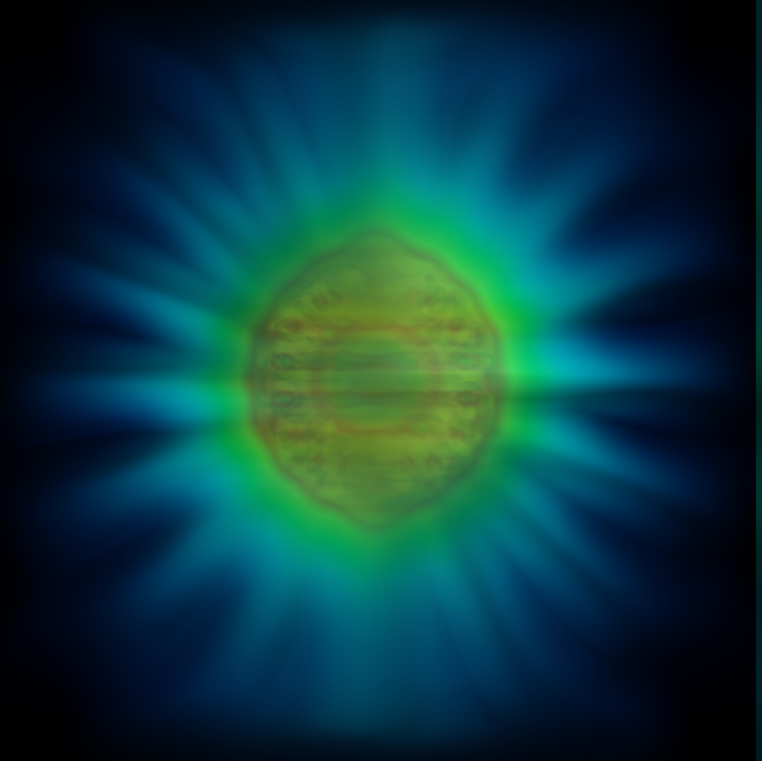
The Photon: Easy to Detect
The photon is the elementary particle associated with electromagnetic radiation:
  visible light
  radio waves
  microwaves
  X-rays
  gamma rays
Key Properties of the Photon
  mass = 0
  charge = 0
  spin = 1
Important Idea
  A photon is best understood as a quantized packet of electromagnetic energy.
Why the Photon Matters
Photons:
  mediate the electromagnetic force
  are among the easiest elementary particles to detect directly
  Every act of seeing depends on photons interacting with matter.
Experimental visualization associated with a single-photon electromagnetic interaction process near a nanoparticle surface.
Image credit: Benjamin Yuen, University of Birmingham (2024) “New theory reveals the shape of a single photon”

Slide 33
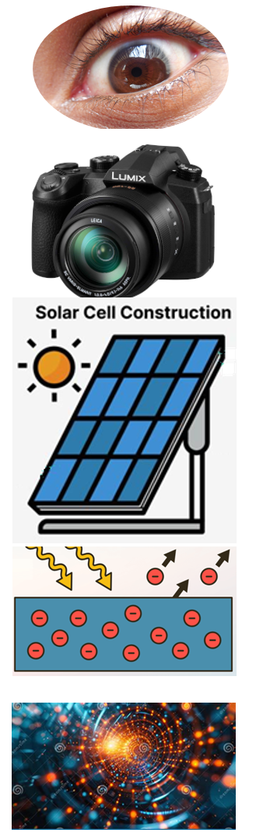
Photon Detection Events
Photons are detected through localized energy-transfer events.
Examples include:
  vision
  cameras
  solar cells
  the photoelectric effect
  photon particle detectors
Quantized Interaction
  A photon transfers energy in discrete amounts.
  It does NOT arrive as a continuously spread-out classical wave.
Example:
The Photoelectric Effect
  A photon transfers energy to an electron
  the electron absorbs the energy
  the electron is ejected
  the detector registers an event
What we directly observe is:
  a localized interaction
  a quantized energy transfer
  a detector event
—not a tiny visible particle traveling through space.

Slide 34
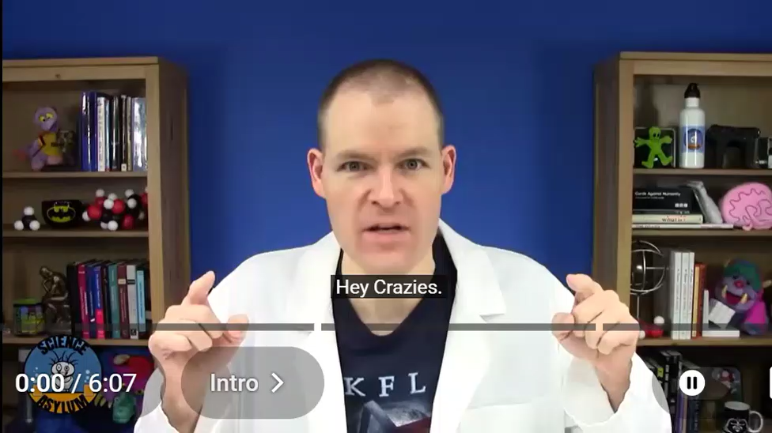

Slide 35
Energy Packets Determined by Their Particle-Like Detection
The Standard Model includes:
  6 Quarks

Slide 36
Energy Packets Determined by Their Particle-Like Detection
The Standard Model includes:
  6 Quarks
  6 Leptons

Slide 37
Energy Packets Determined by Their Particle-Like Detection
The Standard Model includes:
  6 Quarks
  6 Leptons
  6 Bosons (graviton is hypothetical)

Slide 38
Energy Packets Determined by Their Particle-Like Detection
The Standard Model includes:
  6 Quarks
  6 Leptons
  6 Bosons (graviton is hypothetical)
For simplicity, we list one representative particle of each type.
  Fermions (matter-like):
    Quarks and leptons
    Each has a distinct antiparticle
  Bosons (interaction-related):
    Higgs, Photon, gluon, W, Z, Graviton
    Most are their own antiparticles
    Exception: W⁺ has a distinct W⁻
These Energy packets are not observed as objects—we observe them as discrete detection events with specific energy, charge, and spin.

Slide 39
Energy Packets Determined by Their Particle-Like Detection
The Fermions come in three generations:
  Light weight

Slide 40
Energy Packets Determined by Their Particle-Like Detection
The Fermions come in three generations:
  Light weight
  Middle weight

Slide 41
Energy Packets Determined by Their Particle-Like Detection
The Fermions come in three generations:
  Light weight
  Middle weight
  Heavy weight

Slide 42
Energy Packets Determined by Their Particle-Like Detection
The Fermions come in three generations:
  Light weight
  Middle weight
  Heavy weight
Only the light weight and the neutrinos are stable.
  The middle and heavy weight decay rapidly
Our entire periodic table of chemistry is made up of only three fermions:
  Up Quark
  Down Quark
  Electron
Neutrinos are everywhere but do not interact with much of anything and therefore we don’t experience them in everyday life.

Slide 43
Energy Packets Determined by Their Particle-Like Detection
What Do We Mean by “Particle”?
Different Words for the Same Thing
What we call particles in physics are described in different ways:
  “Wavicles” (Strassler)
  “Wave packets” (common physics language)
  “Energy packets” (used in this presentation)
  Quantum States
These are different ways of talking about the same mathematical model.

Slide 44
Energy Packets Determined by Their Particle-Like Detection
What Do We Mean by “Particle”?
What the model actually does:
The model predicts the probability that a detector will register a particle-like event, with specific properties such as:
  Energy
  Charge
  Spin
A “particle” is best understood as a discrete detection event with specific properties, not a little object moving through space.
.

Slide 45
Energy Packets Determined by Their Particle-Like Detection
What Do We Mean by “Particle”?
What the model does NOT do:
The model does not tell us:
  what is “really happening” between detections
  that particles are tiny objects traveling through space
  what physically causes an individual detection event
Bottom line: A “particle” is best understood as a discrete detection event with specific properties.
.

Slide 46
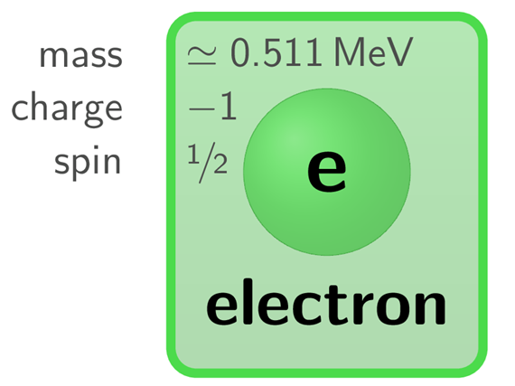
The Electron:
Properties and What They Mean
The electron is a lepton with specific measurable properties:
  Mass: 0.511 MeV
Mass is expressed in energy units because
mass and energy are related (E = mc²)
  Charge: −1
Charge determines how the electron interacts with electromagnetic fields

Slide 47
The Electron:
Properties and What They Mean
The electron is a lepton with specific measurable properties:
  Spin: 1/2
Spin is a quantum property related to angular momentum. It does not mean the electron is physically spinning
Why only multiples of 1/2?
Spin comes from the mathematical structure of the model, which allows only discrete values.
Fermions have half-integer spin (1/2, 3/2, …), while bosons have integer spin (0, 1, 2, …).

Slide 48
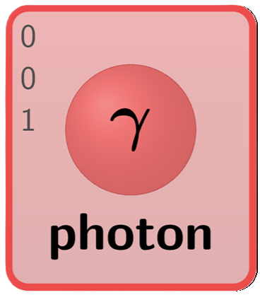
The Photon:
Properties and What They Mean
The photon is a boson with specific measurable properties:
The photon is associated with electromagnetic interactions:
  Mass: 0
Photons always move at the speed of light
  Charge: 0
Photons do not respond to electric charge.

Slide 49
The Photon:
Properties and What They Mean
The photon is a boson with specific measurable properties:
  Energy: variable
Depends on the situation (e.g., color of light)
  Spin: 1
A quantum form of angular momentum (not literal spinning)

Slide 50
The Photon:
Properties and What They Mean
The photon is a boson with specific measurable properties:
  Spin: 1
Why integer spin?
Photons are bosons, and bosons always have integer spin—this follows from the same mathematical structure that limits all spin values.

Slide 51
The Photon:
Properties and What They Mean
The photon is a boson with specific measurable properties:
Polarization (linked to chirality language):
Photons have two possible states:
  Left-handed
  Right-handed
This is somewhat similar to chirality language in fermions and is called polarization.
Bottom line: A photon is a discrete detection event carrying energy and other properties.

Slide 52

What Have We Learned?
From Particles to Detection Events
Central Ideas from This Lecture
The Standard Model predicts measurable detector events with extraordinary precision.
Elementary particles are identified through measurable properties such as:
  mass
  charge
  spin
Physics directly observes:
  flashes
  clicks
  ionizations
  quantized energy transfers
—not tiny visible classical objects.
“Particle” language is therefore operational and instrumental.
Important Shift
Quantum physics moves us away from:
substance-centered thinking
toward:
event-centered thinking.
“Actual occasions” are the events of Process Theology
“Particle-like detections” are the events of Quantum Physics

Slide 53
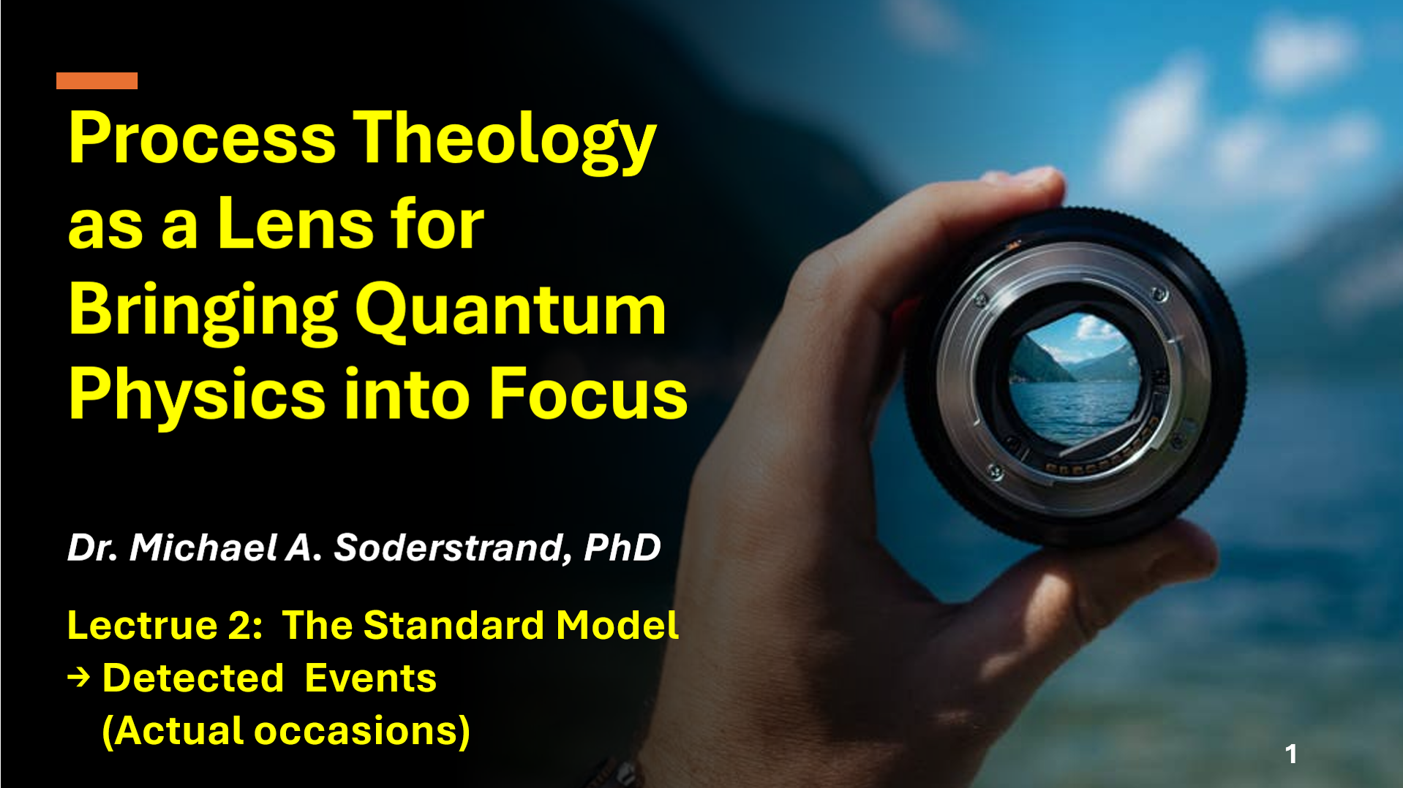
Process Theology as a Conceptual Lens
Process Theology as an Interpretive Framework
Why Use Process Theology Here?
Process Theology provides conceptual language centered on:
  events
  relations
  becoming
  process
This language helps translate difficult quantum concepts into forms accessible to ordinary human understanding.
  detector events are physical observations
  “actual occasions” are philosophical interpretations
Central Idea
The language of “actual occasions” provides one possible way of thinking about localized quantum detection events.

Slide 54

The Astonishing Success of Modern Physics
Symmetry and Conservation
Modern physics discovered a profound connection:
  Symmetry → Conservation Laws
Through the work of Emmy Noether, physicists learned that:
  symmetry in time relates to conservation of energy
  symmetry in space relates to conservation of momentum
  rotational symmetry relates to conservation of angular momentum
The Standard Model Works
The Standard Model has predicted experimental results with extraordinary precision.
ts mathematical structure successfully predicts:
  particle interactions
  decay patterns
  scattering probabilities
  conservation laws
  detector events
with accuracy unmatched anywhere else in science.
Important Idea: The mathematics of physics is not arbitrary. It reflects deep structural regularities in nature.

Slide 55

From Particles to Equations → Structured Possibility
Earlier atomic models eventually failed because they did not fully explain:
  stability
  symmetry
  conservation
  quantum behavior
The Standard Model appears fundamentally different.
Its mathematical structure:
  unifies interactions
  encodes symmetry principles
  predicts experimental outcomes with extraordinary accuracy
The 18 elementary particle types of this lecture series may represent something close to a complete set of fundamental quantum interaction structures.
Next Major Question
If reality is fundamentally event-centered…
then what structures constrain the possible events?
Lecture 3 Will Explore:
probability amplitudes,
Hilbert spaces,
Hamiltonian,
structured possibility,
Primordial Nature

Slide 56


