Slide 1


Process Theology as a Lens for Bringing Quantum Physics into Focus
Dr. Michael A. Soderstrand, PhD
Lecture 3: From Particles to Equations: Structured Possibility and Primordial Nature

Slide 2

Lecture 3
From Particles to Equations: Structured Possibility and Primordial Nature
Today’s Topic:
  Quantum States, Hilbert Space, and the Quantum State Machine
Today’s Lens:
  Primordial Nature of God as a Process Theology Lens for Quantum States
A Critical Move:
  🔵 from observed detector events
  (Lecture 2: Consequent Nature of God: actual occasions)
  🔴 to quantum states and structured possibility
  (Lecture 3: Primordial Nature of God)
  🟢 to the mathematical machinery that organizes and evolves those possibilities
  (Lecture 4: Construction of the Quantum State Machine)
  🟣 to the probabilistic emergence of measurable patterns across many actual occasions
  (Lecture 5: Superjective Nature of God)

Slide 3

Lecture 2 Review
Actual Occasions and Detector Events
Lecture 2 Review: Actual Occasions
and Particle-Like Detections
Process Theology Language:
actual occasions
becoming
event-centered reality
relational process
Quantum Physics Gives Us:
particle-like detection events
quantized interactions
measurable properties
probability distributions
Important Concept
  At the quantum level, physics directly observes quantized detector events rather than tiny visible objects.

Slide 4
Consequent Nature and Actual Occasions
Consequent Nature of God
  receives actual occasions
  incorporates realized events
  preserves realized becoming
Quantum Parallel
  detector events become realized outcomes
  measurements produce realized detector events
  experiments study the statistical patterns of becoming emerging across many realized events
Important:
This lecture series uses Process Theology as a conceptual lens, not as a scientific claim.

Slide 5
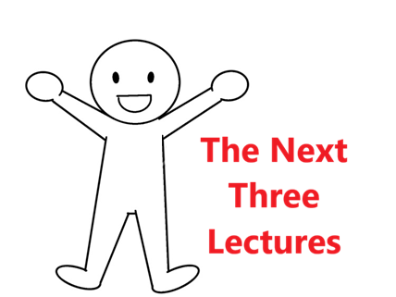
Building and Running the Quantum State Machine
Lecture 3: Structured Possibility
  Structured Possibility
  quantum states
  Hilbert space
  vacuum state
  probability amplitudes
Lecture 4: Construction of the Quantum State Machine
  Building the Quantum State Machine
  fields
  operators
  quantization
  Hamiltonians
Lecture 5: Probabilistic Becoming
  Running the Quantum State Machine
  time evolution
  Born rule
  probabilities
  emergent patterns

Slide 6

Primordial Nature and Structured Possibility
Primordial Nature of God
  ordering of possibilities
  relational structure
  constraints on becoming
  potential forms of realization
Quantum Parallel
  quantum states
  Hilbert space
  structured possibility space
  constrained probabilistic emergence
Important:
Quantum states describe structured possibilities for future actual occasions.

Slide 7
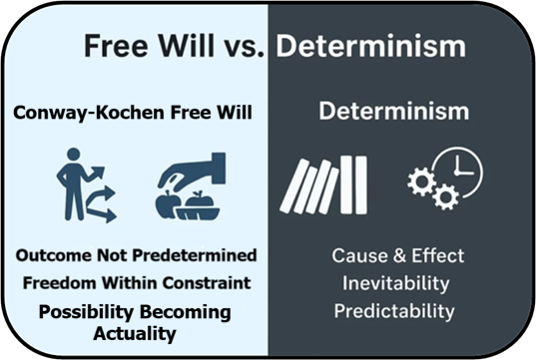
What Physics Establishes — and What It Doesn't
When a quantum event is not predetermined, how should we describe it?
A common interpretation is:
  Not predetermined = Random
But that conclusion is not part of the physics.

Slide 8
What Physics Establishes — and What It Doesn't
Physics establishes:
  ✓ The outcome was not completely predetermined.
Physics does not establish any particular interpretation of that indeterminacy:
  ✗ Randomness
  ✗ Agency
  ✗ Conscious choice
  ✗ Self-creation
  ✗ Any other interpretation
Important Point
  Physics establishes the openness.
  Physics does not determine the meaning of the openness.

Slide 9
Free Will in Process Theology
Actual Occasions
In Process Theology, actual occasions:
  inherit conditions from the past
  are influenced by relationships and circumstances
  are constrained but not completely predetermined
  contribute something novel to becoming
Process Theology Language
This openness is often described as:
  free becoming
  freedom within constraints
  self-creativity
Important
  In Process Theology, free will does not mean unlimited freedom.
  It means openness within constraints.

Slide 10
A Free-Will Parallel in Quantum Physics
What Physics Establishes
  ✔ some quantum events are not completely predetermined by prior information
  ✔ quantum theory predicts probabilities rather than individual outcomes
  ✔ statistical patterns emerge across many events
What Physics Does Not Establish
  ✘ randomness
  ✘ agency
  ✘ conscious choice
  ✘ self-creativity
  ✘ any other interpretation
Important
Physics establishes openness but does not determine the meaning of that openness.

Slide 11
Conway–Kochen Free Will
In This Lecture Series
We use the term Conway–Kochen Free Will to describe:
  ✔ outcomes that are not completely predetermined by prior information
What We Do NOT Mean
  ✘ consciousness
  ✘ agency
  ✘ deliberate choice
  ✘ human decision making
  ✘ any particular interpretation
Important
  Randomness and Conway–Kochen free will are instrumentally indistinguishable.
  Physics cannot experimentally determine the difference.
Key Idea
Conway–Kochen free will is simply our label for the openness established by physics.

Slide 12
What Conway and Kochen Provide
John Conway and Simon Kochen developed two Free Will Theorems exploring the implications of free will in quantum physics.
In This Lecture Series
  We are not using the Free Will Theorems themselves.
  We are using the definition of free will employed by Conway and Kochen.

Slide 13
What Conway and Kochen Provide
In Summary
  Process Theology has a useful concept called free becoming.
  Quantum physics finds a similar openness within constraints.
  Conway and Kochen provide a definition of free will that describes this openness.
  Quantum states encode the constraints on that openness through probability amplitudes and their mathematical relationships..
Important
  Conway–Kochen free will provides the openness.
  Quantum states encode the constraints on that openness.
Next Question
  How do quantum states encode those constraints?
  With that foundation in place, we now turn to quantum states.

Slide 14
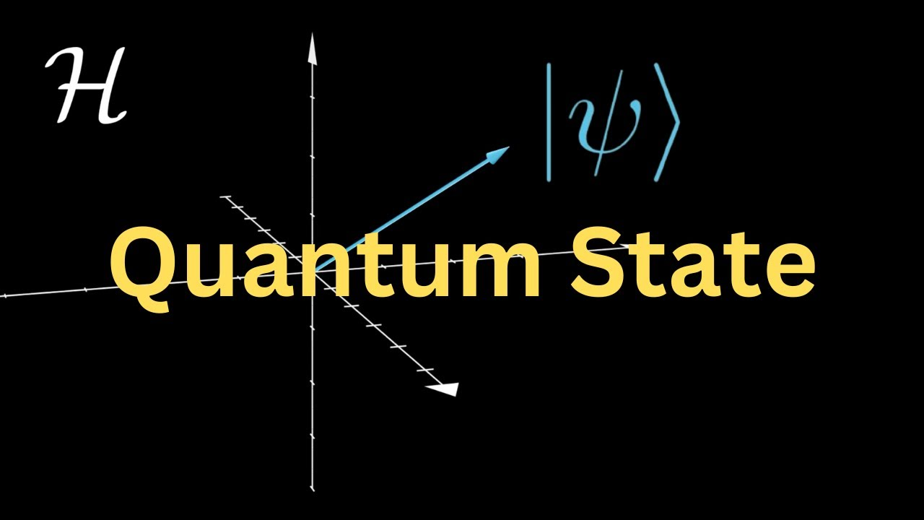
How Do Quantum States Encode Constraints?
Recall
Quantum states encode the constraints on:
  possible future detections
  measurable properties
  allowed outcomes
  structured possibilities
Key Idea
Each quantum state encodes:
  which particles are present
  what properties they may exhibit
  which future detections are possible
  the probability amplitudes associated with those possibilities
Important
  Quantum states do not encode certainty.
  They encode structured possibilities.
We begin by examining increasingly complex quantum states:
  the vacuum state (no particles)
  one-particle states
  multi-particle states

Slide 15
The Simplest Quantum State: The Vacuum State
In the Quantum State Model
The vacuum state:
  contains no particles
  represents the lowest-energy state of the model
  is still a valid quantum state
  contains structured possibilities for future particle-like detections
Process Theology Lens
The vacuum state can be viewed as a model of structured possibility prior to actual occasions.
Key Idea
A quantum state does not require particles.
Particles are only one possible content of a quantum state.
Transition
If the vacuum state contains no particles, what happens when we add one?
Important
The absence of particles is itself represented by a valid quantum state.

Slide 16

One-Particle Quantum States
Starting from the Vacuum State
A one-particle quantum state is created when a single particle is added to the model.
Examples
One Electron State
  one electron is present
  electron properties are encoded in the quantum state
  future particle-like detections are constrained by the quantum state
One Photon State
  one photon is present
  photon properties are encoded in the quantum state
  future particle-like detections are constrained by that state
Process Theology Lens
  The particle does not remove the openness.
  The quantum state constrains the possible ways that openness can become actual.
Transition
  How does the quantum state encode those possibilities and what information needs to be encoded?

Slide 17
What Information Must a Quantum State Encode?
To Predict Future Particle-Like Detections
A quantum state must encode:
  which particles are present
  how many particles are present
  the measurable properties those particles may exhibit
  the possible future particle-like detections
  the relationships among those possibilities
Examples
Important
  A quantum state does not encode a single predetermined future.
  It encodes a structured set of possible future detections.
Process Theology Lens
  The quantum state encodes the constraints on becoming.
  It does not determine exactly which actual occasion will occur.
Transition
  How does the quantum state mathematically encode this information?
One Electron State may encode possibilities related to:
  position
  momentum
  energy
  spin
One Photon State may encode possibilities related to:
  position
  momentum
  energy
  spin

Slide 18
Probability Amplitudes Encode Possibilities
A Quantum State Uses Probability Amplitudes
  A quantum state assigns probability amplitudes to possible future particle-like detections.
  amplitudes are mathematical quantities
  amplitudes can be positive, negative, or complex
  amplitudes are not probabilities
  probabilities are calculated from amplitudes
Example
For a one-electron state:
  possible future detections may occur at different locations
  each possible detection is assigned a probability amplitude
  the amplitudes determine the probabilities of the possible detections
Important
  Probability amplitudes encode the structure of the possibilities.
  They do not specify a single predetermined outcome.
Process Theology Lens
  Probability amplitudes can be viewed as mathematical constraints on becoming.
Transition
  How are all of these amplitudes organized into a single quantum state?

Slide 19
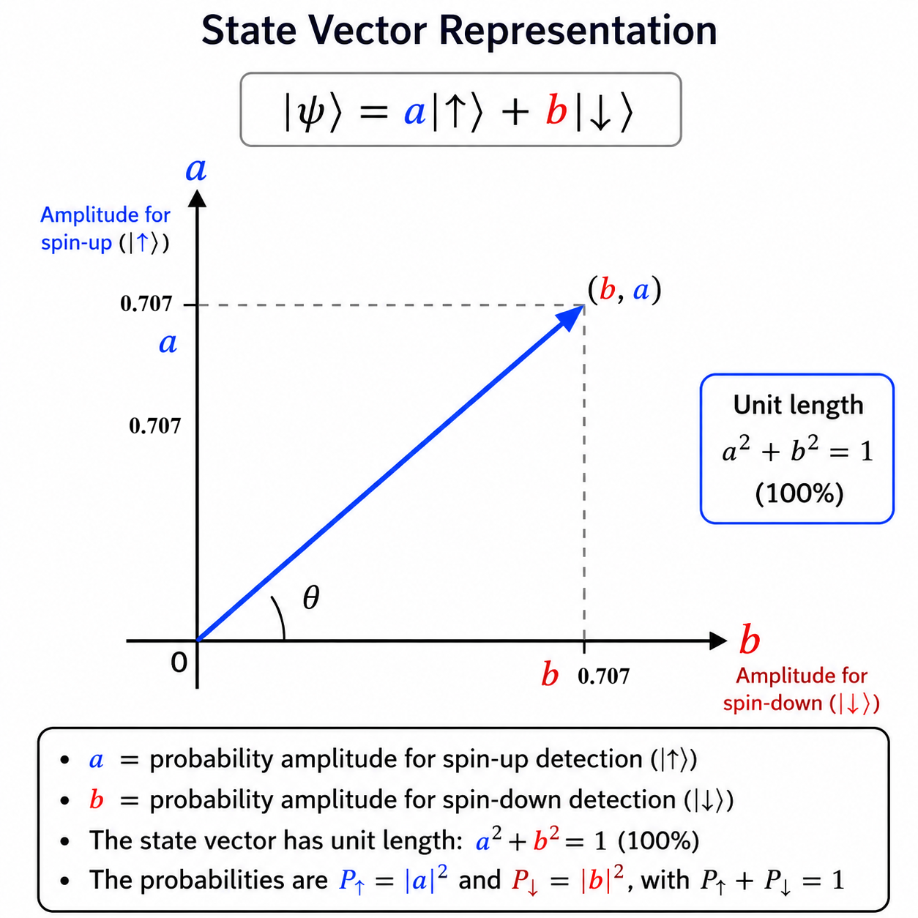

A Simple State Vector
Example: Electron Spin
Suppose an electron can be detected as:
  Spin Up
  Spin Down
A one-electron quantum state assigns a probability amplitude to each possibility.
State Vector Representation
$$\left.\left.\left.∣ψ\right\rangle =a∣↑\right\rangle +b∣↓\right\rangle$$
where:
  a = probability amplitude for spin-up detection
  b = probability amplitude for spin-down detection
Important
  This is one quantum state, not two states.
  The state contains amplitudes for multiple possible future particle-like detections.
  The amplitudes determine the probabilities associated with those detections.
Process Theology Lens
  The quantum state encodes multiple constrained possibilities within a single state.
Transition
  How can one quantum state contain amplitudes for multiple possibilities at the same time?

Slide 20
A Simple State Vector
Example: Electron Spin
Suppose an electron can be detected as:
  Spin Up
  Spin Down
A one-electron quantum state assigns a probability amplitude to each possibility.
State Vector Representation
$$\left.\left.\left.∣ψ\right\rangle =a∣↑\right\rangle +b∣↓\right\rangle$$
where:
  a = probability amplitude for spin-up detection
  b = probability amplitude for spin-down detection
Important
  This is one quantum state, not two states.
  The state contains amplitudes for multiple possible future particle-like detections.
  The amplitudes determine the probabilities associated with those detections.
Process Theology Lens
  The quantum state encodes multiple constrained possibilities within a single state.
Transition
  How can one quantum state contain amplitudes for multiple possibilities at the same time?

Slide 21
From State Vectors to Hilbert Space
We Have Seen:
  A quantum state can be represented by a state vector.
  The state vector contains probability amplitudes.
  The amplitudes encode possible future particle-like detections.
  Different amplitudes correspond to different probability distributions.
The Next Question:
  How are all possible quantum states organized?
Key Idea
  A state vector does not exist by itself.
  It exists within a mathematical framework called Hilbert space.
Transition
  The following video illustrates how Hilbert space organizes quantum states and why physicists use different bases to describe the same quantum state.

Slide 22
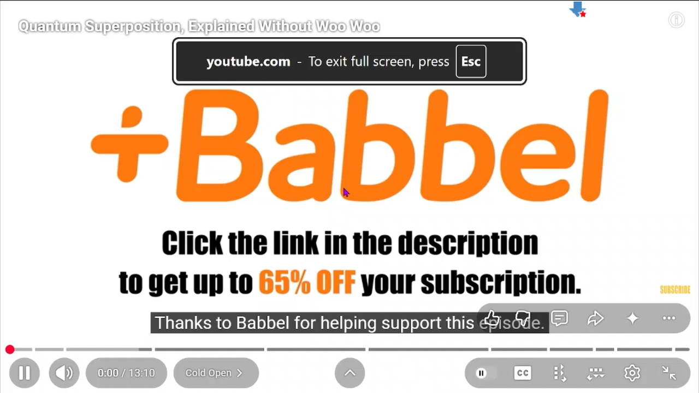

Slide 23
One Quantum State,
Many Possible Detections
Key Lesson From The Video
  A quantum state is represented by a single state vector.
  That state can contain probability amplitudes for many possible future particle-like detections.
Important
  One quantum state does not imply one future outcome.
  One quantum state can encode many possible future particle-like detections.
Process Theology Lens
  One structured possibility can contain many constrained ways of becoming actual.
Transition
  How do probability amplitudes become probabilities of future particle-like detections?
Notice that this is still only one state vector. The vector has not split into two states. Instead, one state contains probability amplitudes for multiple possible detections

Slide 24
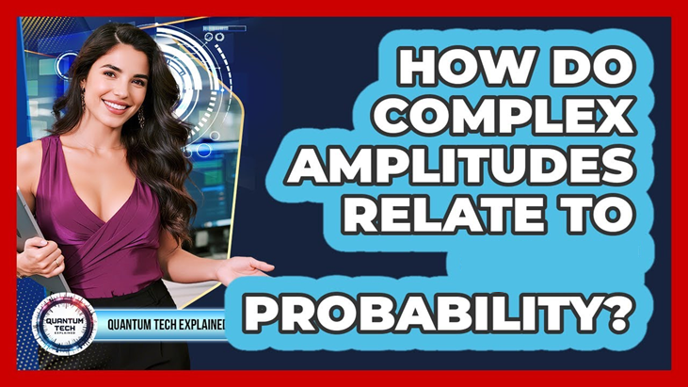
From Probability Amplitudes to Probabilities
The Born Rule
To predict measurable outcomes:
The probability amplitude is converted into a probability.
The probability is calculated from the square of the amplitude.
These probabilities predict the likelihood of future particle-like detections.
Important
Physics predicts probabilities of detections, not specific outcomes.
The quantum state constrains what may occur and how likely each possibility is.
Process Theology Lens
The amplitudes encode the structure of the possibilities.
The Born Rule converts that structure into measurable probabilities.
The Key Idea
A quantum state contains probability amplitudes, not probabilities.
Each possible future particle-like detection is assigned a probability amplitude.
Probability amplitudes can be positive, negative, or complex-valued.
The amplitudes themselves are not directly observable.
Transition: If a quantum state contains many amplitudes, how are they organized into a single mathematical object?

Slide 25
Hilbert Space Organizes the Possibilities
The Key Idea
  A quantum state may contain many probability amplitudes.
Hilbert space provides the mathematical framework that organizes them.
  Each possible future particle-like detection is associated with a probability amplitude.
  Those amplitudes are collected into a single state vector.
  The state vector represents the complete quantum state.
  The state vector exists within Hilbert space.
Important
  Hilbert space is part of the mathematical model.
  It provides a way to organize probability amplitudes into a single quantum state.
Process Theology Lens
  Hilbert space can be viewed as a mathematical representation of structured possibility.
Transition: If Hilbert space organizes all possibilities, why do physicists use different bases to describe the same quantum state?

Slide 26
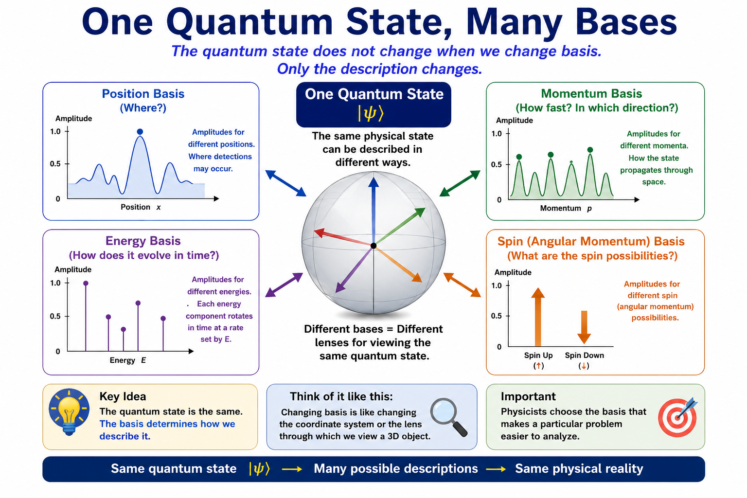
One Quantum State Many Bases
The Key Idea
  The quantum state does not change when we change basis.
  Only the description changes.
Examples
The same quantum state can be described in:
  Momentum basis
  Energy basis
  Angular momentum (spin) basis
  Position basis
Important
  Different bases emphasize different measurable properties.
  Different bases make different aspects of the same quantum state easier to calculate.
  Physicists choose the basis that makes a particular problem easier to calculate.
Transition: Since Hilbert Space is a linear vector space, we can calculate in whichever basis is easiest and then change to Position basis and ADD!
26

Slide 27
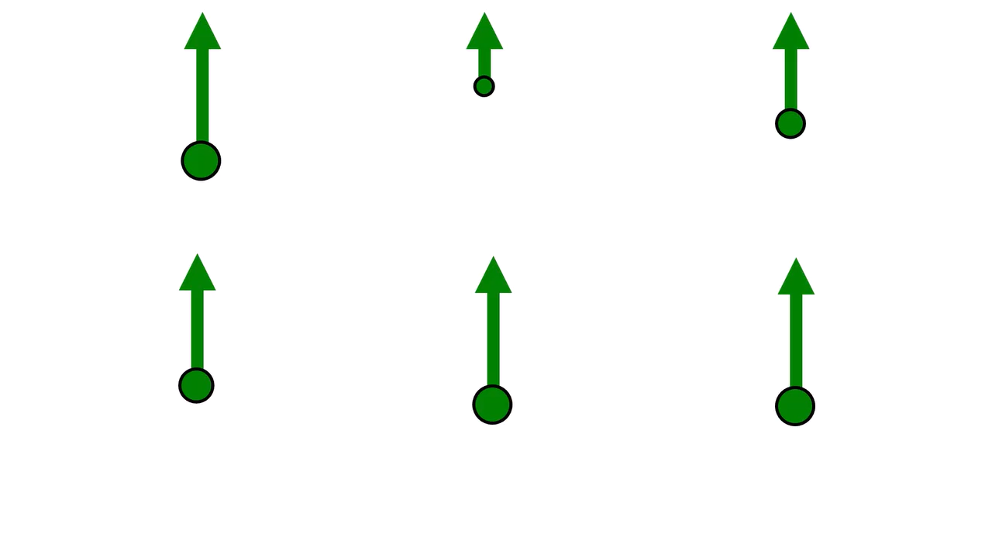
Energy Basis
In the Energy Basis
  The quantum state contains probability amplitudes for different possible energies.
  Time evolution is especially simple in this basis.
  Each energy component behaves like a rotating phasor.
  Higher energy components rotate rapidly in time
  Energy determines the rate of rotation.
Important
Energy and time form a natural pair.
  Energy determines how the quantum state changes with time.
  The energy basis makes time evolution easy to calculate.
Process Theology Lens
  The energy basis describes how structured possibilities unfold through time.
Transition: If energy basis makes time evolution simple, what basis makes motion through space simple?
How Does the Quantum State Evolve in Time?
Example
A single photon is traveling from a laser toward a detector.

Slide 28
Momentum Basis
In the Momentum Basis
  The quantum state contains probability amplitudes for different possible momenta.
  Motion through space is especially simple in this basis.
  Each momentum component behaves like a rotating phasor.
  Higher momentum components rotate more rapidly across space.
  Momentum determines the spatial rate of rotation.
Important
Position and momentum form a natural pair.
  Momentum determines how the quantum state changes across space.
  The momentum basis makes propagation through space easy to calculate.
Process Theology Lens
  The momentum basis describes how possibilities are distributed through space.
Transition: If momentum basis tells us how a quantum state moves through space, what basis tells us about its possible spin detection?
How Does the Quantum State Move Through Space?
Example
A single photon is traveling from a laser toward a detector.

Slide 29
Spin Basis
In the Spin Basis
  The quantum state contains probability amplitudes for different possible spin detections.
  Spin properties are especially simple in this basis
  Each spin component is assigned a probability amplitude.
  Different spin amplitudes correspond to different possible spin detections.
  Angular momentum determines how the quantum state behaves under rotations.
Important
Rotation and angular momentum form a natural pair.
  Angular momentum determines rotational behavior.
  The spin basis makes rotational properties easy to calculate.
Process Theology Lens
  The spin basis describes structured possibilities associated with rotational symmetry.
Transition: If energy, momentum, and spin can each be described in their own basis, where do measurable particle-like detections actually occur?
What Spin Detections Are Possible?
Example
A single photon is traveling from a laser toward a detector.

Slide 30
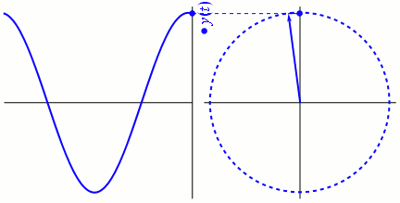
Other Basis
Position Basis
In the Position Basis
  Rotations in other bases become waves.
  Particle-like detections are described in terms of position in actual space.
  Contributions from energy, momentum, and spin are combined in this basis.
  Interference between probability amplitudes becomes visible.
  The result is a probability distribution for possible detections.
Important
Position basis is where experiments live.
  Detectors record particle-like detections at specific locations.
  Position basis connects the mathematical model to observable measurements.
Transition: How can simple rotating phasors in energy and momentum space produce interference patterns in position space?
Where Can Particle-Like Detections Occur?
Example
A single photon is traveling from a laser toward a detector.

Slide 31
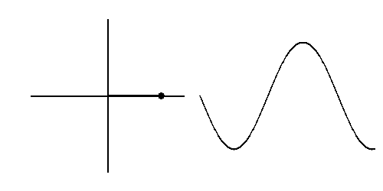
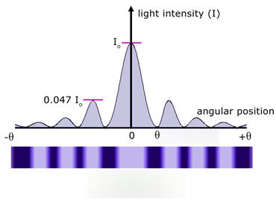
Energy basis
Momentum basis
Spin basis
Position basis
Sum along the Red Line and then apply the Born Rule

Slide 32

HILBERT SPACE
Hilbert Space Is:
  the mathematical structure containing all allowed quantum states
  a structured possibility space
  a relational framework for quantum probabilities
Hilbert Space Organizes:
  possible configurations
  probability amplitudes
  allowed quantum relationships
  constraints on probabilistic outcomes
Important:
Hilbert space can be understood philosophically as a structured space of possible becoming.

Slide 33
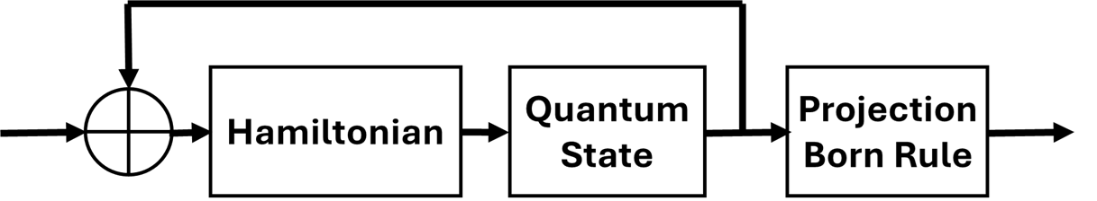
The Quantum State Machine Model
Hamiltonian / State Evolution
Process Theology Lens:
  Superjective Nature
  lure toward patterned becoming
  emergence of ordered probabilities
Hilbert Space / Quantum States
Process Theology Lens:
  Primordial Nature
  structured possibility
  constrained becoming
  ordered potentiality
Born Rule / Detector Events
Process Theology Lens:
  Consequent Nature
  realized actual occasions
  accumulated realized events
The model predicts probabilistic patterns across many actual occasions rather than predetermined individual events.
33

Slide 34
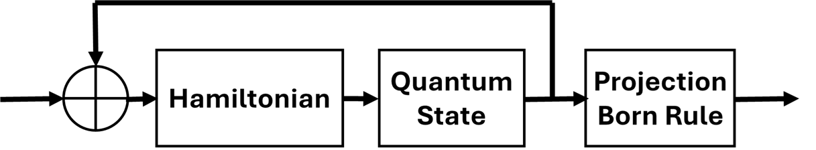
Looking Ahead
Quantum States and Hilber Space
This lecture focused on Structured Possibility (quantum states )
  superposition as a vector
  state vectors represent all possibilities
  Hilbert space
  changes of basis
These mathematical structures describe the possible outcomes of future detection events.
  But where do these quantum states come from?
In the next two lectures we will explore:
  Lecture 4: Building the Quantum State Machine
  Lecture 5: Running the Quantum State Machine
Central Question
  How does a mathematical structure of possibilities become a model that predicts actual events?

Slide 35


