Slide 1


Process Theology as a Lens for Bringing Quantum Physics into Focus
Dr. Michael A. Soderstrand, PhD
Lecture 4: Quantization: Building the Quantum State Machine → Ordered Indeterminacy (Creativity under constraint)

Slide 2
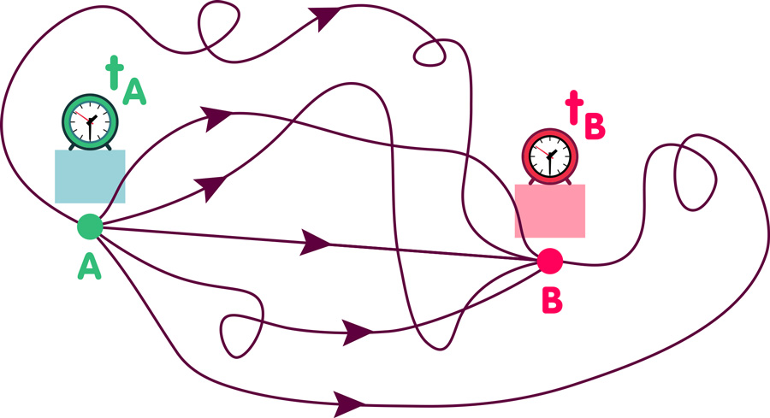
Every Possible Path?
One of the most common statements in popular quantum physics is that a particle literally travels every possible path simultaneously from the source to the detector.
  What if I told you that is a lie?
  Well… maybe not exactly a lie, but certainly an oversimplification not justified by the mathematics.
Tonight I want to explain:
  Why physicists say this,
  What the mathematics actually does, and
  Why we need to be very careful about what it really means.

Slide 3
Why Physicists Say This
Physicists often describe a particle as “Exploring every possible path simultaneously”
  Because the mathematics assigns a probability amplitude to every possible path connecting the source and detector.
  Because this statement is provocative, intuitive, and fits naturally with realist interpretations in which quantum fields or amplitudes are treated as physically real.
What the Model Actually Does:
  The quantum state machine model is designed to accurately predict the probabilities associated with particle-like detections.
  The model is not designed to tell us what path a particle “really” takes between detections — or even whether the particle takes a path at all.

Slide 4

A Simple Example for Clarification
The Experiment
  Imagine a laser emitting photons one at a time toward a detector.
  There are no slits, barriers, or obstacles between the laser and detector.
If photons behaved like perfectly classical particles and every photon left the laser with exactly the same position and momentum:
  We would expect every detection to occur at exactly the same point.
  But that is not what experiments show.

Slide 5

A Simple Example for Clarification
Why Classical Particles Fail
  Real photons do not leave the laser with perfectly defined position and momentum.
  The more precisely we localize the photon at emission, the less precisely its momentum can be defined.
$$Δx Δp≥\frac{ℏ}{2}$$
  For large objects, this uncertainty is insignificant compared to the total momentum of the object.
  For elementary particles such as photons, the uncertainty becomes significant.
As a result, photon detections no longer occur at exactly the same point on the detector.

Slide 6


Baseballs vs Photons
Imagine replacing the photons with baseballs launched from a pitching machine.
  No pitching machine can launch every baseball with exactly the same position and momentum.
  Mechanical imperfections produce a spread of trajectories and impact locations.
  Baseballs are also subject to the uncertainty principle.
  $$Δx Δp≥\frac{ℏ}{2}$$
  But for macroscopic objects such as baseballs, the quantum uncertainty is insignificant compared to the total momentum of the baseball.
The spread in baseball trajectories is therefore dominated by mechanical error rather than quantum uncertainty.

Slide 7
Why Alternative Baseball Paths Are Irrelevant
In principle, the mathematical model can assign probability amplitudes to many possible baseball trajectories.
  But for macroscopic objects, amplitudes associated with alternative paths almost completely cancel.
  Only amplitudes very close to the classical trajectory contribute measurably to the final probability.
In practice, the classical path is the only significant trajectory for the baseball.
This is why baseballs appear to follow a single well-defined path.

Slide 8

Why Photons Are Different
Lasers also contain small mechanical and optical imperfections.
But for photons, the uncertainty principle becomes significant.
$$Δx Δp≥\frac{ℏ}{2}$$
Because photons carry extremely small momentum, the uncertainty in momentum becomes experimentally important.
As a result, photon detections no longer occur at exactly the same point on the detector.
Individual detections initially appear random.
But over time, a stable probability distribution emerges.

Slide 9
Why Physicists Talk About “All Possible Paths”
For photons, many possible paths contribute measurably to the final probability amplitudes.
  Physicists therefore often describe the photon as “exploring all possible paths simultaneously.”
But this statement can be misleading in two important ways:
  It is the mathematical model — not necessarily the photon itself — that encodes multiple paths.
  In practice, paths whose amplitudes contribute negligibly to the final probability are ignored.
The experiments confirm the detection probabilities predicted by the model.
  Whether the photon literally travels those paths is a separate interpretive question.

Slide 10
Why Begin with Classical Mechanics?
To build our quantum state machine model, we first need a classical model.
Our Example: A Baseball Pitching Machine
Classical physics provides two equivalent ways to describe the path the baseball takes:
  Newtonian Mechanics
    Based on forces and accelerations.
  Lagrangian Mechanics
    Based on the principle of stationary action and trajectories.
Both describe the same classical behavior and make the same predictions.

Slide 11
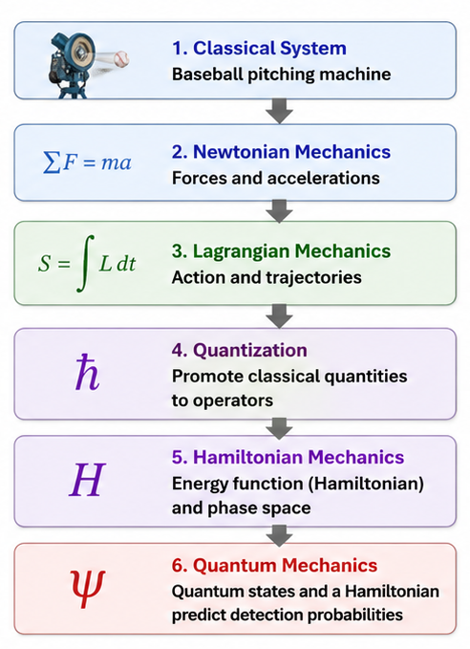

Roadmap:
From Baseballs to the Quantum State Machine
A real system that can be understood using classical physics.
One classical description of the motion.
An equivalent classical description chosen because it is best suited for quantization.
Replace classical quantities with operators and construct the quantum model. The bridge from classical to quantum.
The classical theory recast into the framework used by quantum theory.
The quantum state machine that makes experimentally testable predictions.

Slide 12

Why Start with the Lagrangian Rather than Newtonian Mechanics?
Newtonian and Lagrangian mechanics make the same classical predictions.
The Lagrangian works naturally with systems containing many interacting parts.
The Lagrangian can be written in a form that respects fundamental symmetries.
The Lagrangian extends naturally to elementary particles and their associated fields and therefore provides the preferred starting point for modern quantization.

Slide 13


Slide 14

Lessons from the Video
Particles do not take all paths simultaneously
  The Lagrangian Model accurately predicts classical trajectories by exploring every possible path.
  But that does not mean that in reality particles explore every possible path.
Newtonian Mechanics and Lagrangian Mechanics are two classical models that predict the same results
  Both are predictive models but neither necessarily represents reality.
Configuration Space, Hamiltonian Mechanics and Quantum Mechanics
  In modeling we often find it useful to plot things in hypothetical spaces
  Physics experiments occur in ordinary spacetime. Later we will represent those observations using the position basis of Hilbert Space.
  Hamiltonian Mechanics and Quantum Mechanics use abstract mathematical spaces, including Hilbert Space, that are part of the predictive model we will develop next.

Slide 15
Three Levels of Description
The laser-to-detector experiment can be described at three different levels.
  Each level works well within a particular domain.
  But each level also has important limitations.
Level 1:
  Classical Particle Mechanics
Level 2:
  Classical electromagnetic fields
Level 3:
  Quantized fields and the Quantum State Machine Model

Slide 16


Level 1: Classical Particle Mechanics
In classical mechanics, particles are modeled as objects with:
  position,
  momentum,
  and trajectories.
The classical Lagrangian provides a mathematical framework for predicting how these trajectories evolve through time.
  For macroscopic objects, the model predicts the familiar classical trajectories we observe experimentally.
  This approach works extremely well when uncertainty effects are negligible.

Slide 17
Level 1: Classical Particle Mechanics
The classical Lagrangian is constructed from classical quantities such as:
  kinetic energy,
  potential energy,
  and classical fields.
The Lagrangian encodes the physical rules governing the system.
  In classical mechanics, these rules determine how particles and fields evolve through time.
  For macroscopic systems, the predictions agree extraordinarily well with experiment.
The Classical Lagrangian

Slide 18

Why Classical Particle Trajectories Fail for Photons
Photons do not behave like classical particles following single well-defined trajectories.
The uncertainty principle becomes experimentally important.
$$Δx Δp≥\frac{ℏ}{2}$$
Many possible paths contribute measurably to the final probability amplitudes.
Classical particle trajectories alone cannot explain the experimentally observed probability distributions of photon detections.

Slide 19
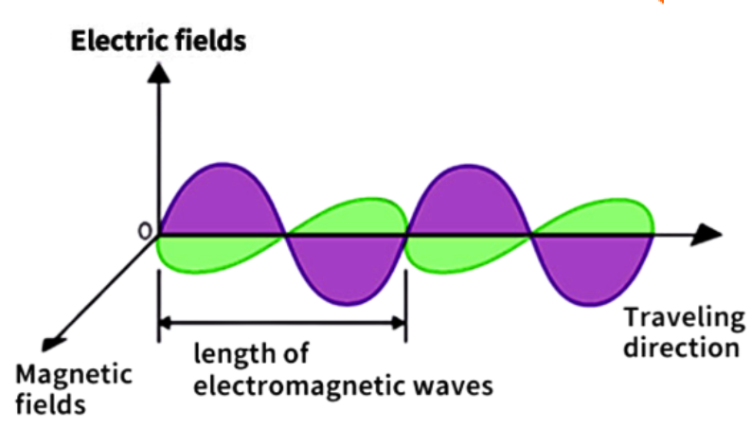
Level 2: Classical Electromagnetic Fields
Instead of treating light as a particle trajectory, classical electromagnetism models light as a wave in an EM field.
  A classical field assigns values or vectors to every point in spacetime.
  The field version of the Lagrangian produces Maxwell's equations, allowing us to predict how electromagnetic waves propagate and how light intensity is distributed through space.
  Energy introduced into the electromagnetic field by the laser propagates continuously through space and time according to Maxwell's equations.

Slide 20
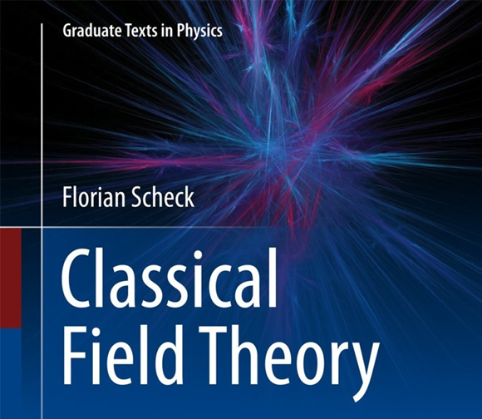
What Classical Fields Successfully Predict
Classical electromagnetic fields successfully predict many observed properties of light.
  Interference patterns produced by overlapping light waves.
  Diffraction patterns produced when light passes through openings or around obstacles.
  The propagation of electromagnetic waves through space.
  The distribution of light intensity across a detector.
In our laser-to-detector experiment:
  Maxwell's equations correctly predict where light intensity will be greatest and where it will be weakest.
  The resulting intensity distribution closely matches the pattern that emerges after many photon detections.

Slide 21
The Crisis of Classical Physics
Despite the success of predictions made using classical physics, there were serious problems:
  Classical electromagnetism was extraordinarily successful.
  Yet several experiments produced results that classical physics could not explain.
  These were not small discrepancies.
  In several cases, classical theory predicted results that were catastrophically wrong.

Slide 22

Catastrophic Failures of Classical Physics
Classical physics was extraordinarily successful, but several important predictions were disastrously wrong.
Blackbody Radiation
  Classical physics predicted that the energy emitted at short wavelengths should become infinite.
  This became known as the ultraviolet catastrophe.
Atomic Stability
  Classical electromagnetism predicted that orbiting electrons should continuously radiate energy.
  Atoms should rapidly collapse into their nuclei.
  Stable atoms should not exist.
Atomic Spectra
  Classical theory predicted that atoms should emit a continuous spectrum of light.
  Experiments instead revealed sharply defined spectral lines.
  Atomic energy appeared to be quantized.

Slide 23
Catastrophic Failures of Classical Physics
More Experimental Failures
The Photoelectric Effect
  Light below a threshold frequency could not eject electrons, regardless of intensity.
  Electron energy depended on light frequency rather than total light energy.
Electron Diffraction
  Electrons produced interference and diffraction patterns similar to waves.
  Classical particle trajectories could not explain this behavior.
Discrete Photon Detections
  Classical electromagnetic fields spread energy continuously through space.
  Experiments detected light as localized, discrete events rather than continuous arrivals.
Bottom Summary
Classical physics could not simultaneously explain the wave-like and particle-like behavior observed in matter and light.

Slide 24
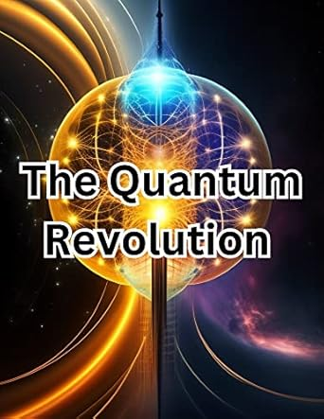
Classical physics was failing.
Classical particle trajectories could not explain quantum phenomena.
Classical electromagnetic fields successfully predicted many wave-like effects.
Yet classical physics could not explain:
  atomic stability,
  atomic spectra,
  the photoelectric effect,
  electron diffraction,
  or discrete photon detections.
The Critical Insight
Physicists did not abandon the classical Lagrangian.
The Lagrangian already encoded the physical structure and dynamics of the system.
Instead, they developed a new procedure called quantization.
Quantization would transform a successful classical model into a quantum one.

Slide 25
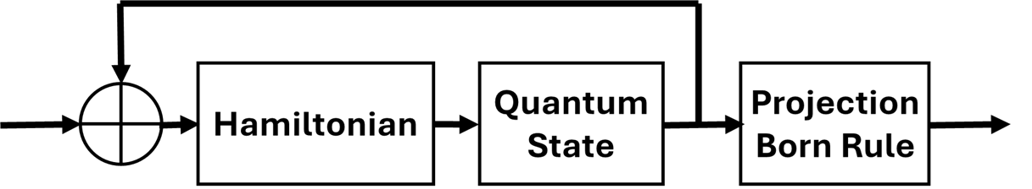
From Blueprint to Quantum State Machine
The starting point is the classical Lagrangian.
Quantization of the Lagrangian is a process in which the classical fields are replaced by operators and used to construct the Hamiltonian and define the quantum states.
The result is a quantum model built from:
  A Hamiltonian
    Encodes the allowed energy structure and governs state evolution.
  Quantum States
    Represent the possible configurations of the system.
  Hilbert Space
    The mathematical space containing all possible quantum states.
The Result
Classical Lagrangian → Quantization → Hamiltonian + Quantum States → Quantum State Machine

Slide 26
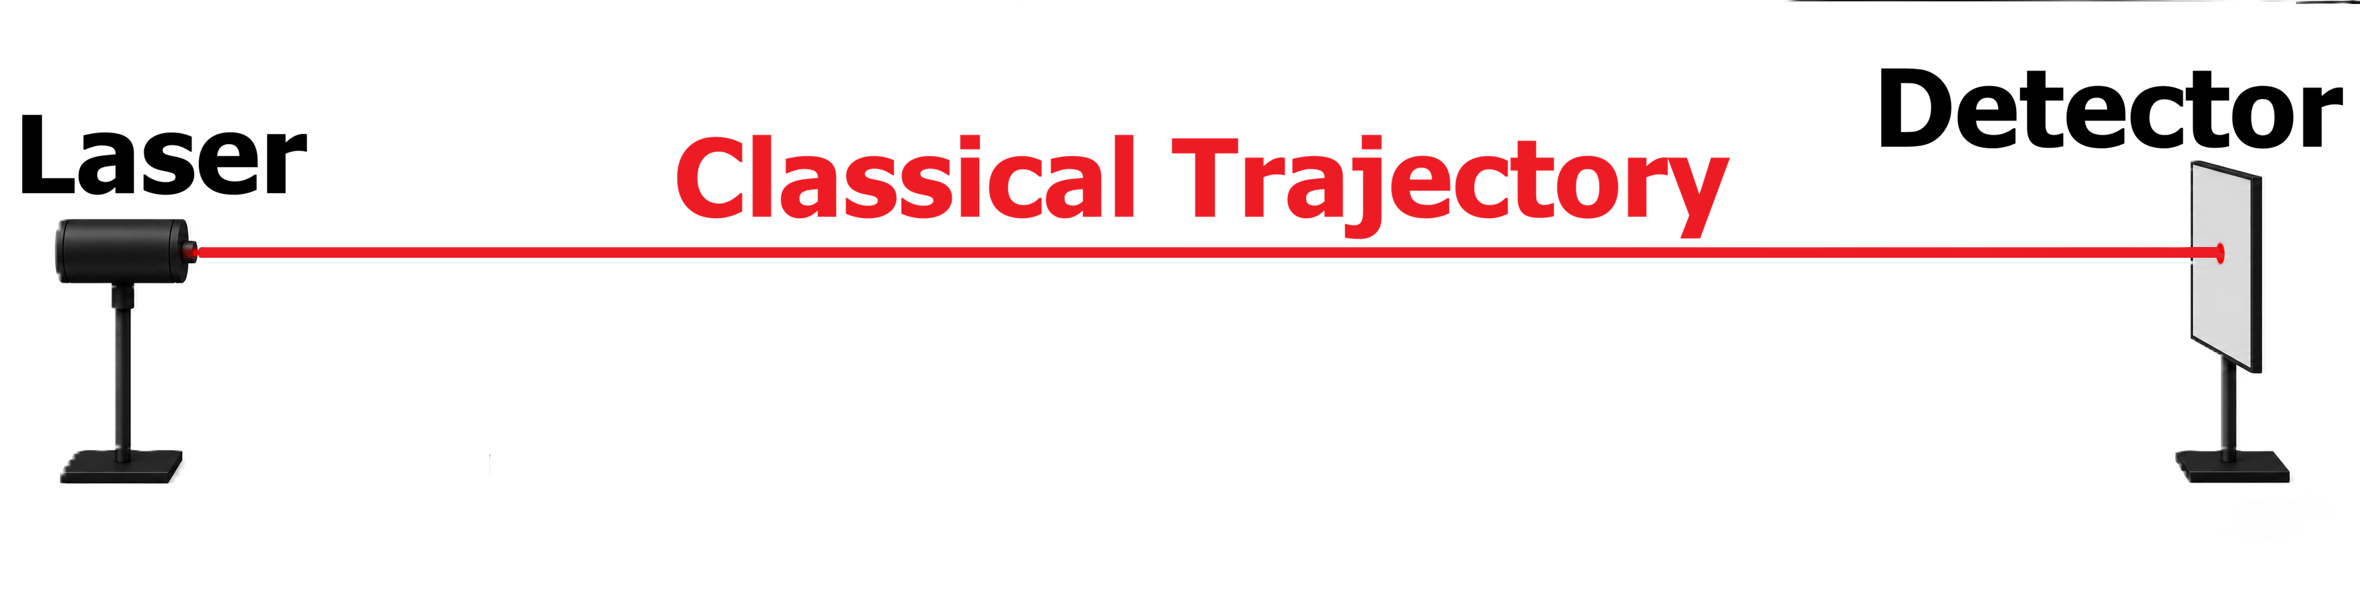
Our Example: A Single Photon Experiment
To demonstrate how the Quantum State Machine is constructed, we will use a very simple experiment:
  A laser sends a single photon to a detector.
Why this example?
  It is simple enough to understand step-by-step.
  It contains all of the essential elements of quantization.
  The same modeling procedure is used for virtually all quantum systems.
Key Concept:
  We are now leaving the roadmap and beginning the actual construction of the model. Although our example is simple, the procedure we develop i essentially the same procedure used throughout modern quantum physics.

Slide 27
Our Example: A Single Photon Experiment
What We Actually Observe:
  A source event
  A detector click
  A statistical pattern after many repetitions
We do not directly observe:
  A photon in flight
  A wave packet in flight
  A field in flight
  A wavefunction in flight
Key insight:
  The purpose of the model is to predict the probability of detector clicks. The mathematical objects we introduce along the way are part of the predictive framework.

Slide 28


The Experimental Setup
Our experiment contains:
  Source → Empty Space → Detector
Unlike a light bulb:
  The laser produces a highly focused beam.
  The beam directs energy toward the detector.
For modeling purposes:
  We represent the beam as an electromagnetic field traveling from source to detector.
Key Concept:
  At this stage we are still doing classical physics.
  We have not yet introduced photons, quantum states, or quantization.

Slide 29

The Experimental Setup
How Do We Model the Beam?
A focused electromagnetic beam can be represented mathematically as:
  A combination of many pure sine waves
This decomposition is called:
  Fourier Series or Fourier Transform
Why do this?
  Because the sine-wave components behave like harmonic oscillators.
Key Concept:
  The purpose of the Fourier decomposition is not to discover what the beam 'really is.
  The purpose is to expose the harmonic oscillators hidden within the electromagnetic field.

Slide 30
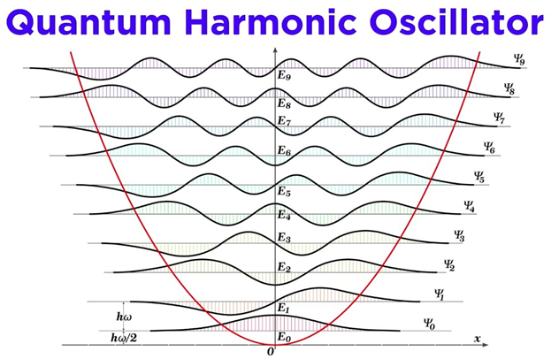
Why Are Harmonic Oscillators Important?
Quantization in quantum physics does not mean:
  Chopping a wave into little pieces.
Quantization begins with:
  Classical Harmonic Oscillators
  These oscillators will become the building blocks of the Quantum State Machine.
Key Concept:
  Before we can quantize anything, we must first identify the classical harmonic oscillators that are present in the electromagnetic field.

Slide 31

Where We Are Going?
Goal: Build a Quantum State Model for a Single Photon
  We begin with a classical electromagnetic field.
  We identify the harmonic oscillators hidden within that field.
  We quantize those oscillators.
  The resulting quantum model predicts detector probabilities.
Key Concept:
  Notice that we still do not have a photon.
  The photon will emerge later from the quantization procedure.

Slide 32
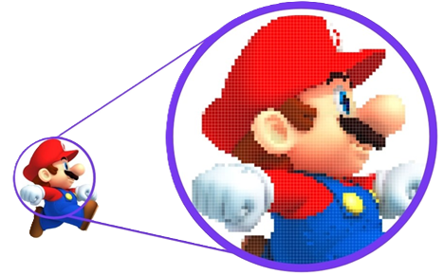

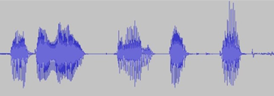
A Common Misconception About Quantization
Popular Description
  Quantization means chopping a continuous thing into little pieces.
Examples:
  Pixels in a digital image
  Frames in a movie
  Samples in a digital recording
But that is NOT what happens in quantum field theory.

Slide 33
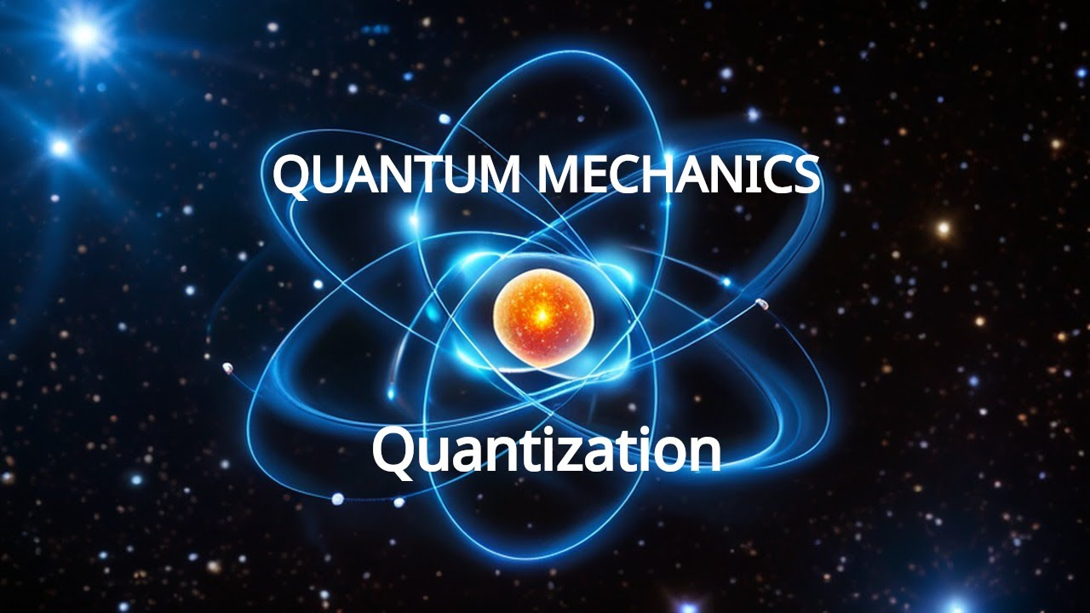
What Quantization Actually Requires
Before quantization we must first identify:
  Classical Harmonic Oscillators
Why?
  Because harmonic oscillators are the objects that will eventually be quantized.
Basic Procedure:
  First we find the oscillators.
  Then we quantize them.
  We do not quantize the electromagnetic field directly.

Slide 34

The Modeling Problem
We wish to model:
  A laser
  Sending a single photon
  To a detector
The electromagnetic field can be represented in more than one way.
  Modeling Requires Choices
  There is not a single mandatory starting point. We have options.

Slide 35
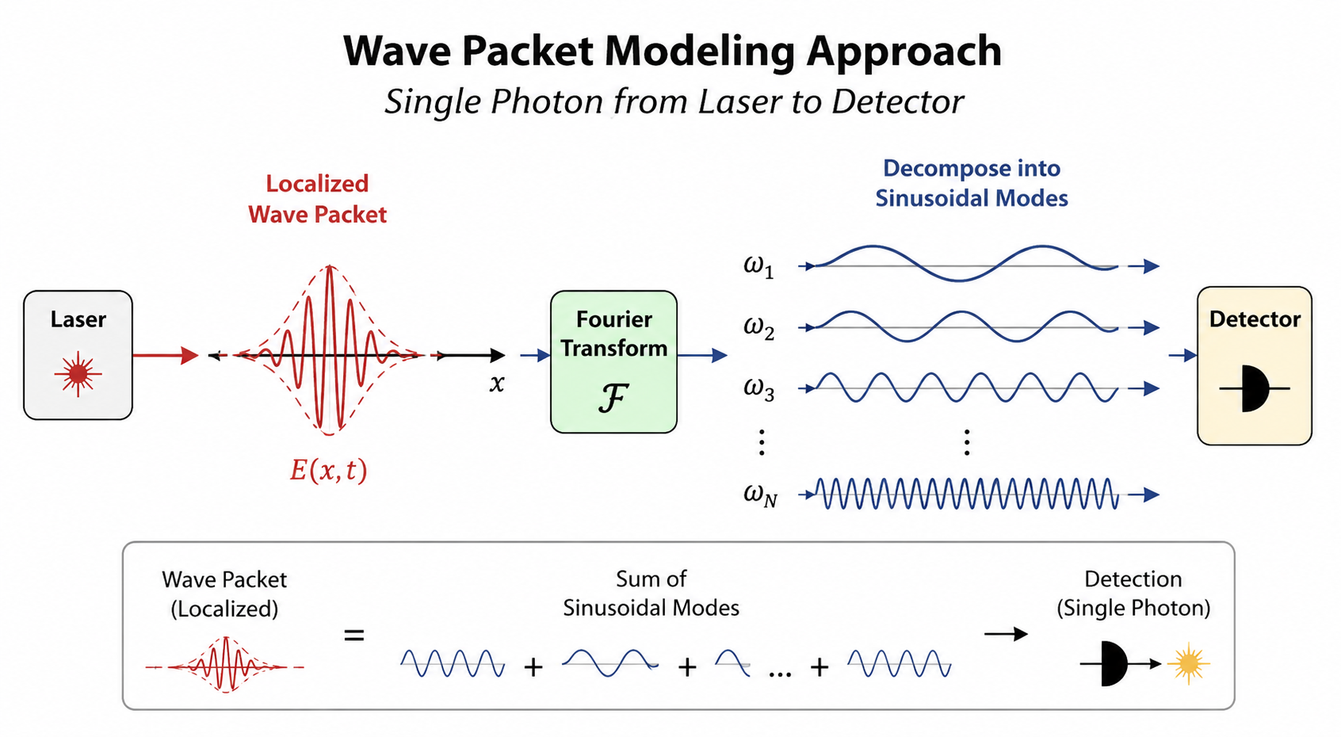
Modeling Choice #1
Wave Packet Approach
Represent the electromagnetic field as:
A Localized Wave Packet
Then use:
Fourier Transform to decompose the wave packet into sinusoidal modes.
Result
  The harmonic oscillators appear directly.
  This approach resembles the physical experiment most closely.

Slide 36
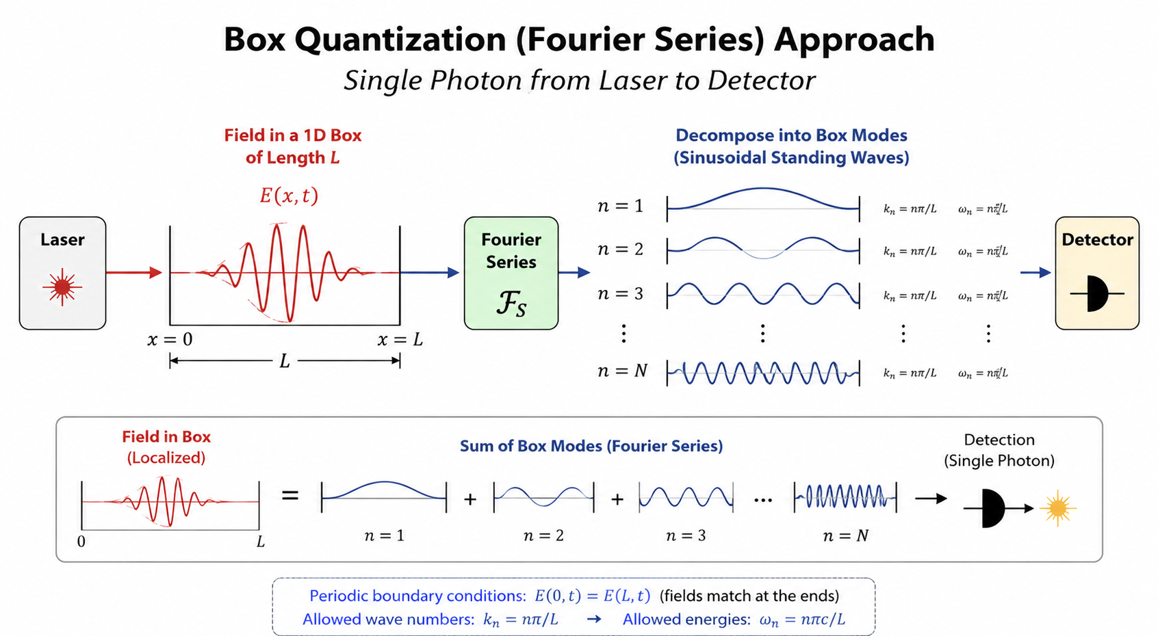
Modeling Choice #2
Box Quantization
Place the electromagnetic field inside a large box.
Then use:
Fourier Series to decompose the field into standing-wave modes.
Result
  The harmonic oscillators appear directly.
  The box is a mathematical device, not part of the experiment.

Slide 37
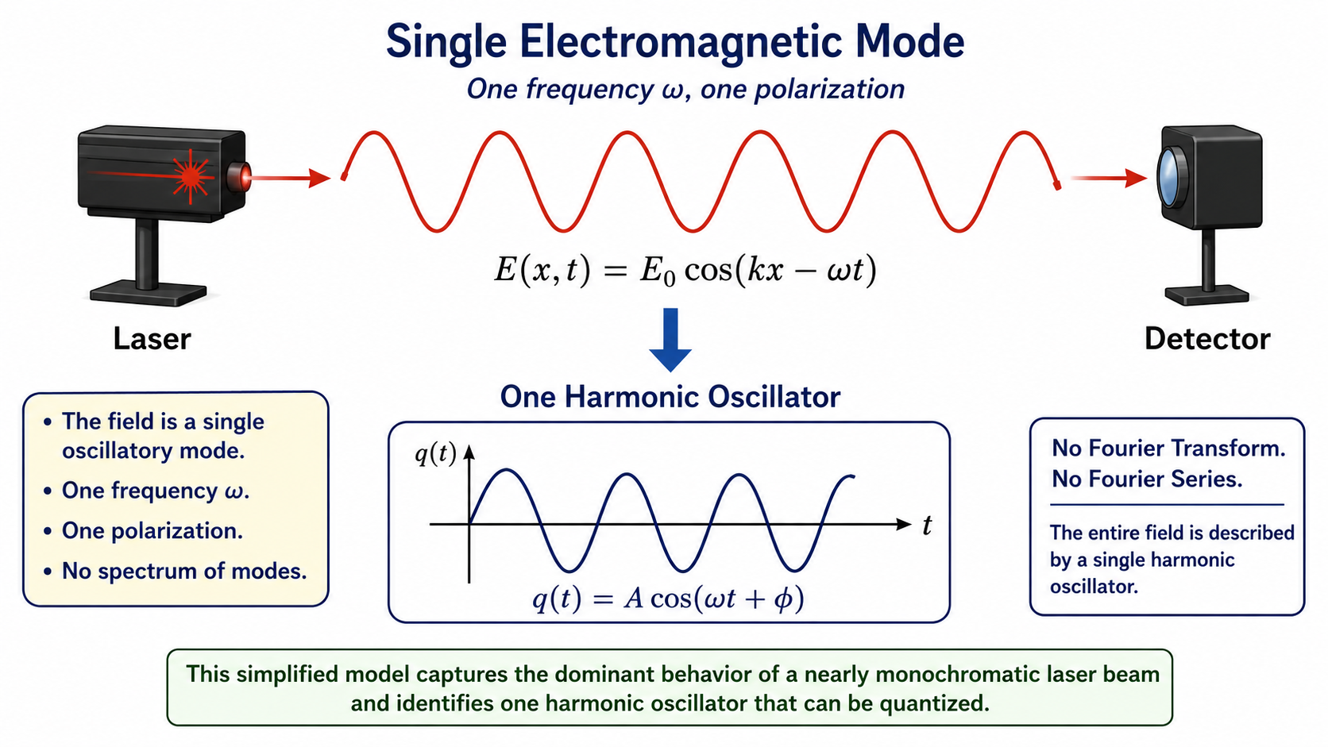
Modeling Choice #3
Single Electromagnetic Mode
For a highly stabilized laser, we may idealize the laser-to-detector experiment as a single-frequency electromagnetic wave.
The field is represented by a single oscillatory mode with one frequency and one polarization.
Result
  This simplified model captures the dominant behavior of a nearly monochromatic laser beam and provides the most direct path to quantization.
  The resulting harmonic oscillator will become the fundamental building block of the Quantum State Machine Model.

Slide 38
Three Classical Descriptions of the Same Experiment
The laser-to-detector experiment can be modeled in several different ways:
Model 1: Wave Packet
  Electromagnetic pulse
  Fourier Transform
  Many frequency components
  Harmonic oscillators identified from the spectrum
Model 2: Standing Waves
  Electromagnetic field represented by standing-wave modes
  Fourier Series
  Many standing-wave modes
  Harmonic oscillators identified from the modes
Model 3: Single Electromagnetic Mode
  Nearly monochromatic laser beam
  One frequency
  One mode
  One harmonic oscillator
Key Point:
  All three models describe the same physical experiment from different mathematical perspectives.

Slide 39
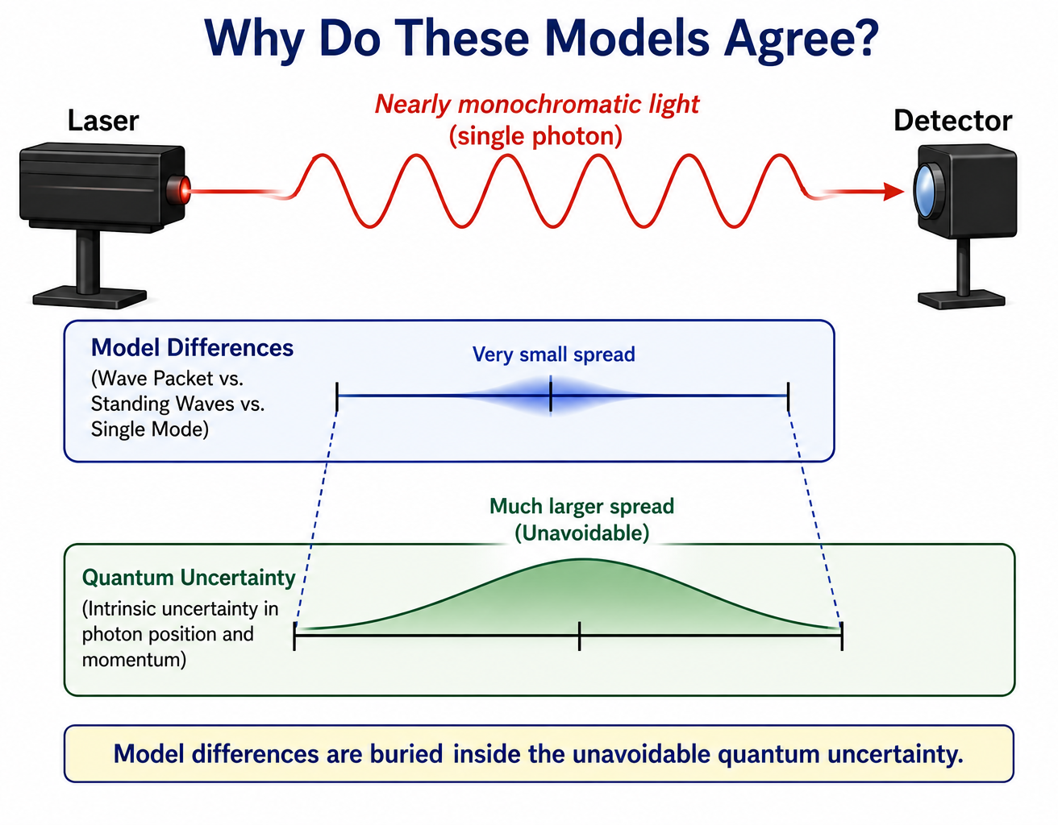
For a highly stabilized laser emitting nearly monochromatic photons:
  The laser frequency is extremely well defined.
  Differences among the three classical descriptions become very small.
  Those differences become negligible compared with the intrinsic quantum uncertainty that every photon possesses in its position and momentum.
  As a result, all three models predict essentially the same experimentally observable photon detection probabilities.

Slide 40
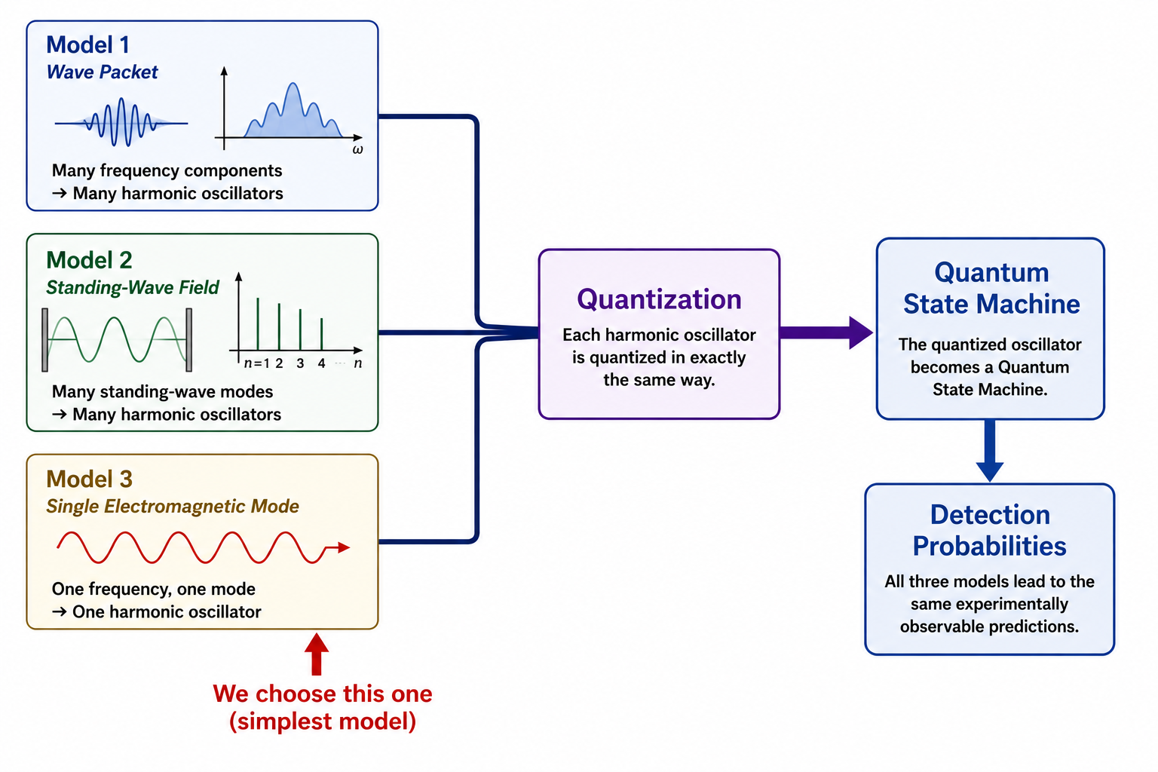
The Power of Quantization
Although the classical descriptions are different:
  Each model identifies harmonic oscillators.
  Every harmonic oscillator is quantized in exactly the same way.
  Quantization converts each harmonic oscillator into a Quantum State Machine.
Because all three models lead to essentially the same observable predictions:
  We are free to choose the classical model that is easiest to quantize.
For this lecture we will use: Model 3: Single Electromagnetic Mode
  Because it contains only one harmonic oscillator and clearly illustrates the quantization procedure.

Slide 41

An Important Modeling Lesson
The three approaches:
  Start differently
  Use different mathematics
  Look very different
  Yet they produce the same harmonic oscillators and ultimately the same quantum model.
Note:
  This should remind us of Newtonian Mechanics and Lagrangian Mechanics.
  Different models can lead to the same predictions.
  Models are NOT reality

Slide 42

What Has Been Quantized So Far?
Nothing Has Been Quantized at All!
We have only identified:
Classical electromagnetic fields
Classical Fourier modes
Classical harmonic oscillators
The energies are still continuous.
The oscillators are still classical.
Next Step
How do we convert a classical harmonic oscillator into a quantized harmonic oscillator?

Slide 43
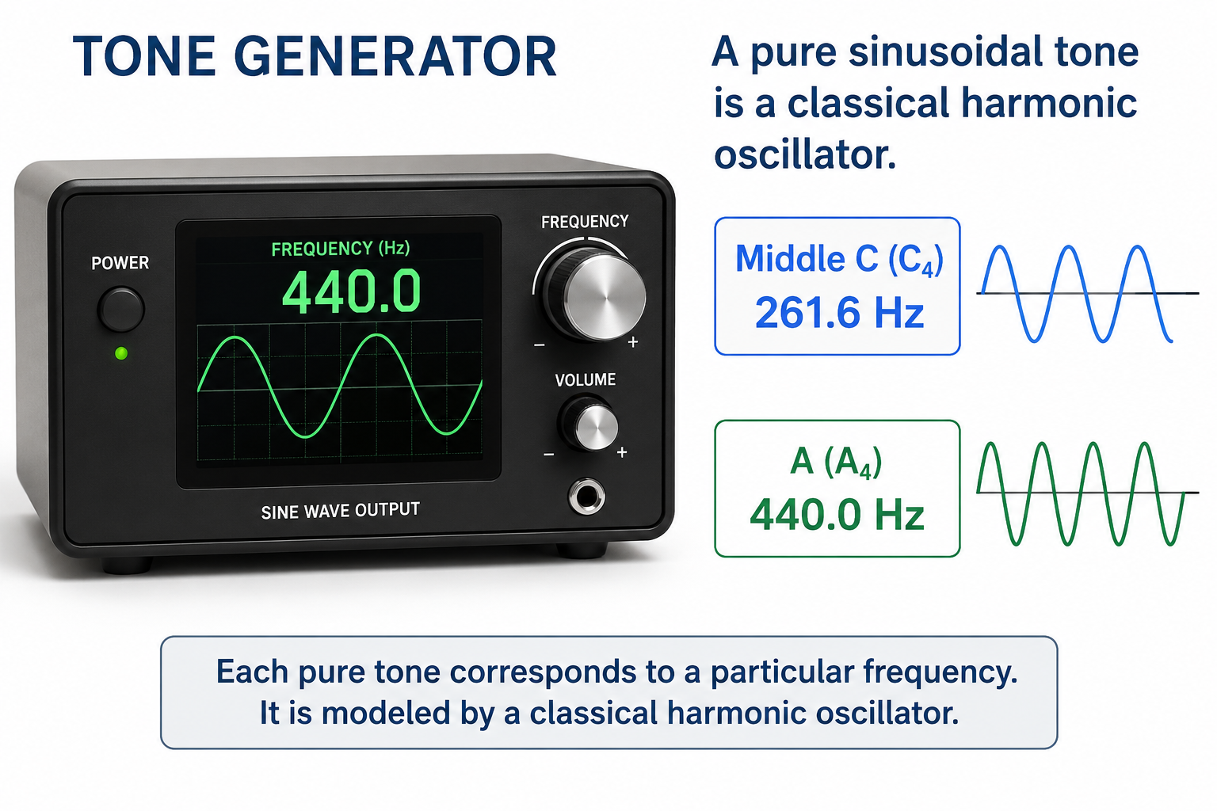
Time for a Deep Dive Into Harmonic Oscillators
So far we have identified:
  Classical electromagnetic fields
  Classical Fourier modes
  Classical harmonic oscillators
But we have not yet examined a harmonic oscillator in detail.
Before we quantize anything, let's look closely at a single harmonic oscillator.
Bottom takeaway
  A pure sinusoidal tone is a classical harmonic oscillator.

Slide 44
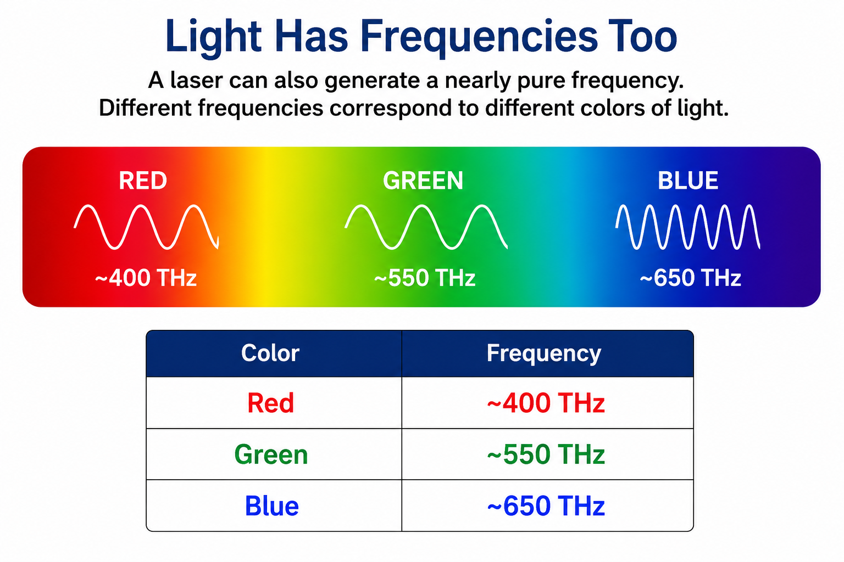
Light Has Frequencies Too
A laser can also generate a nearly pure frequency.
For our experiment:
  Red Laser Mode = 400 THz
This single Fourier mode behaves like a classical harmonic oscillator.
  The tone generator provides sounds we can hear
  The laser generator provides light we can see

Slide 45
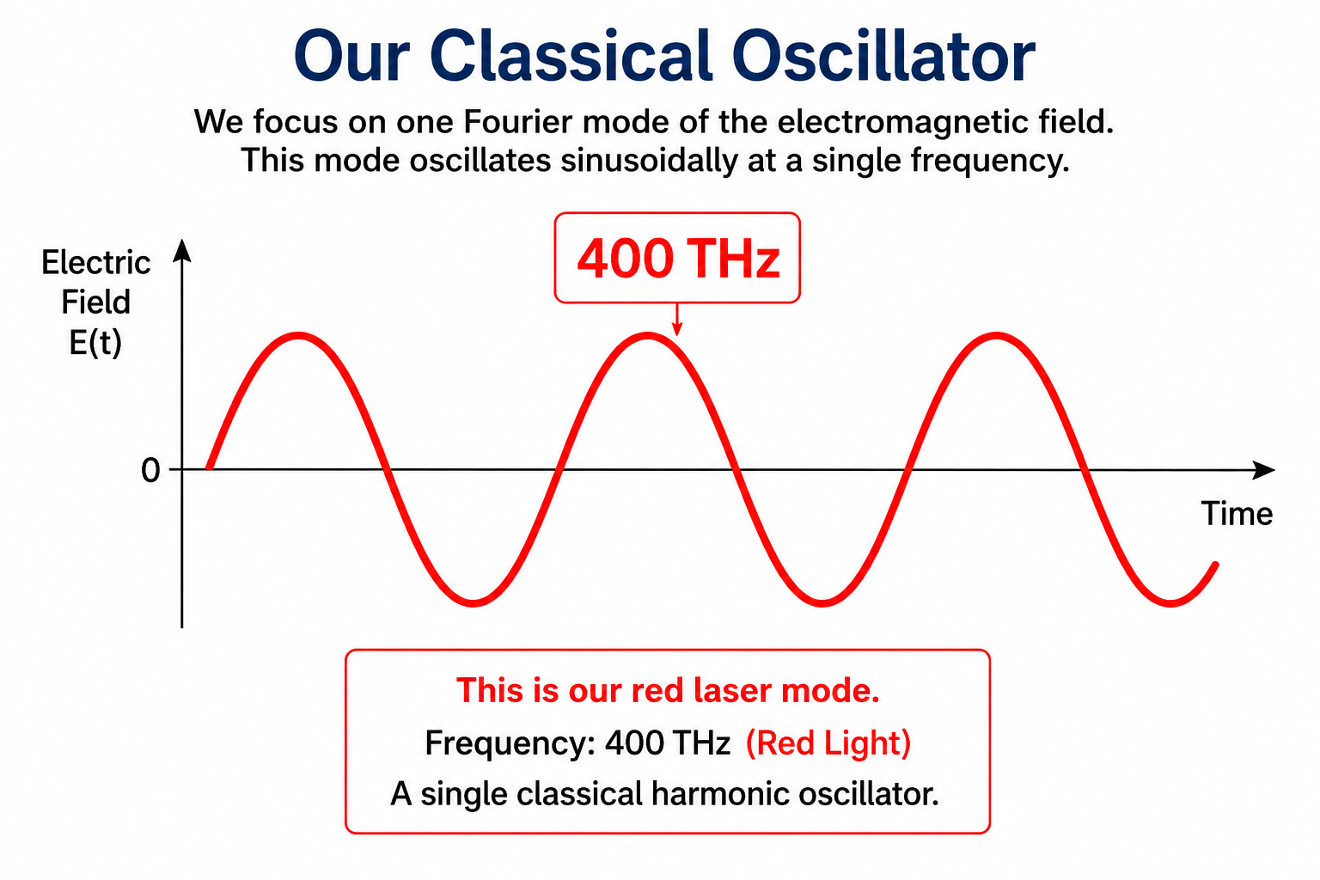
Our Classical Oscillator
We now focus on one Fourier mode only.
  Frequency: 400 THz
  Color: Red
At this stage:
  Classical field
  Classical Fourier mode
  Classical harmonic oscillator
  Nothing has been quantized.

Slide 46
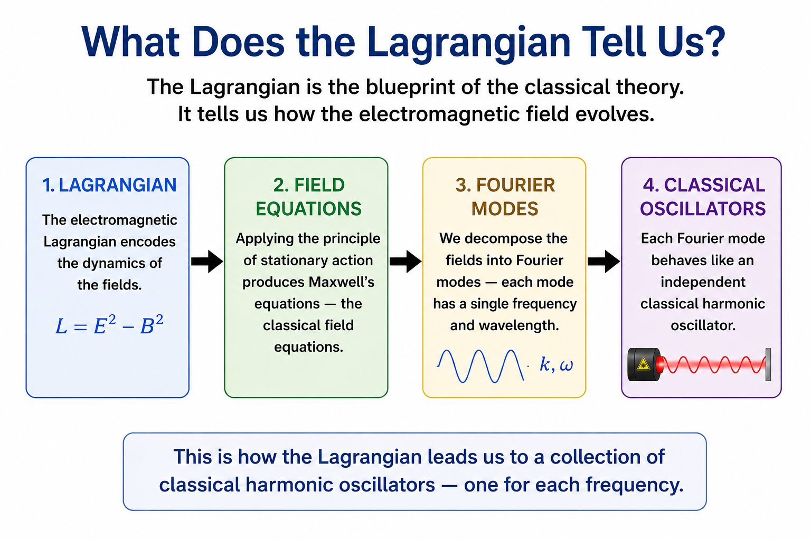
What Does the Lagrangian Tell Us?
Earlier we used the electromagnetic Lagrangian:
  to describe the classical field
  to determine how the field evolves
  The Fourier decomposition revealed a collection of classical harmonic oscillators.
  Our red 400 THz mode is one of them.

Slide 47
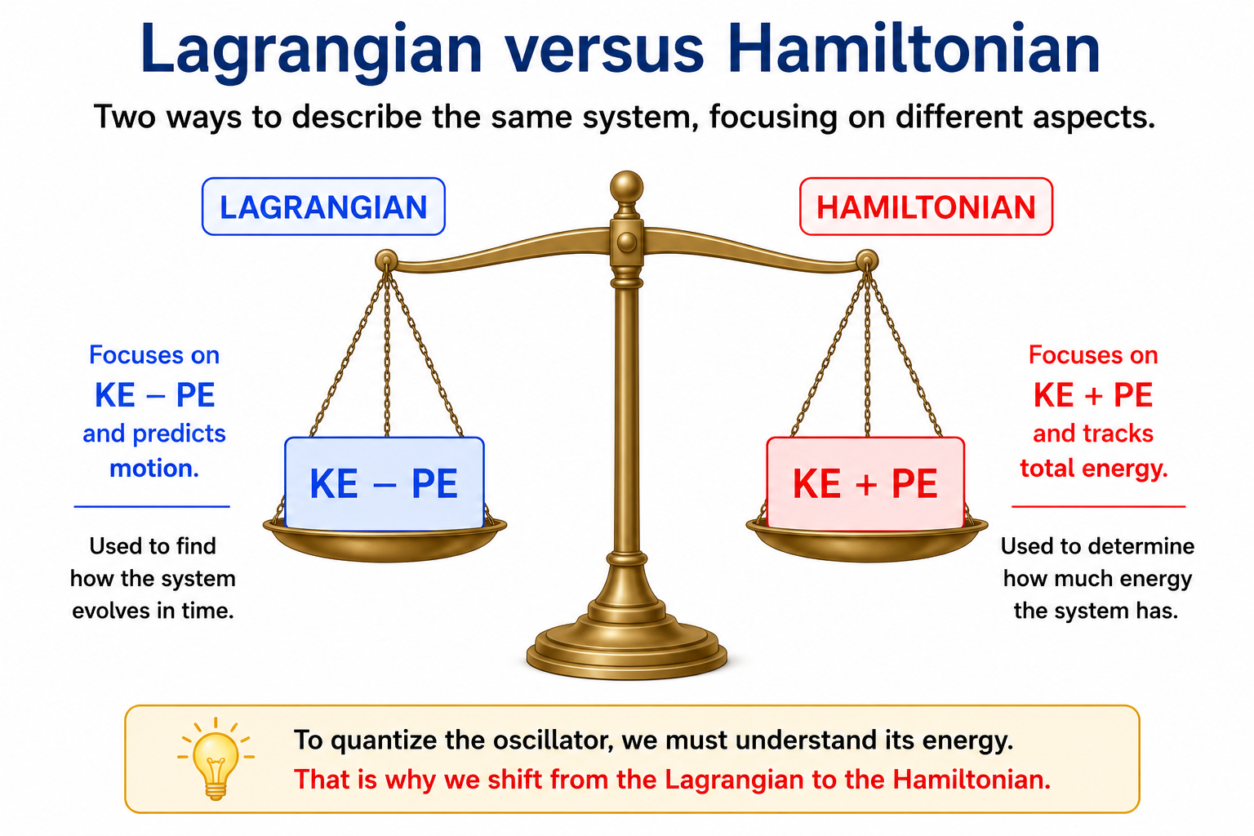
Lagrangian versus Hamiltonian
Lagrangian Mechanics focuses on:
  KE − PE
  and predicts motion.
Hamiltonian Mechanics focuses on:
  KE + PE
  and tracks total energy.
To quantize the oscillator, we must understand its energy.
The Lagrangian Blueprint allowed us to identify the harmonic oscillators
It has now done its job and we need the Hamiltonian to continue

Slide 48
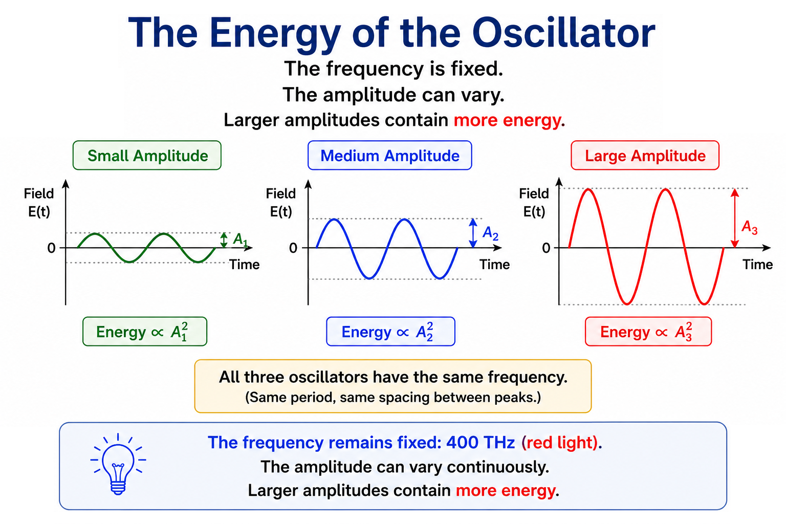
The Energy of the Harmonic Oscillator
The frequency remains fixed:
  400 THz
  The amplitude can vary continuously.
  Larger amplitudes contain more energy.
At this stage:
  Energy is still continuous.

Slide 49
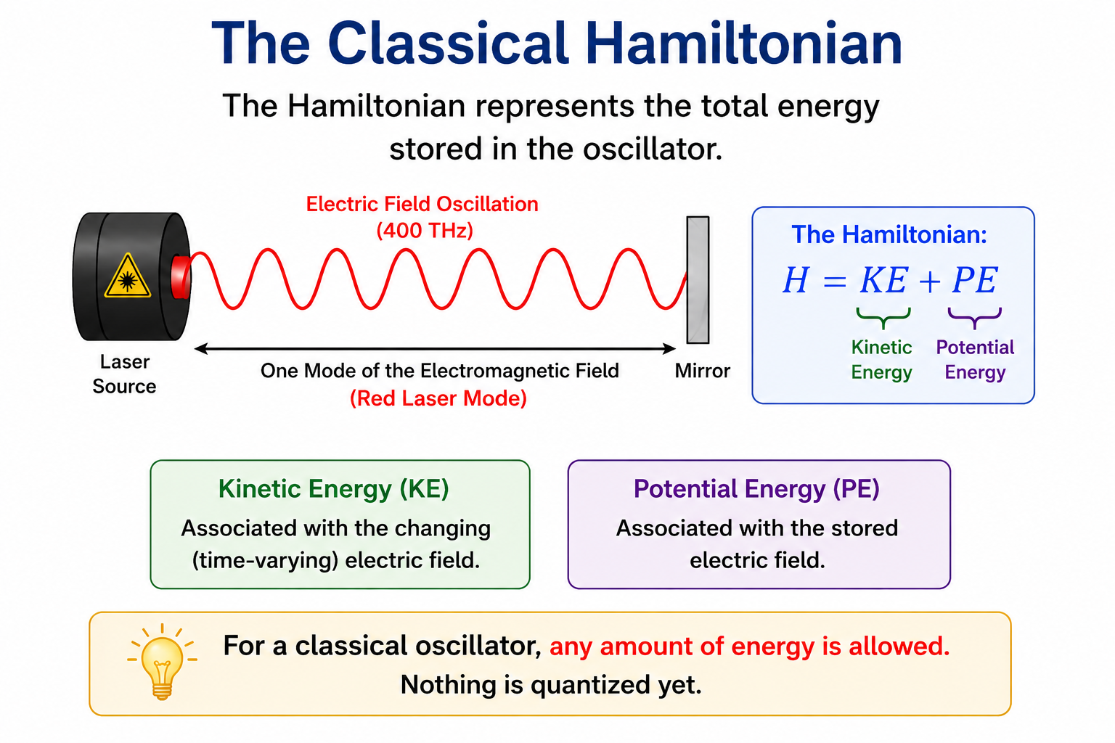
The Classical Hamiltonian
The Hamiltonian represents the total energy stored in the oscillator.
For a classical oscillator:
  Any energy is allowed.
  Nothing is quantized yet.

Slide 50
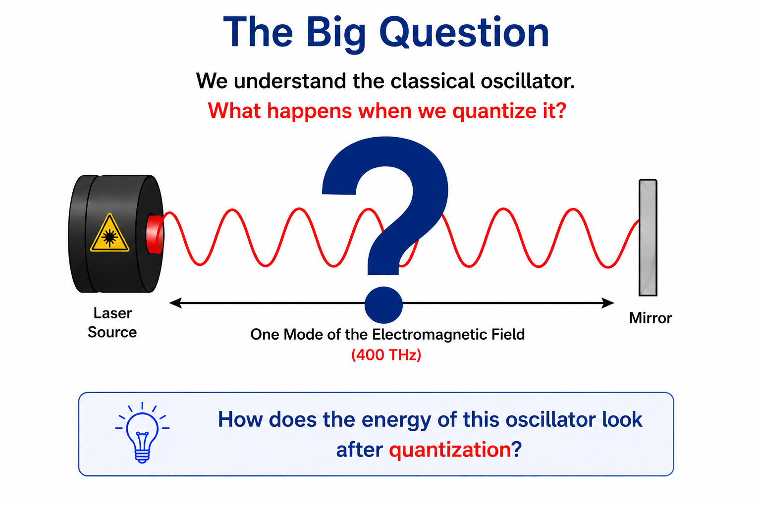
The Big Question
Our oscillator is still classical.
  Its energy can take any value.
  We know this is wrong.
  Only certain energy levels are allowed.
How can we quantize the oscillator?
  The frequency must stay the same.
  But the energy must be quantized.
  How can we do this?

Slide 51
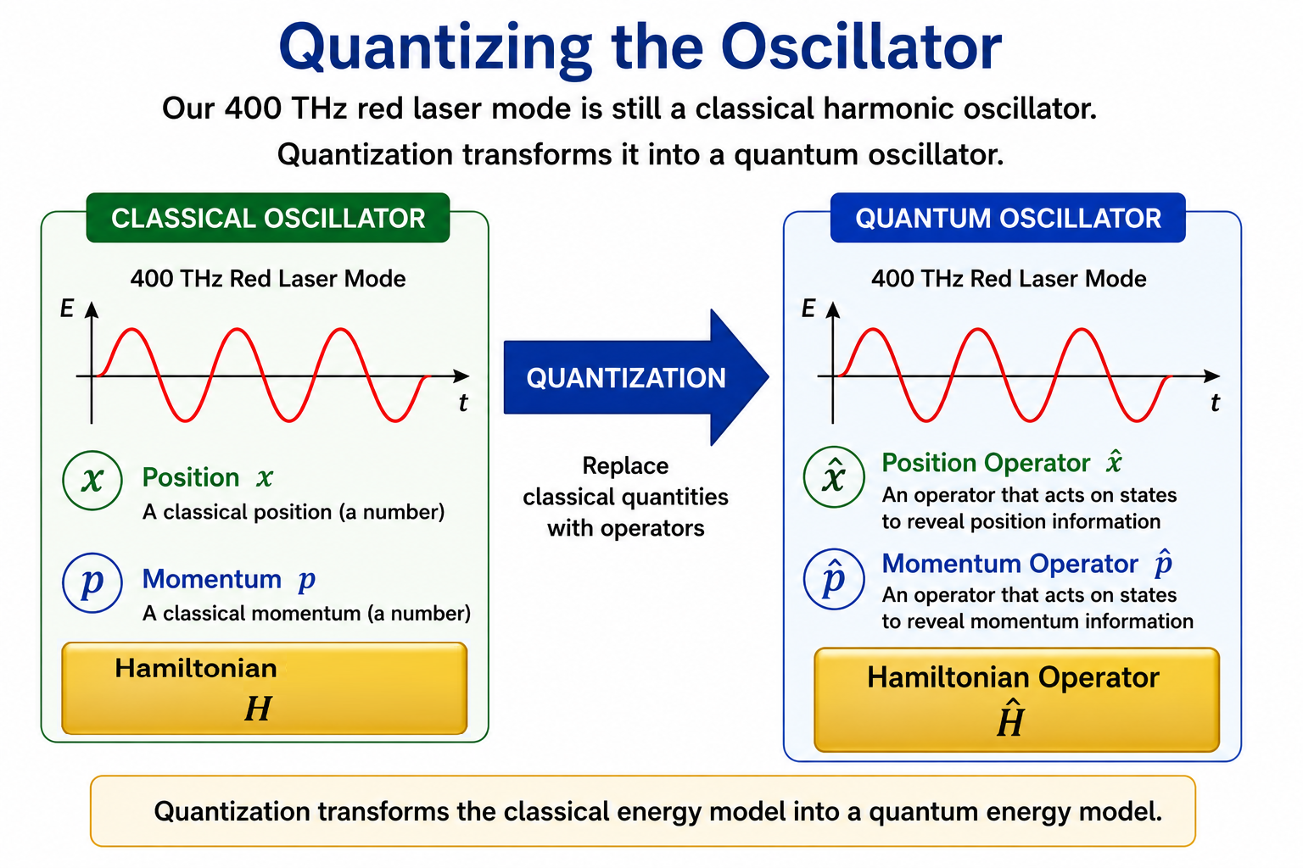


Quantizing the Harmonic Oscillator
Our 400 THz red laser mode is still a classical harmonic oscillator.
  Its total energy is described by the classical Hamiltonian: $H=KE+PE$
Quantization replaces the classical position and momentum variables with operators:
  $x→\hat{x}$
  $p→\hat{p}$
As a result, the classical Hamiltonian becomes a Hamiltonian operator:
  $$H→\hat{H}$$
Quantization transforms the classical energy model into a quantum energy model.

Slide 52
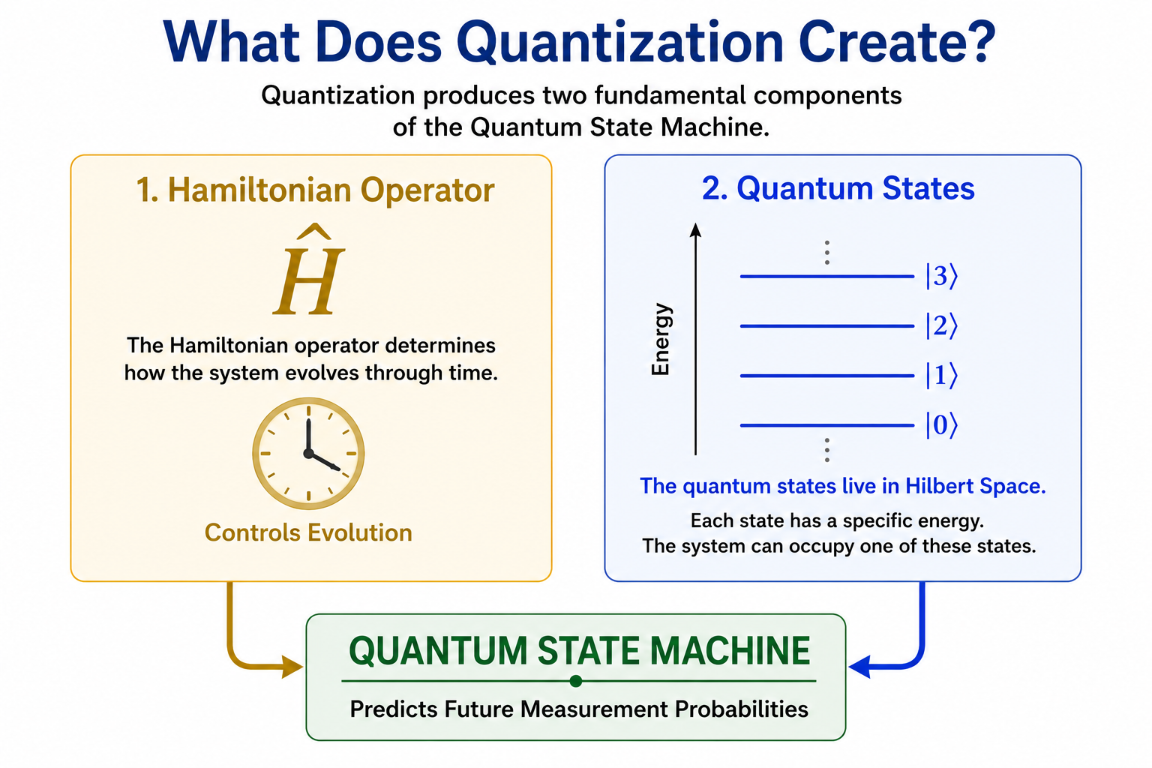

What Does Quantization of the Harmonic Oscillator Create?
Quantization produces two fundamental components of the Quantum State Machine.
Hamiltonian Operator:
$$\hat{H}$$
  The Hamiltonian operator determines how the system evolves through time.
Quantum States
$$\left.\left.\left.\left.∣0\right\rangle , ∣1\right\rangle , ∣2\right\rangle , ∣3\right\rangle ,…$$
  The quantum states live in Hilbert Space.
Together:
  Hamiltonian Operator + Quantum States = Quantum State Machine

Slide 53
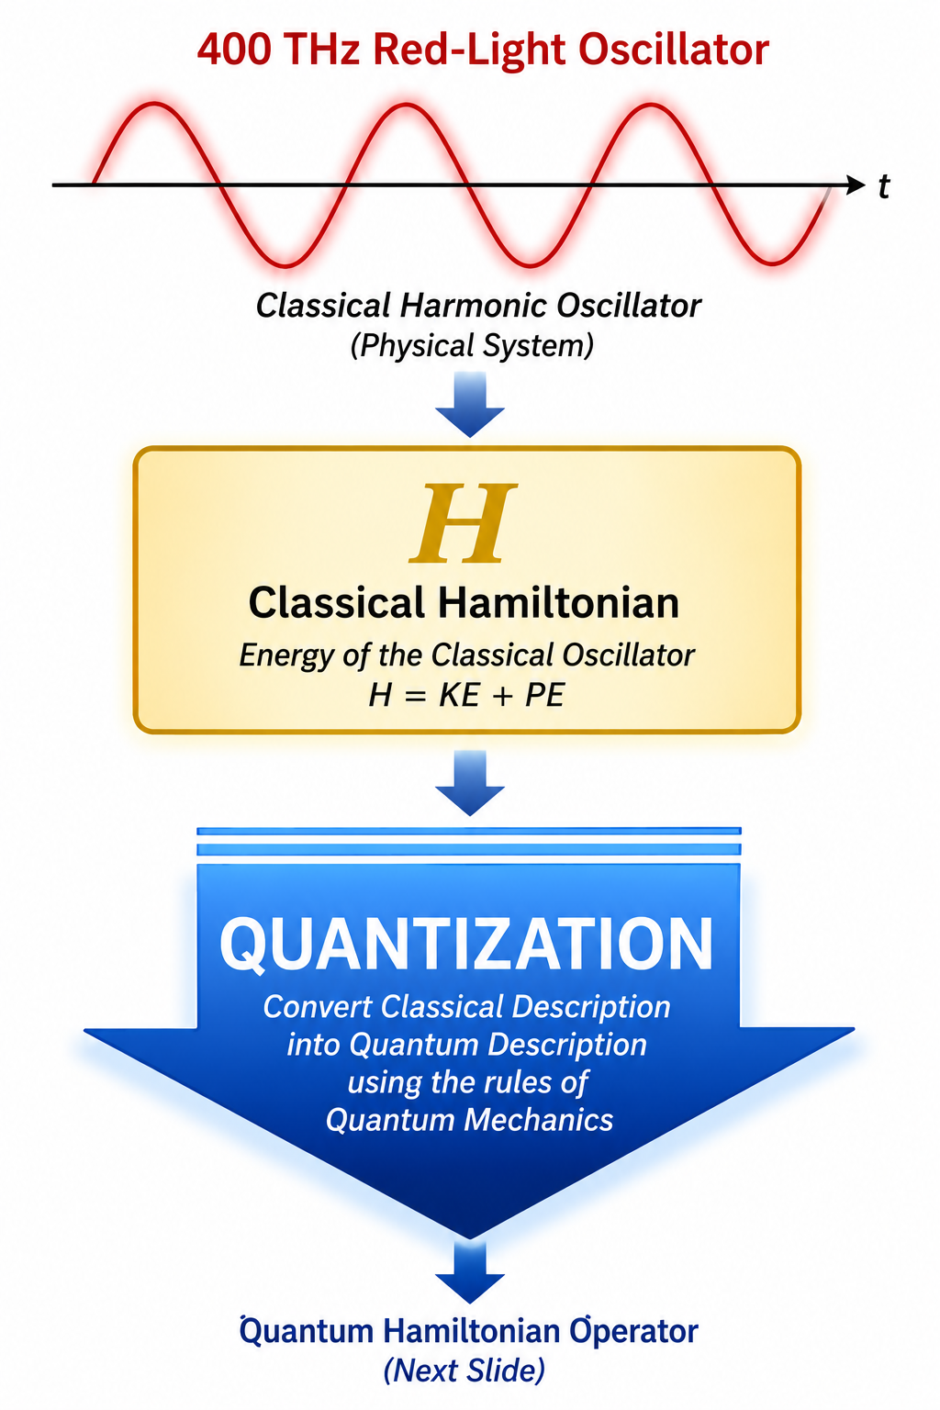

Quantization of the Hamiltonian
We begin with a classical harmonic oscillator.
For our example:
  A 400 THz red-light oscillator
The classical oscillator possesses:
  Position $x$
  Momentum $p$
These quantities determine the oscillator's energy:
  $H=KE+PE$
The goal of quantization is to convert this classical energy description into a quantum Hamiltonian operator.

Slide 54
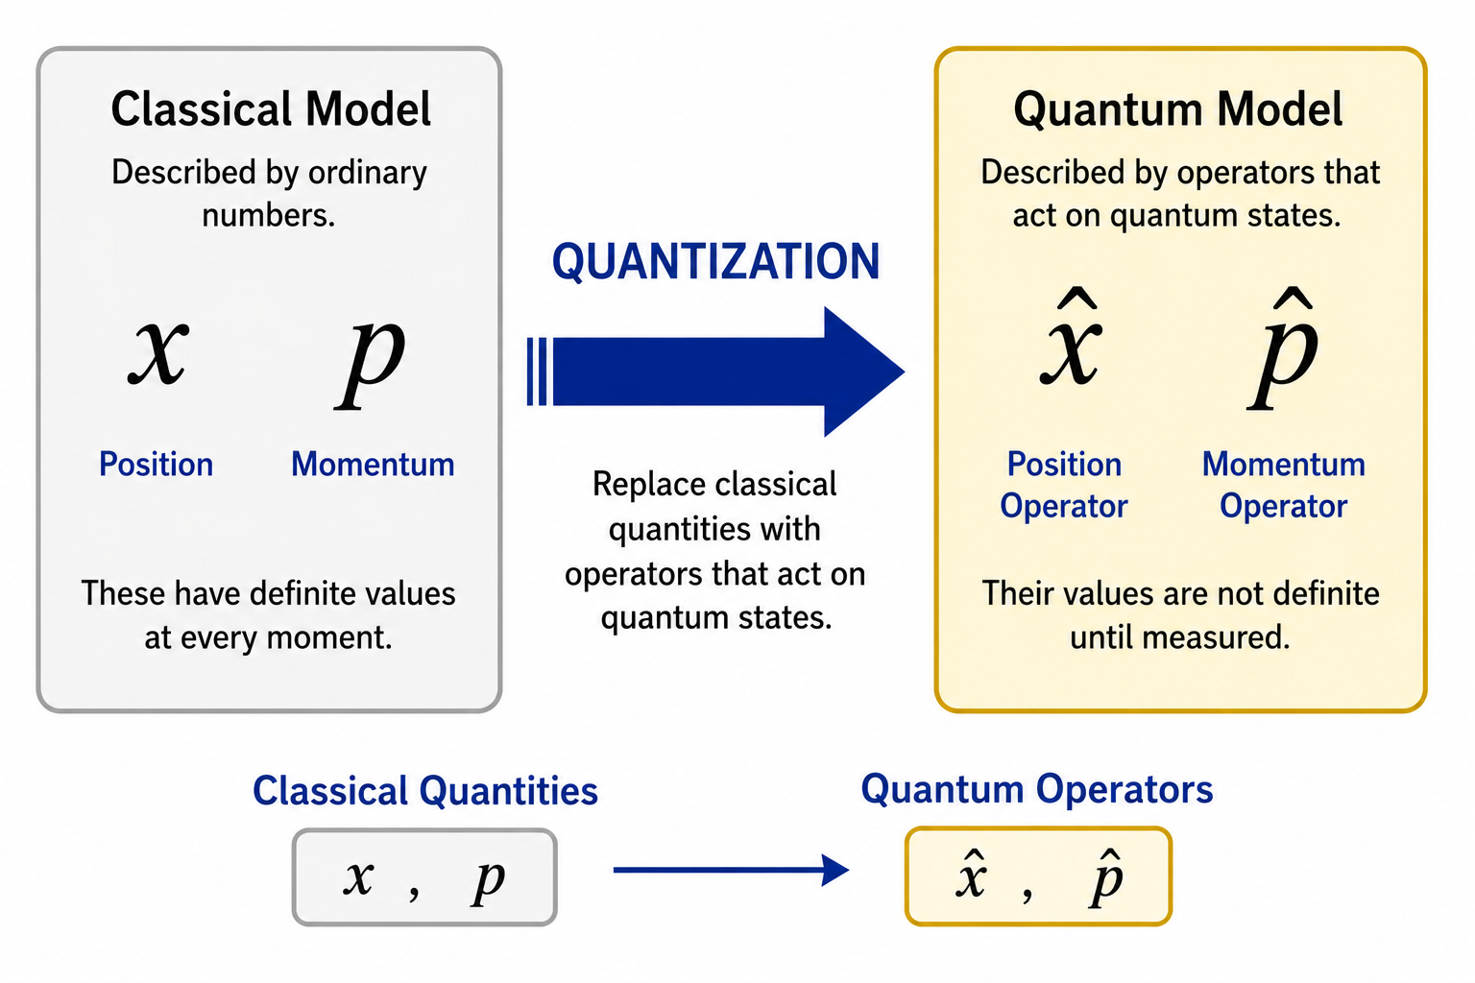

Classical Quantities Become Operators
Quantization replaces classical quantities with mathematical operators.
  $x→\hat{x}$
  $p→\hat{p}$
Instead of describing exact trajectories, the model now works with operations acting on quantum states.
Position Operator
  Asks: Where could the system be found?
Momentum Operator
  Asks: How could the system be moving?

Slide 55
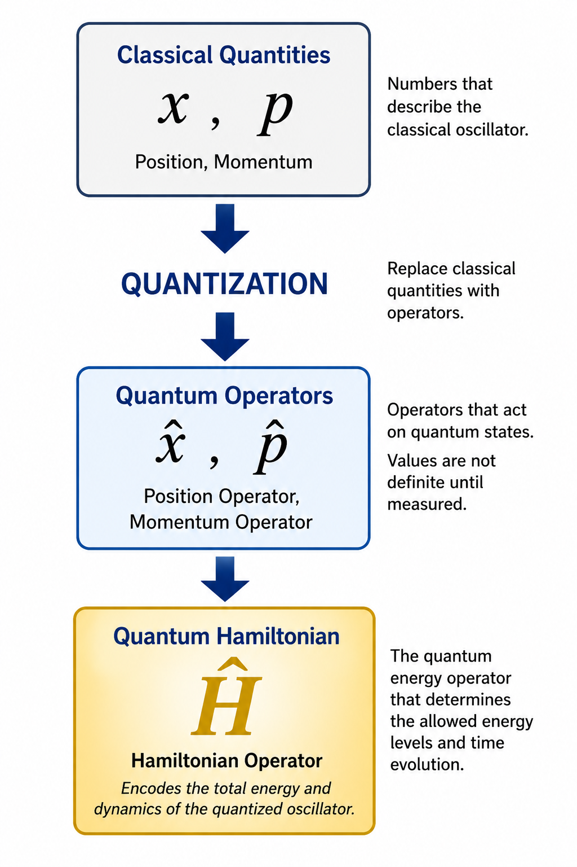

Building the Quantum Hamiltonian
The classical Hamiltonian depended on:
  $x$ and $p$
The quantum Hamiltonian is built from:
  $\hat{x}$ and $\hat{p}$
The result is a new object:
  $$\hat{H}$$
The Hamiltonian Operator.

Slide 56
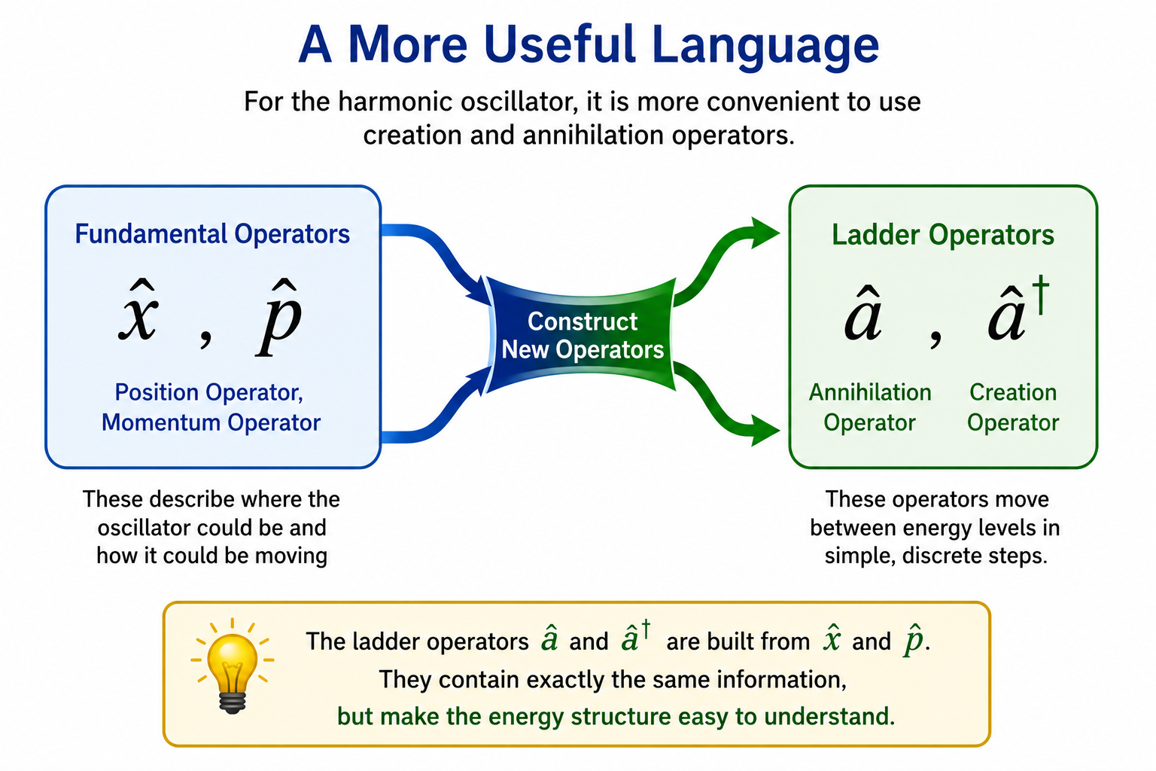

A More Useful Language
For harmonic oscillators there is a simpler description.
Instead of working directly with:
  $\hat{x}$ and $\hat{p}$
physicists define two new operators:
  Creation Operator: ${\hat{a}}^{†}$
  Annihilation Operator: $\hat{a}$
These contain exactly the same information but make the energy structure easy to see.

Slide 57
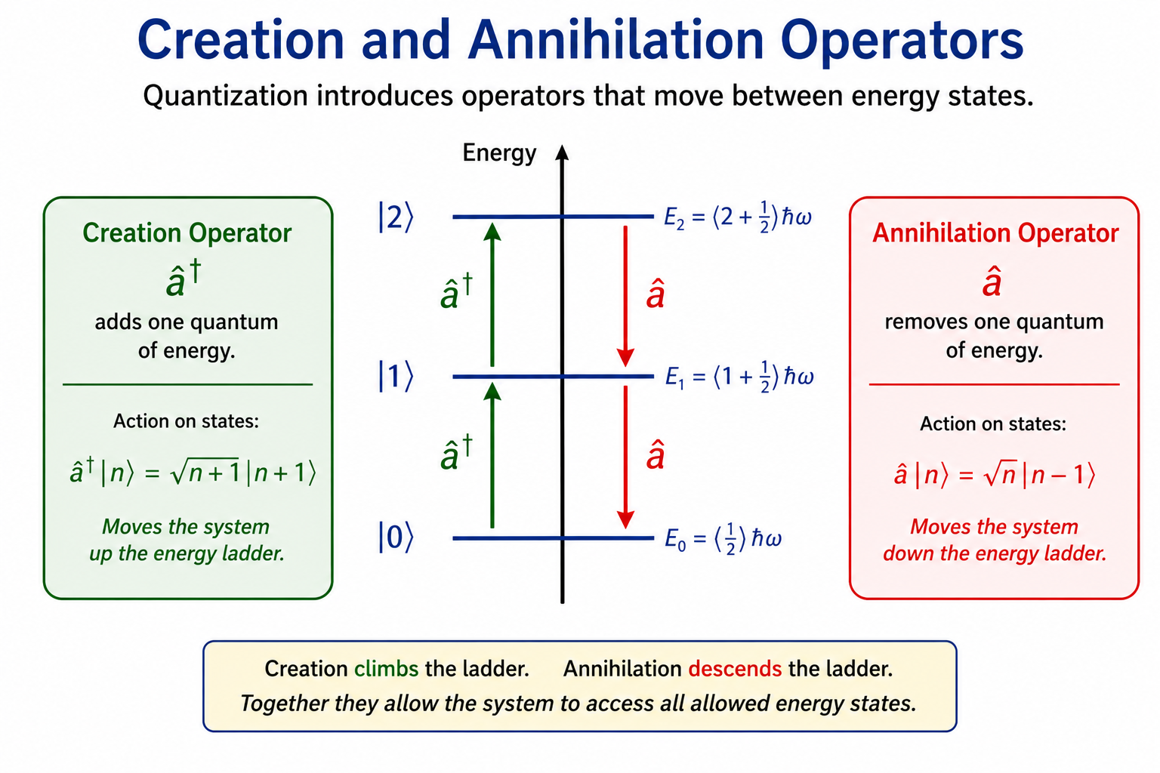
Moving Between Energy Levels
These operators do the same thing as the position and momentum operators, but they do it more directly
  The creation operator adds one quantum of energy.
  The annihilation operator removes one quantum of energy.
These operators build the Hamiltonian structure of the quantized oscillator.

Slide 58
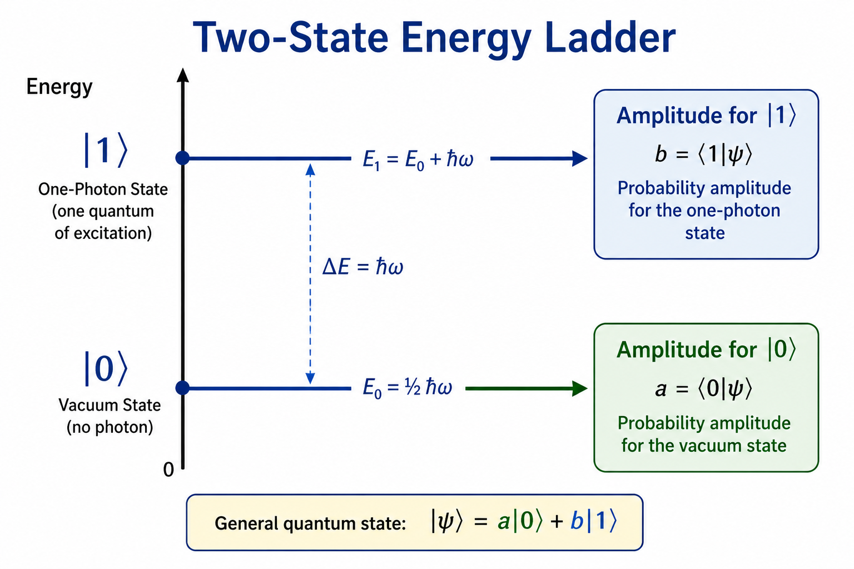

Quantization Also Creates Quantum States
Quantization does not only create a Hamiltonian Operator.
  It also creates the allowed quantum states of the oscillator.
For our laser example the most important states are:
  Vacuum State: $\left.∣0\right\rangle$
  One-Photon State: $\left.∣1\right\rangle$

Slide 59
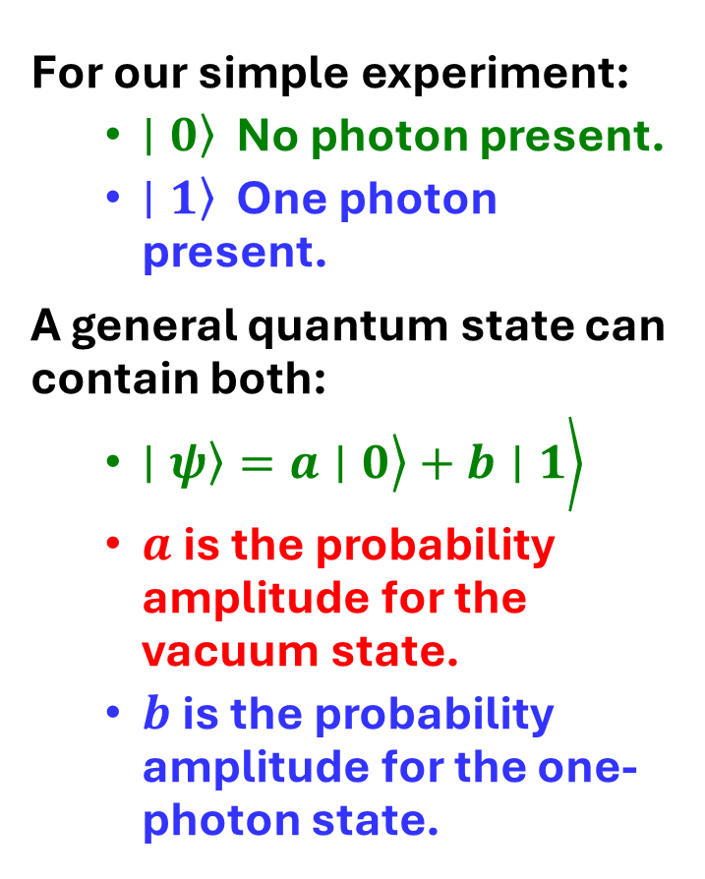
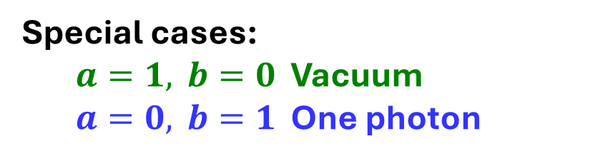
What Do These States Mean?
For our simple experiment:
  $\left.∣0\right\rangle$ No photon present.
  $\left.∣1\right\rangle$ One photon present.
A general quantum state can contain both:
  $\left.\left.\left.∣ψ\right\rangle =a∣0\right\rangle +b∣1\right\rangle$
  $a$is the probability amplitude for the vacuum state.
  $b$is the probability amplitude for the one-photon state.
Special cases:
  $a=1, b=0$ Vacuum
  $a=0, b=1$ One photon

Slide 60
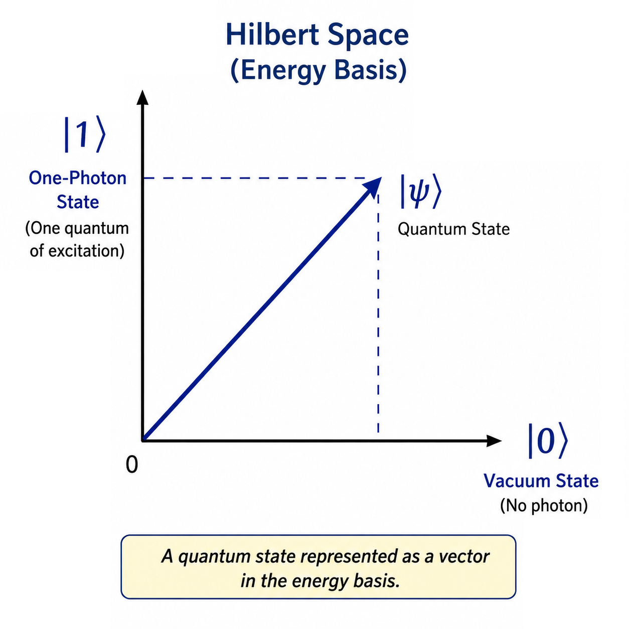
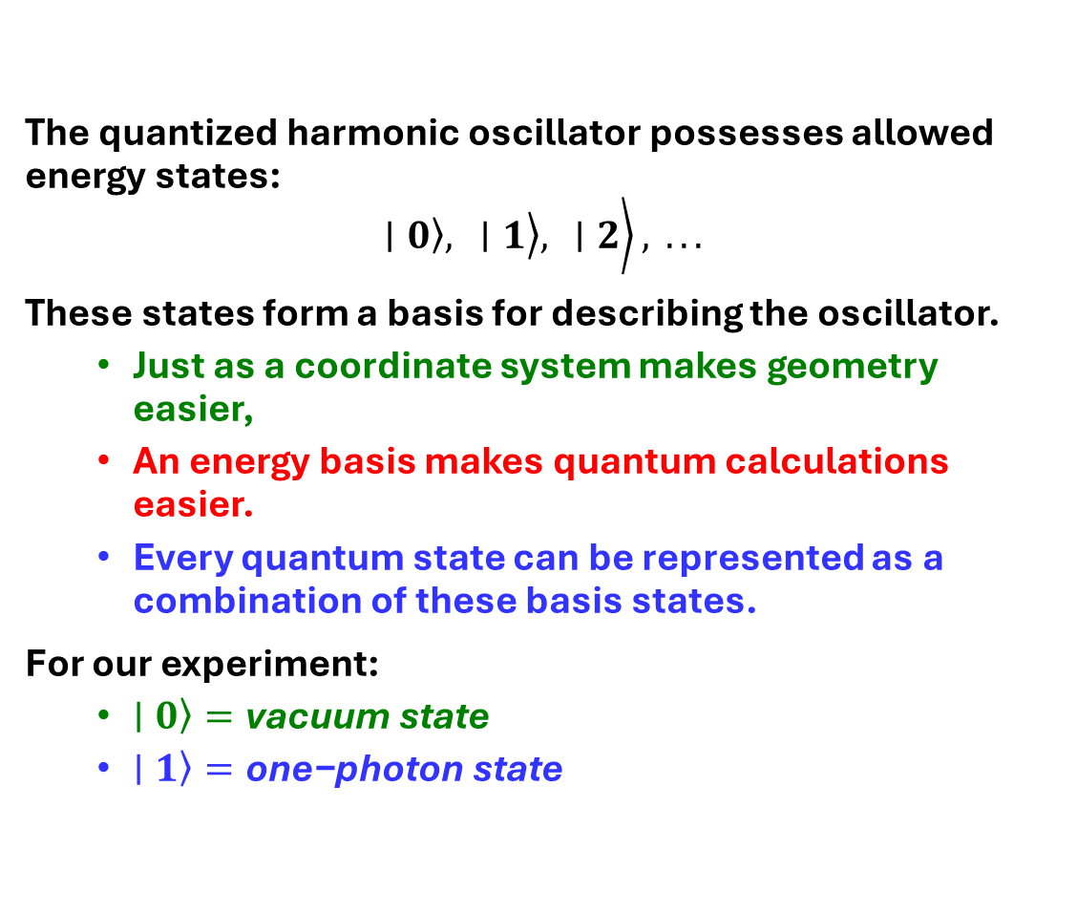
The Energy Basis in Hilbert Space
The quantized harmonic oscillator possesses allowed energy states:
$$\left.\left.\left.∣0\right\rangle , ∣1\right\rangle , ∣2\right\rangle , ...$$
These states form a basis for describing the oscillator.
  Just as a coordinate system makes geometry easier,
  An energy basis makes quantum calculations easier.
  Every quantum state can be represented as a combination of these basis states.
For our experiment:
  $\left.∣0\right\rangle =\text{vacuum} \text{state}$
  $\left.∣1\right\rangle =\text{one}\text{−}\text{photon} \text{state}$

Slide 61
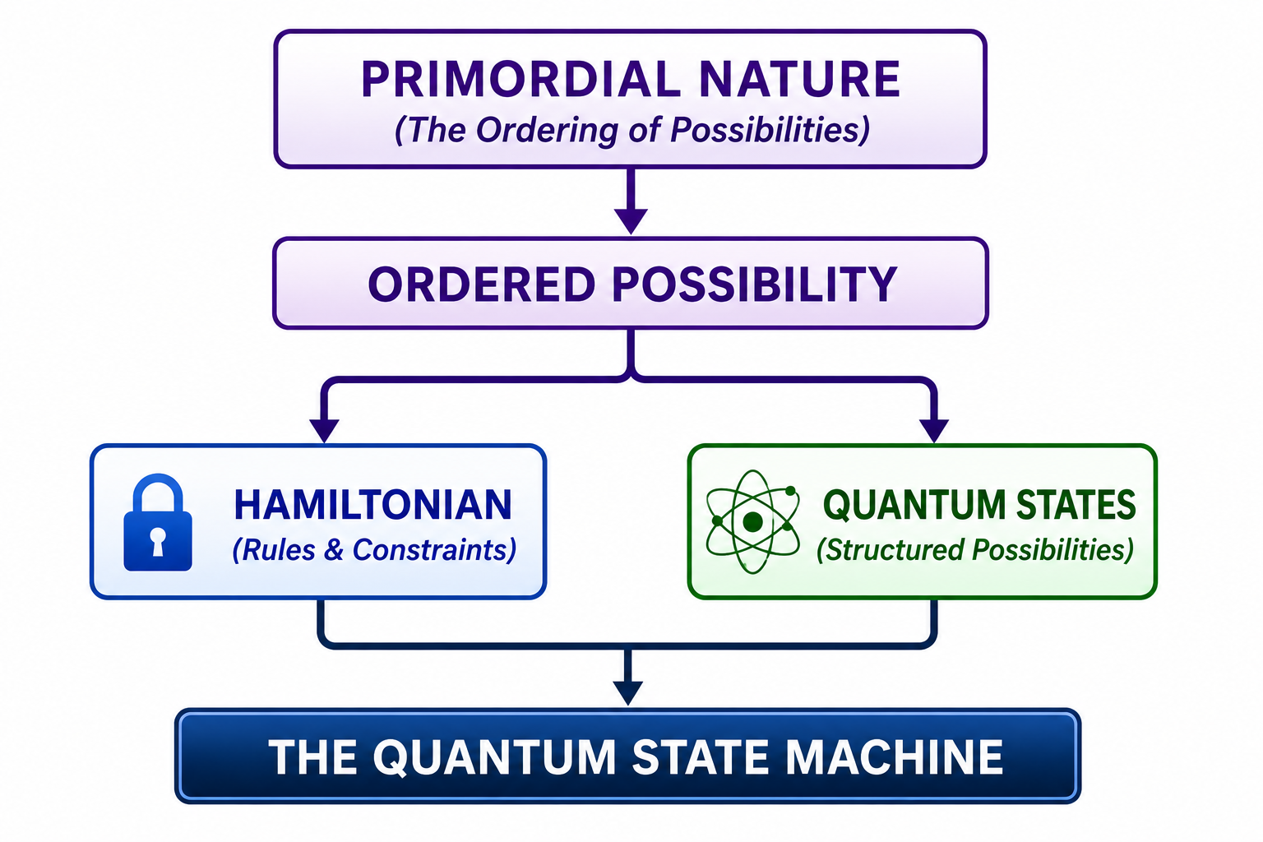
Primordial Nature: Ordered Possibility
Process Theology Lens
The Primordial Nature of God is the ordering of possibilities.
  Not every future is possible.
  Possibilities are constrained, structured, and related.
Quantum State Machine
The Primordial Nature is represented by:
  The Hamiltonian (the rules and constraints)
  The Quantum State Space (the possibilities)
  Together they define what can and cannot occur.
Key Insight
  The Hamiltonian does not determine a single future.
  It structures the space of possible futures.

Slide 62
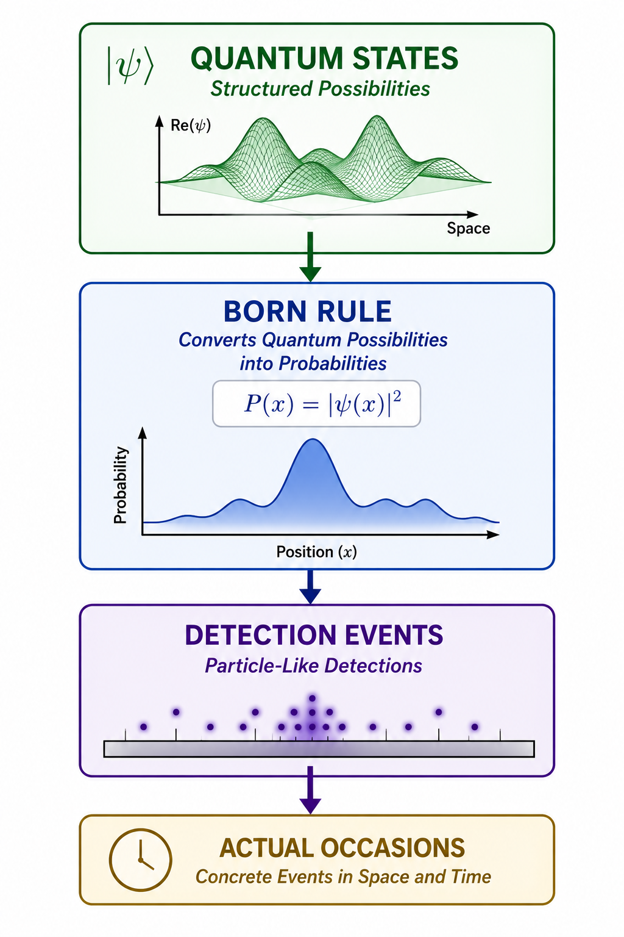
Consequent Nature: Actualized Events
Process Theology Lens
  The Consequent Nature of God includes the actual events that occur in the world.
  Possibilities become actual occasions.
  The world gains new facts.
Quantum State Machine
  The Born Rule predicts the probabilities of particle-like detections.
  These detections are the actual events observed in experiments.
Key Insight
  The Quantum State Machine does not predict certainty.
  It predicts the probabilities of actual occasions.

Slide 63
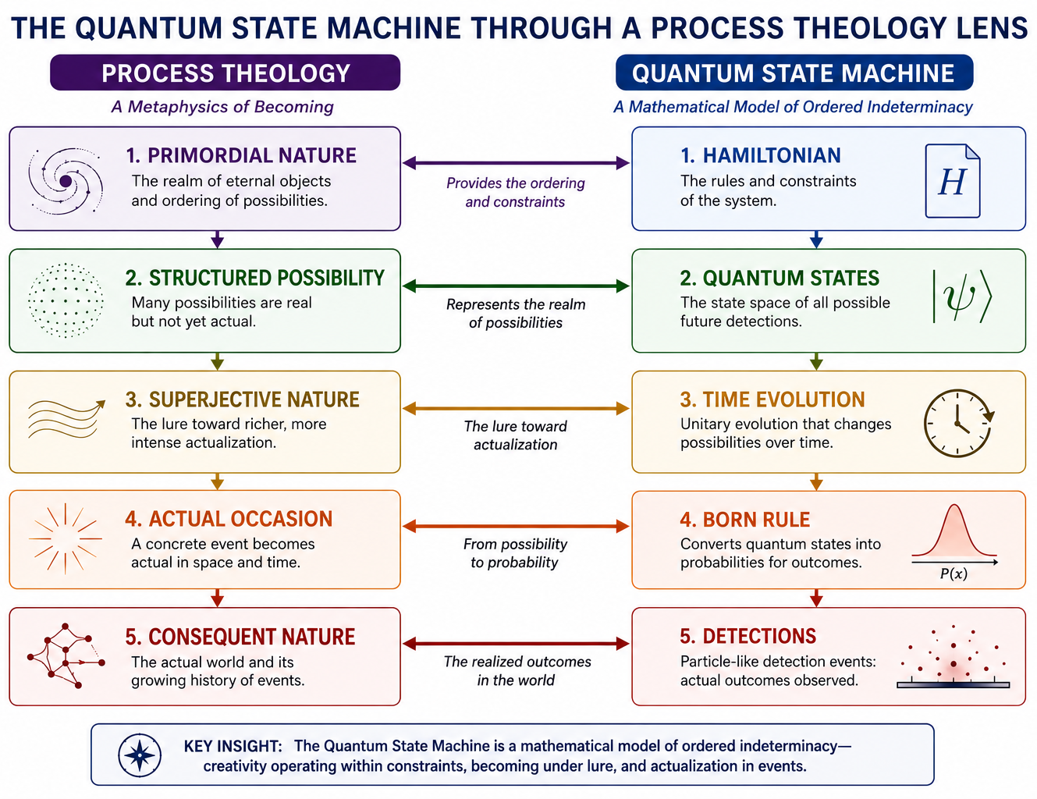
Quantum State Machine
    Hamiltonian
    ↓
    Quantum States
    ↓
    Time Evolution
    ↓
    Born Rule
    ↓
    Particle-Like Detections
Key Insight
  The Quantum State Machine is a model of:
  Creativity Operating Within Constraints

Slide 64

The Unfinished Story...
Tonight we built the Quantum State Machine.
We identified:
  The rules (Hamiltonian)
  The possibilities (Quantum States)
  The mechanism for predicting detections (Born Rule)
But one essential question remains:
How do the possibilities change with time?
  How does the machine evolve?
  How does the future emerge from structured possibility?
  How does the lure toward actualization operate?
Next Lecture
  Running the Quantum State Machine
  Time Evolution and Becoming

Slide 65


