Slide 1


Process Theology as a Lens for Bringing Quantum Physics into Focus
Dr. Michael A. Soderstrand, PhD
Lecture 5: Running the Model: Time Evolution and Becoming → Creative Advance (Ordered process becoming form)

Slide 2

What Is a State Machine?
A state machine is a system that can be in one of several well‑defined states.
At any moment:
  The system occupies one state
  Inputs cause transitions to other states
Many everyday systems can be described this way.
Examples include:
  Elevator controllers
  Traffic lights
  Vending machines
We will use a simple vending machine as an example.

Slide 3

Example: Vending Machine States
Our simplified vending machine has four states.
State 0 — Ground State (Idle)
LED message:
"Please enter the two‑digit number corresponding to the product you would like to purchase."
State 1 — Pay State
LED message:
"Please tap your credit card to pay."
State 2 — Vending State
LED message:
"Please remove your product from the bottom door."
State 3 — Error State
LED message:
"Sorry, there has been an error. Please hit any button to reset."
At any moment the machine is in exactly one of these states.

Slide 4
Example: Vending Machine States
Transitions Between States:
Examples:
  Idle → Pay (customer enters valid product number)
  Pay → Vending (payment is approved)
  Vending → Idle (customer removes product)
  Any state → Error (invalid input, payment failure, mechanical problem)
These transition rules determine how the machine evolves over time.
In computer science this transition rule is the logic of the machine.

Slide 5
Example: Vending Machine States
Connecting the Example to Physics:
This simple machine illustrates three important ideas.
State Space
The list of possible states the system can occupy. In quantum physics the state space is called Hilbert Space.
Evolution Rule
Rules that determine how the system moves from one state to another. In quantum physics these evolution rules are generated by the Hamiltonian.
Observable Output
The LED display tells the user what state the machine is in. In physics we also need a rule that connects the quantum state to what we observe in experiments (The Born Rule).
With this idea in mind, we can now build a state machine description of quantum physics.

Slide 6
The Quantum Field Theory (QFT) Model
Hamiltonian
Quantum
State
Projection
Born Rule
Input Prepared
Photon emitted from the laser
Starts in the Vacuum State
No particles present

Slide 7
The Quantum Field Theory (QFT) Model
Hamiltonian
Quantum
State
Projection
Born Rule
The feedback loop repeatedly updates the quantum description of the photon as it propagates through space and time.
The Hamiltonian determines the evolution from the vacuum state to a state containing one photon.

Slide 8
The Quantum Field Theory (QFT) Model
Hamiltonian
Quantum
State
Projection
Born Rule
Output provides the probability of detecting the particle at any point in spacetime.

Slide 9
The Quantum Field Theory (QFT) Model
Hamiltonian
Quantum
State
Projection
Born Rule
This step extracts observable probabilities from the quantum state.
In simple cases, this is done by changing basis and applying the Born rule.
More generally, it involves applying a measurement operator—constructed from the same operators that define the model—and then using the Born rule to obtain probabilities.

Slide 10
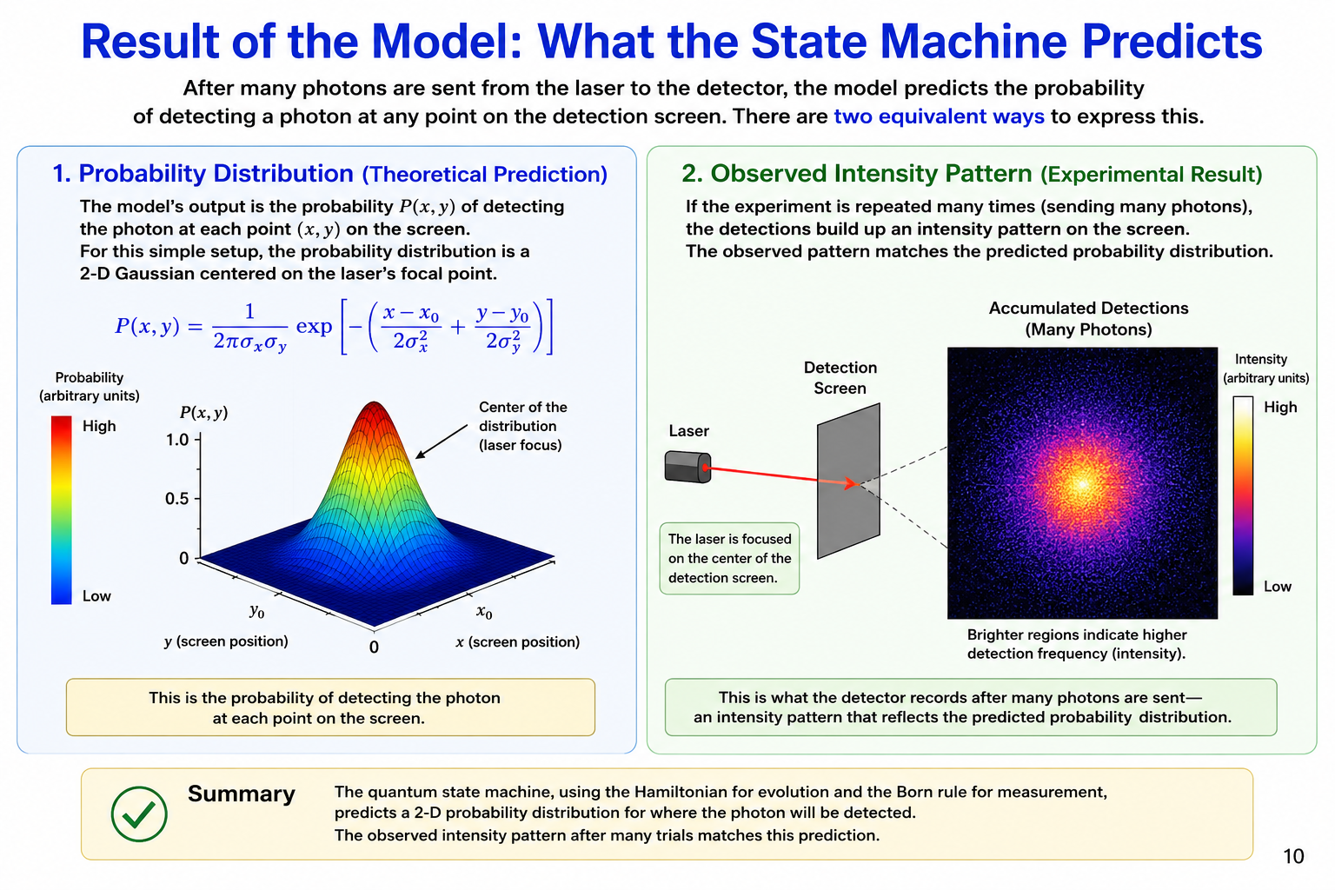
The Result of Running the Model
The experiment:
Sending one photon at a time from a laser to a detector
What is the result of running the model?
Each individual photon is detected at one location sampled from this probability distribution.

Slide 11
The Result of Running the Model
The experiment:
Sending one photon at a time from a laser to a detector
What is the result of running the model?
After many photons, the accumulated detections reproduce the predicted probability distribution.

Slide 12

A Process Theology Perspective
The Superjective Nature of God
The Quantum State Machine has evolved the quantum state from the emission of a single photon to a prediction of where that photon may be detected.
From a Process Theology perspective,
  The Hamiltonian may be understood as describing the Superjective Nature of God—the continual lure guiding the process of becoming.
  The quantum state represents the unfolding process of becoming.
  The Born Rule reveals the probability distribution toward which the process of becoming has been guided.
  Individual photon detections are Actual Occasions.
  As more and more Actual Occasions occur, they gradually reveal the probability distribution—the emergent pattern toward which the lure has been guiding the process.
Key Idea
  The lure does not determine a single event.
  It guides the process toward an emergent pattern that becomes visible only through many Actual Occasions.

Slide 13
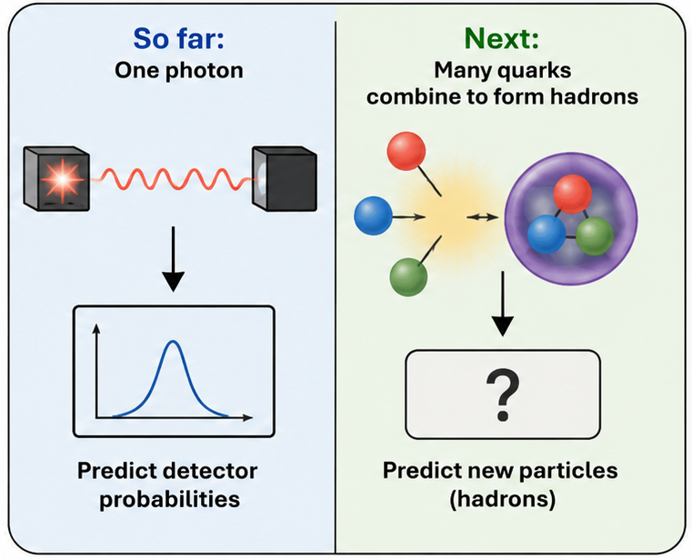
From Predicting Experiments to Predicting New Particles
Up to now...
We have used the quantum state machine to predict the outcome of one simple experiment:
  Prepare one photon
  Run the Hamiltonian
  Apply the Born Rule
  Predict where the photon may be detected
Now we ask a much bigger question...
Can the same quantum state machine predict entirely new particles?
  Not detector patterns...
  ...but predict the stable building blocks of matter itself.

Slide 14
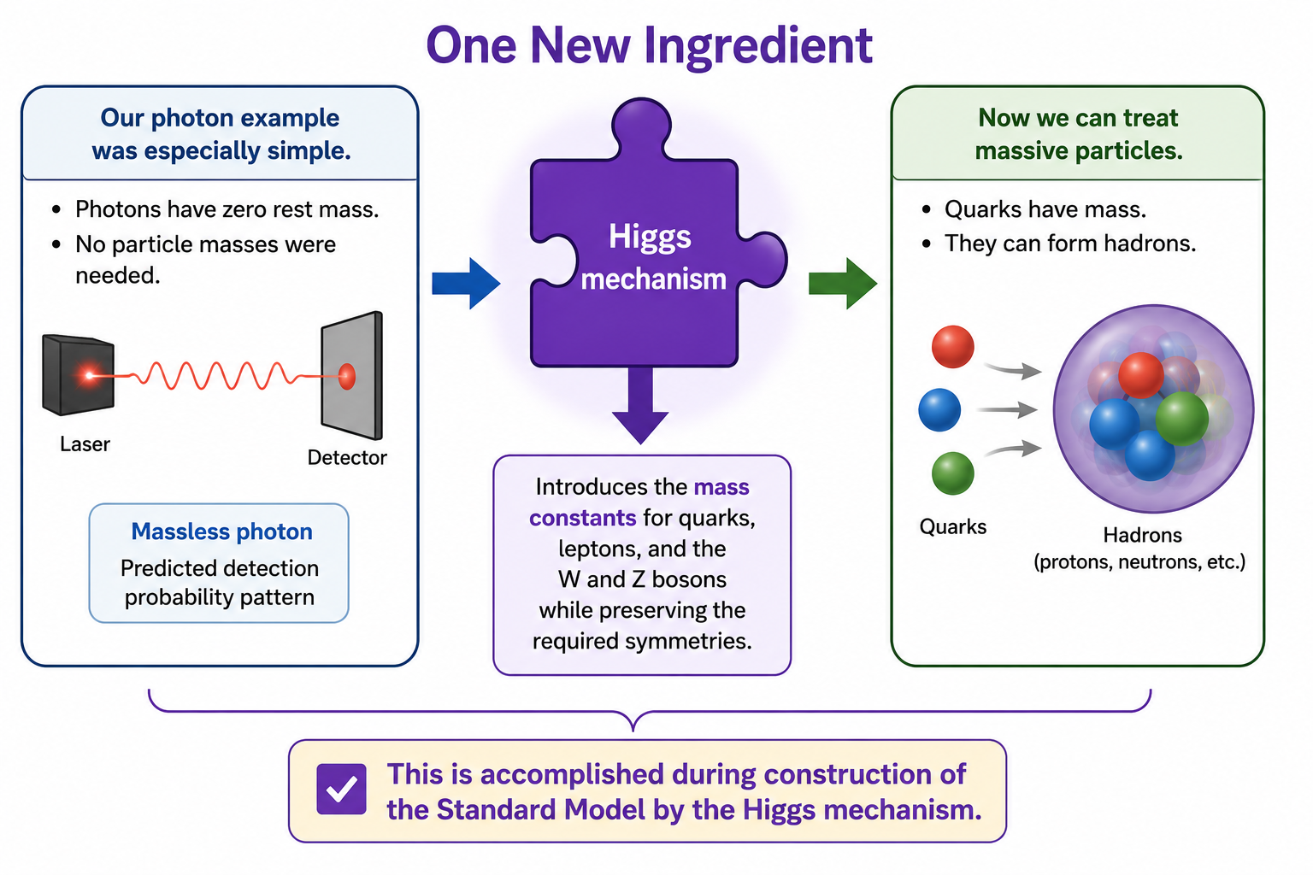
One More Ingredient Before We Continue
Our photon example was especially simple.
  Photons have zero rest mass.
  No particle masses were needed.
  Quarks, however, do have mass.
Before we can run the quantum state machine for quarks and hadrons, the Hamiltonian must already contain the masses of the elementary particles.
  This is accomplished during construction of the Standard Model by the Higgs mechanism.
  After that construction is complete,
  the Hamiltonian is finished and ready to run.

Slide 15
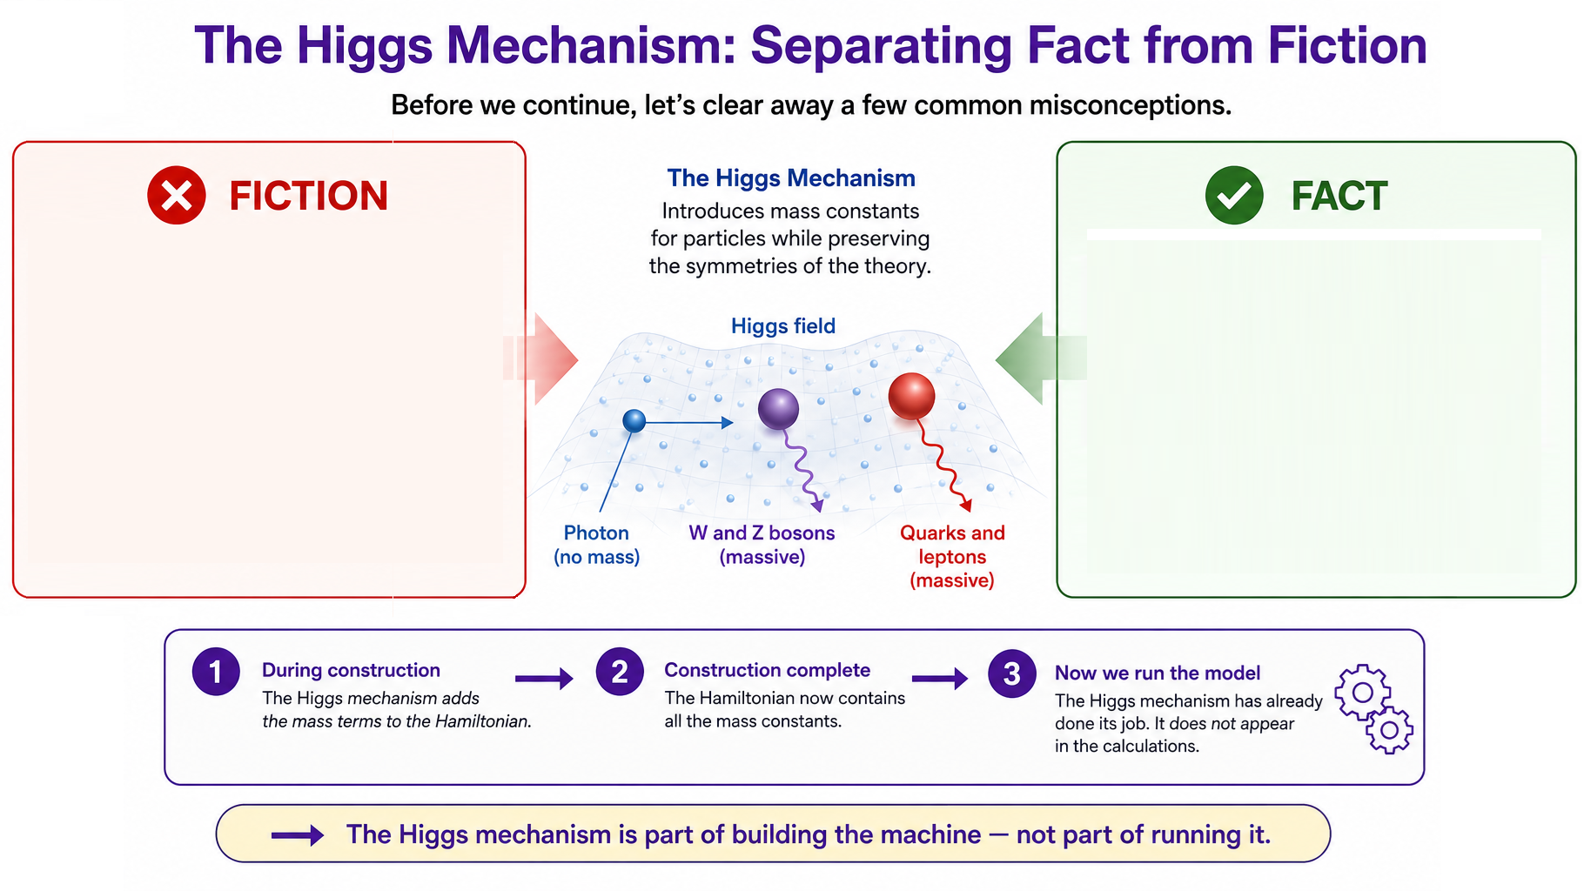
  ❌ "The Higgs boson gives particles their mass."
  ✔ The Higgs mechanism is the part of the Standard Model that introduces the particle mass constants into the Hamiltonian while preserving the theory's required symmetries.

Slide 16
  ❌ "Particles get mass by plowing through an invisible Higgs molasses."
  ✔ That analogy is memorable but misleading. Mass is not the result of friction or drag.

Slide 17
  ❌ "The Higgs boson is the God Particle."
  ✔ This nickname came from a popular science book, not from physics. It has no scientific meaning and no connection to theology (It was actually the God Damn Particle!).

Slide 18
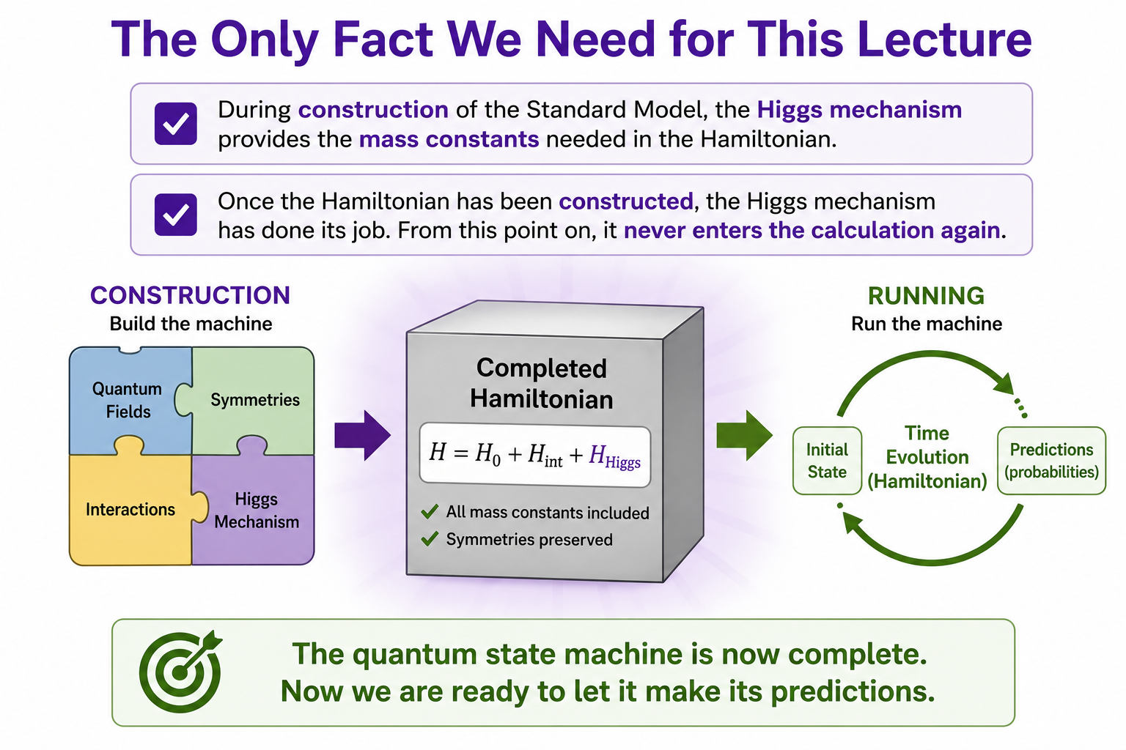
The Higgs Mechanism: Separating Fact from Fiction
The Only Fact We Need for This Lecture
  ✓ During construction of the Standard Model, the Higgs mechanism provides the mass constants needed in the Hamiltonian.
  ✓ Once the Hamiltonian has been constructed, the Higgs mechanism has already done its job.
  ✓ From this point on, it never enters the calculation again.
Now we are ready to let the completed Quantum State Machine make its predictions.

Slide 19
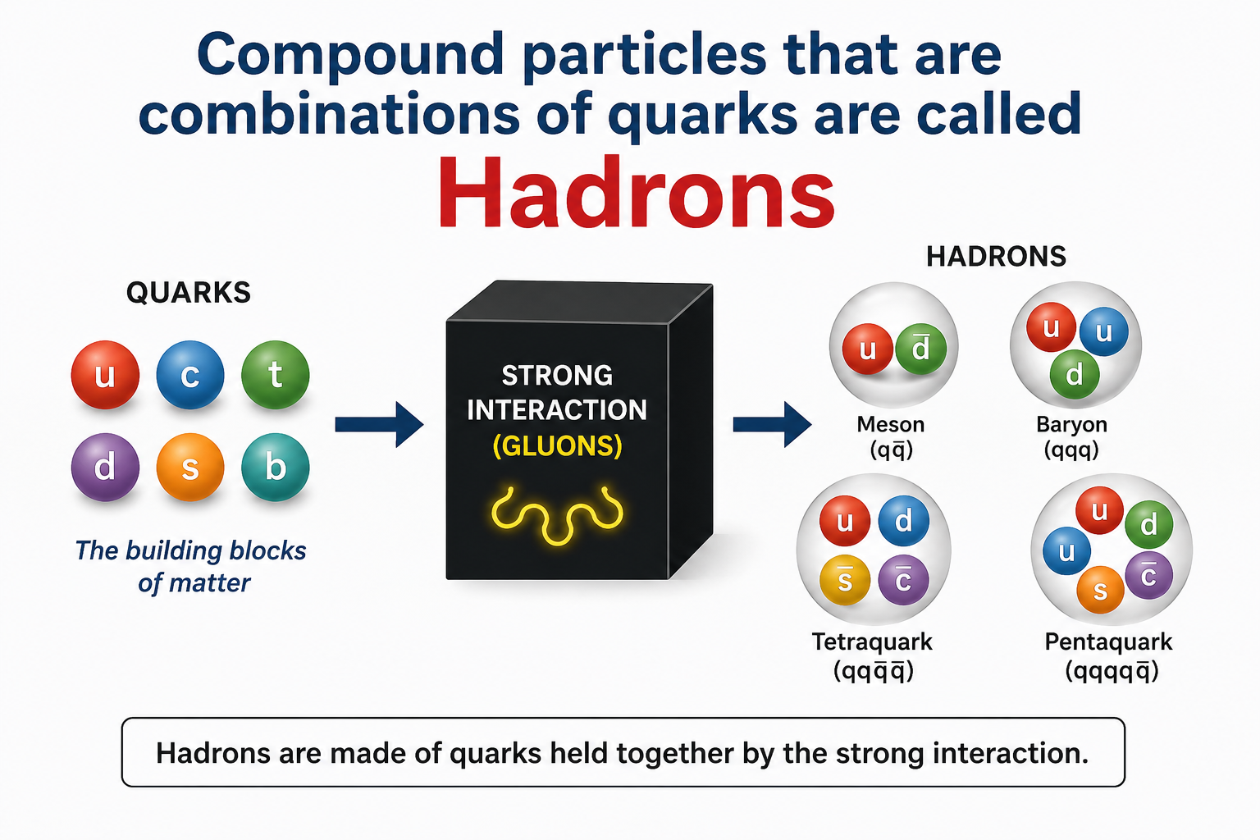
Running the Model to Predict Hadrons
Question
  Can the same Quantum State Machine predict particles made from multiple quarks?
Answer
  Yes!
  With the completed Hamiltonian—including the particle masses introduced during model construction—we now prepare different combinations of quarks and allow the Hamiltonian to evolve the quantum state.
The Strong Interaction
  Gluons mediate the strong interaction between quarks.
  The Hamiltonian evolves the quantum state until stable bound states emerge.
  The same Quantum State Machine that predicted the detection of a single photon now predicts the structure of matter.

Slide 20
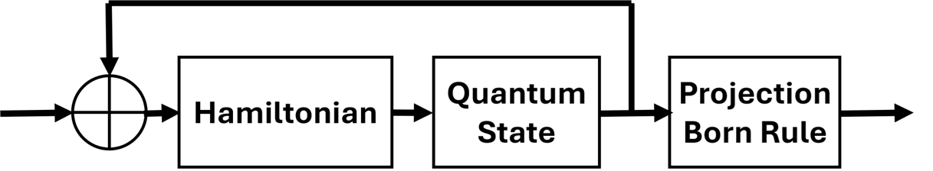
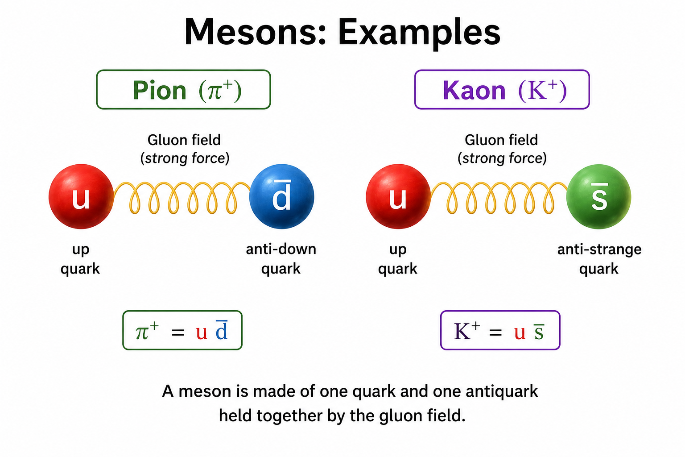
Mesons — Two-Quark Bound States
Prepared Input
  One quark
  One antiquark
Quantum State Machine Prediction
  Stable two-quark bound states called mesons
Examples
  Pions
  Kaons
Key Idea
  The same Hamiltonian that evolved a single photon now predicts stable quark–antiquark bound states.

Slide 21
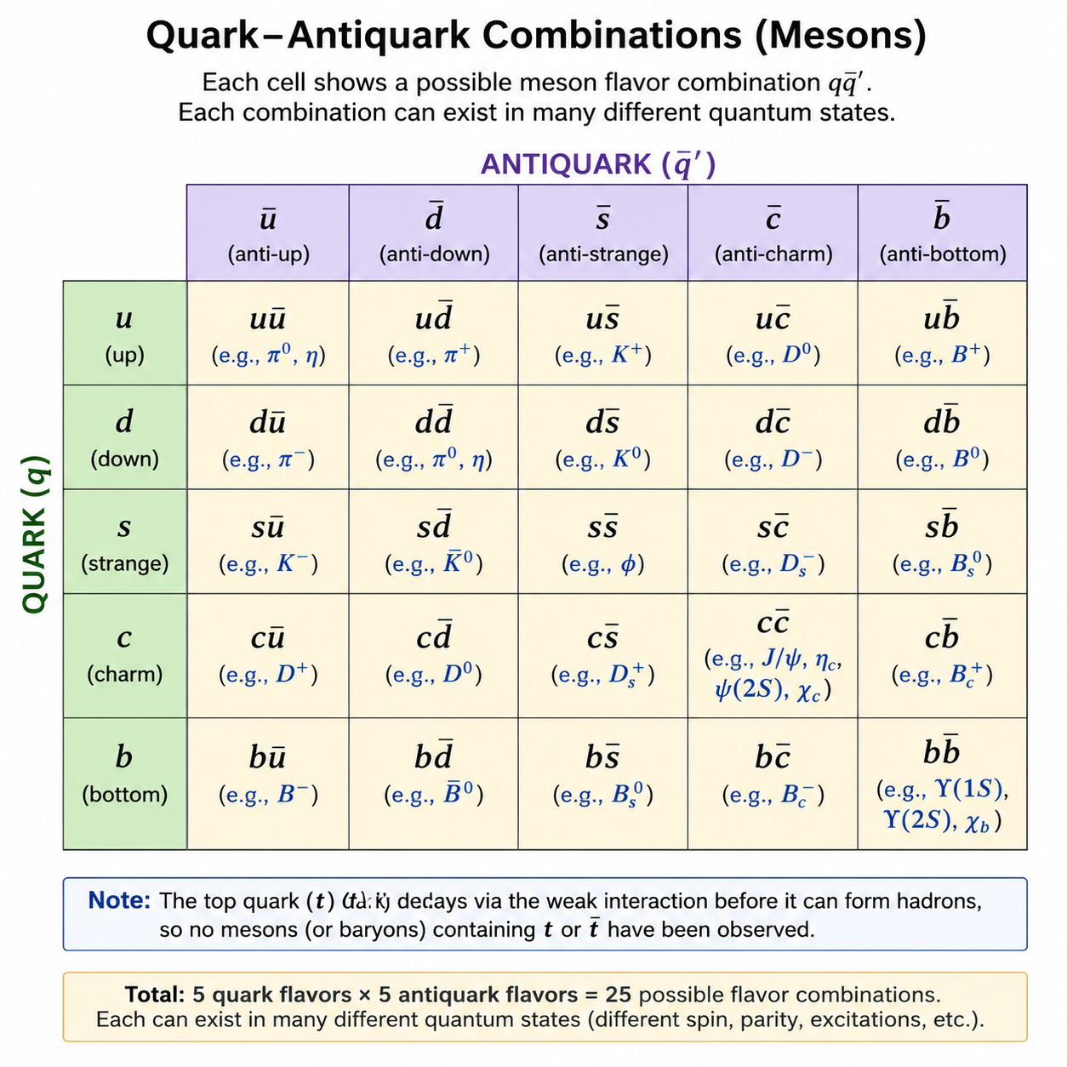
How Many Mesons Does the Model Predict?
The model predicts hundreds of mesons
There are six quarks and six anti-quarks so you might think there are only 36 mesons
However, the top quark and top anti-quark decay too rapidly to combine with other quarks so that would appear to generate 25 mesons
But when we combine elementary particles some may be spin up and some spin down, different parity, different excited states — this results in hundreds of mesons.
All are predicted by the model

Slide 22
A Process Theology Perspective
The Same Lure...Greater Complexity
  The same Quantum State Machine that predicts the behavior of a single photon also predicts the existence of an entire family of mesons.
From a Process Theology perspective,
  The Superjective Nature of God is not confined to simple systems.
  The same lure guides the evolution of every quantum state, whether describing a photon or a quark–antiquark system.
  Experimental observations of mesons are Actual Occasions.
  Together they reveal the deeper mathematical pattern predicted by the Quantum State Machine.
Key Idea
  One lure...many different expressions of becoming.

Slide 23
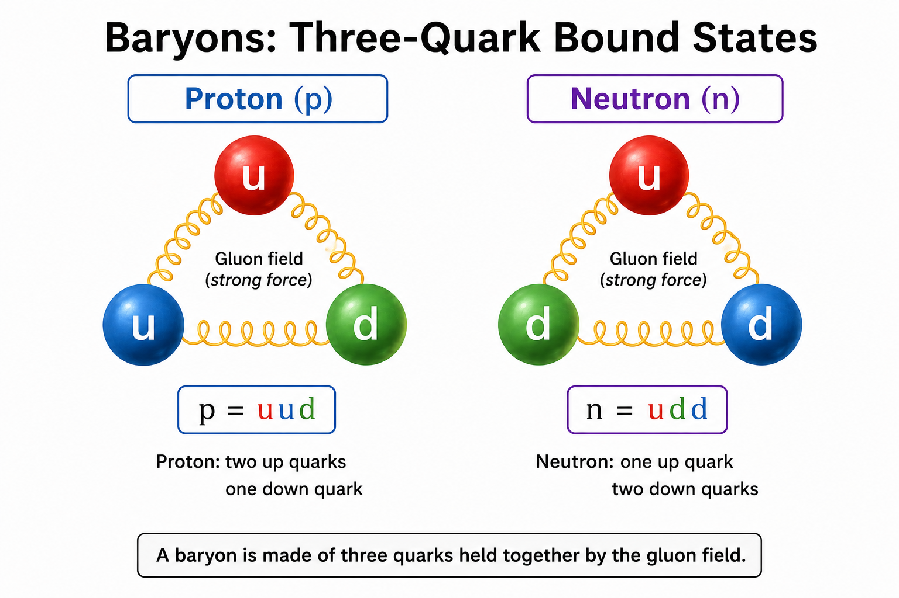
Baryons — Three-Quark Bound States
Prepared Input
  One quark
  A second quark
  A third quark
Quantum State Machine Prediction
  Stable three-quark bound states called baryons
Examples
  Proton
  Neutron
Key Idea
  The same Hamiltonian that evolved a single photon now predicts stable three-quark bound states.

Slide 24
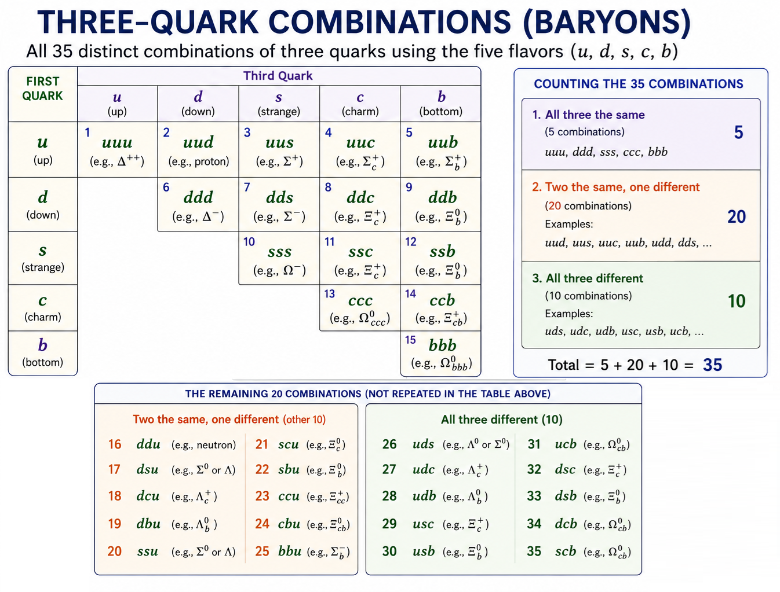
How Many Baryons Does the Model Predict?
The model predicts hundreds of baryons
There are 5 quark flavors (u, d, s, c, b) excluding the top quark
Since the order doesn't matter—a proton is the same whether you write uud, udu, or duu—there are exactly 35 distinct flavor combinations.
Each flavor combination can exist in many quantum states (Spin, Orbital angular momentum, Parity, Excited energy levels).
Result: Hundreds of baryons predicted by the model and observed experimentally.
All are predicted by the model

Slide 25
A Process Theology Perspective
Building the Stable Matter of the Universe
  The Quantum State Machine now predicts the stable baryons that make ordinary matter possible.
From a Process Theology perspective,
  The Superjective Nature of God continues to guide the process of becoming.
  Rather than separate acts of creation, the proton and neutron may be understood as new expressions of the same quantum dynamics.
  As experiments observe many Actual Occasions, the underlying probability patterns predicted by the Born Rule become increasingly apparent.
Key Idea
  The same lure that guides a single photon also guides the emergence of the stable building blocks of matter.

Slide 26
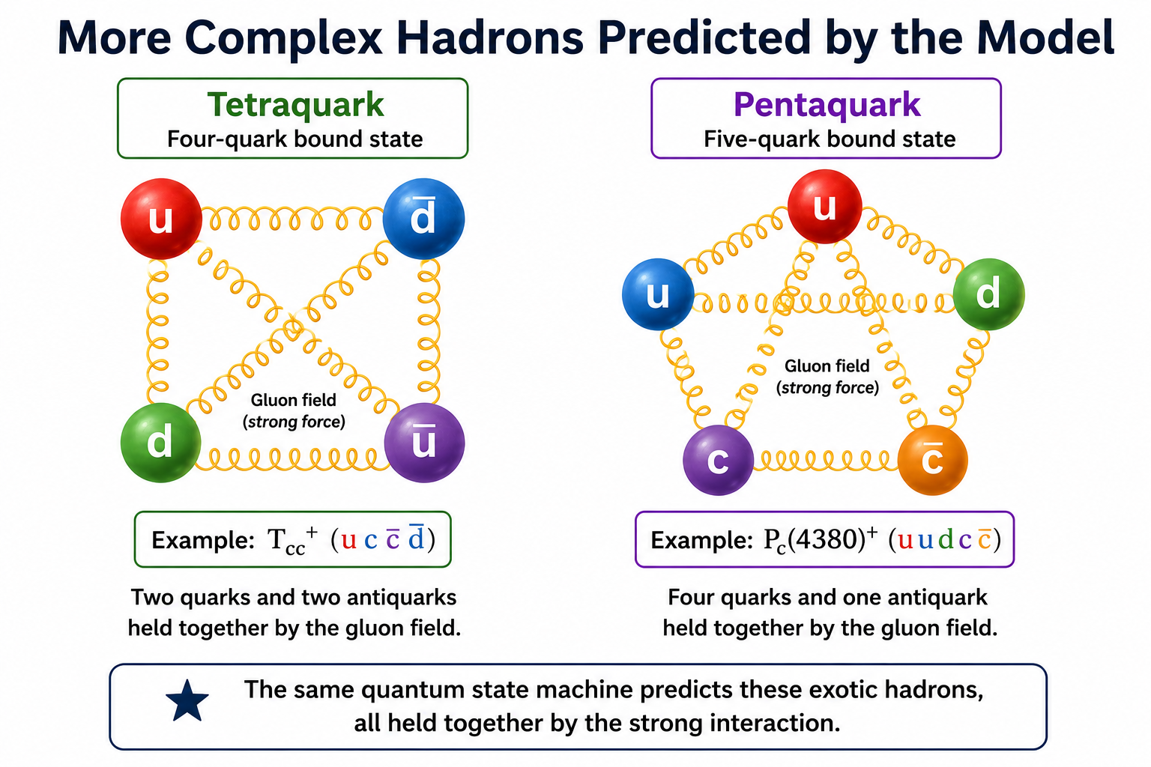
More Complex Hadrons
The same quantum state machine predicts even richer combinations of quarks.
Tetraquarks
  Four-quark bound states
Pentaquarks
  Five-quark bound states
These exotic hadrons were predicted by the quantum state machine and later confirmed experimentally.
Key Idea
The same Hamiltonian successfully predicts increasingly complex bound states without changing the underlying theory.

Slide 27
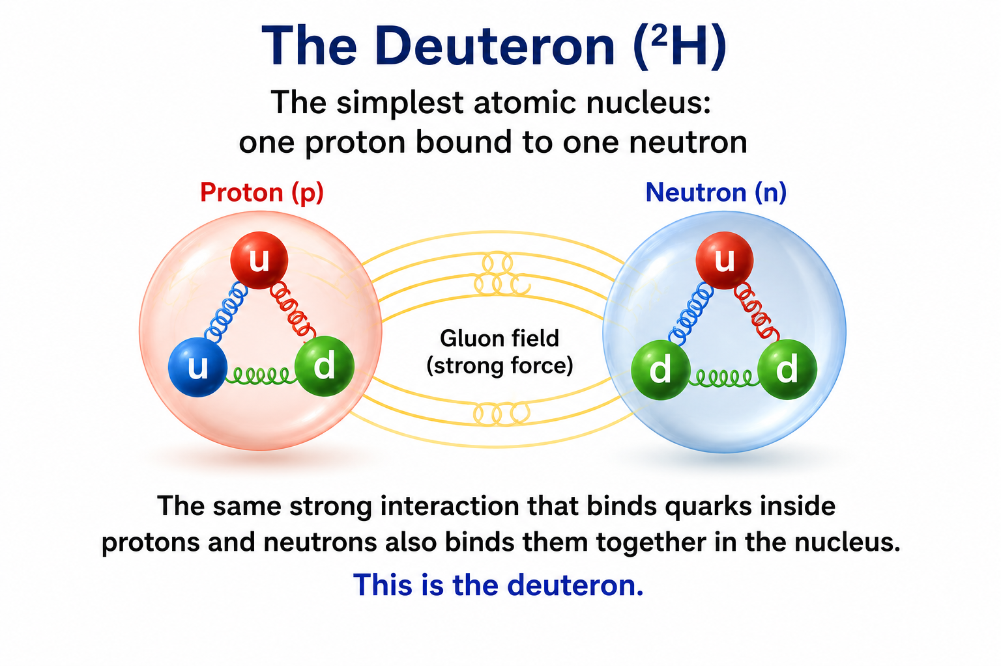
From Hadrons to Atomic Nuclei
The quantum state machine predicts not only individual hadrons but also the interactions that build atomic nuclei.
The Deuteron
  One proton bound to one neutron
  The simplest atomic nucleus after hydrogen
  The same strong interaction that binds quarks into protons and neutrons also gives rise to the force that binds nuclei together.
Modern Confirmation
  Physicists have also discovered rare six-quark bound states such as the d(2380)*.
  These states were predicted by the quantum state machine model before they were experimentally confirmed.
Key Idea
  The same quantum state machine predicts the structure of matter—from single particles to atomic nuclei—without changing the underlying theory.

Slide 28
Looking More Closely at the Proton and Neutron
The Quantum State Machine predicts many different baryons.
Let's look more closely at the two that make up nearly all of the ordinary matter around us.
Proton
  Up + Up + Down (uud)
Neutron
  Up + Down + Down (udd)

Slide 29
Looking More Closely at the Proton and Neutron
The Quantum State Machine predicts much more than their quark composition.
It also predicts:
  their rest masses
  their electric charges
  their magnetic moments
  their spins
  their stability
Every one of these predictions can be and has been tested experimentally.

Slide 30
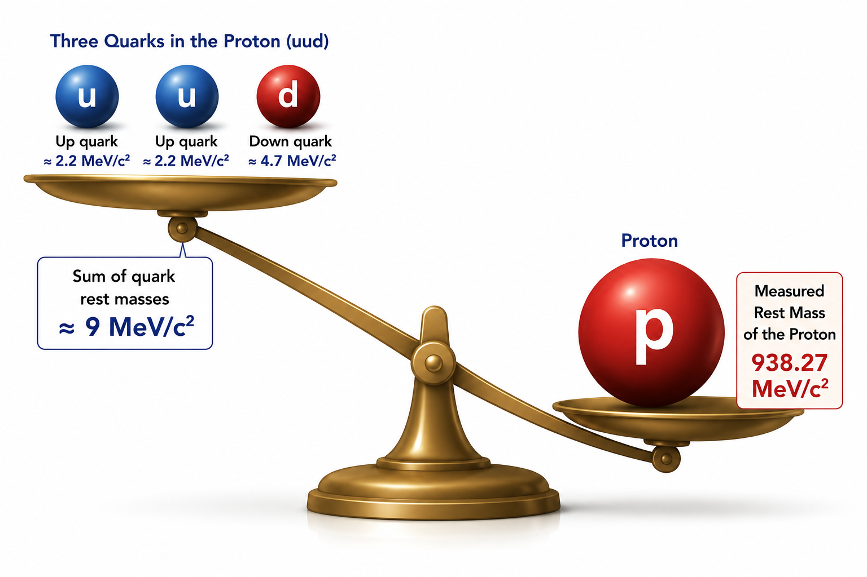
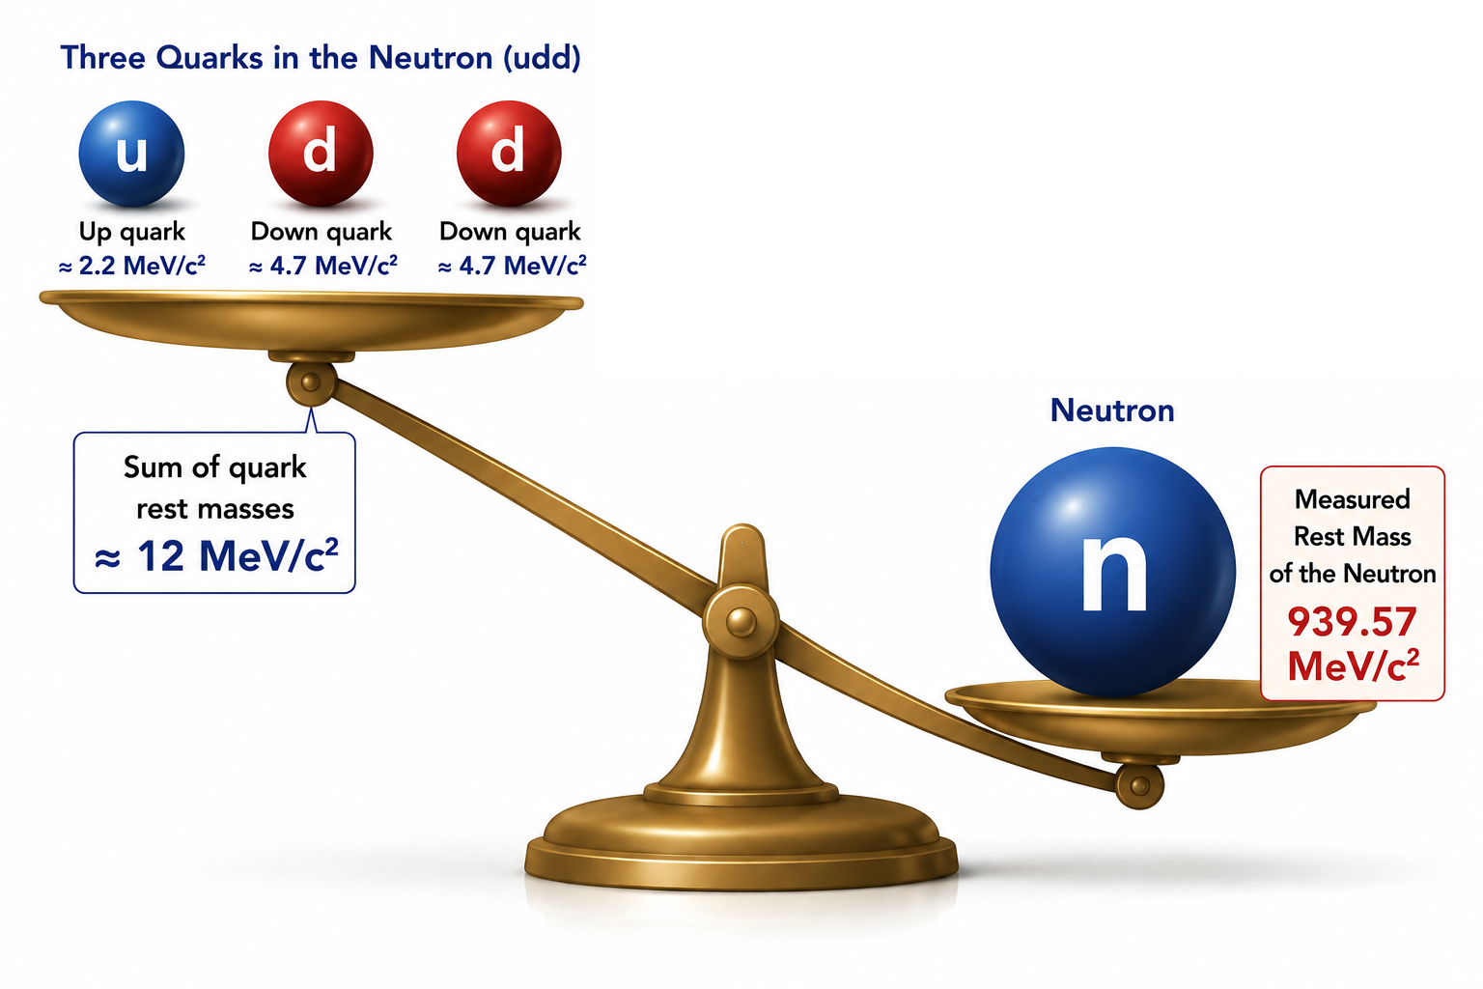
Our First Surprise: Where Does the Mass Come From?
Since the proton and neutron are made from three quarks, we might naturally expect:
  Rest Mass of Proton = Sum of the Rest Masses of its Quarks
  Rest Mass of Neutron = Sum of the Rest Masses of its Quarks
Let's see what the Quantum State Machine predicts...
The quarks account for only about 1% of the proton's and neutron's rest mass!
Where does the other 99% come from?

Slide 31
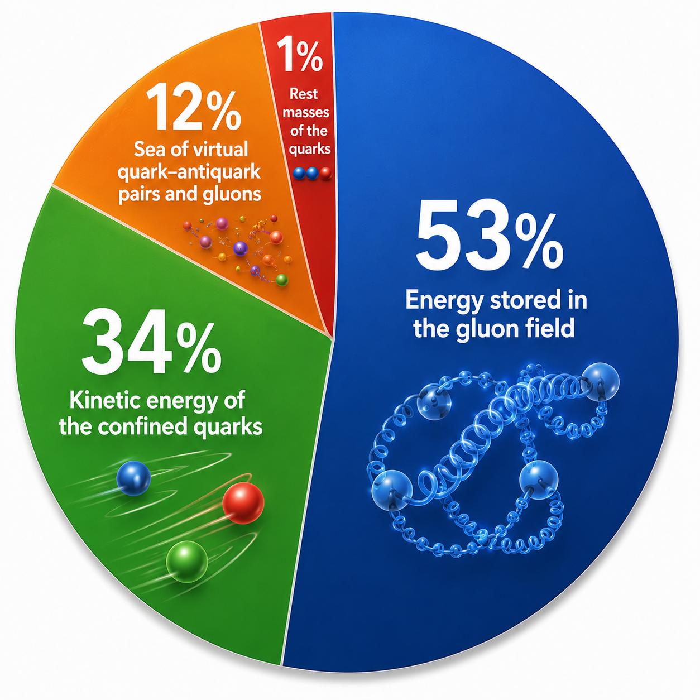
Most of the Mass Is Confined Energy
The Answer:
The Quantum State Machine predicts that the proton's and neutron's rest mass comes primarily from energy inside the bound state.
Approximate contributions:
  53% Energy stored in the gluon field
  34% Kinetic energy of the confined quarks
  12% Sea of virtual quark–antiquark pairs and gluons
  1% Rest masses of the three quarks

Slide 32
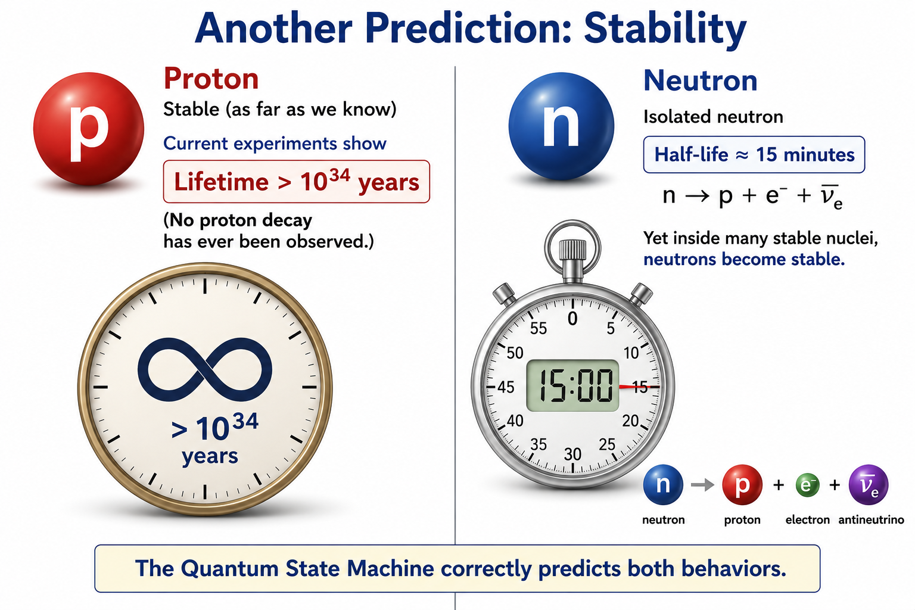

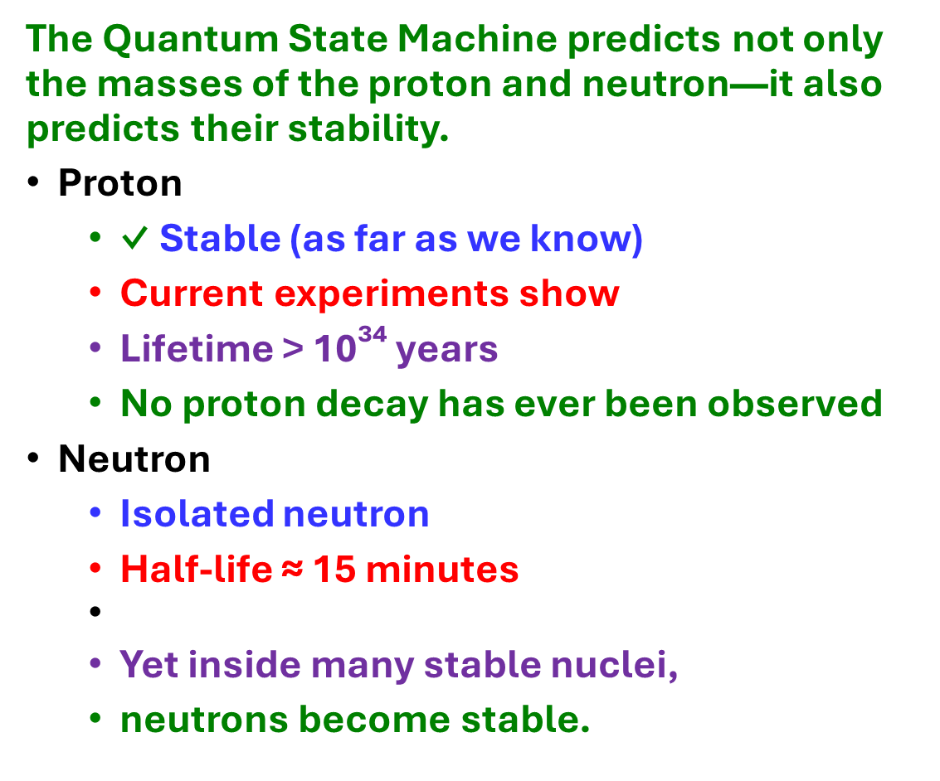
Another Prediction: Stability
The Quantum State Machine predicts not only the masses of the proton and neutron—it also predicts their stability.
Proton
  ✓ Stable (as far as we know)
  Current experiments show
  Lifetime > 10³⁴ years
  No proton decay has ever been observed
Neutron
  Isolated neutron
  Half-life ≈ 15 minutes
  Yet inside many stable nuclei,
  neutrons become stable.

Slide 33
A Process Theology Perspective
From Possibility to Structure
  We have now seen that the Quantum State Machine predicts not only stable particles but also their measurable properties.
Through the lens of Process Theology
  Process Theology describes this as the continuing work of the Superjective Nature of God.
  The lure guides the quantum state through its process of becoming.
  The Born Rule reveals the mathematical pattern toward which the process of becoming has been guided.
  Repeated Actual Occasions gradually reveal that emergent order through experiment.
Key Idea
  The order we observe in nature emerges through countless Actual Occasions, yet it is already reflected in the probability distribution predicted by the Quantum State Machine.

Slide 34
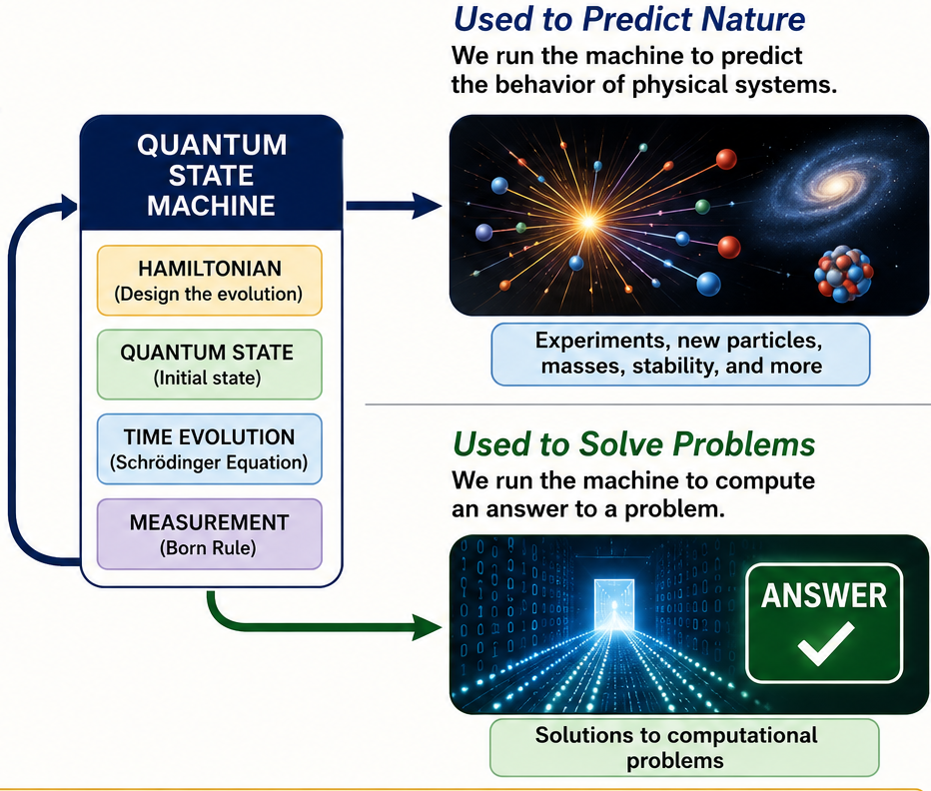
Can We Use the Quantum State Machine to Solve Problems?
So far we have used the Quantum State Machine to predict the behavior of nature.
  ✓ It predicts the results of physics experiments.
  ✓ It predicts the existence of new particles.
  ✓ It predicts their measurable properties.
Can the same mathematical framework be used for a completely different purpose?
  Instead of predicting the outcome of a physics experiment...
  Can we use the Quantum State Machine to solve computational problems?

Slide 35
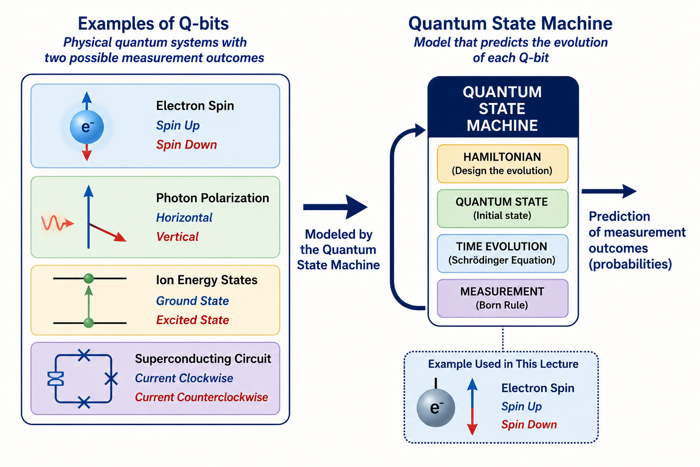
The Simplest Quantum System
The simplest quantum computer is built from physical quantum systems called q-bits.
Examples include
  ✓ An electron's spin
  ✓ The polarization of a photon
  ✓ The energy states of an ion
  ✓ Superconducting electrical circuits
The Quantum State Machine models the evolution of each q-bit.

Slide 36
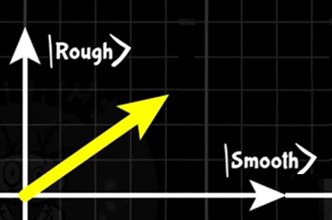
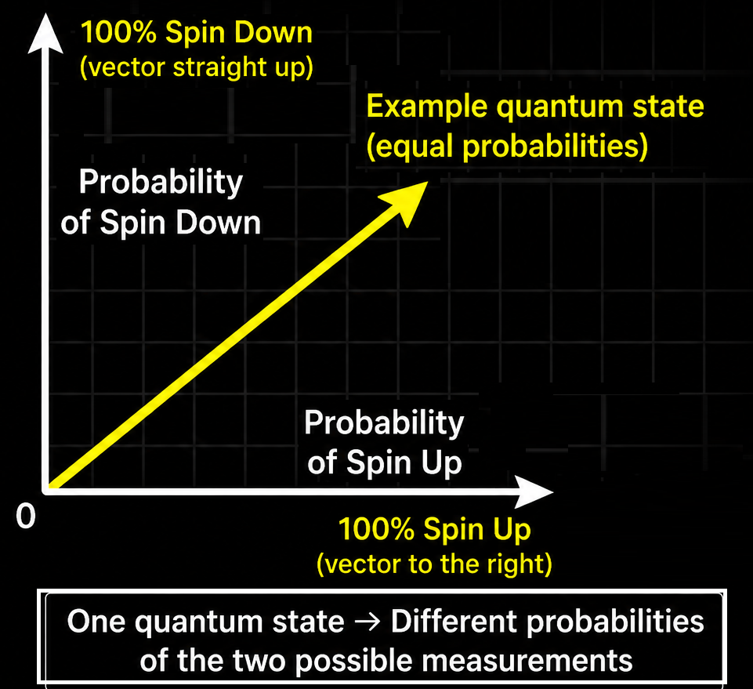
The Quantum State of a Q-bit
In Lecture 3 we learned an important lesson.
  ✓ A quantum system is always in one quantum state.
  ✓ It is not in several states at the same time.
  The quantum state determines the probabilities of the possible measurement outcomes.
For our q-bit, those measurement outcomes will be:
  ✓ Spin Up
  ✓ Spin Down
Next, let's see how we represent that quantum state.

Slide 37
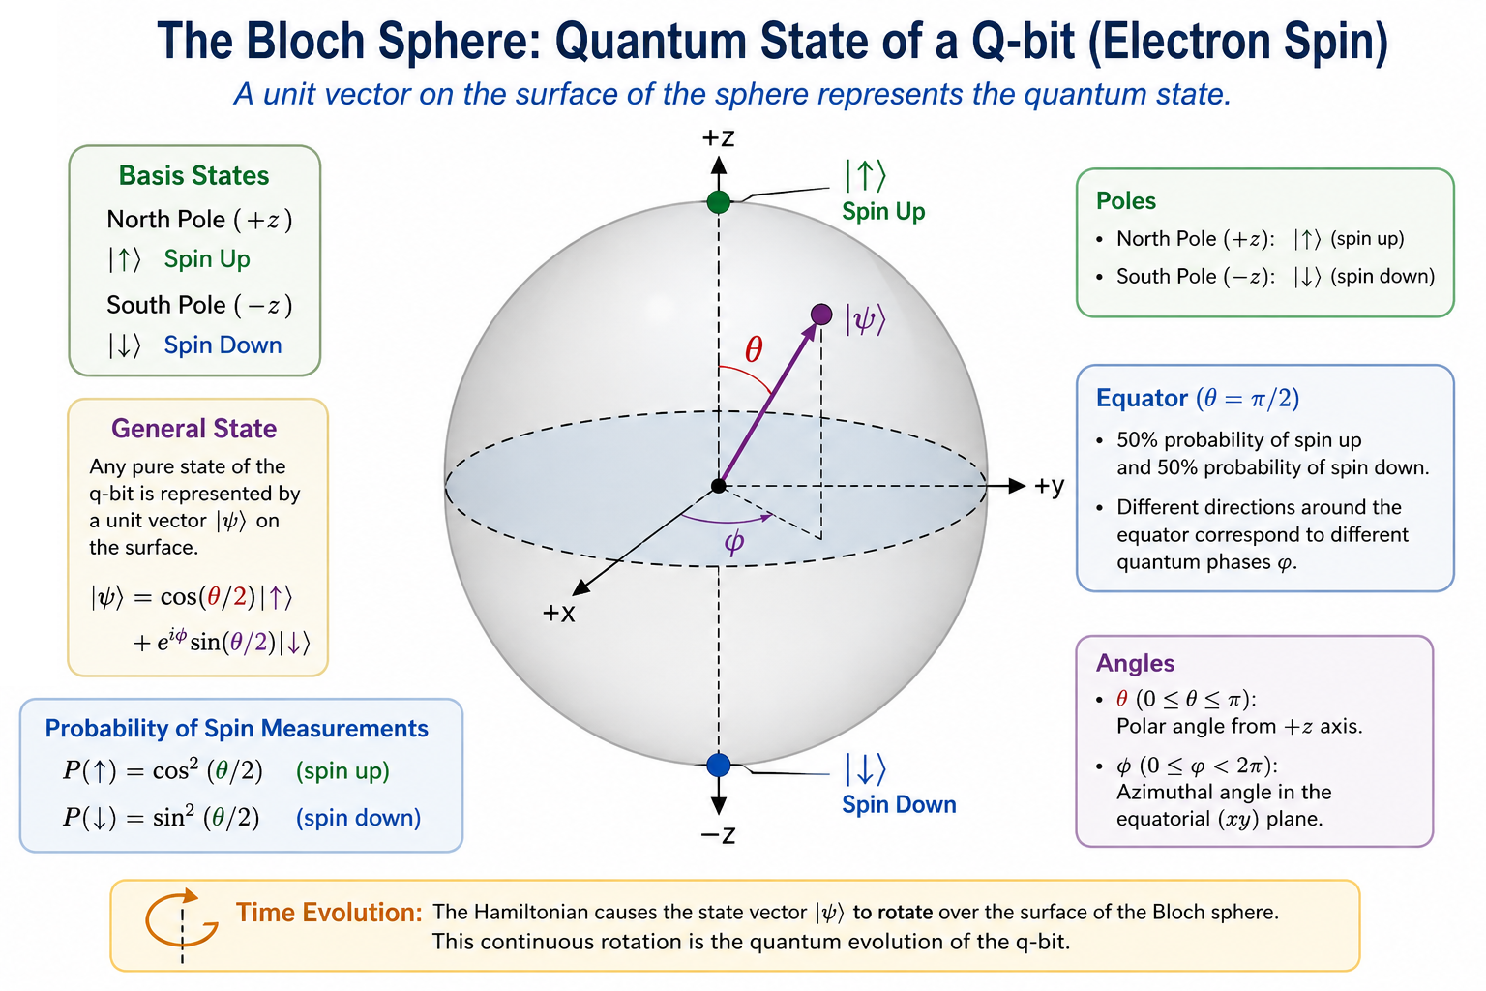
The Bloch Sphere: Visualizing a Q-Bit Quantum State
A q-bit can be formed from the two possible spin states of an electron.
Basis States
  North Pole → Spin Up (100% probability of measuring spin up)
  South Pole → Spin Down (100% probability of measuring spin down)

Slide 38
The Bloch Sphere: Visualizing a Q-Bit Quantum State
Most quantum states are not purely spin up or spin down.
Instead, the quantum state is represented by a unit vector extending from the center of the Bloch sphere to its surface.
  Every point on the surface represents a different quantum state.
  The direction of the vector determines the probabilities of measuring spin up or spin down.

Slide 39
The Bloch Sphere: Visualizing a Q-Bit Quantum State
The Equator:
  Vectors pointing toward the equator represent states with a 50% probability of spin up and a 50% probability of spin down.
  Different directions around the equator all have the same 50–50 probabilities, but they represent different quantum phases.
The Hamiltonian acts by continuously rotating this state vector over the surface of the Bloch sphere.

Slide 40
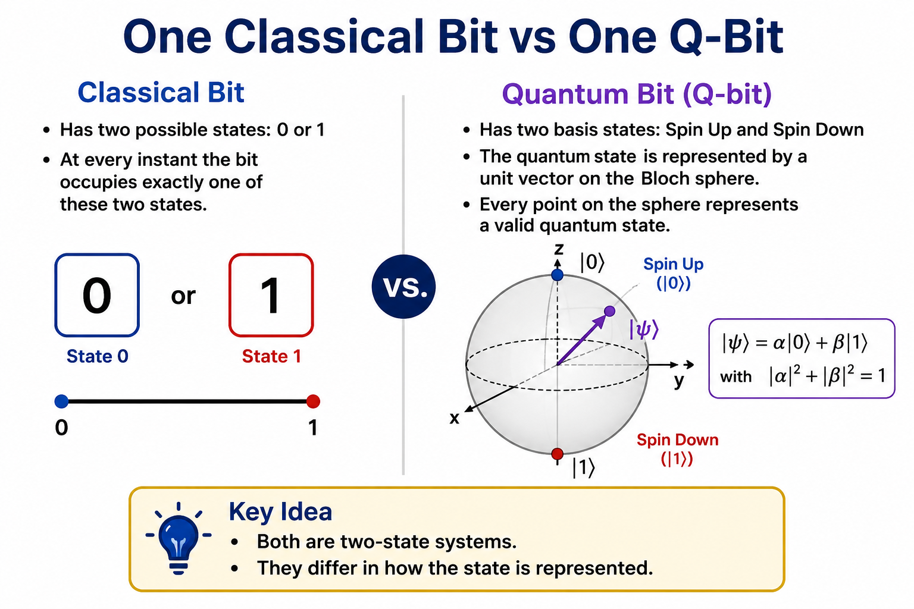
One Classical Bit vs. One Q-bit
Classical Bit
  Has two possible states: 0 or 1
  At every instant the bit occupies exactly one of these two states.
Quantum Bit (Q-bit)
  Has two basis states: Spin Up and Spin Down
  The quantum state is represented by a unit vector on the Bloch sphere.
  Every point on the sphere represents a valid quantum state.
Key Idea
  Both are two-state systems.
  They differ in how the state is represented.

Slide 41
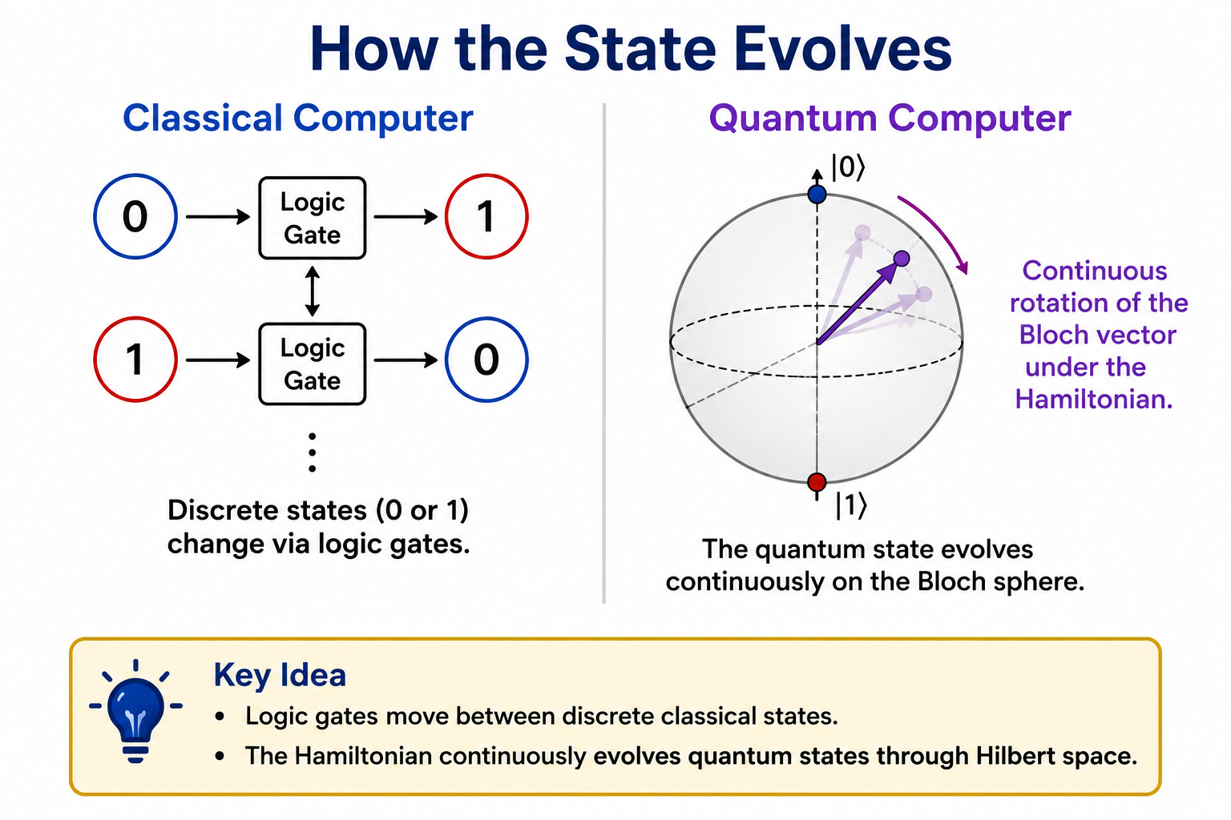
How the State Evolves
Classical Computer
  A classical bit changes state through logic gates.
Examples:
  0 → 0
  0 → 1
  1 → 0
  1 → 1
Each gate performs one simple logical operation.
Quantum Computer
  A q-bit evolves according to the Hamiltonian.
  The Hamiltonian continuously changes the quantum state.
  For one q-bit this evolution can be visualized as a continuous rotation of the Bloch vector.
Key Idea
  Logic gates move between discrete classical states.
  The Hamiltonian continuously evolves quantum states through Hilbert space.

Slide 42
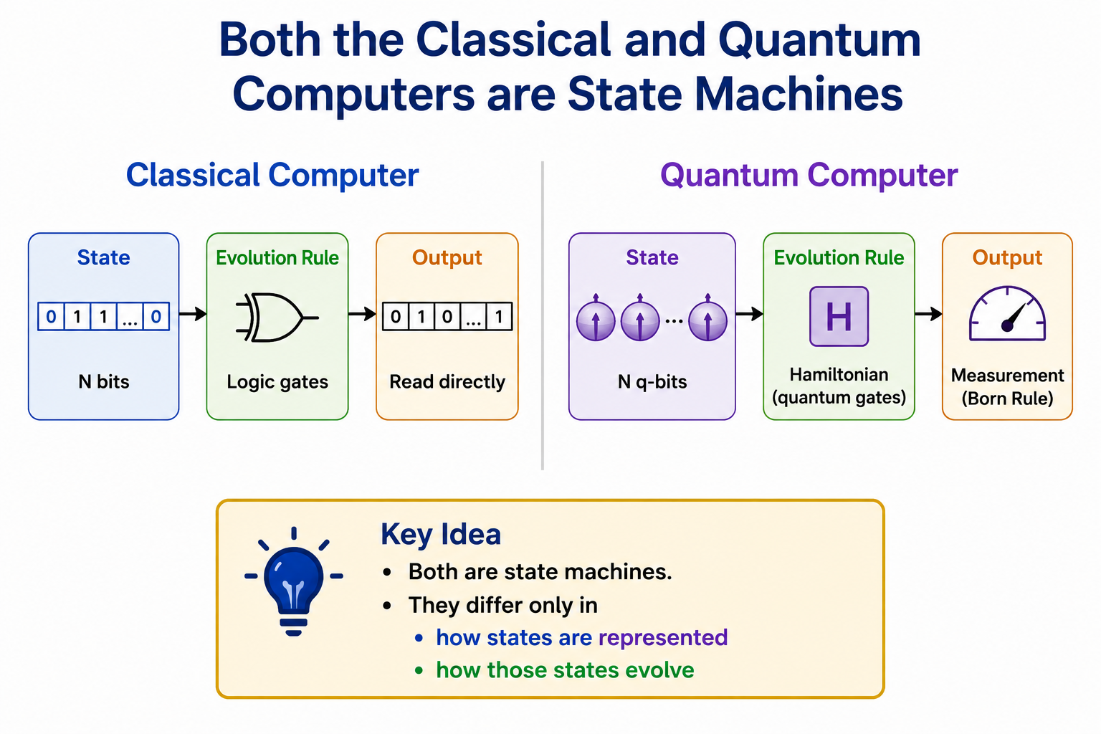
Both the Classical and Quantum Computer are State Machines
Classical Computer
State
  Register containing N bits
Evolution Rule
  Logic gates (Transistors)
Output
  Read the bit pattern directly
Quantum Computer
State
  Register containing N q-bits
Evolution Rule
  Hamiltonian
  (implemented using quantum gates)
Output
  Measurement
  (Born Rule)
Both the classical computer and the quantum computer are state machines that only in:
  how states are represented
  how those states evolve

Slide 43
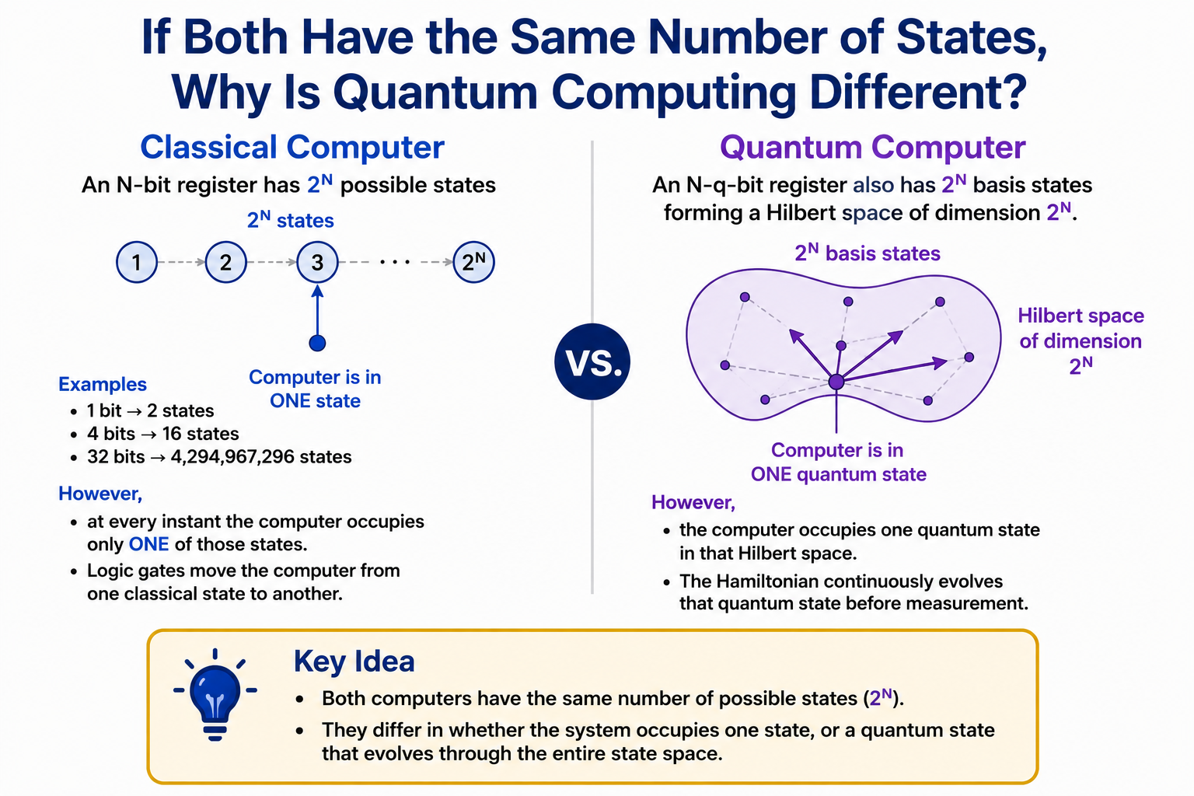
If Both Have the Same Number of States, Why Is Quantum Computing Different?
Classical Computer
  An N-bit register has
  2ᴺ possible states
Examples
  1 bit → 2 states
  4 bits → 16 states
  32 bits → 4,294,967,296 states
However,
  at every instant the computer occupies only ONE of those states.
  Logic gates move the computer from one classical state to another.
Quantum Computer
  An N-q-bit register also has
  2ᴺ basis states
  forming a Hilbert space of dimension 2ᴺ.
However,
  At every instant the quantum computer occupies one quantum state in that Hilbert space.
  The Hamiltonian continuously evolves that quantum state before measurement.

Slide 44
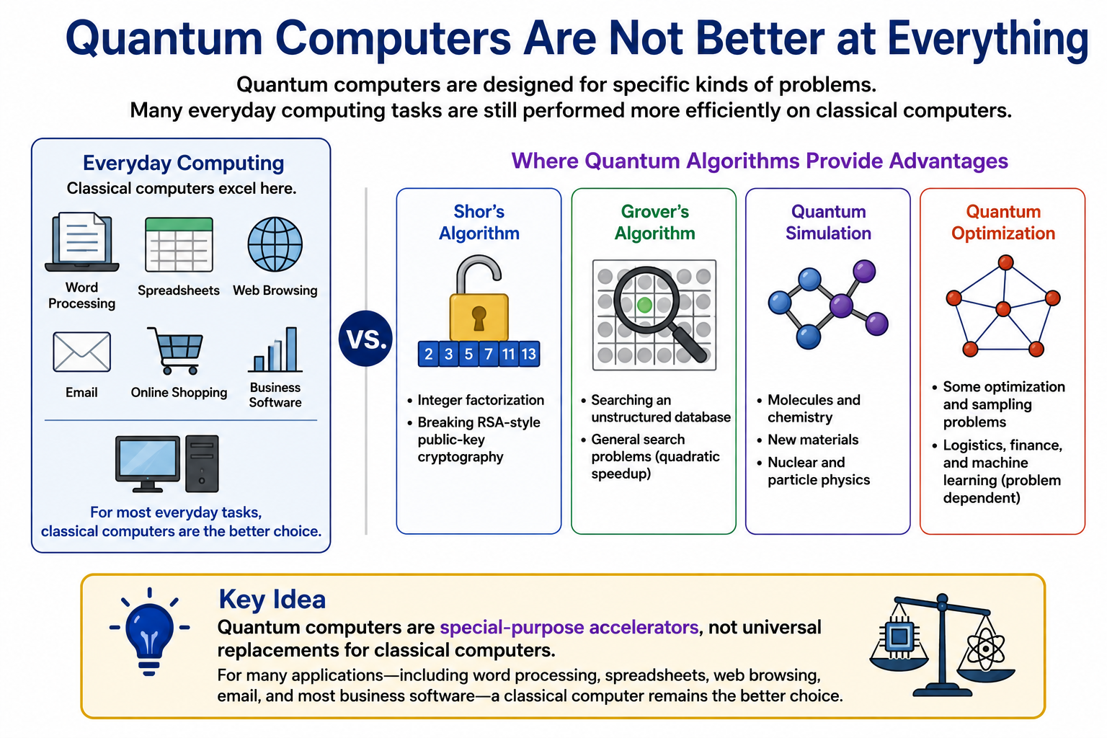
Quantum Computers Are Not Better at Everything
Quantum computers are designed for specific kinds of problems.
  Many everyday computing tasks are still performed more efficiently on classical computers.

Slide 45
Quantum Computers Are Not Better at Everything
Examples where quantum algorithms provide significant advantages include:
  Shor's Algorithm
  • Integer factorization
  • Breaking RSA-style public-key cryptography
  Grover's Algorithm
  • Searching an unstructured database
  • General search problems (quadratic speedup)
  Quantum Simulation
  • Molecules and chemistry
  • New materials
  • Nuclear and particle physics
  Quantum Optimization
  • Some optimization and sampling problems
  • Logistics, finance, and machine learning (problem dependent)

Slide 46
Quantum Computers Are Not Better at Everything
Key Idea
  Quantum computers are special-purpose accelerators, not universal replacements for classical computers.
  For many applications—including word processing, spreadsheets, web browsing, email, and most business software—a classical computer remains the better choice.

Slide 47
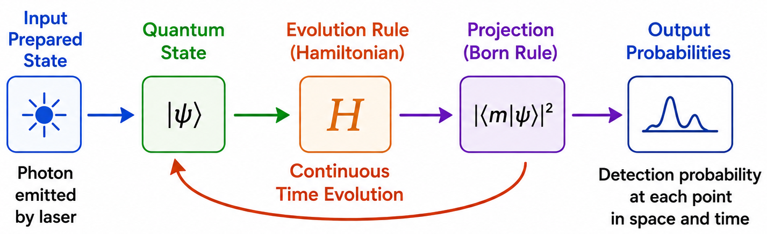
Where Does the Quantum Advantage Come From?
Both computers have exponentially many possible states.
The difference is not the number of states.
The difference is how those states evolve.
Classical Computer
Logic gates move from one classical state to another.
The programmer designs the logic by writing computer code.
Quantum Computer
  The Hamiltonian evolves the entire quantum state coherently through Hilbert space.
  The programmer designs the Hamiltonian (using quantum gates) so that useful probability amplitudes reinforce one another
  Unwanted probability amplitudes cancel through interference
  Only after this evolution is complete is the quantum state measured.
Key Idea
  The power of quantum computing comes from controlling the evolution of the quantum state before measurement.

Slide 48
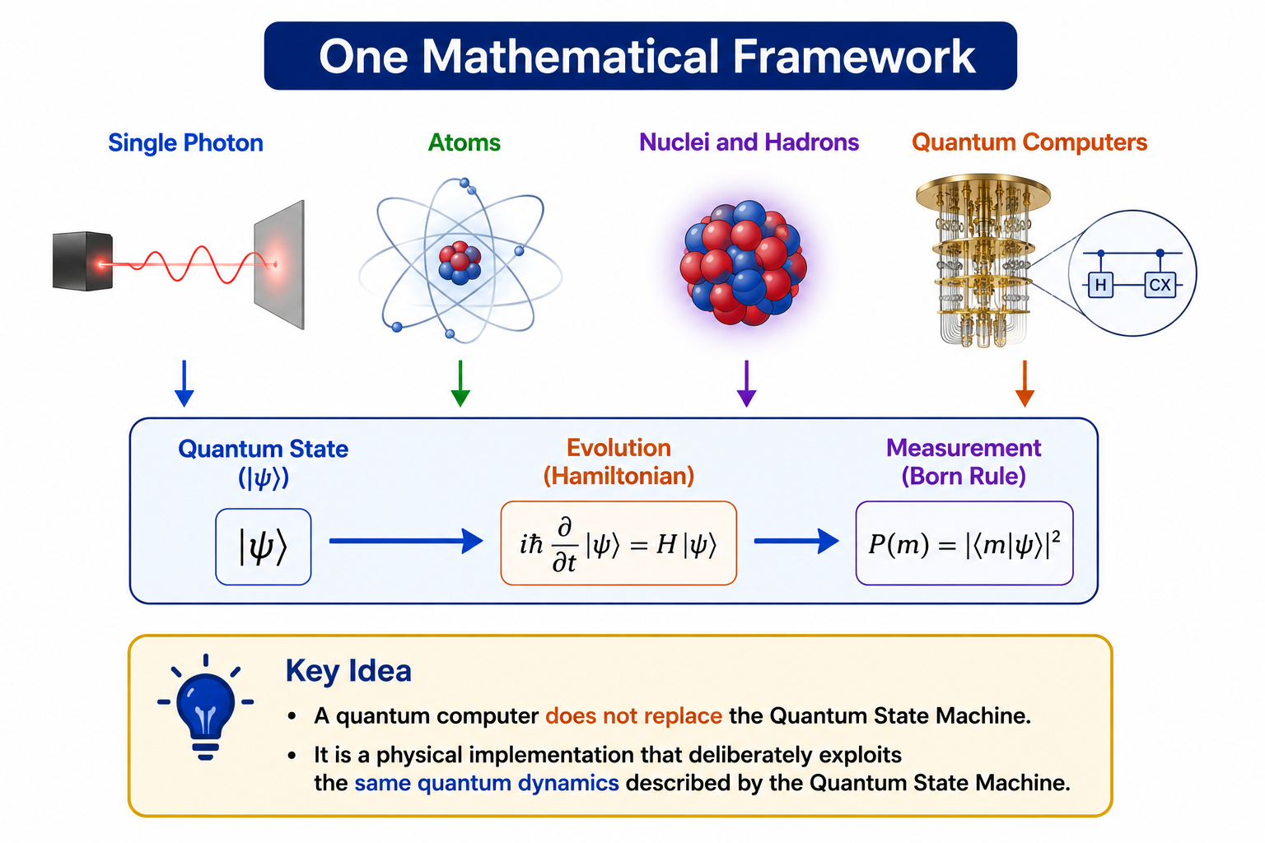
One Mathematical Framework
The same quantum formalism can be used to describe
  the evolution of a single photon,
  the formation of atoms, nuclei, and hadrons,
  and the operation of quantum computers.
In every case,
  the Hamiltonian governs the evolution of the quantum state.
  The Born Rule connects the quantum state to experimental observations.
Key Idea
  A quantum computer does not replace the Quantum State Machine.
  It is a physical implementation that deliberately exploits the same quantum dynamics described by the Quantum State Machine.

Slide 49
A Process Theology Perspective
One Lure...Many Expressions
Throughout this lecture we have seen one mathematical framework applied to
  photons
  mesons and baryons
  nuclei
  quantum computers
From a Process Theology perspective,
  The Superjective Nature of God is the theological description of the same continual lure that the Hamiltonian mathematically describes.
  The evolving quantum state represents the process of becoming.
  The Born Rule reveals the emergent pattern toward which that becoming is being guided.
  Individual observations are Actual Occasions that progressively reveal that pattern.
Key Idea
  One mathematical framework...
  One process of becoming...
  One continual lure toward an emergent order.

Slide 50
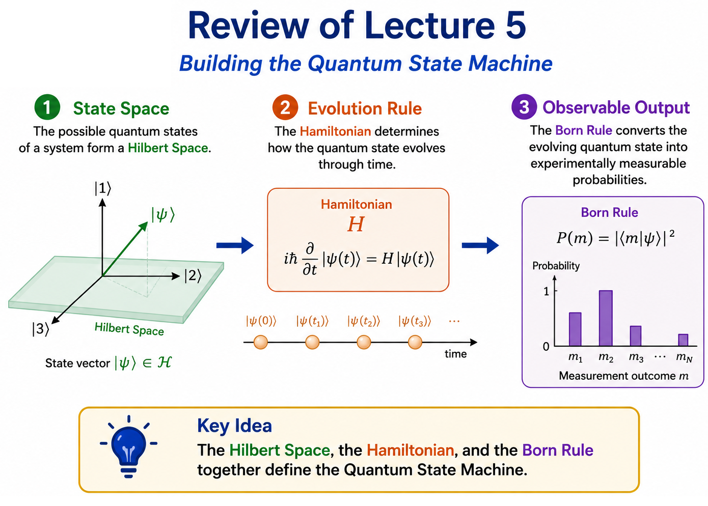
Lecture 5 Review
Building the Quantum State Machine
1. State Space
  The possible quantum states of a system form a Hilbert Space.
2. Evolution Rule
  The Hamiltonian determines how the quantum state evolves through time.
3. Observable Output
  The Born Rule converts the evolving quantum state into experimentally measurable probabilities.
Key Idea
  The Hilbert Space, the Hamiltonian, and the Born Rule together define the Quantum State Machine.

Slide 51
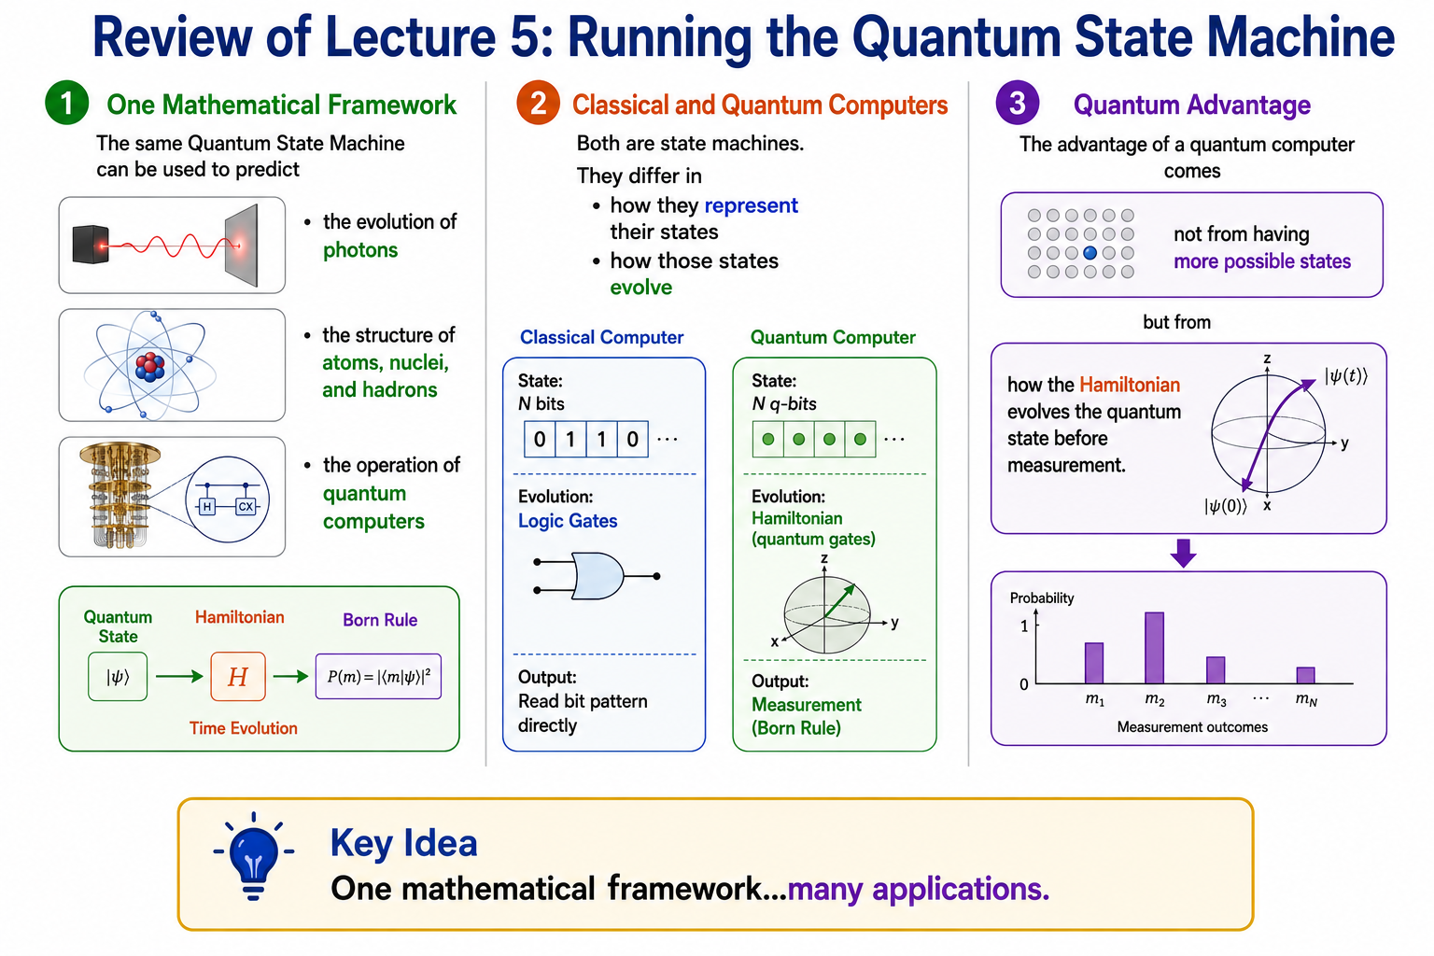
Lecture 5 Review
Running the Quantum State Machine
One Mathematical Framework
  The same Quantum State Machine can be used to predict
    the evolution of photons
    the structure of atoms, nuclei, and hadrons
    the operation of quantum computers.

Slide 52
Lecture 5 Review
Running the Quantum State Machine
Classical and Quantum Computers
  Both are state machines that differ in:
    How they represent their states
    How those states evolve.

Slide 53
Lecture 5 Review
Running the Quantum State Machine
Quantum Advantage
  The advantage of a quantum computer comes:
    Not from having more possible states
  But from
    How the Hamiltonian evolves the quantum state before measurement.
Key Idea
  One mathematical framework...
  many applications.

Slide 54
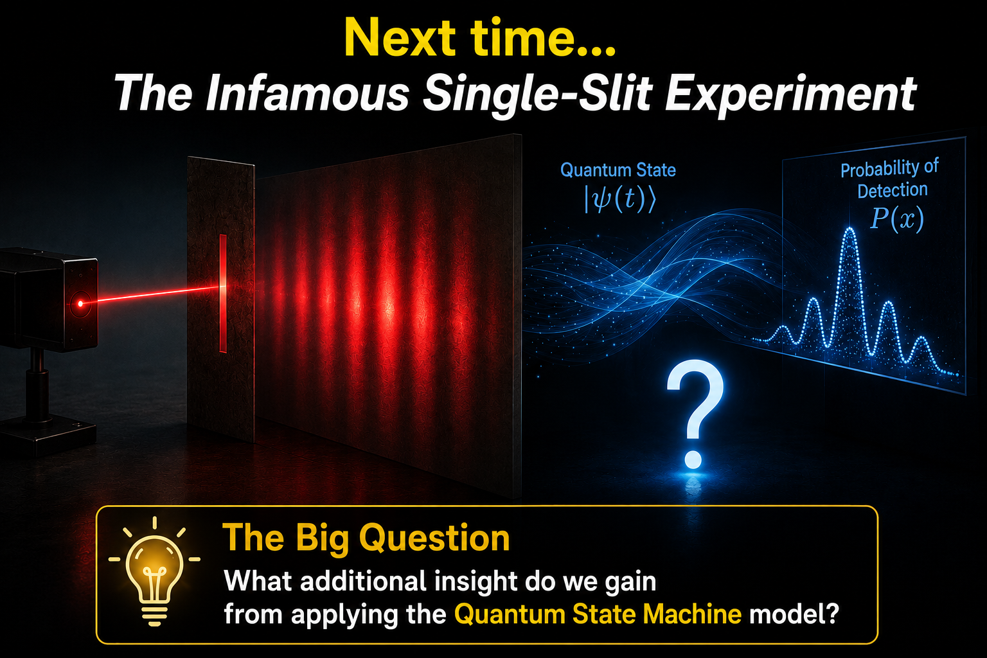
Next Time...
The Infamous Single-Slit Experiment
For more than one hundred years, physicists have explained the spreading of light passing through a narrow slit using
  Classical Electromagnetism
and
  the Uncertainty Principle.
These explanations correctly predict the observed probability distribution.
But are they telling the whole story?

Slide 55
Next Time...
The Infamous Single-Slit Experiment
Next time we will compare three different descriptions of the same experiment.
Classical Electromagnetism
  Predicts the intensity distribution of the light wave.
The Uncertainty Principle
  Predicts the probability distribution for detecting photons.
The Quantum State Machine
  Predicts the complete quantum evolution that gives rise to the probability distribution.

Slide 56
Next Time...
The Infamous Single-Slit Experiment
The Big Question
  What additional insight do we gain by applying the Quantum State Machine model itself?

Slide 57


