Slide 1


Process Theology as a Lens for Bringing Quantum Physics into Focus
Dr. Michael A. Soderstrand, PhD
Lecture 6: The Single Slit Experiment →
Tendency and Pattern (Lure / aim expressed
probabilistically)

Slide 2

The Infamous Single-Slit Experiment
If there is one experiment that has challenged our intuition about reality more than any other, it is the single-slit experiment.
  The experimental setup is remarkably simple.
  The results are anything but simple.
Today we will ask one fundamental question:
  Where will each photon land on the screen?
Detection Screen
Laser
Single Slit
2

Slide 3

What Do We Actually Observe?
When thousands of photons pass through a single slit...
  Each photon is detected at one location on the screen.
  The photons do not arrive uniformly across the screen.
  As more and more photons arrive, they gradually build a distinctive pattern of alternating bright and dark regions.
The mystery is not only why the beam spreads...
  The mystery is also why there are places where no photons are ever detected.

Slide 4
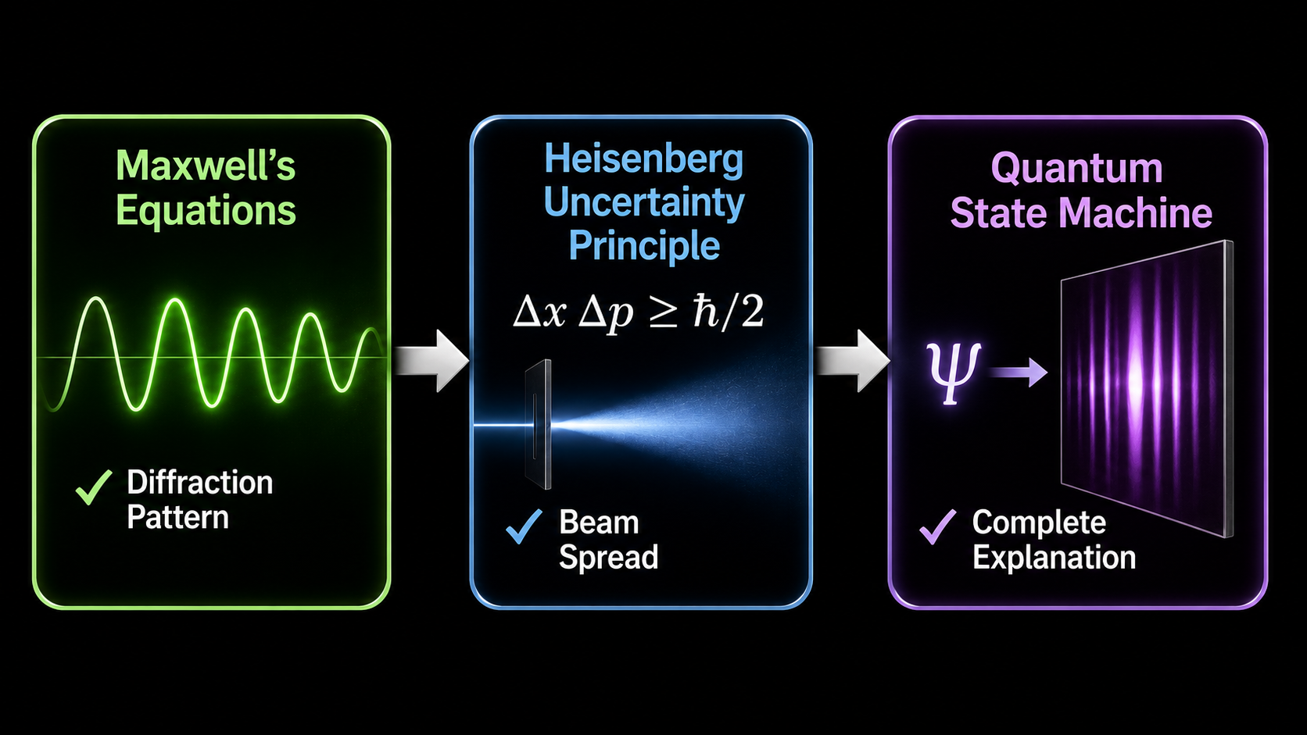
Three Models...Three Pieces of the Puzzle
Each model explains an important part of the experiment.
Each model answers a different scientific question about the experiment.
Maxwell's Equations
  Predict the diffraction pattern.
  Treat light as a continuous electromagnetic wave.
Heisenberg's Uncertainty Principle
  Explains why the beam spreads after passing through a narrow slit.
  Does not explain the bright and dark regions.
Quantum State Machine
  Predicts the probability distribution of photon detections.
  Naturally produces both the beam spread and the diffraction pattern.
  Explains how individual photon detections accumulate into the observed intensity pattern
Today we will see how these three models fit together.

Slide 5
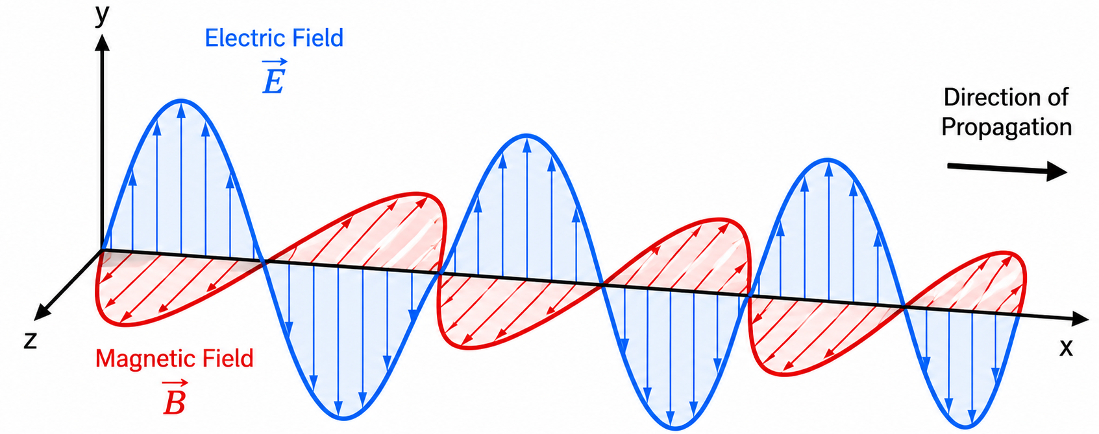
Maxwell's Equations
Maxwell's equations describe light as a continuous electromagnetic wave.
These equations successfully predict
  Reflection
  Refraction
  Polarization
  Diffraction
They correctly predict the intensity pattern produced by the single-slit experiment.

Slide 6
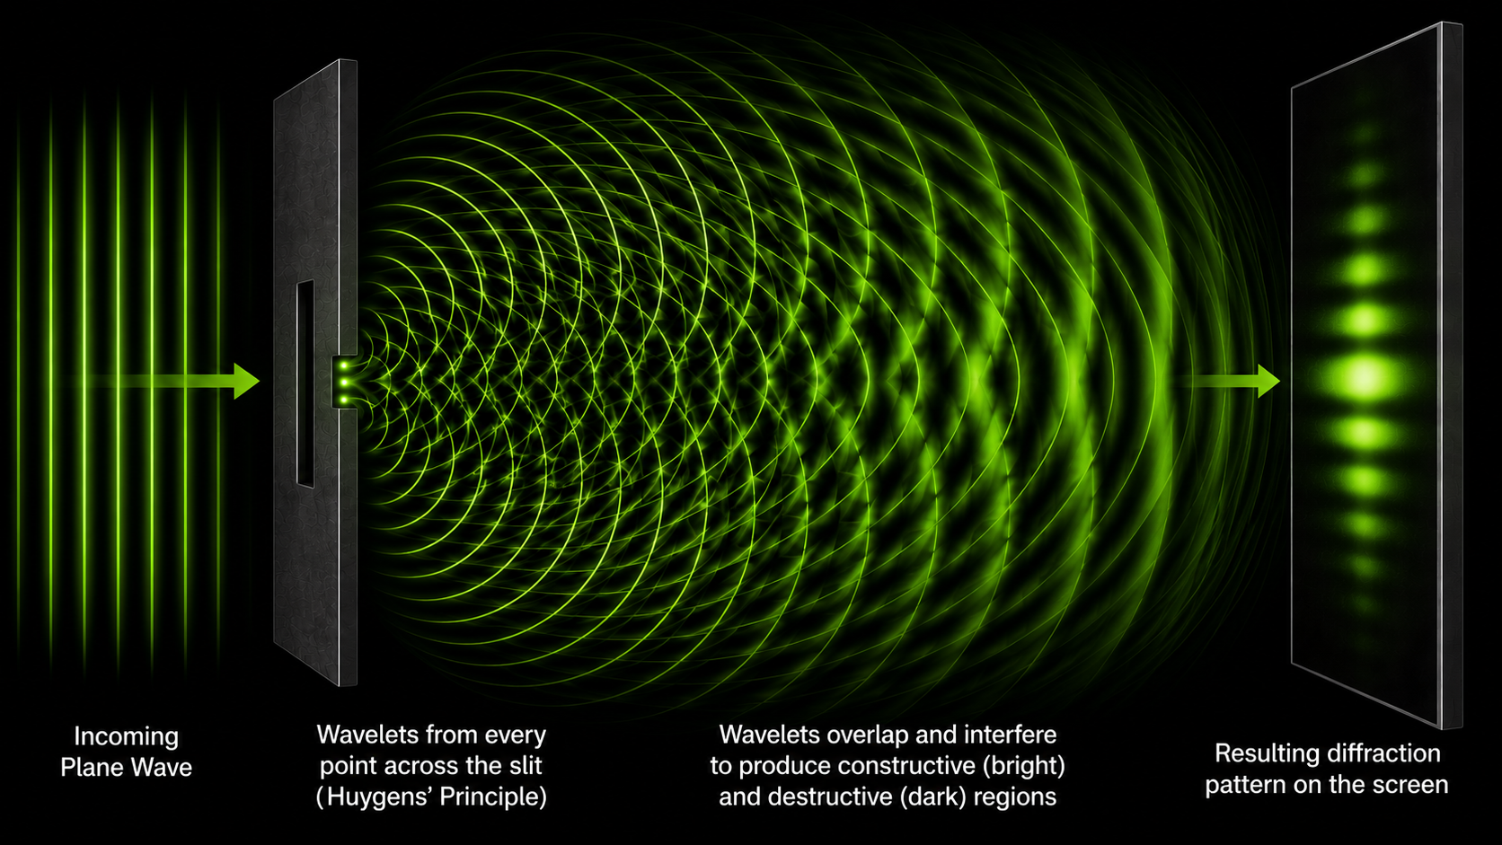
A Wave Passing Through a Narrow Opening
According to Maxwell's equations,
  Every point across the opening acts like a new source of electromagnetic waves.
  These waves interfere with one another.
  The result is a diffraction pattern.

Slide 7
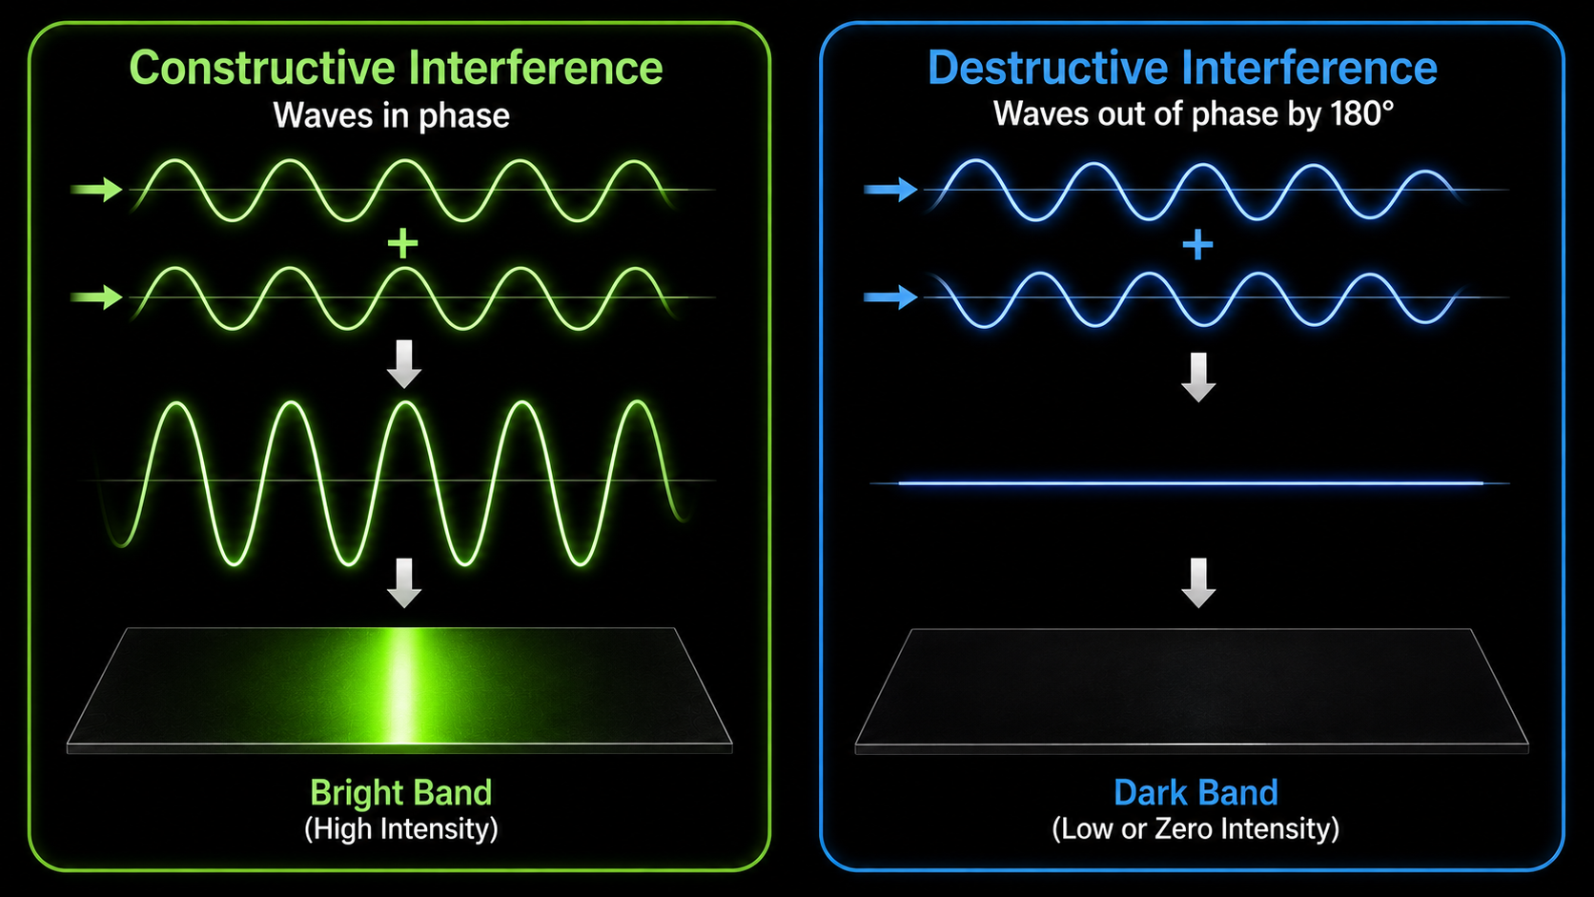
Constructive and Destructive Interference
Where waves arrive in phase,
  Their amplitudes add.
  Bright region.
Where waves arrive out of phase,
  Their amplitudes cancel.
  Dark region.
Maxwell's equations predict the location of every bright and dark region.

Slide 8
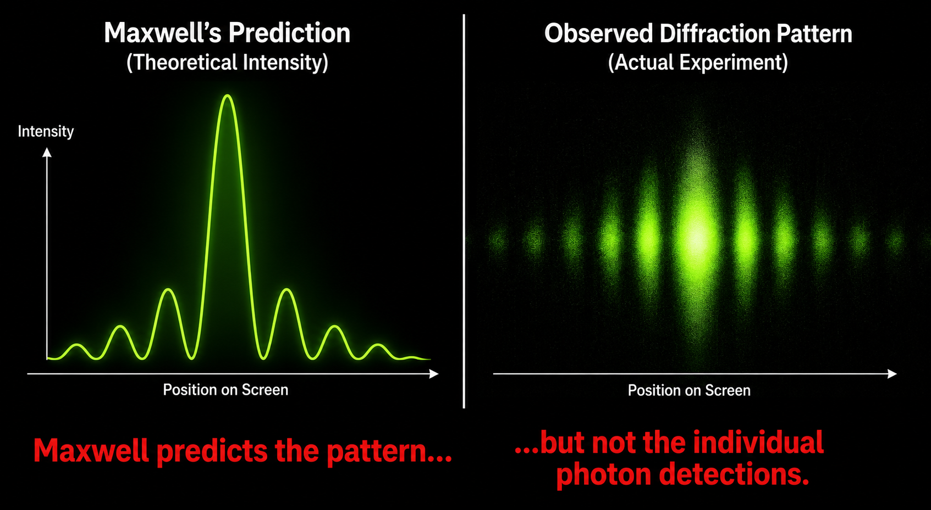
Maxwell Gets the Pattern Exactly Right
The predicted intensity matches the observed diffraction pattern remarkably well.
  The locations of the bright and dark regions are exactly where Maxwell's equations predict.
But one important question remains...
  Where are the photons?

Slide 9
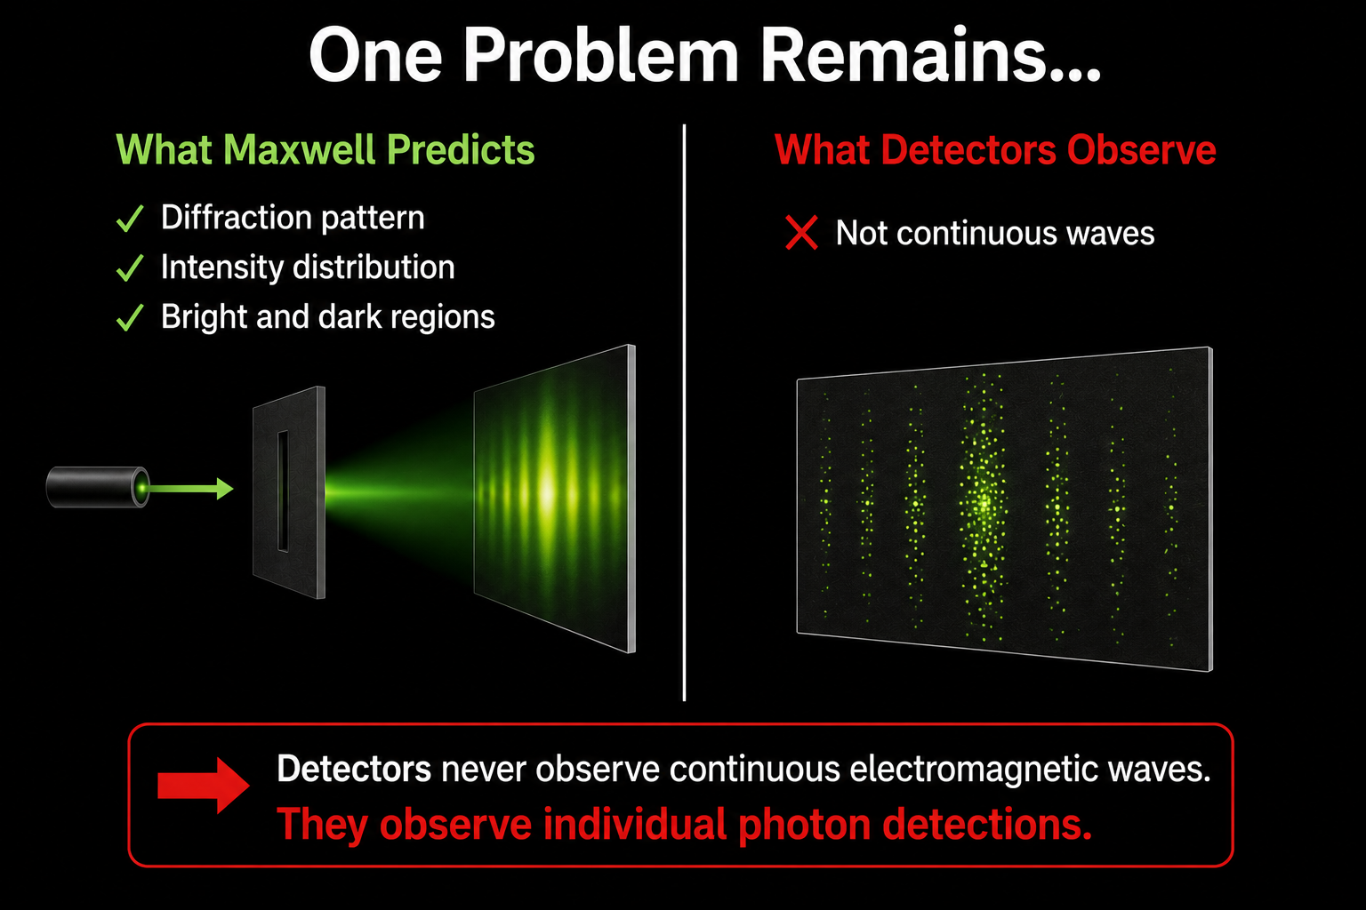
One Problem Remains...
Maxwell predicts
  ✓ the pattern
  ✓ the intensity
  ✓ the dark regions
But detectors never observe
  continuous electromagnetic waves.
They observe
  individual photon detections.

Slide 10
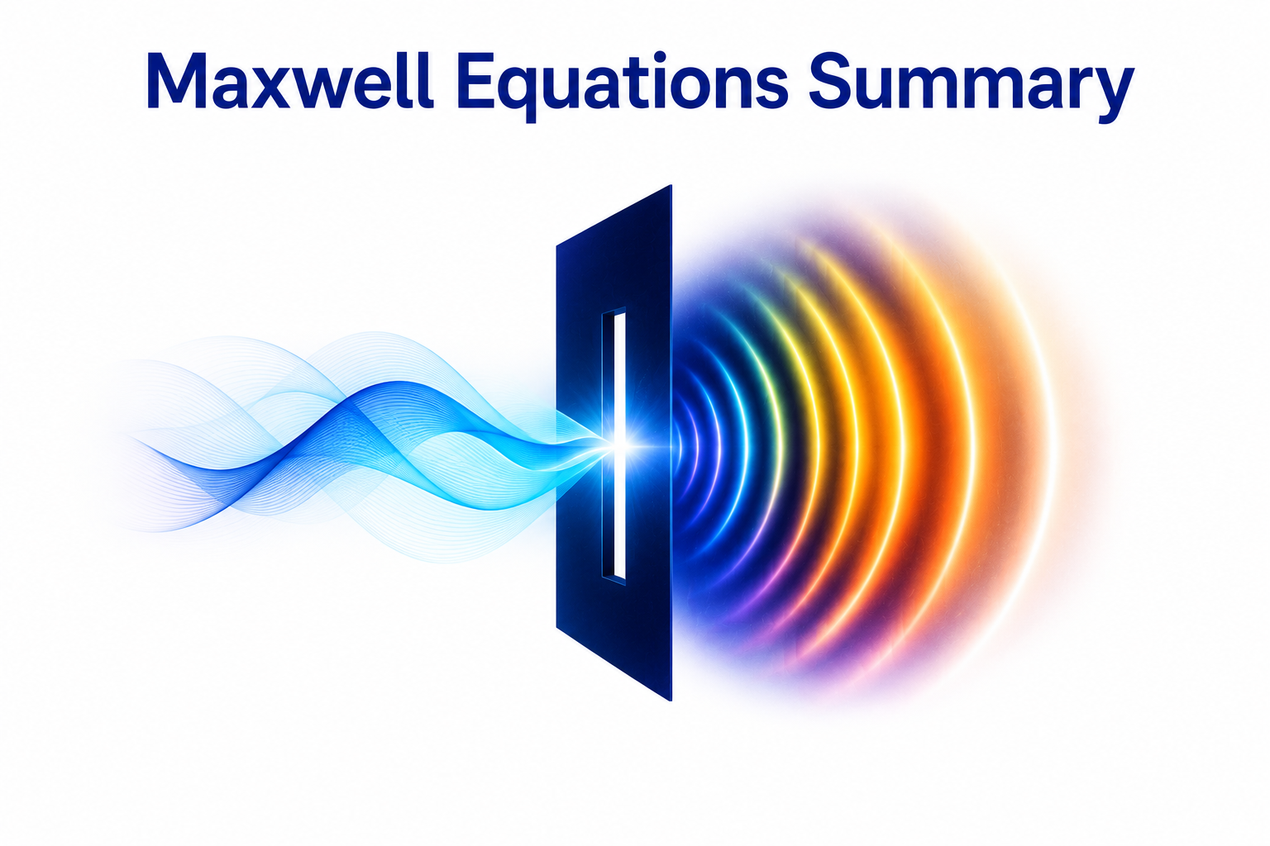
Maxwell Equations Summary
Maxwell's Equations
  ✓ Explains
  ✓ Reflection
  ✓ Refraction
  ✓ Polarization
  ✓ Diffraction
  ✓ Intensity distribution
  ✓ Locations of the bright regions
  ✓ Locations of the dark regions
Still Unexplained
  ❓ Individual photon detections
  ❓ Where will each photon land?

Slide 11
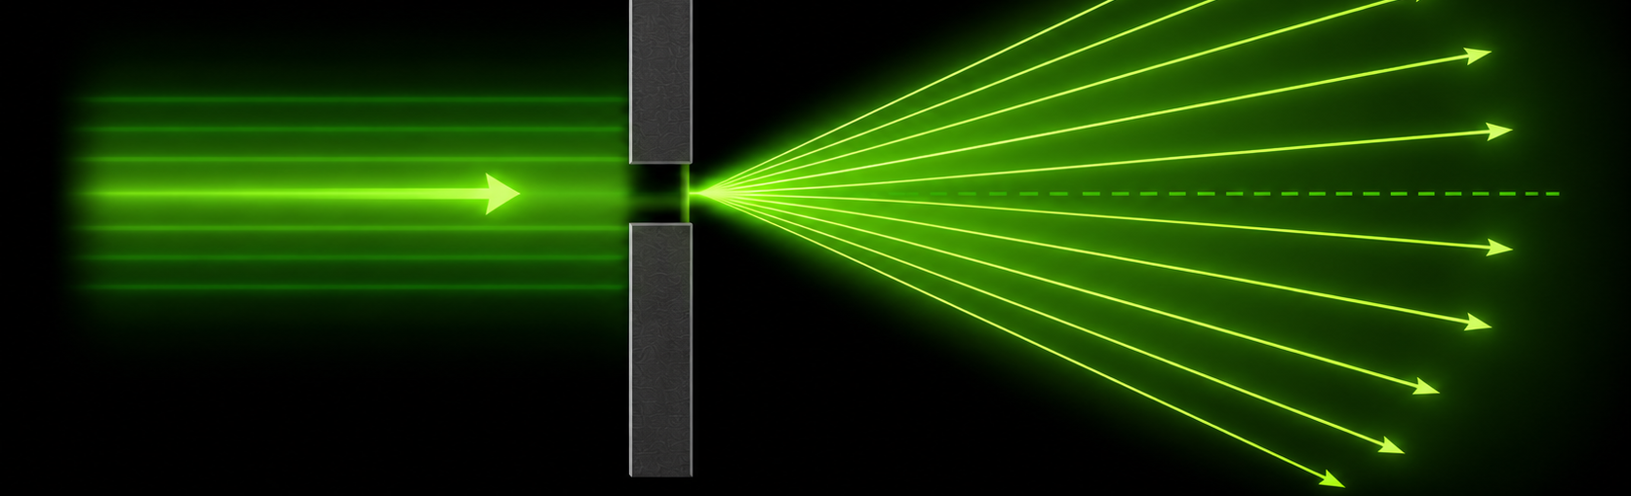
The Heisenberg Uncertainty Principle
Maxwell explains why the diffraction pattern contains bright and dark regions.
  But Maxwell does not explain why the beam spreads after passing through a narrow slit.
The Heisenberg Uncertainty Principle answers that question.

Slide 12
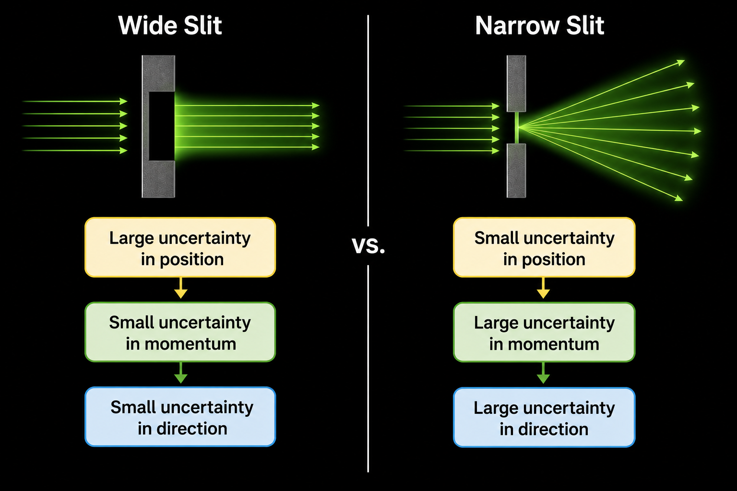
Position and Momentum Cannot Both Be Known Precisely
The Heisenberg Uncertainty Principle states
  The more precisely a particle's position is known...
  The less precisely its momentum can be known.
Passing through a narrow slit precisely determines the photon's horizontal position.
  Its horizontal momentum therefore becomes uncertain.

Slide 13
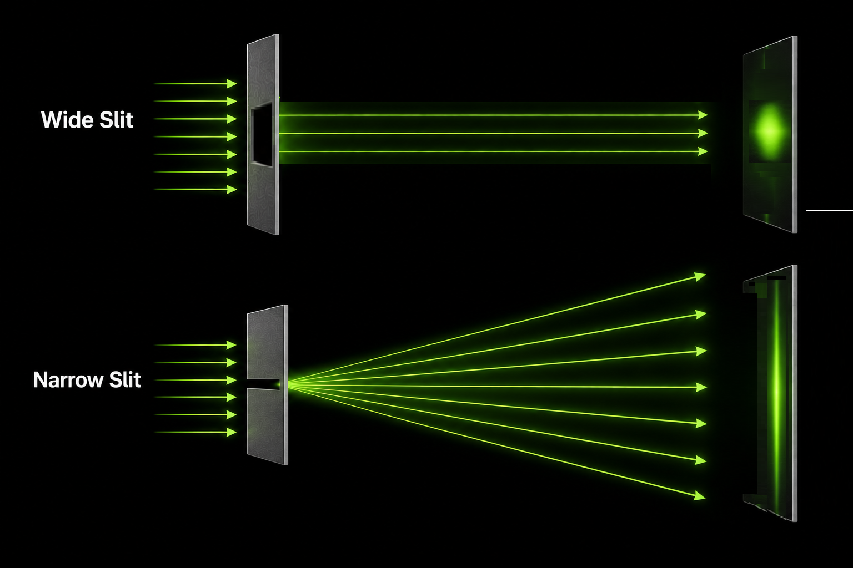
Why the Beam Spreads
As the slit becomes narrower,
  The uncertainty in horizontal momentum increases.
  Photons therefore leave the slit over a wider range of angles.
  The beam spreads.
This prediction agrees remarkably well with experiment.

Slide 14


Slide 15
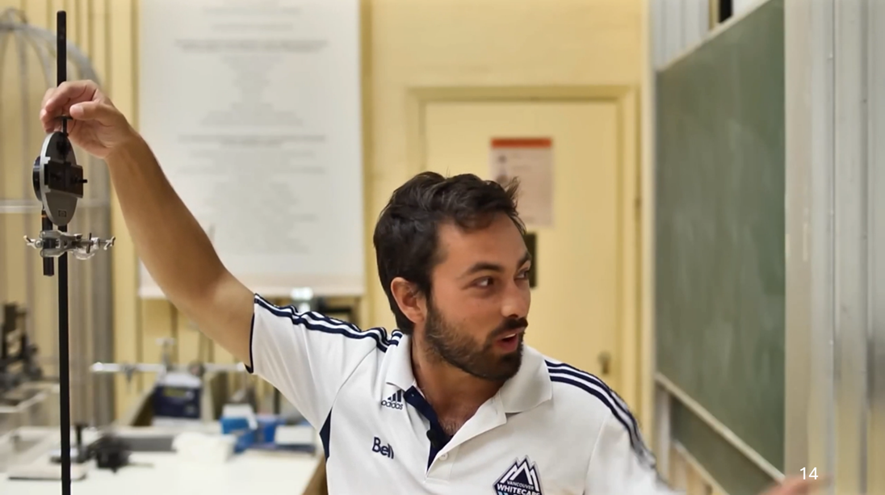
What We Just Saw on the Video
We just saw in a physics lab what we predicted using the Heisenberg Uncertainty principle.
  The Heisenberg Uncertainty Principle has done something very important.
  It correctly predicts that the beam spreads as the slit narrows.
  But did you notice what it didn't explain?

Slide 16
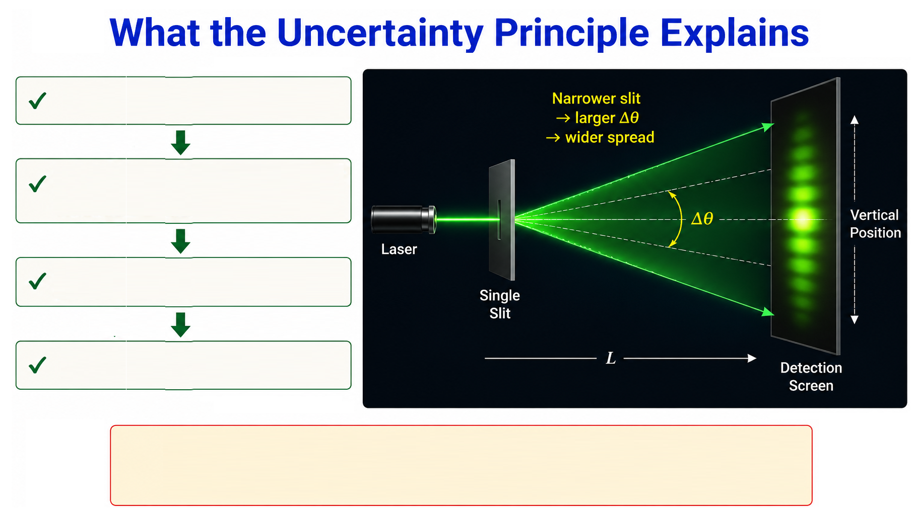
  Narrow slit
  Increased uncertainty in transverse momentum
  Larger spread of photon directions
  Wider beam
The Uncertainty Principle successfully predicts the overall beam spread

Slide 17
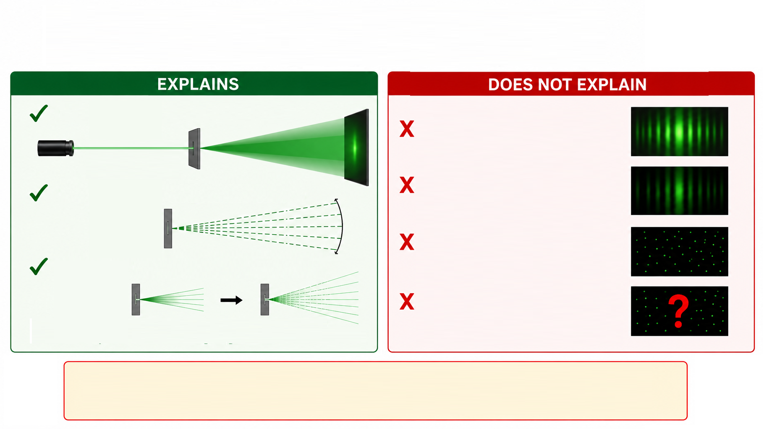
...But Not the Whole Experiment
Beam spreads
Bright regions
Wider angular distribution
Dark regions
Individual photon detections
Narrower slit → larger spread
Wider slit: Smaller spread
Where the next photon lands
Narrower slit: Larger spread
The uncertainty principle predicts the overall width of the distribution, but not its detailed probability pattern.

Slide 18
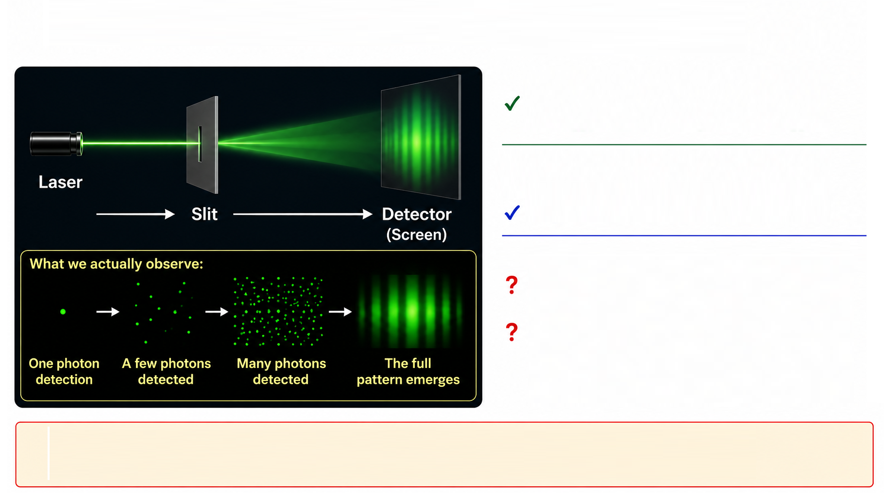
We Still Need One More Piece
Maxwell’s Equations tell us:
  Where the bright and dark bands occur
Heisenberg's Uncertainty Principle tells us:
  Why the beam spreads
But neither tells us:
  Where will the next photon land?
  Why do thousands of individual photons build exactly the Maxwell intensity distribution?
To answer those questions, we need a different model –
The Quantum State Machine model

Slide 19
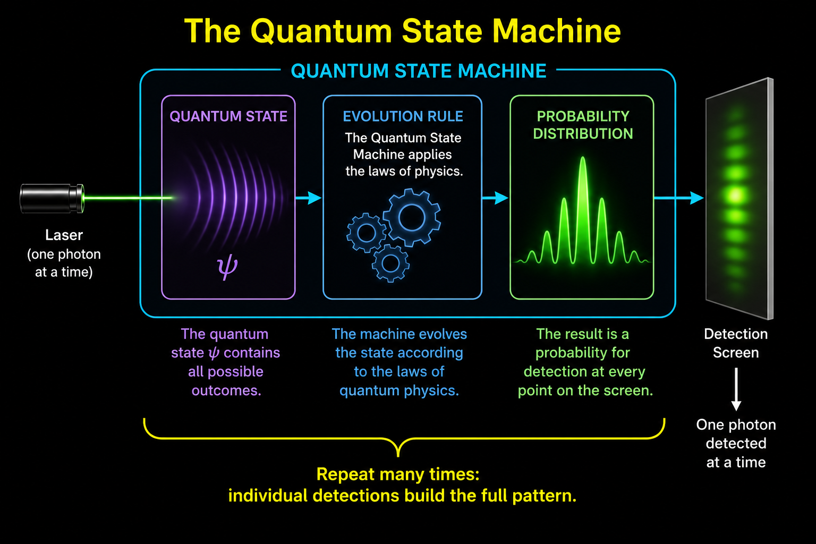
The Quantum State Machine
The Quantum State Machine predicts the probability of every possible measurement outcome.
Instead of treating light as
  continuous waves
or simply
  uncertain particles
The Quantum State Machine describes
  A quantum state, ψ (Psi)
  Evolving in Hilbert space
  Whose probability amplitudes determine where individual photon detections occur.

Slide 20
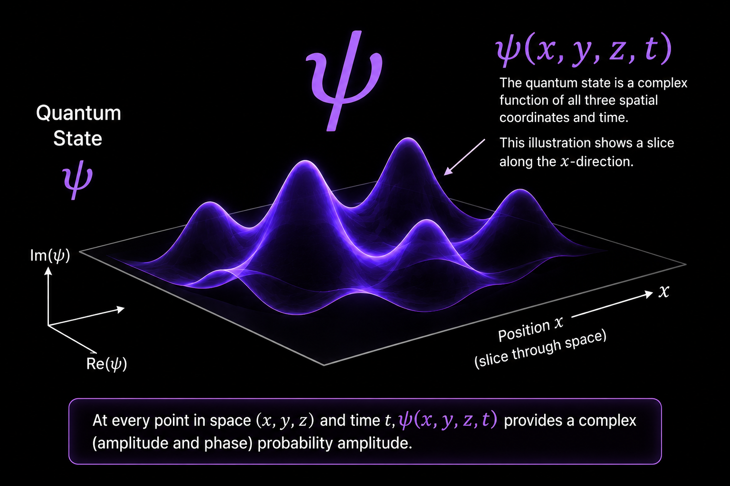
The Quantum State ψ
The quantum state describes the present state of the system.
It encodes
  The probability amplitudes for every possible measurement outcome.
  The phase relationships between those amplitudes.
  Everything needed to predict the probabilities of future measurements.
The quantum state evolves continuously with time.

Slide 21
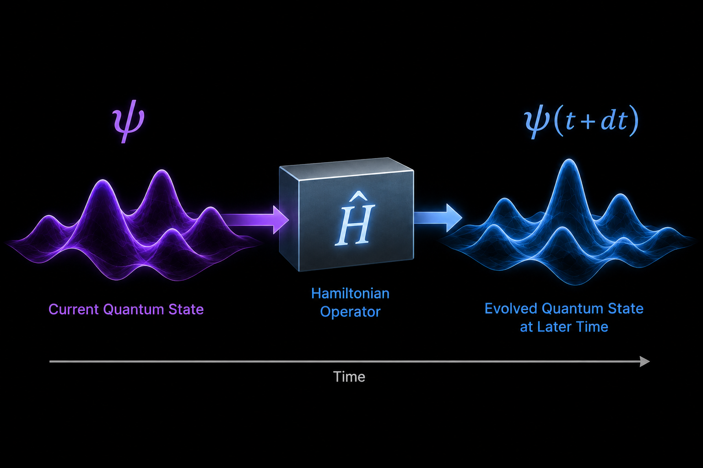
The Hamiltonian Operator Ĥ
It is a mathematical operator (often involving derivatives) that:
  Operates on the current quantum state, ψ.
  Determines how the quantum state evolves continuously with time.
  Produces the evolving quantum state used to predict future measurements.
Recall: During quantization, the classical fields are replaced by quantum fields containing operators, and these operators are assembled into the Hamiltonian operator that acts on the quantum state.
  The Hamiltonian operator tells the Quantum State Machine how the quantum state evolves.
The Hamiltonian operator acts on the quantum state.

Slide 22

Bringing the Pieces Together
The Quantum State Machine has two essential parts:
  The quantum state, ψ, describes the present state of the system.
  The Hamiltonian operator, Ĥ, determines how the quantum state evolves.
What happens when the Hamiltonian operator acts on the quantum state?

Slide 23
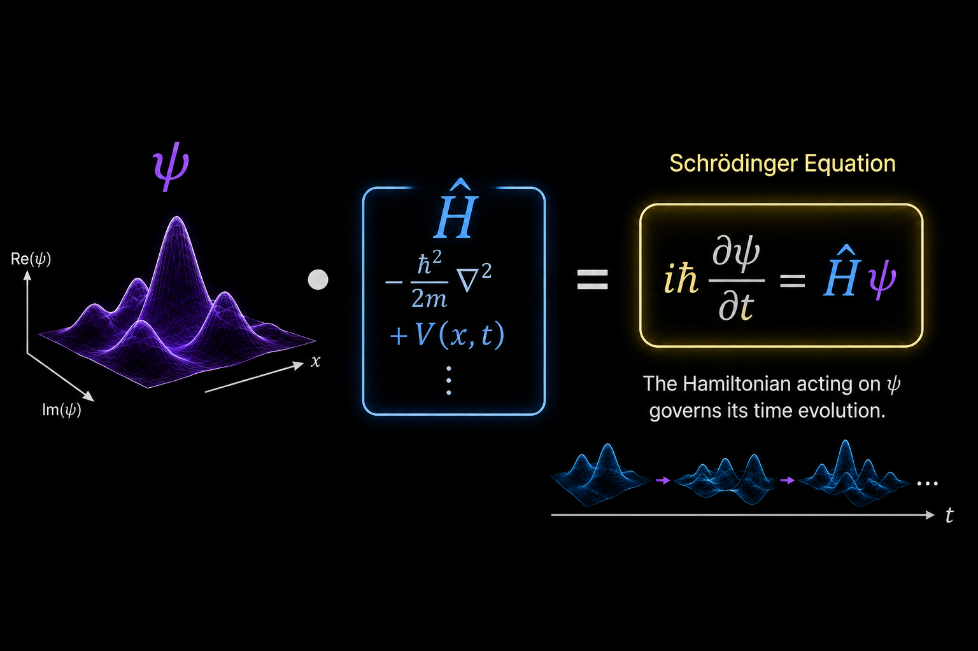
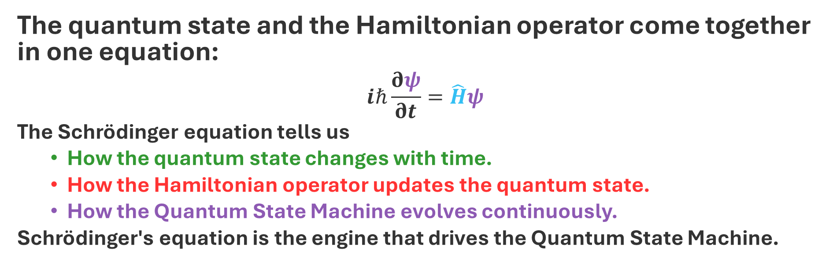
Schrödinger's Equation
The quantum state and the Hamiltonian operator come together in one equation:
$$iℏ\frac{∂ψ}{∂t}=\hat{H}ψ$$
The Schrödinger equation tells us
  How the quantum state changes with time.
  How the Hamiltonian operator updates the quantum state.
  How the Quantum State Machine evolves continuously.
Schrödinger's equation is the engine that drives the Quantum State Machine.

Slide 24
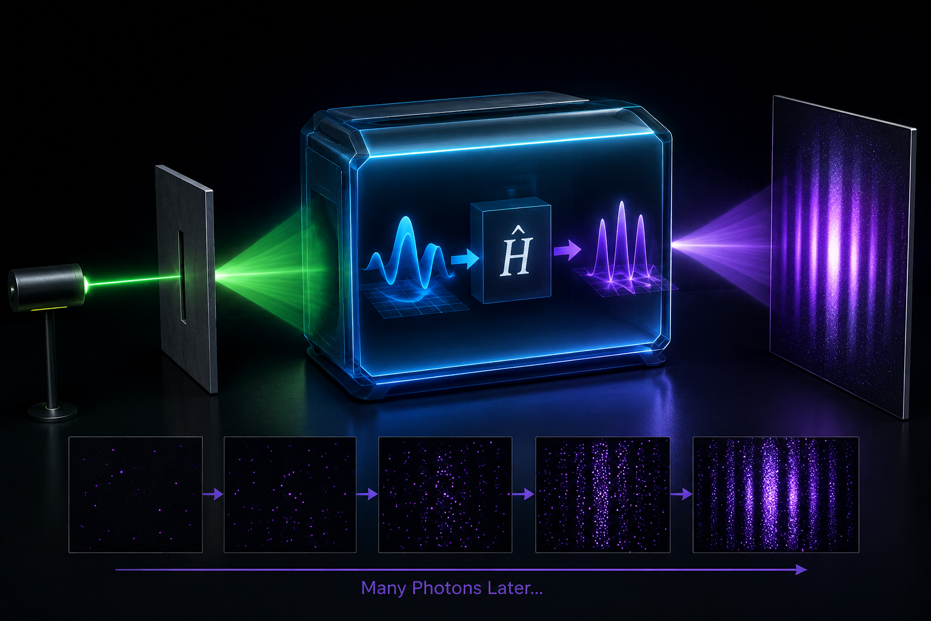
Running the Quantum State Machine for the Single-Slit Experiment
Now let's use the Quantum State Machine to model the single-slit experiment.
  The Quantum State Machine has already been constructed.
  The experimental setup is already encoded in the Hamiltonian operator.
  The only remaining task is to prepare the initial quantum state.
Every prediction begins by preparing an initial quantum state, ψ₀.

Slide 25
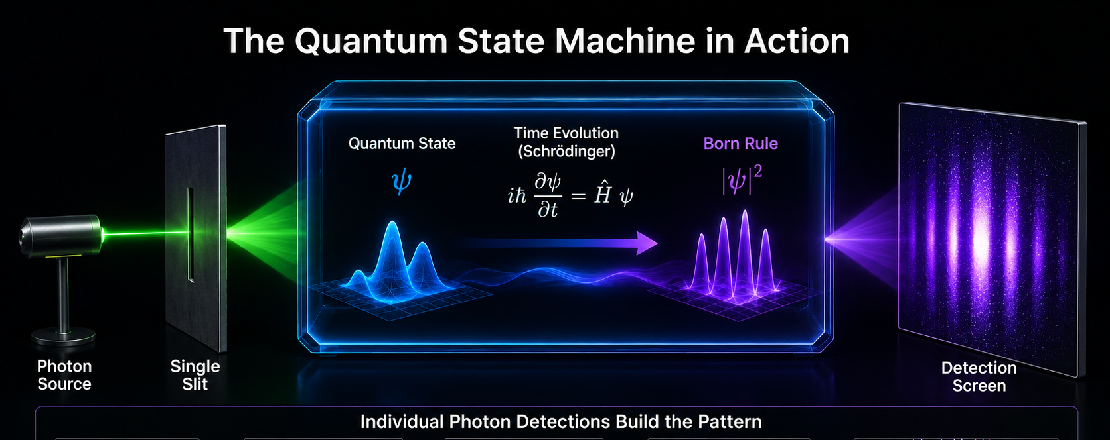
Preparing the Initial Quantum State
Before reaching the slit, the photon is traveling toward the barrier.
  That situation is represented mathematically by the initial quantum state, ψ₀.
  The initial quantum state contains everything known about the photon before it reaches the slit.

Slide 26

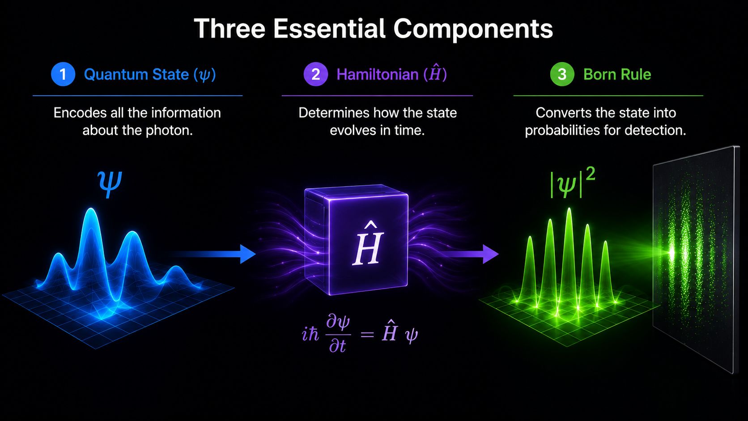
The Quantum State Evolves
Schrödinger's equation is applied continuously.
  The Hamiltonian operator acts on the quantum state.
  As the photon approaches and passes through the slit.
The quantum state changes continuously.
The Quantum State Machine computes the evolving quantum state.
26

Slide 27
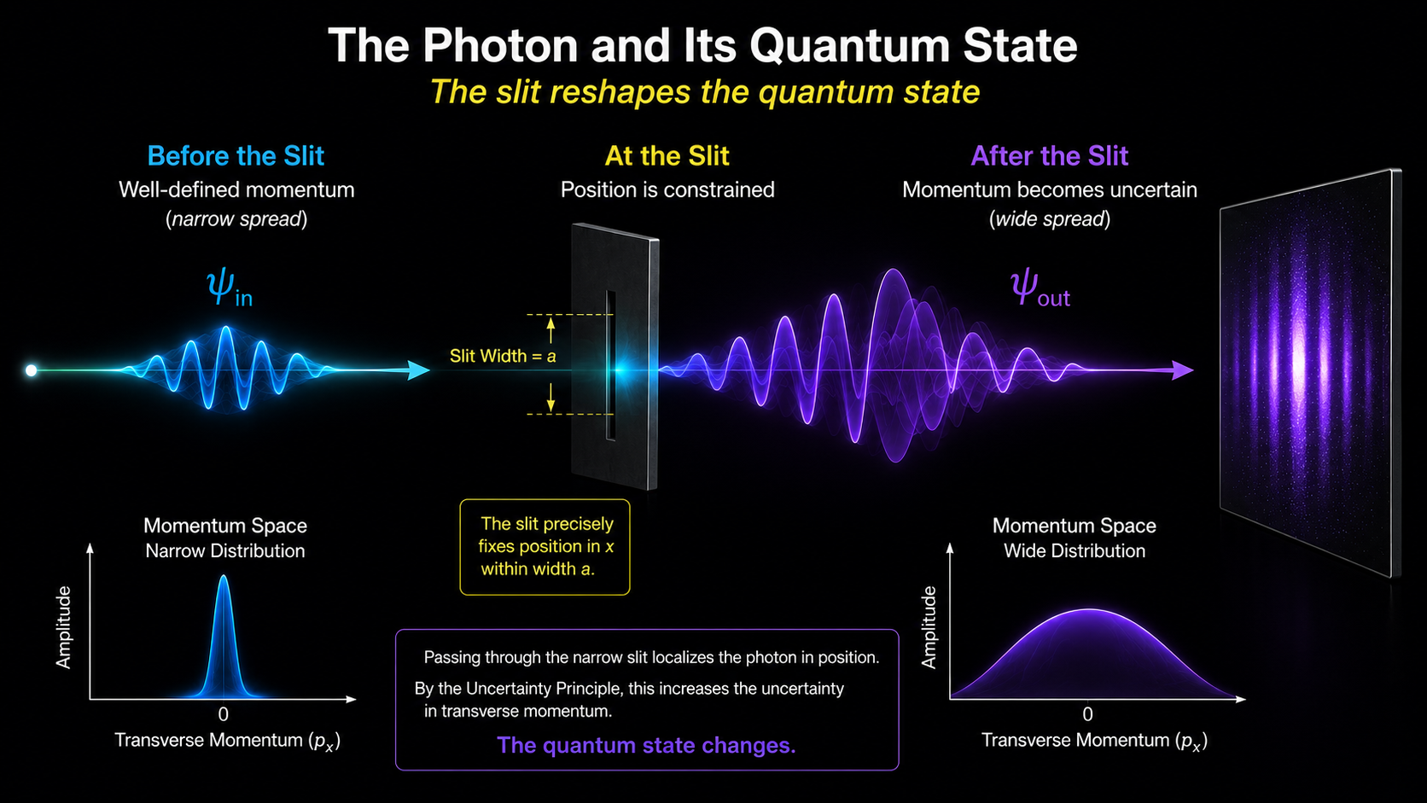
The Quantum State Changes After Passing Through the Slit
The quantum state has changed.
It now contains
  The probability amplitudes
  The phase relationships
  The complete probability structure
For every possible detection point on the screen.
The prediction is now encoded in the evolved quantum state.

Slide 28
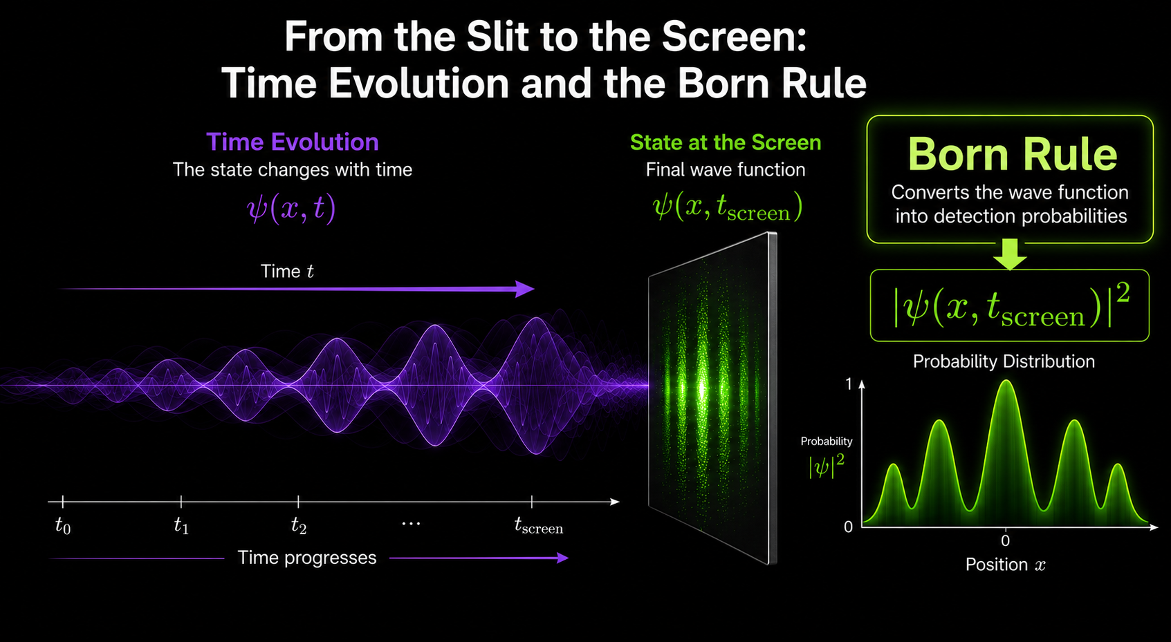

Converting Amplitudes into Probabilities
The Born Rule converts the probability amplitudes contained in the quantum state into measurable probabilities.
$$P\left(x\right)=∣ψ\left(x\right)∣^{2}$$
The Born Rule converts the evolving quantum state into experimentally testable predictions.

Slide 29
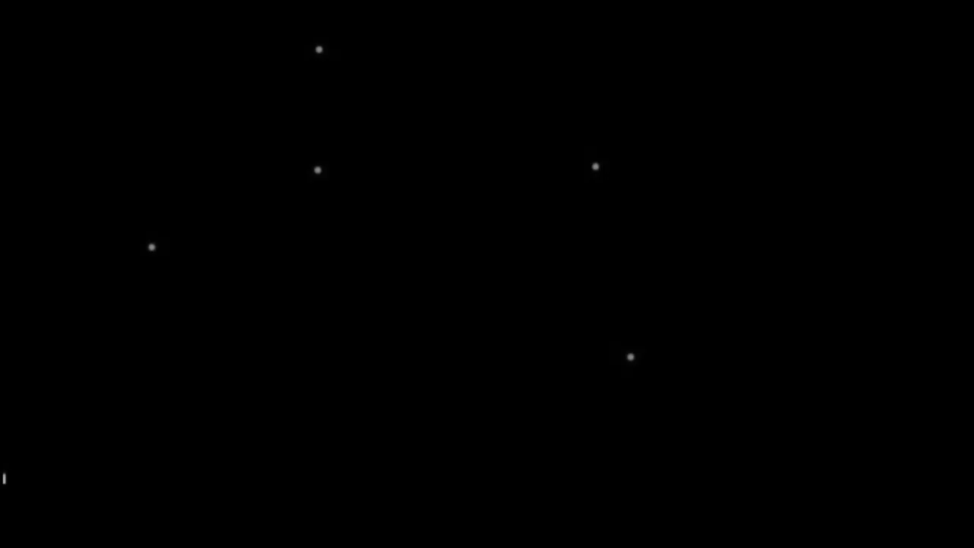

Slide 30
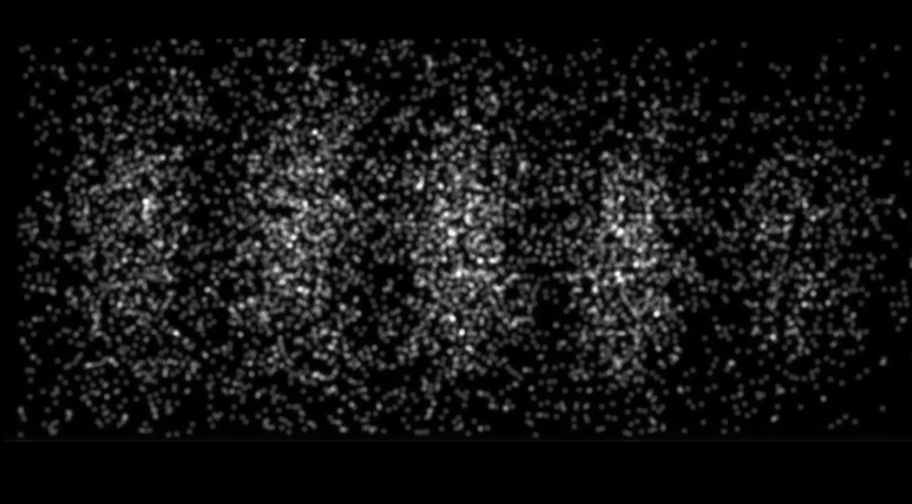

Slide 31
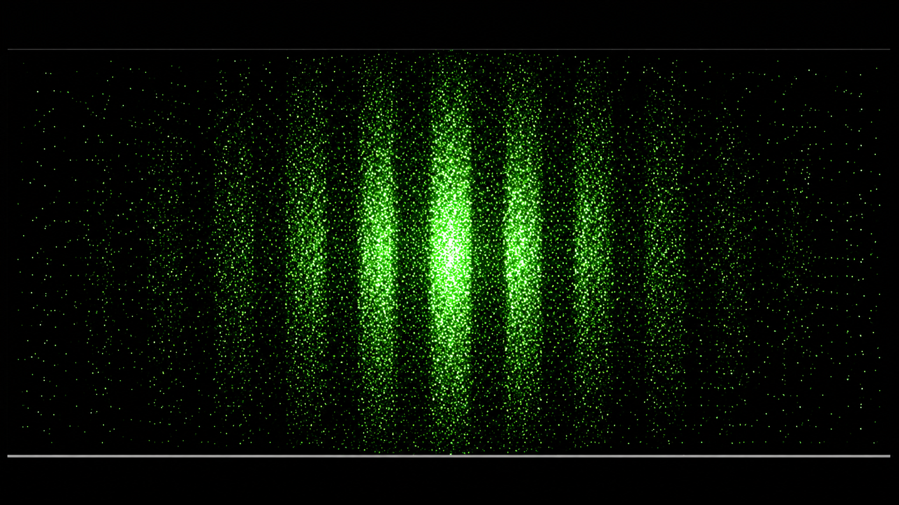

Slide 32
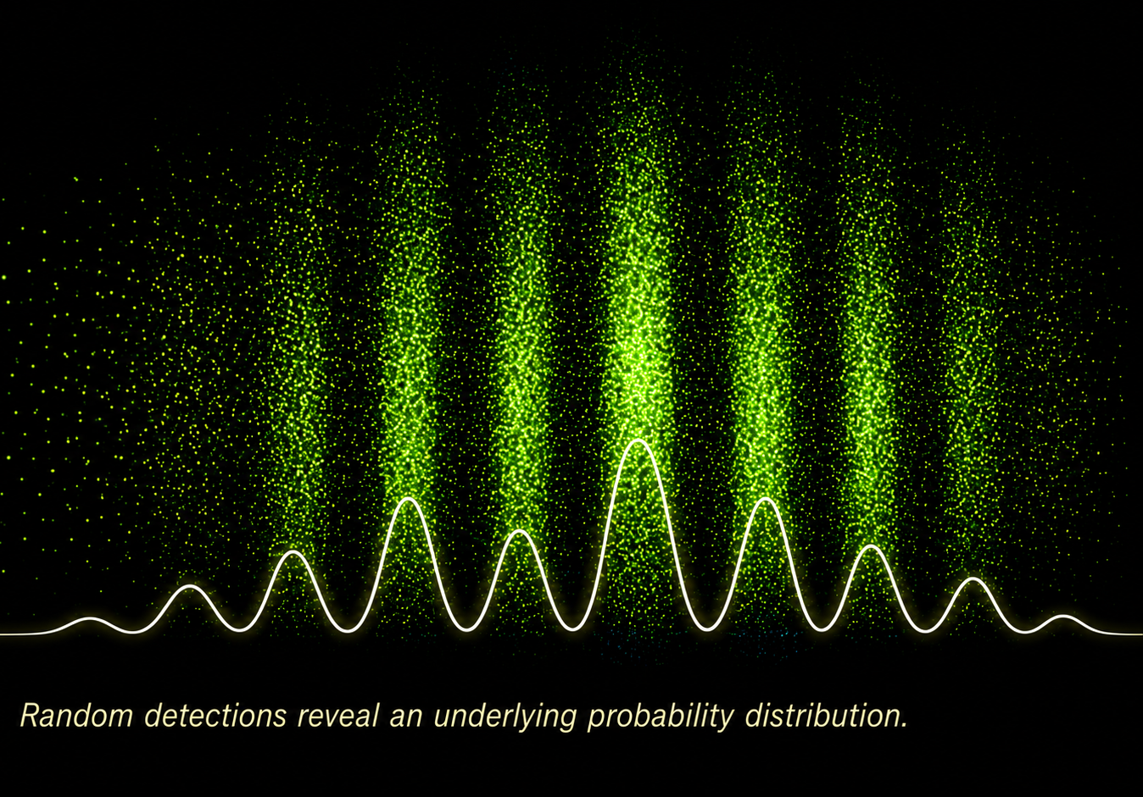
What Did We Just See?
We watched exactly what the model predicted:
  Each photon arrived as a single detection.
  Each detection appeared random.
  Yet together they formed the probability distribution predicted by the Quantum State Machine.
The Quantum State Machine predicts the probability distribution—not the landing position of any individual photon.
What we just witnessed in the video was Conway-Kochen free will in action: individual photon detections remained underdetermined—even though the overall probability distribution was precisely predicted.

Slide 33
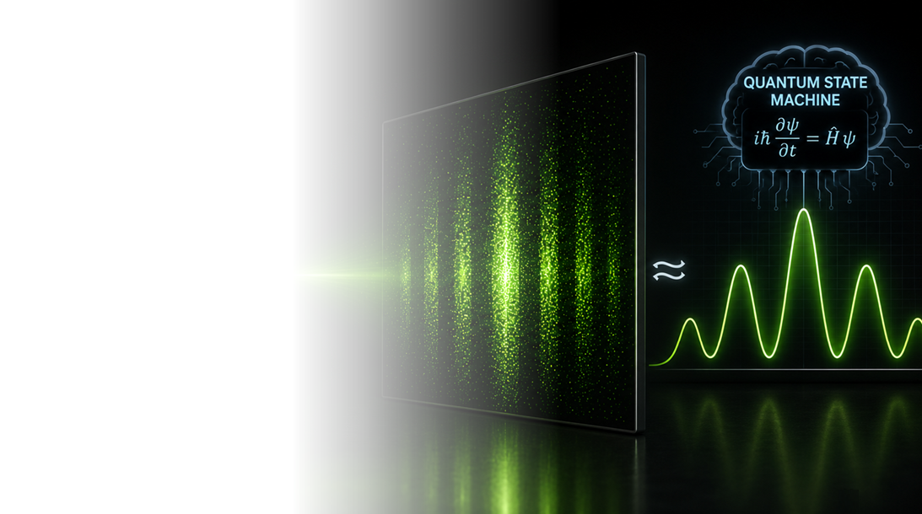
The Amazing Achievement of the Quantum State Machine Model
The Quantum State Machine correctly Predicts
  ✓ Beam spread
  ✓ Bright regions
  ✓ Dark regions
  ✓ Complete probability distribution
  ✓ Statistical accumulation of individual photon detections
  ✓ The experimentally observed diffraction pattern
The Quantum State Machine predicts every experimentally observable statistical feature of the single-slit experiment.

Slide 34
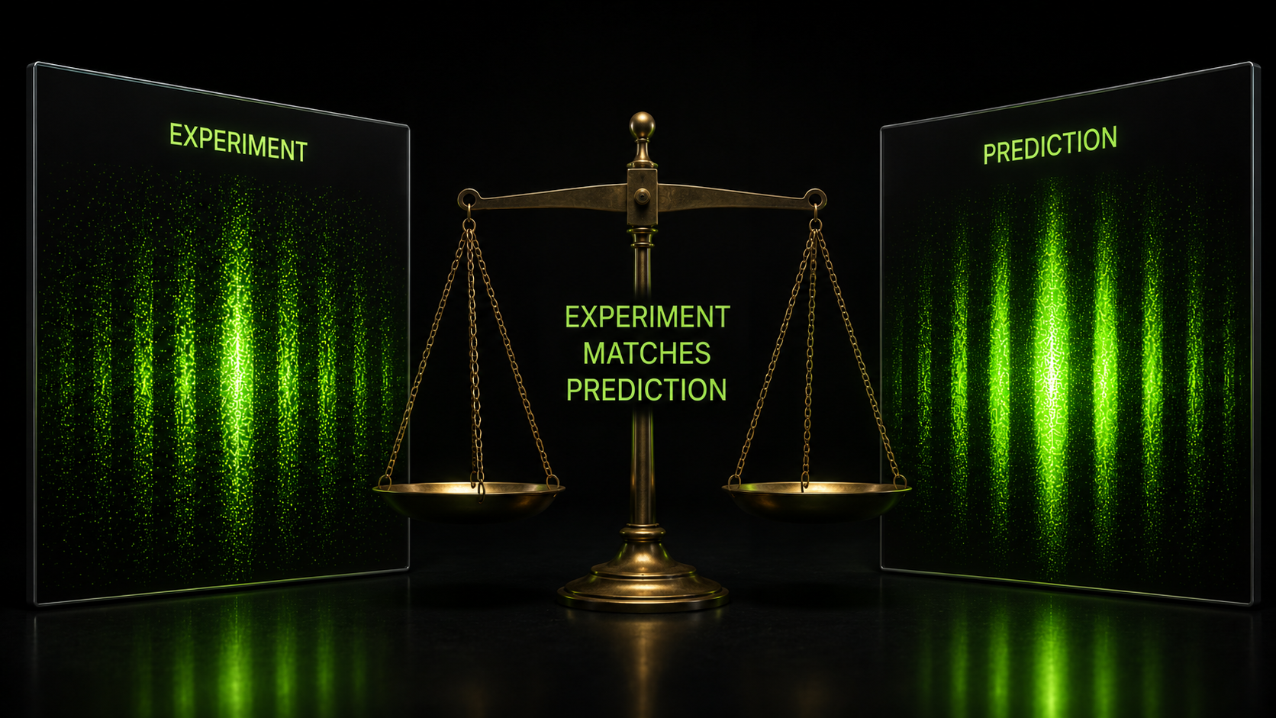
The Quantum State Machine Model Also Predicts the Free Will of the Photons
The Quantum State Machine predicts
  ✓ the probability of every possible outcome.
It does not predict
  ✗ which individual photon will be detected next.
What we just witnessed in the video was Conway-Kochen free will in action: individual photon detections remained underdetermined—even though the overall probability distribution was precisely predicted.
The Quantum State Machine predicts not only the probability distribution—it also predicts that the individual detection events remain underdetermined, consistent with the Conway-Kochen free will we just observed in the video.

Slide 35
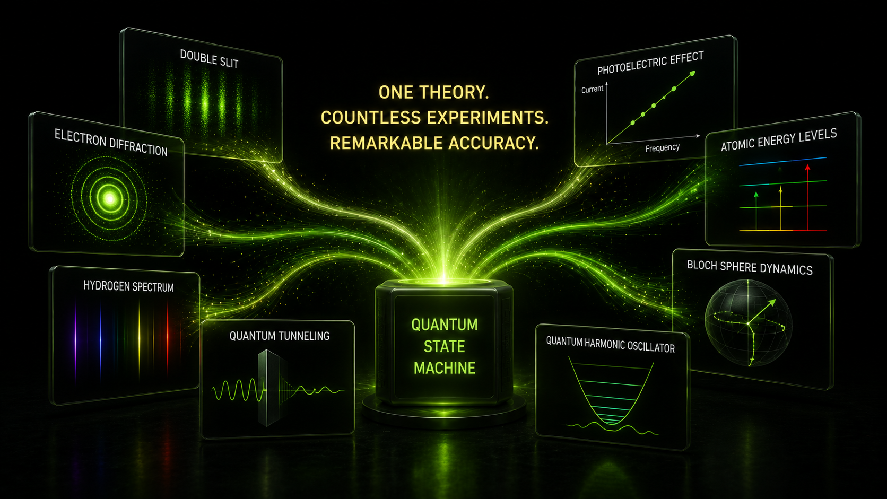
Three Models...One Complete Understanding
The single-slit experiment has taught us some important lessons:
  Maxwell's equations explain the wave nature of light.
  Heisenberg's Uncertainty Principle explains why the beam spreads.
  The Quantum State Machine incorporates both and predicts everything that modern physics can predict about the single-slit experiment—including the underdetermined nature of the individual detection events.
Its extraordinary predictive success makes the Quantum State Machine one of the greatest scientific models ever developed.
35

Slide 36
Three Models...One Complete Understanding
The single-slit experiment has taught us some important lessons:
  Maxwell's equations explain the wave nature of light.
  Heisenberg's Uncertainty Principle explains why the beam spreads.
  The Quantum State Machine incorporates both and predicts everything that modern physics can predict about the single-slit experiment—including the underdetermined nature of the individual detection events.
Its extraordinary predictive success makes the Quantum State Machine one of the greatest scientific models ever developed.
36

Slide 37
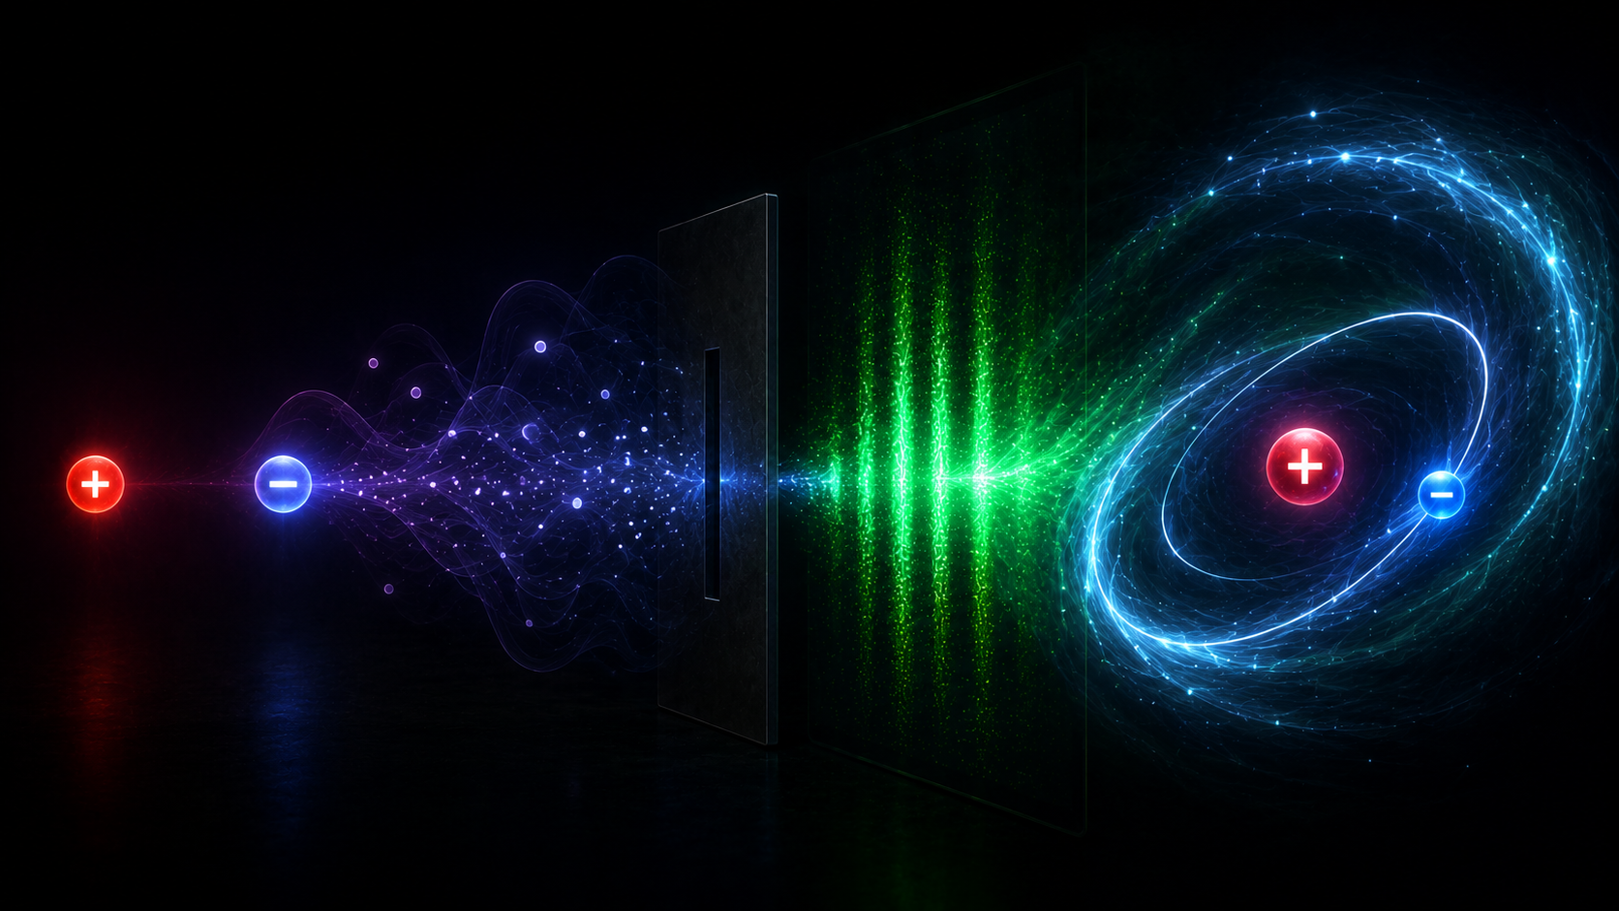
Next Time...
Can the Quantum State Machine Build an Atom?
  Today we used the Quantum State Machine to predict the single-slit experiment.
  Next time we will use the same Quantum State Machine to answer a much bigger question.
Can it predict the structure of an atom?
  We will begin with a single proton and a single electron.
  We will allow the Quantum State Machine to evolve the quantum state.
  We will watch a hydrogen atom emerge.
The same Quantum State Machine that predicts the single-slit experiment also predicts the existence of atoms.

Slide 38


