Slide 1


Process Theology as a Lens for Bringing Quantum Physics into Focus
Dr. Michael A. Soderstrand, PhD
Lecture 7: Bound States: The Hydrogen Atom
and Stable Matter → Enduring Relations
(Societies with inherited order)

Slide 2
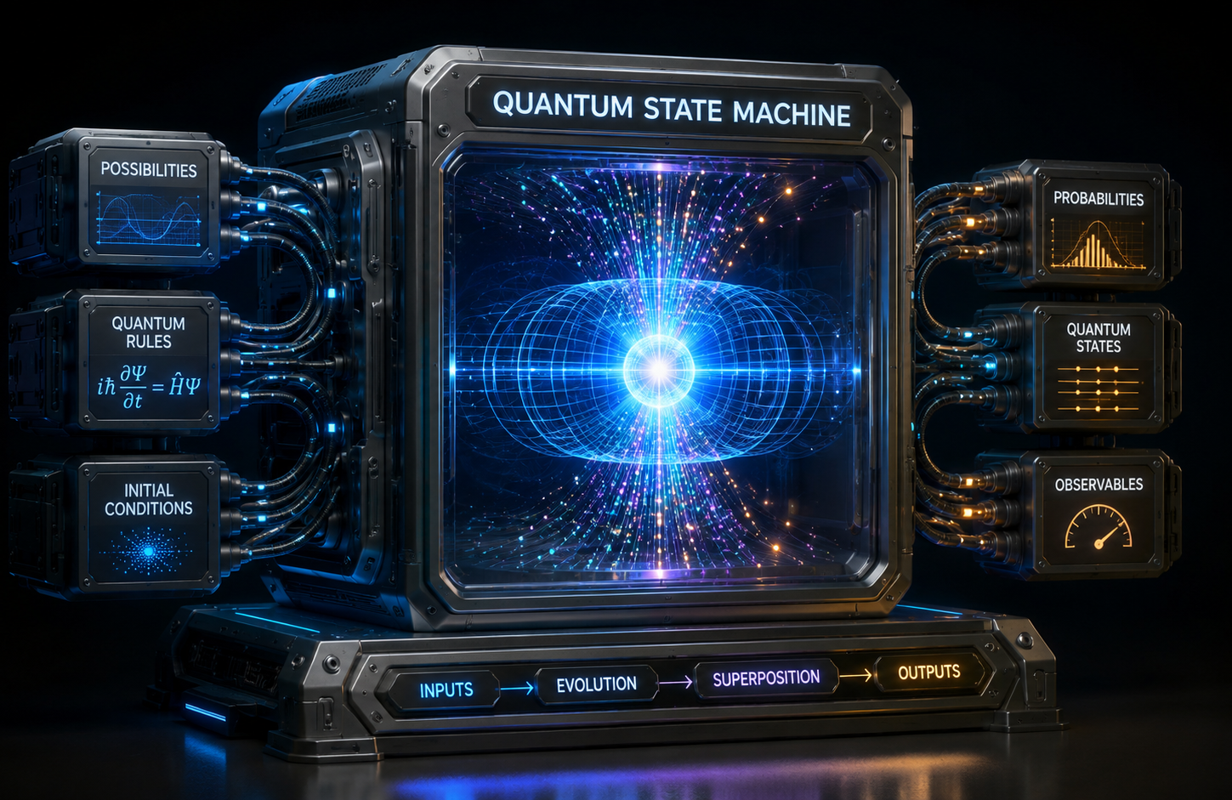
Can the Quantum State Machine Build an Atom?
From Stable Hadrons to Hydrogen
  In our last lecture, we used the Quantum State Machine to build hadrons.
  Today we take the next step.
  Can the same machinery build atoms?

Slide 3
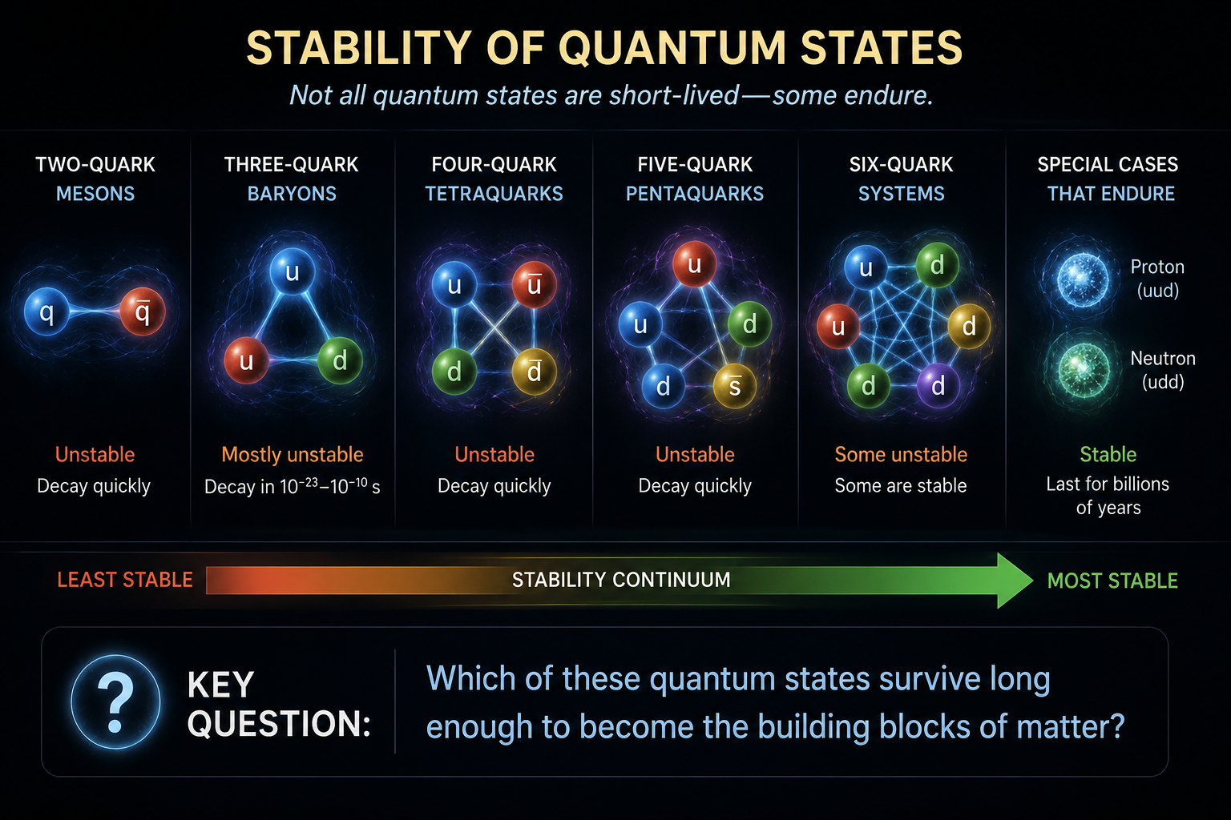
Review: What Did We Build?
Back in Lecture 5 we used the Quantum State Machine to build:
  Two-quark mesons
  Three-quark baryons
  Four-quark tetraquarks
  Five-quark pentaquarks
  Six-quark systems
Key Question
  Which of these quantum states survive long enough to become the building blocks of matter?

Slide 4
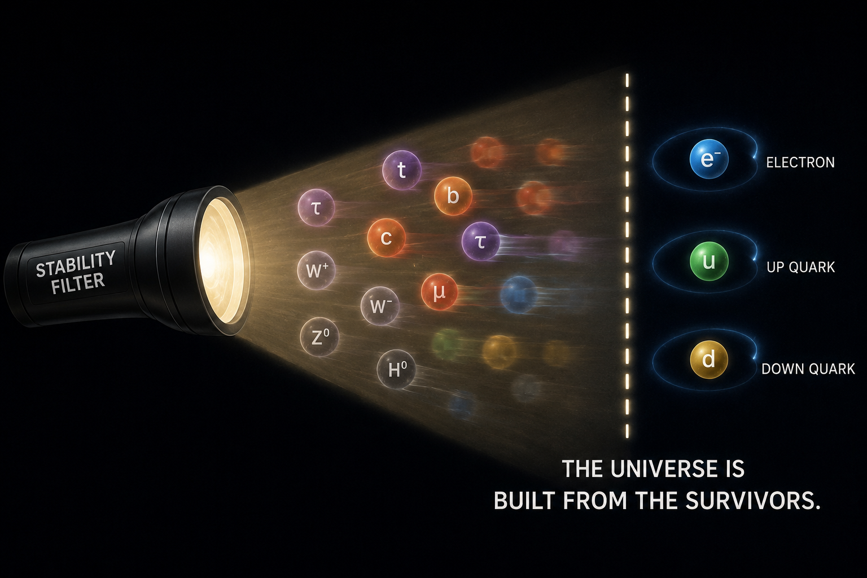
Stability Matters
Of the eighteen elementary particles in the Standard Model:
  Most decay rapidly
  Heavy quarks decay
  Muons and taus decay
  W, Z, and Higgs bosons decay
Among the particles that make ordinary matter:
  Electron is stable
  Up quark is stable
  Down quark is stable
The universe is built from the survivors.

Slide 5
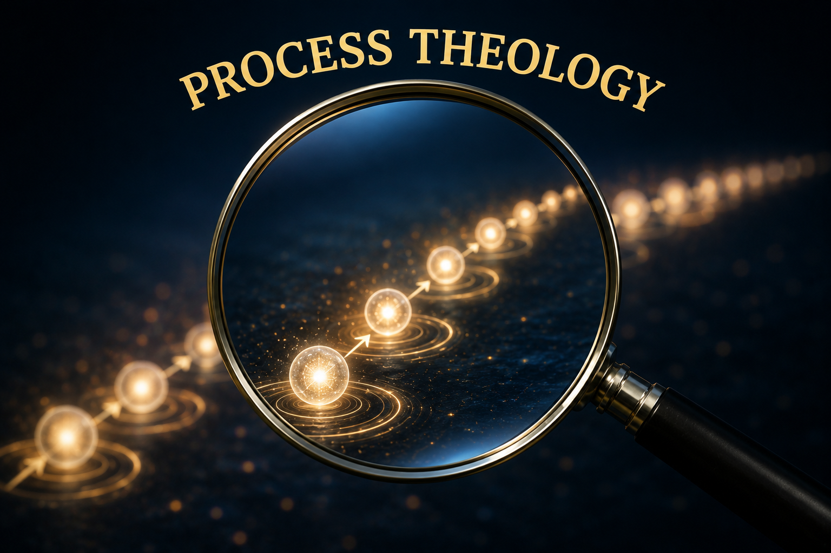
Particle Detections and Actual Occasions
Every Particle Detection is an Actual Occasion
  Every detected particle is a momentary event.
  It exists only in the present.
  It is immediately succeeded by the next actual occasion.
  Even particles that appear "persistent" are experienced as a succession of new actual occasions.
  Reality unfolds as an ongoing sequence of events rather than enduring objects.

Slide 6
The Consequent and Primordial Nature of God
Through the Process Lens
Consequent Nature
  Every particle detection becomes an actual occasion.
  Each actual occasion is immediately received into God's consequent nature.
  Reality unfolds one event at a time.
Primordial Nature
  Provides the mathematical possibilities expressed as the laws of physics.
  The Quantum State Machine embodies those laws.
  Those laws determine which particles remain stable and which decay.

Slide 7
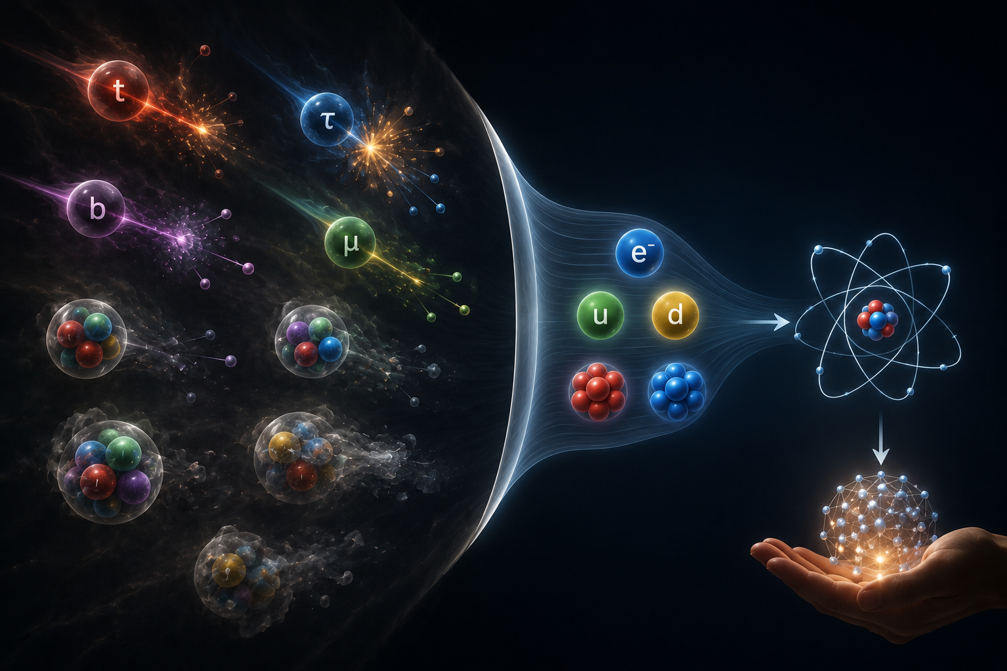
Why Ordinary Matter Exists
Most Particles Are Temporary
  Heavy quarks rapidly decay into lighter particles.
  Muons and tau particles are unstable.
  Most hadrons exist for only tiny fractions of a second.
Only a small family of particles remains stable long enough to build the ordinary universe:
  electrons
  up quarks
  down quarks
  protons
  neutrons
These enduring particles become the building blocks of atoms and ordinary matter.

Slide 8
The Superjective Nature: The Lure Toward Enduring Patterns
Through the Process Lens
Superjective Nature
  God lures creation toward enduring patterns of order and complexity.
  This lure never overrides the laws of physics.
Instead, stable structures emerge because the laws of physics make them possible.
  Enduring particles become atoms.
  Atoms become chemistry.
  Chemistry becomes stars, planets, and eventually life.
The Quantum State Machine describes how these stable patterns emerge.
  The Process Lens offers one way of understanding why enduring patterns have such profound significance in the unfolding of reality.

Slide 9
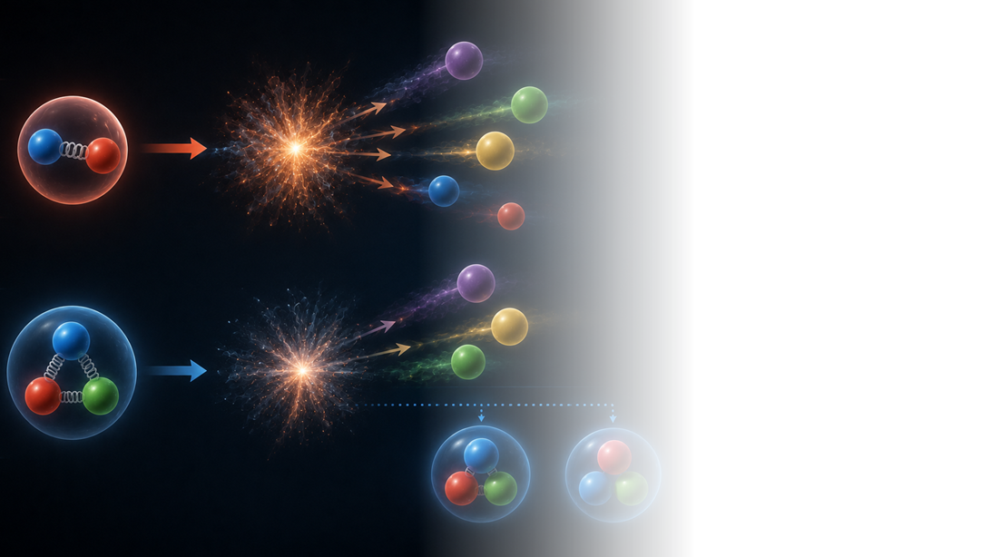
The Fate of the Hadrons
Mesons (2 quarks)
  All mesons eventually decay
  None are permanent building blocks of matter
Baryons (3 quarks)
  Most baryons decay.
Two are special:
  Proton
  Neutron
These become the foundation of everything around us.

Slide 10
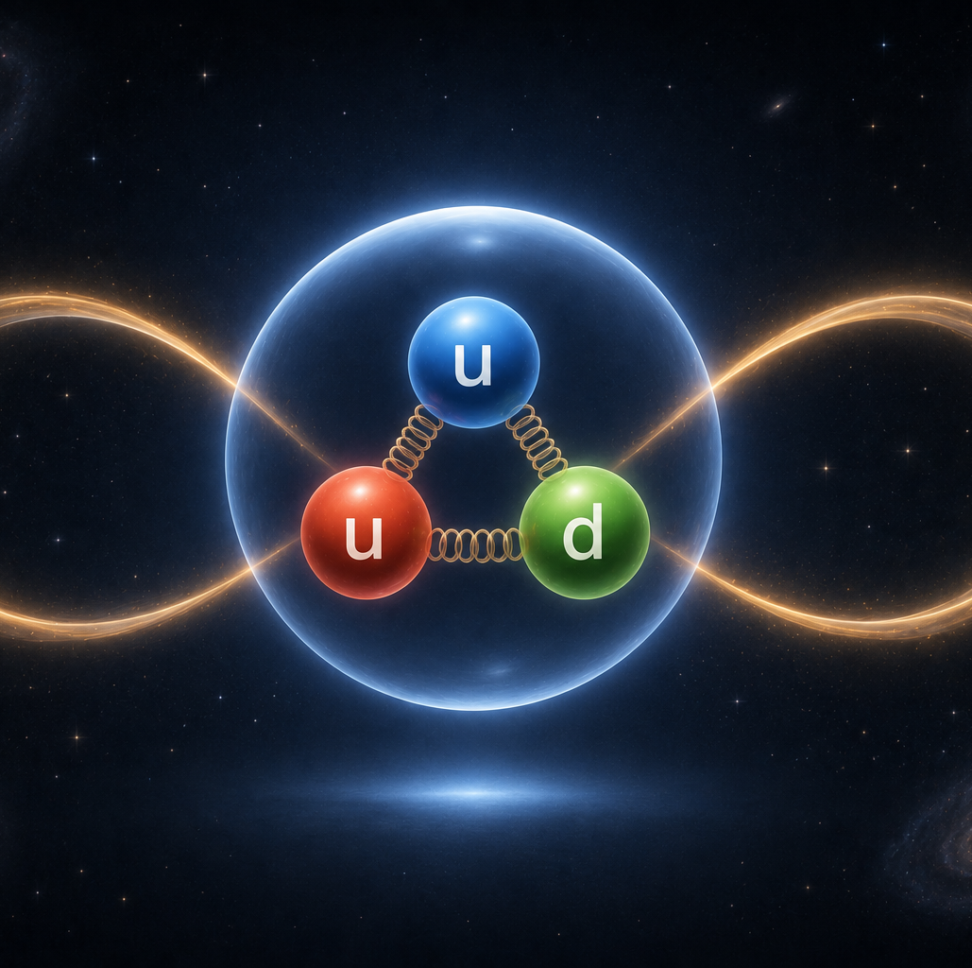
The Champion of Stability
Proton (uud)
  No proton decay has ever been observed
  Experimental limits exceed 10³⁴ years
  The proton may be the most stable massive particle in the universe.
  Every atom depends on its stability.

Slide 11
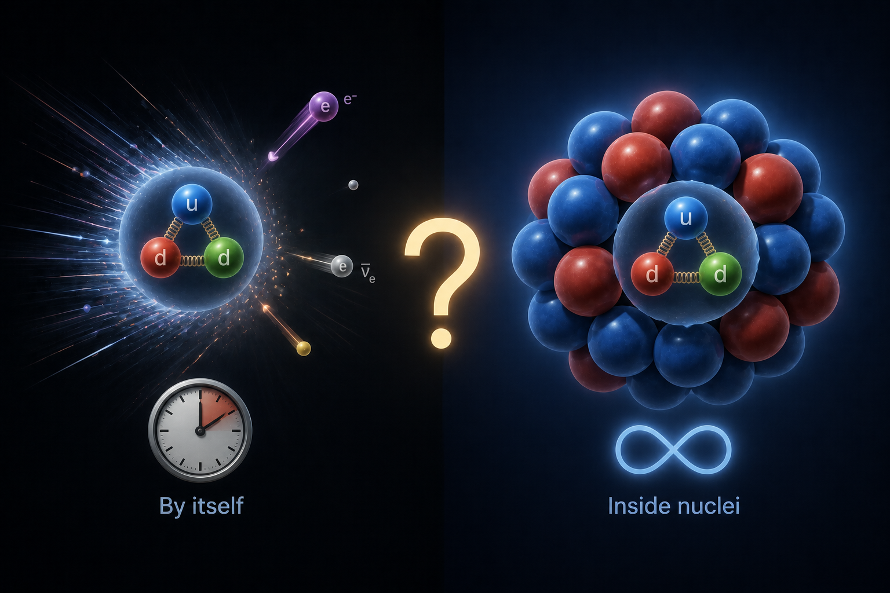
The Curious Case of the Neutron
Neutron (udd)
By itself:
  Half-life ≈ 15 minutes
Inside many nuclei:
  Stable for billions of years
Question: What changed?
  The neutron did not change.
  The quantum state changed.

Slide 12
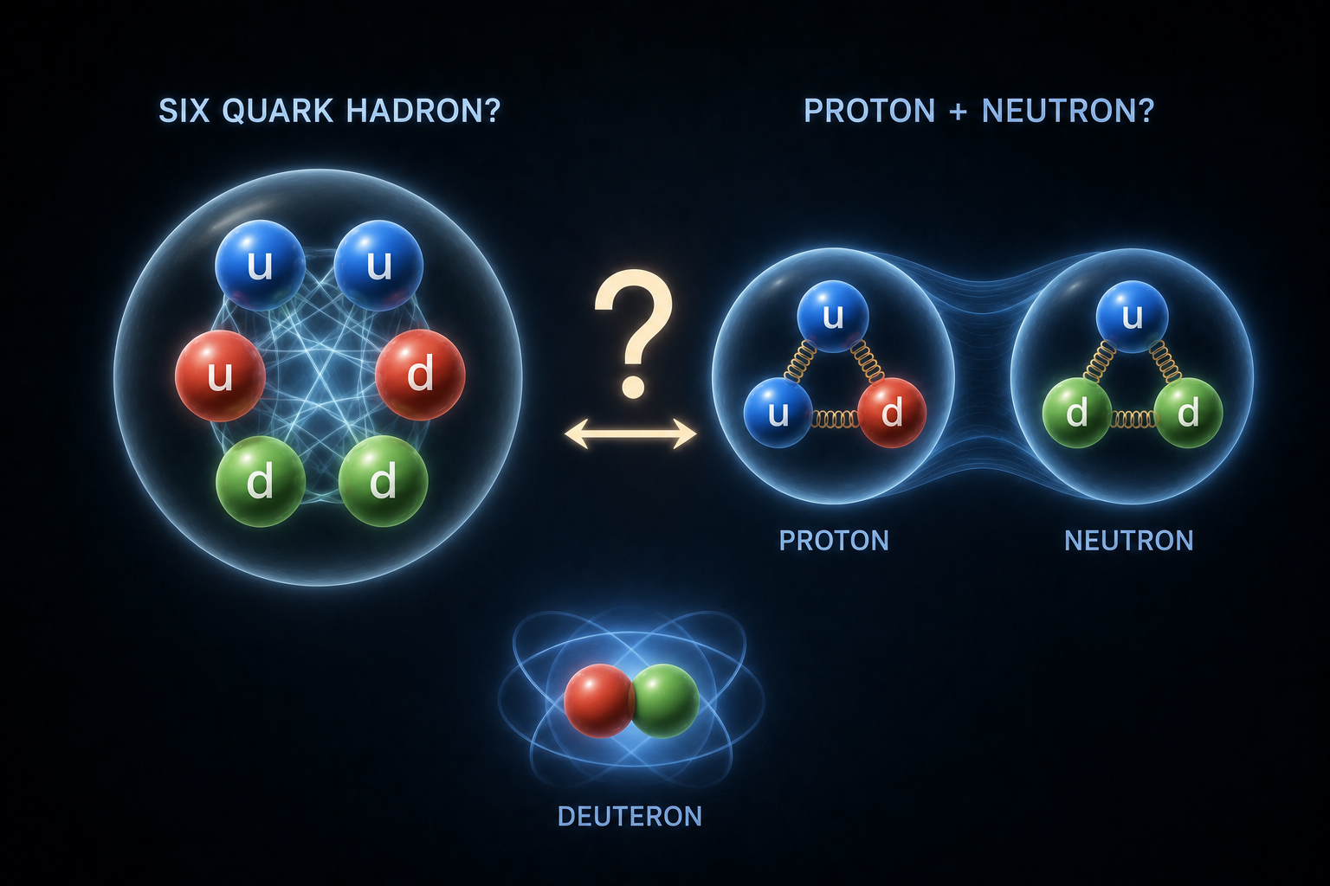
Remember the Six-Quark Hadron
Combine:
  One proton (uud)
  One neutron (udd)
Total: Six quarks
  This combination forms the deuteron.
  The simplest stable nucleus containing a neutron.

Slide 13
Remember the Six-Quark Hadron
What Did We Actually Build?
Did we build:
  A six-quark hadron?
  or
  A proton and neutron bound together?

Slide 14
Remember the Six-Quark Hadron
The Answer Is Both
At the quark level:
  The deuteron contains six interacting quarks.
At the nuclear level:
  It behaves like a proton and a neutron bound together.
These are two different descriptions of the same quantum system

Slide 15
Remember the Six-Quark Hadron
What Holds the Deuteron Together?
  Not the strong force that confines quarks inside a proton.
  Not the strong force that confines quarks inside a neutron.
Instead...
  There is a residual strong interaction that acts between the proton and neutron.
  This residual force binds them into a stable nucleus.
That is why physicists don't usually call the deuteron a six-quark hadron.

Slide 16
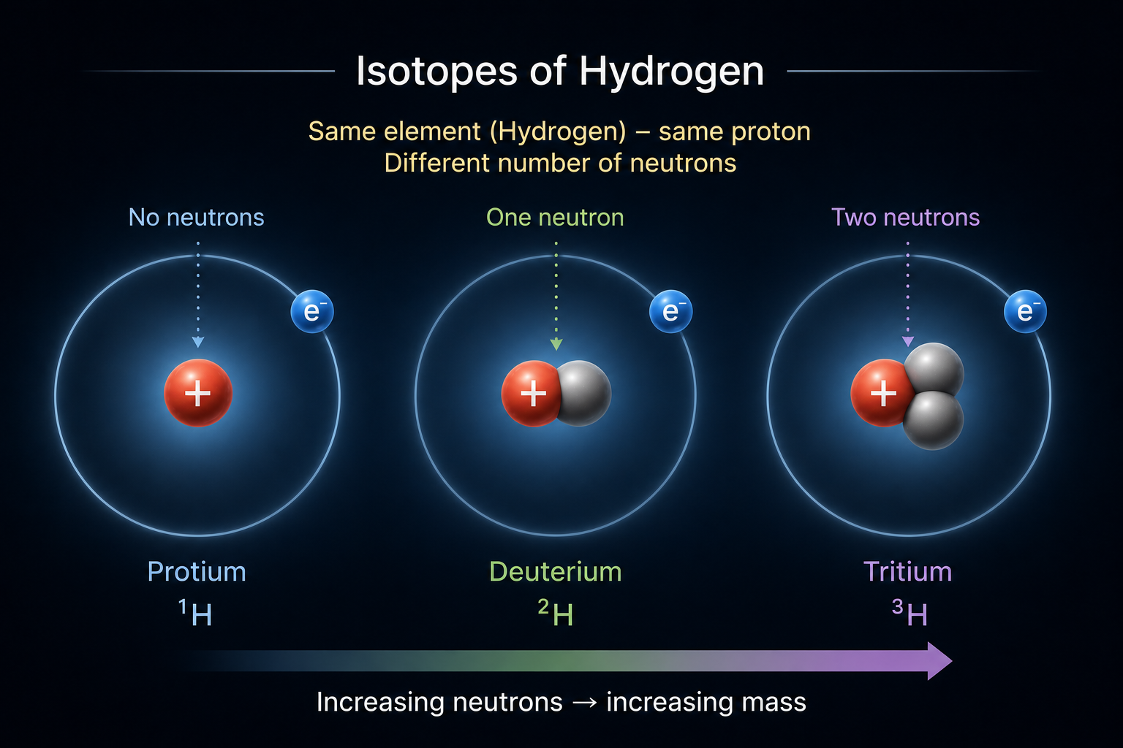
Hydrogen Is More Than One Nucleus
A hydrogen nucleus always contains
  one proton.
But it may contain
  no neutrons
  one neutron
  two neutrons
These are different isotopes of hydrogen.

Slide 17
The Three Isotopes of Hydrogen
Protium
  1 proton
  0 neutrons
Deuterium
  1 proton
  1 neutron
Tritium
  1 proton
  2 neutrons
All three are isotopes of hydrogen.
  Changing the number of neutrons changes the isotope—not the element.
  Unless otherwise specified, "hydrogen" refers to protium (¹H).

Slide 18
The Three Isotopes of Hydrogen
The element with one proton is called hydrogen.
  Adding a neutron does not create a new element.
  Instead, it creates a new isotope.
However, the naming convention is:
  One proton → Hydrogen
  One proton + one neutron → Deuterium
  One proton + two neutrons → Tritium
The number of protons determines the element.
The number of neutrons determines the isotope.

Slide 19
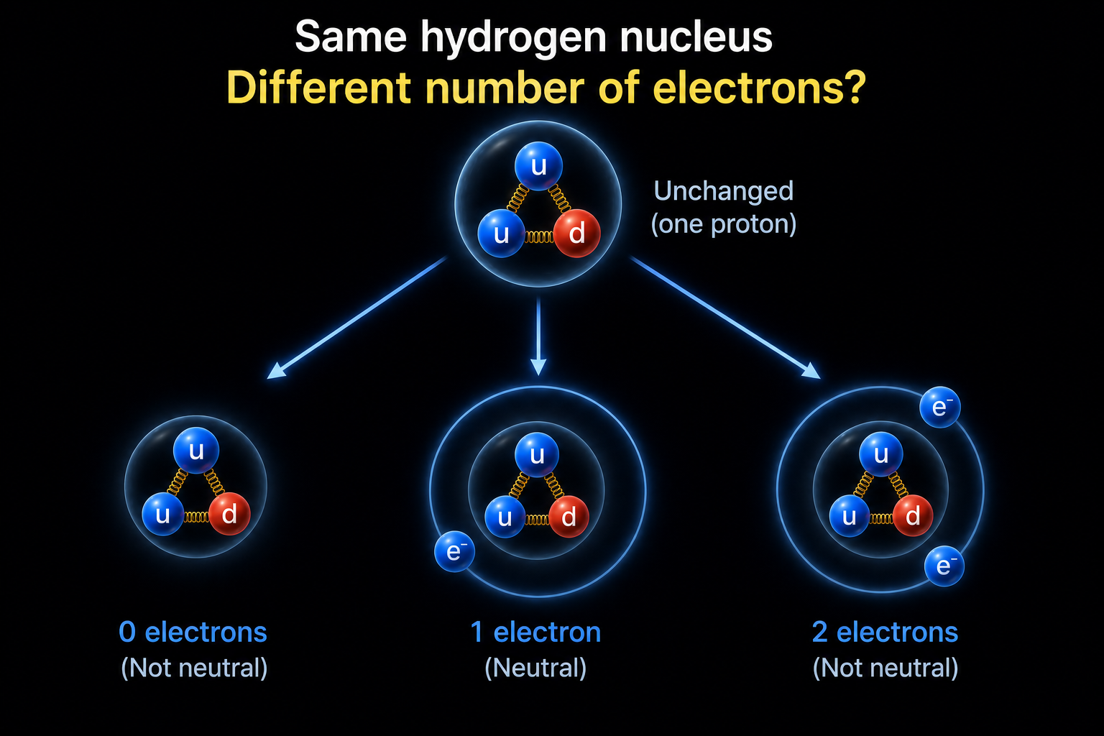
A Different Question
Suppose we leave the nucleus completely unchanged.
Instead...
  What if we change the number of electrons?
  Does it become a different element?

Slide 20
Ionization
A hydrogen nucleus may have:
  no electrons
  one electron
  two electrons.
These are different ionization states.
Every hydrogen atom can exist in different ionization states

Slide 21
Ionization
Changing Electrons Changes the Ionization State
Hydrogen can exist as
  H⁺ (no electrons)
  H (one electron)
  H⁻ (two electrons)
Adding or removing electrons changes the ionization state.
  It does not change the element.

Slide 22
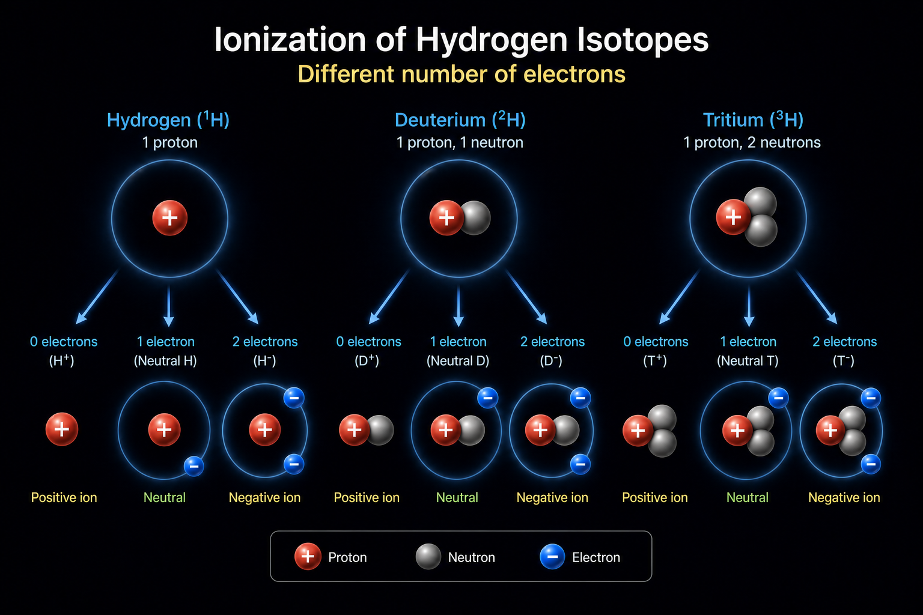
Ionization
These are different ionization states.
  Hydrogen may be ionized.
  Deuterium may be ionized.
  Tritium may be ionized.
Every hydrogen isotope can exist in different ionization states.

Slide 23

D = deuterium (²H)
  1 proton
  1 neutron
  Stable
  Often called "heavy hydrogen"
T = tritium (³H)
  1 proton
  2 neutrons
  Radioactive, with a half-life of about 12.3 years
Although H, D and T are widely accepted symbols in chemistry and physics, their official isotopic notation are ¹H, ²H and ³H.
By convention, the three isotopes of hydrogen are commonly represented as:
H = ordinary hydrogen (protium, ¹H)
  1 proton
  0 neutrons
  About 99.98% of naturally occurring hydrogen
You'll see all six notations used

Slide 24
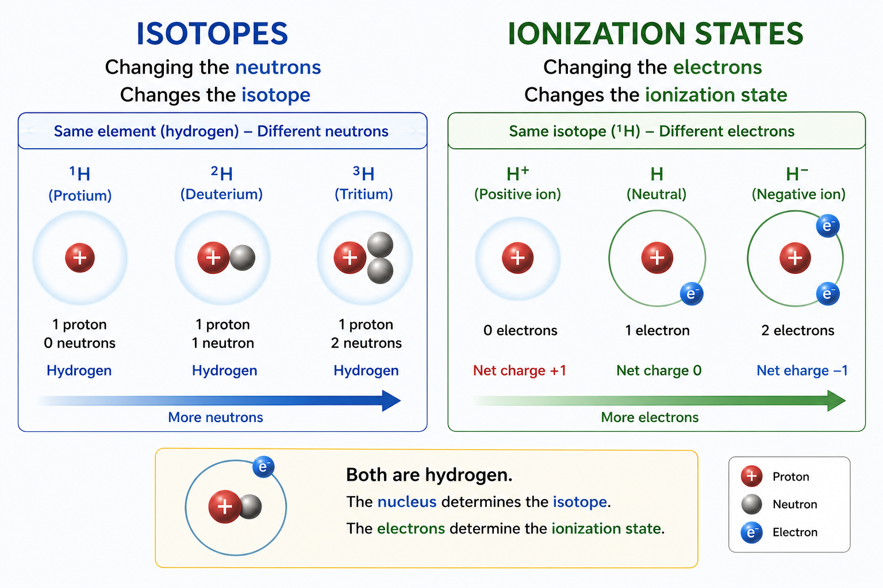

Two Different Ideas
Changing the neutrons
  Changes the isotope
Changing the electrons
  Changes the ionization state
Both are hydrogen.
  The nucleus determines the isotope.
  The electrons determine the ionization state.

Slide 25
Two Different Ideas
Changing the neutrons
  Changes the isotope
Changing the electrons
  Changes the ionization state
Both are hydrogen.
  The nucleus determines the isotope.
  The electrons determine the ionization state.

Slide 26
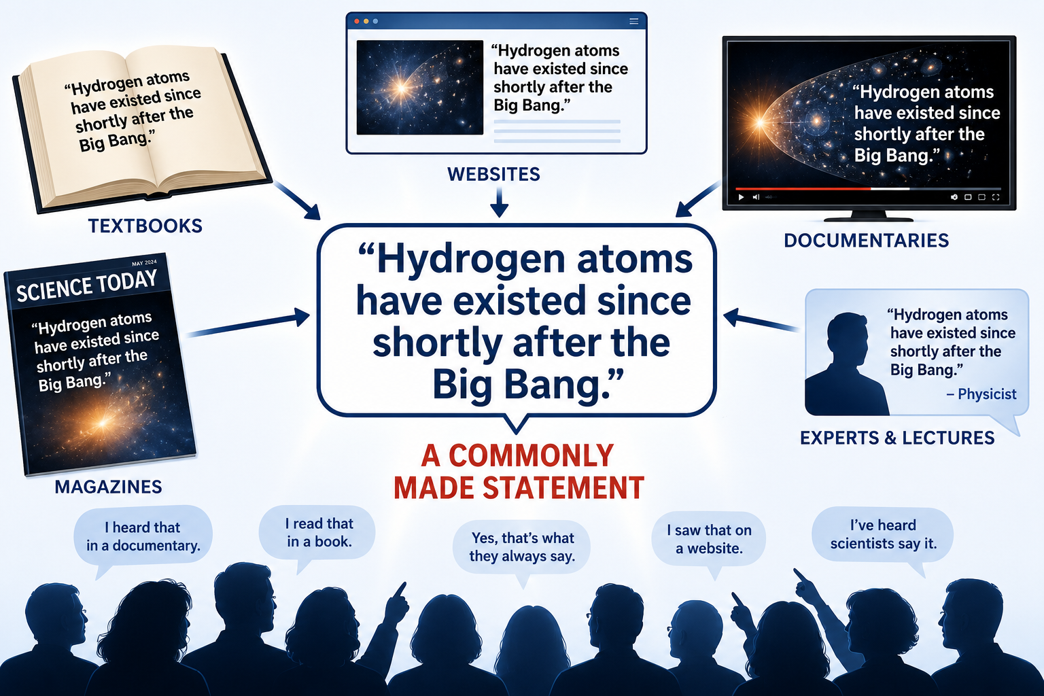
A Statement You Have Probably Heard
"Hydrogen atoms have existed since shortly after the Big Bang."
  This statement appears in books, documentaries, websites, and physics discussions.
  You'll hear Nick Lucent make exactly this statement in the video we will show in the next lecture.

Slide 27
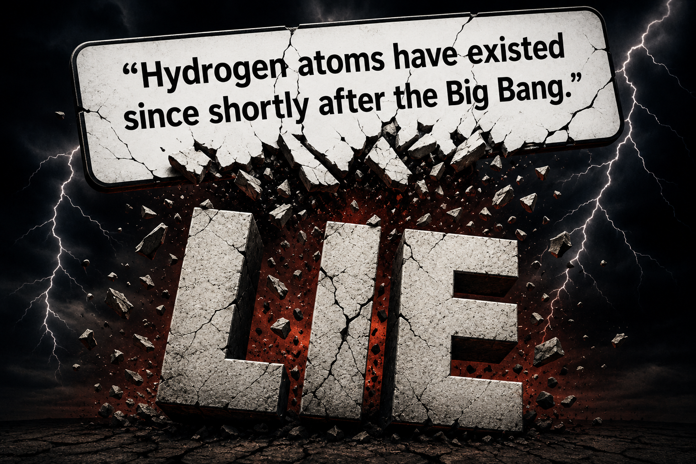
What If I Told You That Is a Lie?

Slide 28


What Physicists Really Mean
Here is the actual story:
  Most hydrogen nuclei (that is, single protons) were produced during Big Bang nucleosynthesis a few minutes after the Big Bang.
  Those nuclei have survived for nearly the entire history of the universe.
But that is not quite the same thing as saying:
  "Every hydrogen atom has existed since the Big Bang."

Slide 29
What Is a Hydrogen Atom?
Physicists define hydrogen by its nucleus:
  One Proton
  The electrons determine the ionization state.
Hydrogen can have:
  No electron
  One electron
  Two electrons
It is still hydrogen.

Slide 30
However, Not Every Proton Was Created Long Ago
New protons are created all the time.
  Nature creates new protons in energetic astrophysical environments.
  Physicists routinely create new protons in high-energy particle accelerators.
Therefore:
  Not every proton in the universe is 13.8 billion years old.

Slide 31
The Real Story
Most of the hydrogen nuclei around us were created only minutes after the Big Bang.
However, hydrogen atoms have repeatedly:
  Lost electrons
  Captured electrons
  Formed molecules
  Been incorporated into stars
  Been recycled through matter
The proton survives.
The hydrogen atom is continually reborn.

Slide 32
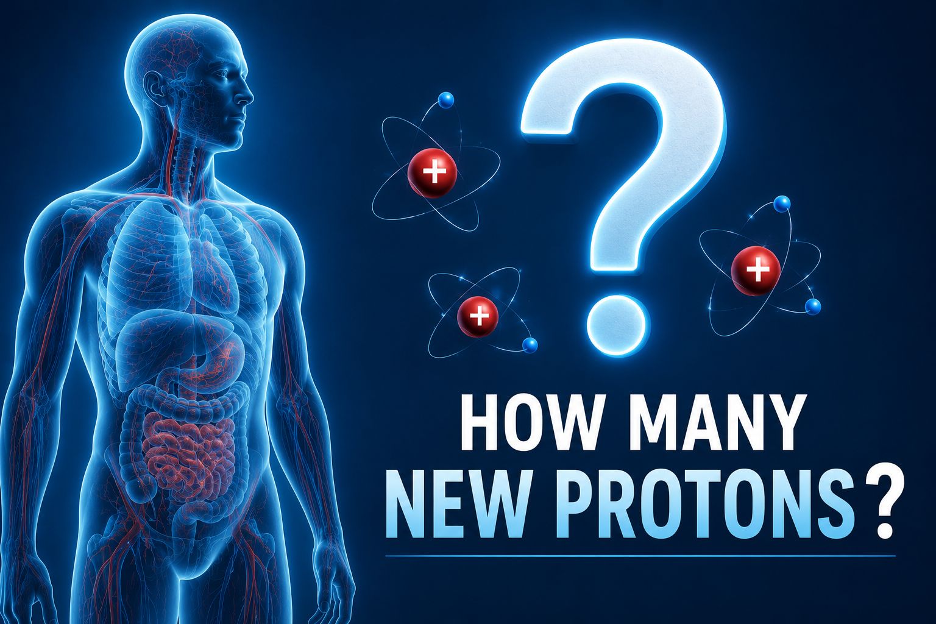
How Many Hydrogen Atoms in Your Body Were NOT Created Minutes After the Big Bang?
A typical 70 kg (154 lb) adult contains approximately
  4 × 10²⁷ hydrogen atoms
No one knows exactly what fraction of today's protons were created during Big Bang nucleosynthesis.
  For illustration only, suppose that 99.999999999999% of all protons came from the Big Bang.
  What would that mean?

Slide 33
How Many Hydrogen Atoms in Your Body Were NOT Created Minutes After the Big Bang?
The Answer May Surprise You
Even with that extraordinarily high percentage...
  Your body would still contain approximately 40 trillion hydrogen atoms that were NOT created minutes after the Big Bang.
Why?
  Because a tiny percentage of an enormous number is still an enormous number.

Slide 34
How Many Hydrogen Atoms in Your Body Were NOT Created Minutes After the Big Bang?
The “Big Lie” is Actually a “Small Lie”
  All of the hydrogen atoms in your body were created minutes after the Big Bang.
...that statement cannot be literally true.
  It is an excellent approximation.
  It is not an exact statement.

Slide 35
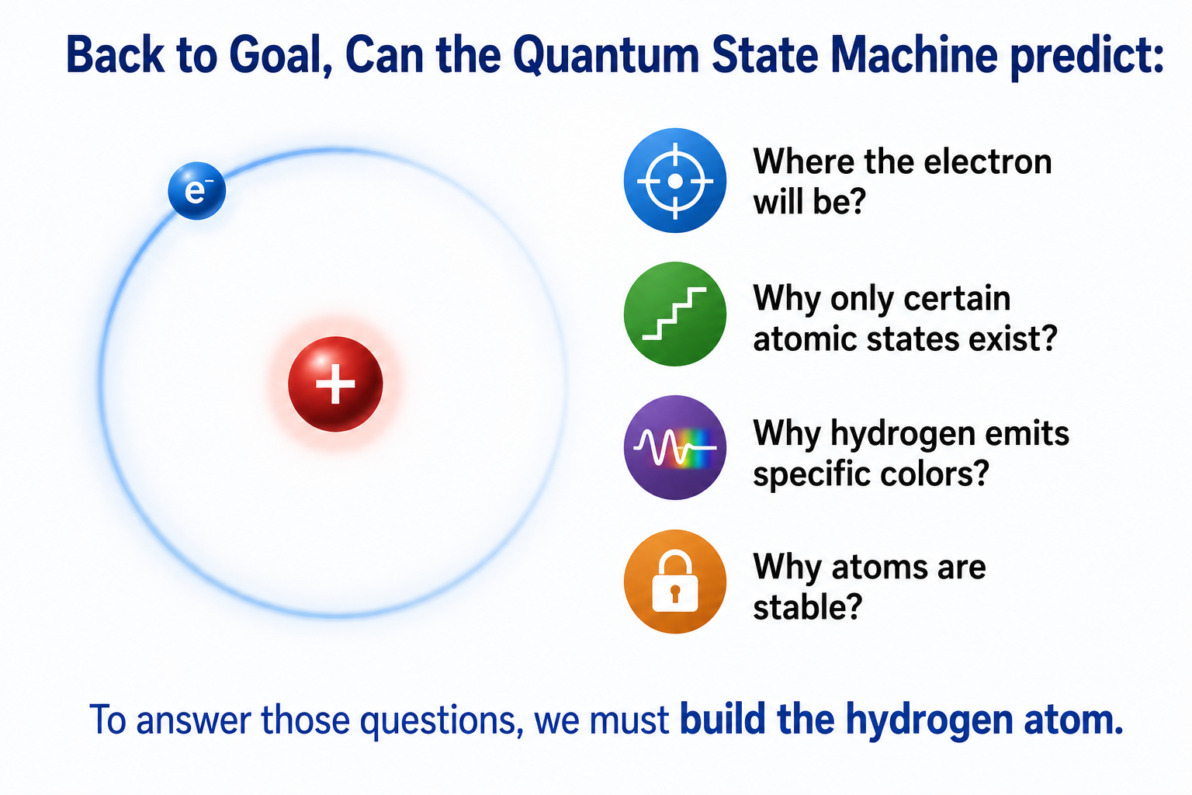
Back to Our Goal
Can the Quantum State Machine predict:
  Where the electron will be?
  Why only certain atomic states exist?
  Why hydrogen emits specific colors?
  Why atoms are stable?
To answer those questions, we must build the hydrogen atom.

Slide 36
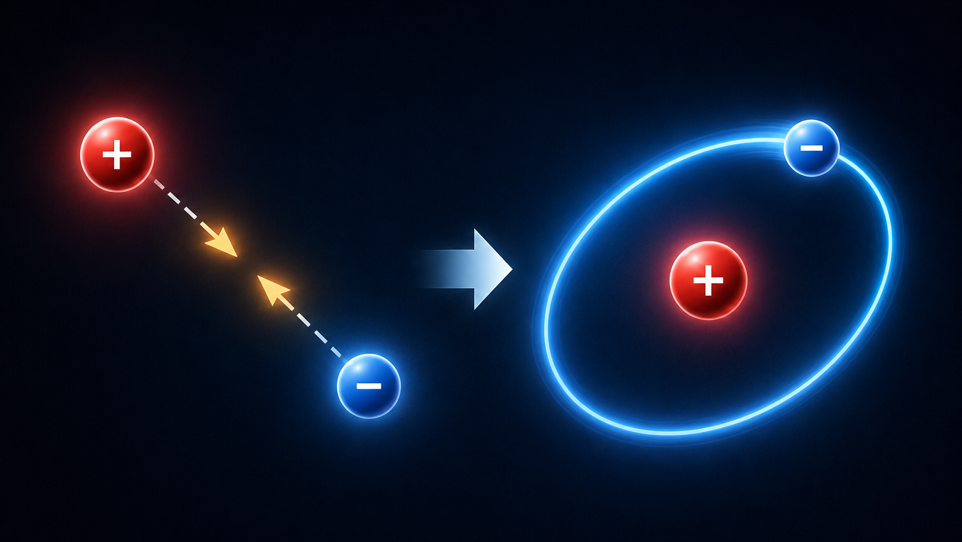
Building the Hydrogen Atom
Suppose we begin with:
  One proton
  One electron
  Initially separated by some distance.
The electric attraction between them pulls them together.
What happens next?

Slide 37
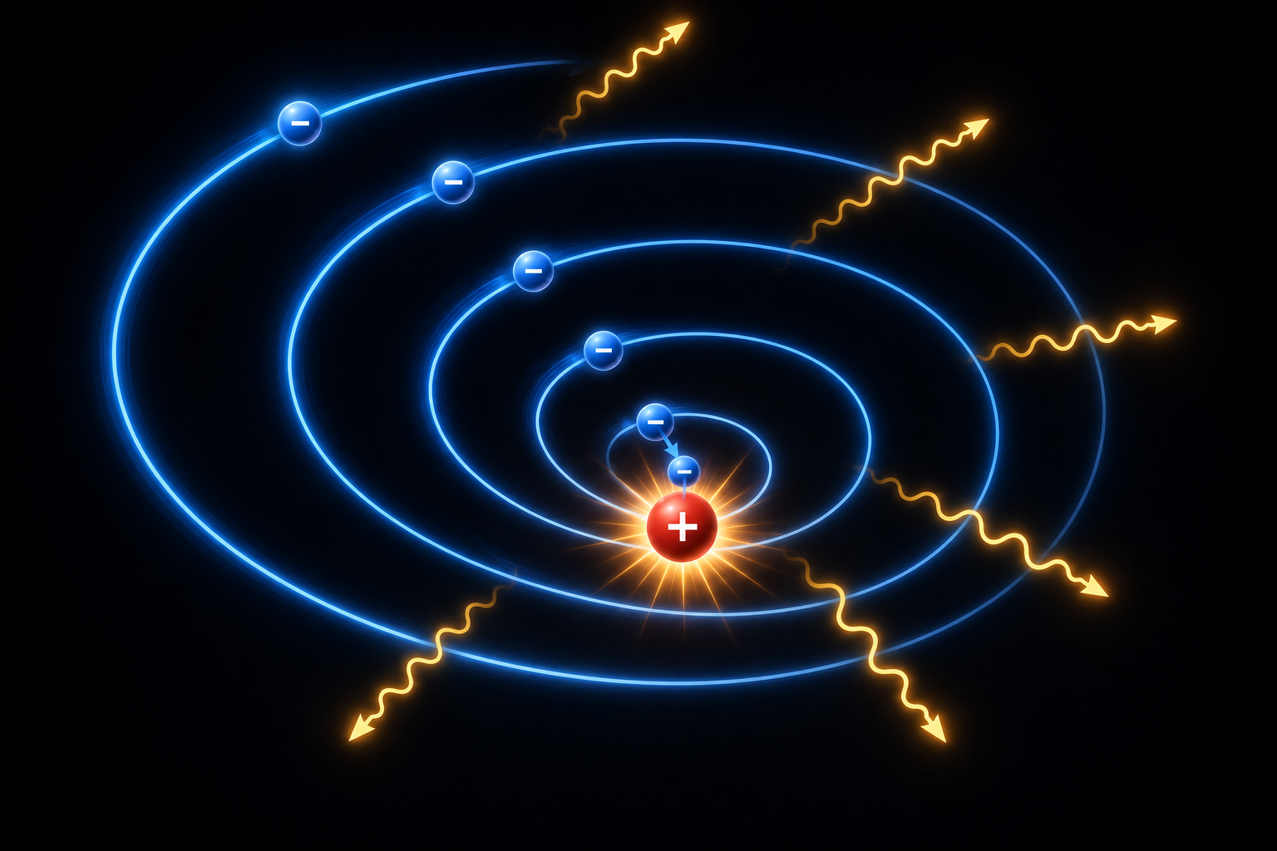
The Classical Prediction
According to classical physics:
  Opposite charges attract.
  The electron accelerates toward the proton.
  An accelerating electric charge radiates energy.
  The electron loses energy and spirals inward.
Eventually the electron crashes into the proton.

Slide 38
The Classical Conclusion
Classical physics predicts:
  Stable hydrogen atoms cannot exist.
  Stable chemistry cannot exist.
  Stable matter cannot exist.
Yet atoms clearly do exist.
  Classical physics predicts the wrong universe.
  If classical physics were correct, we would not exist!

Slide 39
What Went Wrong?
Everything seems correct:
  The electric attraction is correct.
  The mathematics of classical mechanics is correct.
The prediction is wrong because
  classical physics ignores the quantum nature of matter.
  A new principle is required.

Slide 40
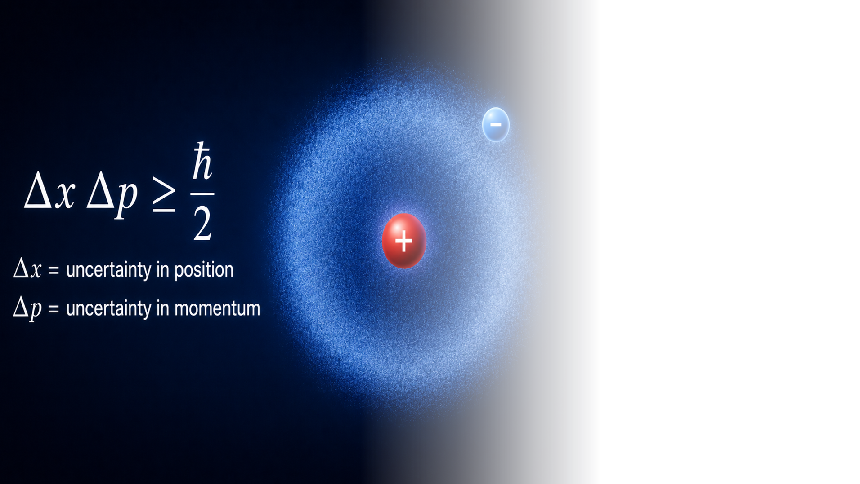
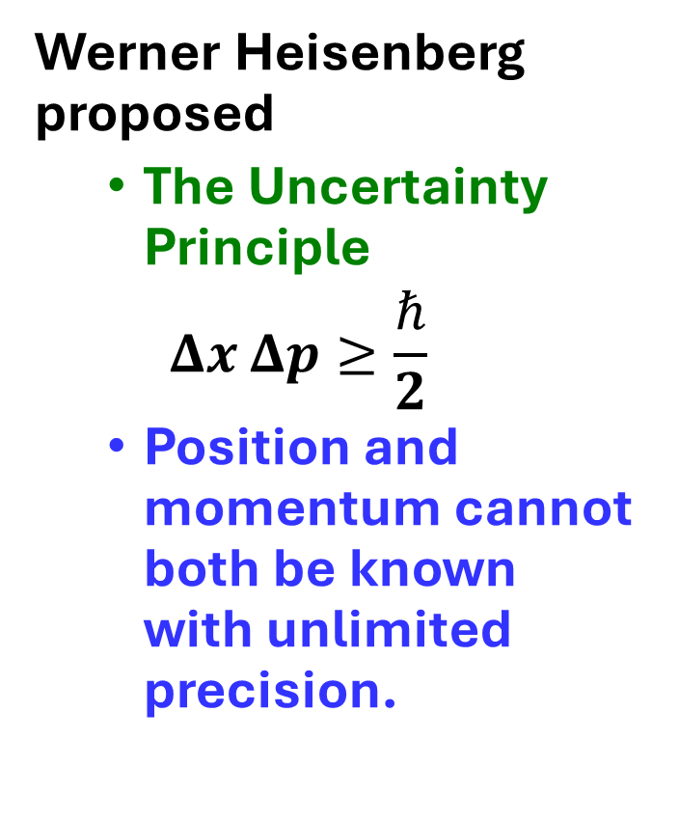
Heisenberg's Answer
Werner Heisenberg proposed
  The Uncertainty Principle
  $$Δx Δp≥\frac{ℏ}{2}$$
  Position and momentum cannot both be known with unlimited precision.
40

Slide 41
Why the Electron Cannot Collapse
Suppose the electron is forced into the proton.
Then
  Position uncertainty becomes extremely small.
  Momentum uncertainty becomes extremely large.
Kinetic energy becomes enormous.
  The enormous kinetic energy prevents collapse.
  The electron is confined to a shell around the proton
  The atom remains stable.

Slide 42
The Electron Shell Emerges
The competition between
  electrical attraction
and
  quantum uncertainty
produces a stable electron shell.
  The Uncertainty Principle correctly predicts
  that atoms can exist.

Slide 43
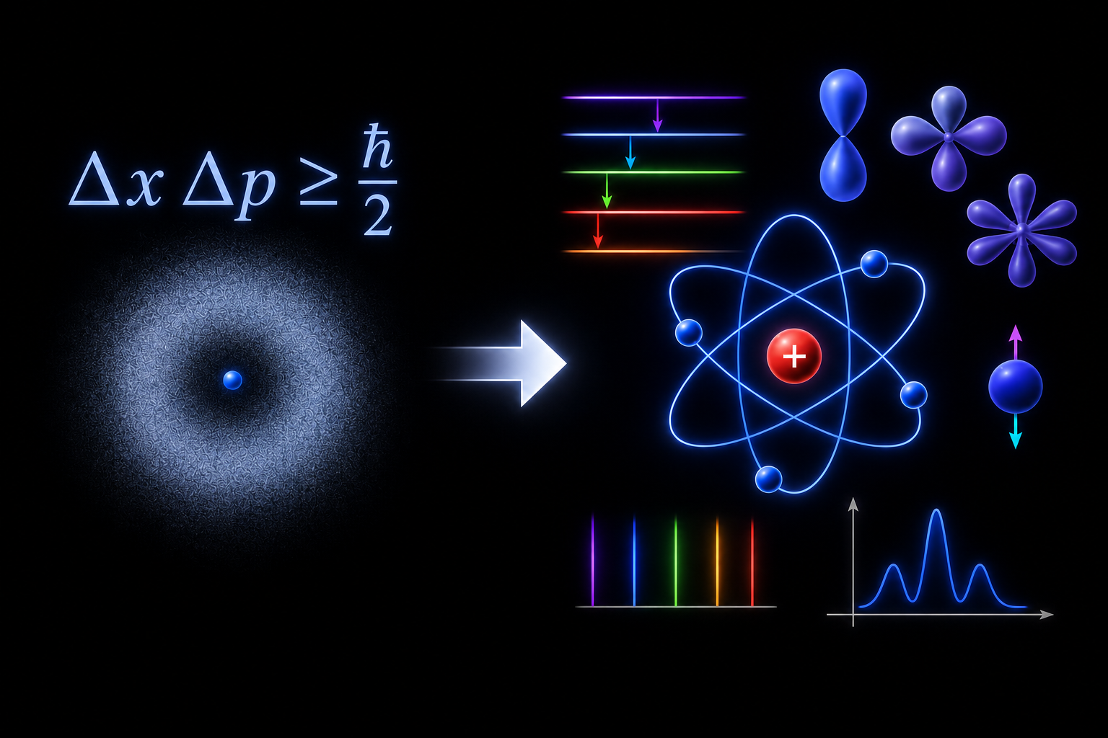

But Heisenberg Doesn't Tell the Whole Story
The Uncertainty Principle explains
  why atoms are stable.
It does not predict
  the exact electron probability distribution
  the allowed energy levels
  the spectral lines
  electron spin
  orbital shapes
For that we need something more powerful.

Slide 44
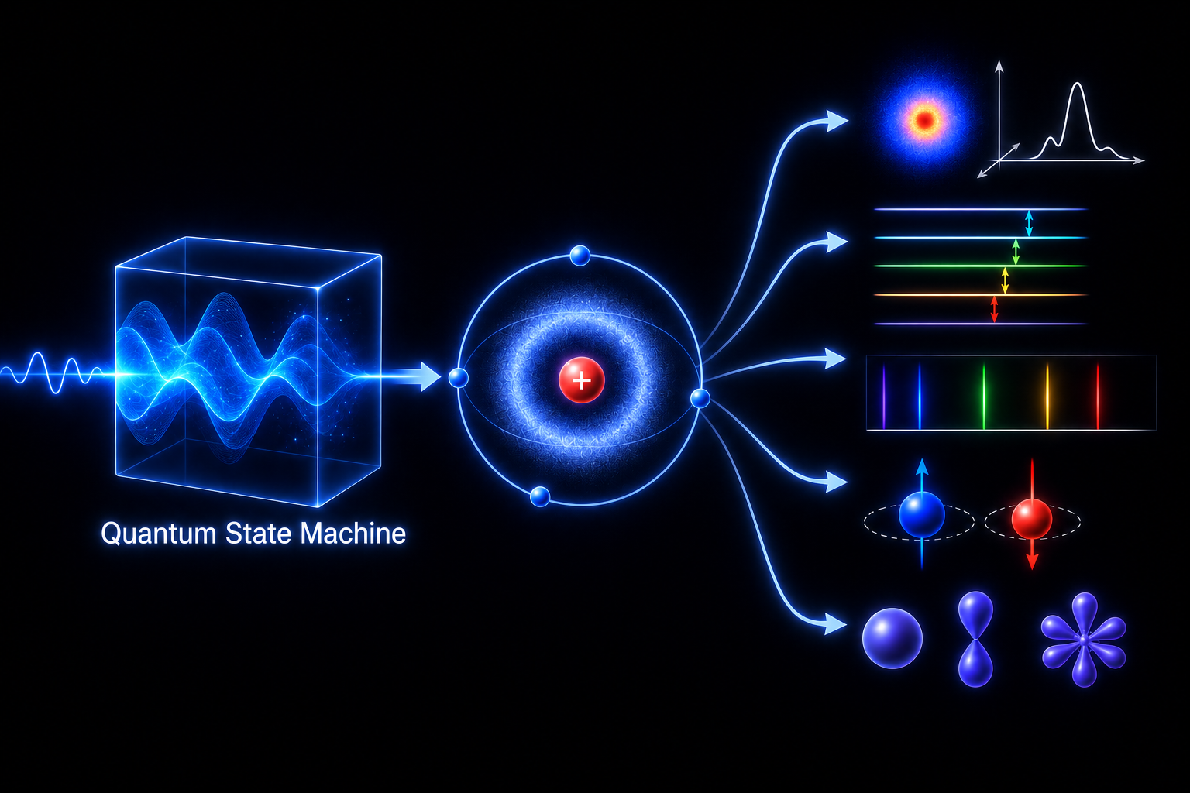
The Quantum State Machine
Starting with
  one proton
  one electron
the Quantum State Machine predicts
  the electron probability distribution
  the stable bound states
  the allowed energy levels
  angular momentum
  spin
  transition probabilities
  the hydrogen emission spectrum
Using exactly the same Quantum State Machine we used to predict all of our other experimental results.

Slide 45
The Quantum State Machine
The Quantum State Machine predicts
  the radius of the electron cloud
  the orbital structure
  the hydrogen spectrum
  fine structure
  hyperfine structure
  Zeeman splitting
  and every experimentally observed property of hydrogen.
The agreement with experiment is extraordinary.

Slide 46
Looking Through the Process Lens
Stable atoms are not permanent objects.
  They are enduring patterns maintained by the laws of physics.
The hydrogen atom is another example of:
  Stable Matter → Enduring Relations
  A society whose order is inherited from one moment to the next.

Slide 47
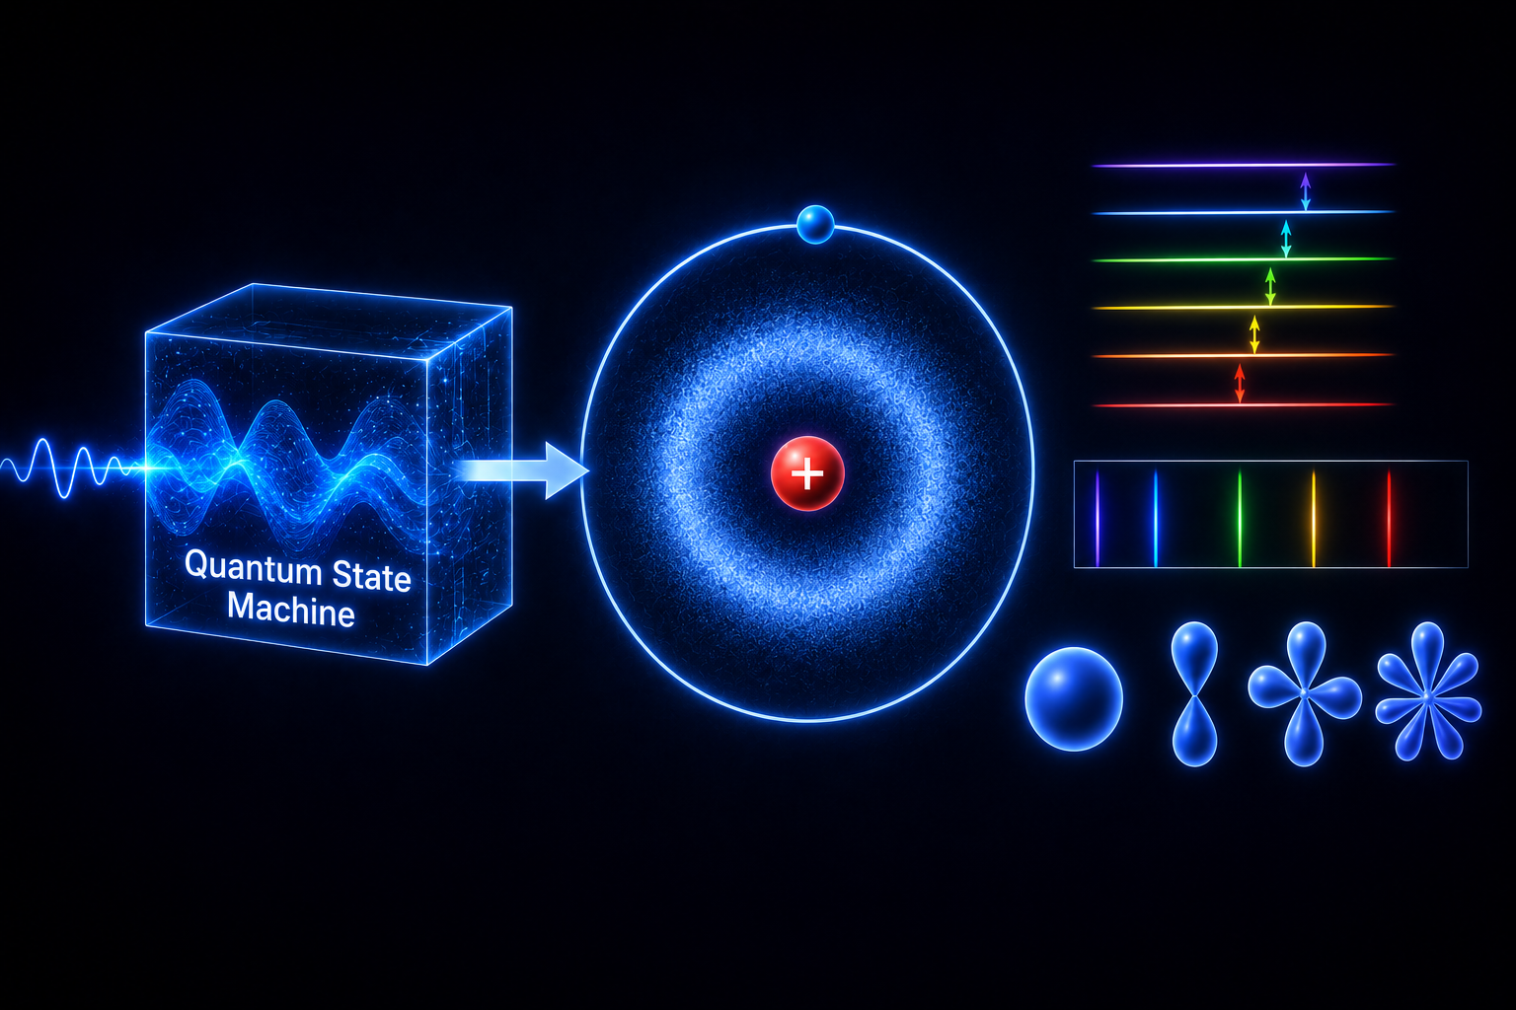
The Quantum State Machine Has Built an Atom
We began with
  an electron
  a proton
We ended with
  The Hydrogen Atom
The Quantum State Machine has now successfully built
  particles
  hadrons
  nuclei
  atoms
The journey continues...

Slide 48
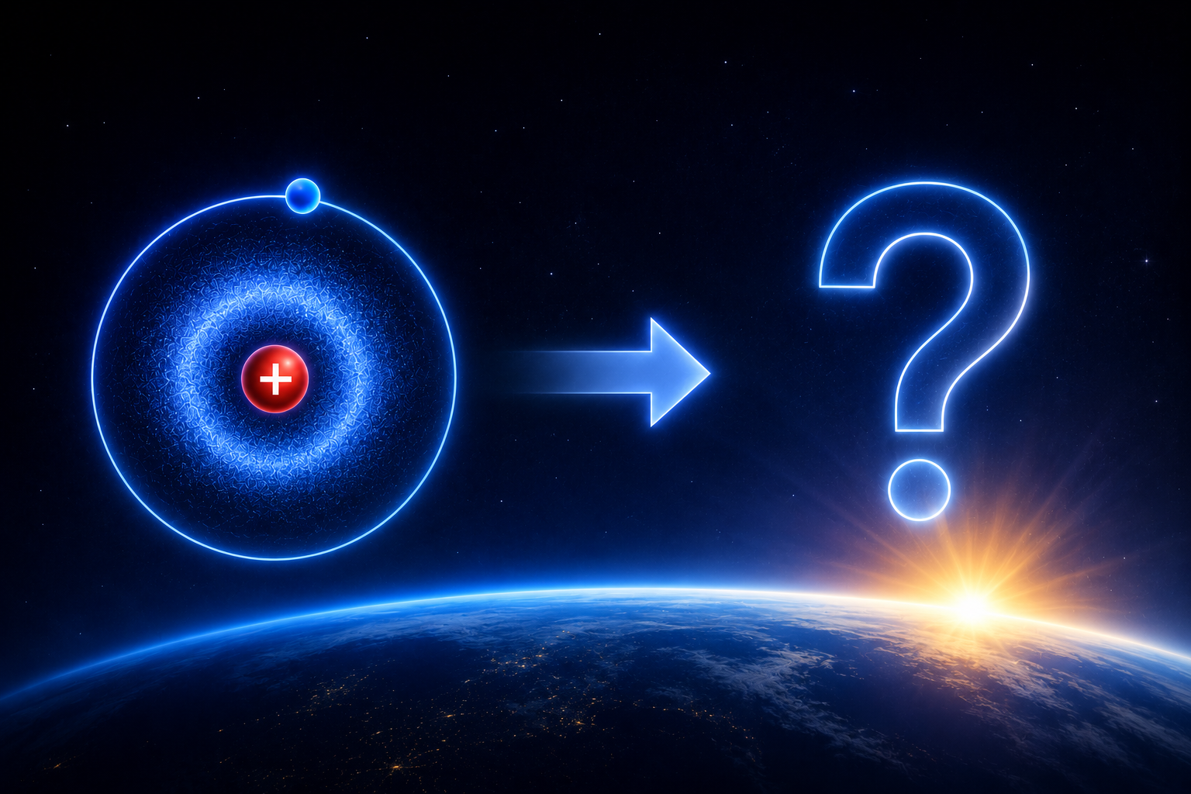
Next Week
Our final lecture of the series
  Starting with hydrogen, we'll let the Quantum State Machine build the entire periodic table.
  We'll follow that chemistry into stars, planets, and ultimately life itself.
  We will see where we are headed in the future.

Slide 49


