Slide 1
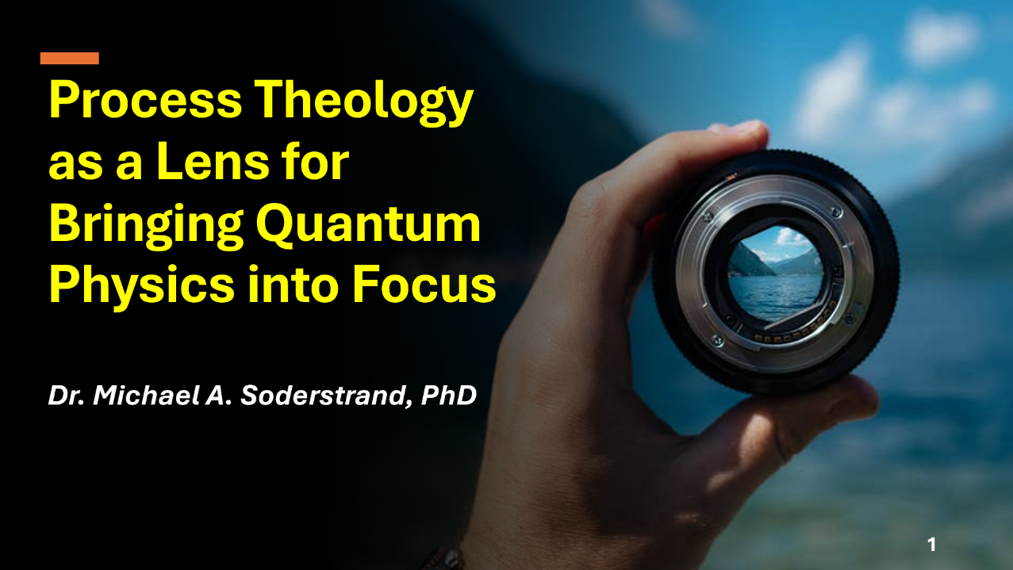

Process Theology as a Lens for Bringing Quantum Physics into Focus
Dr. Michael A. Soderstrand, PhD
Lecture 8: Summary and Conclusions
→ Understanding Physics Through the
Process Lens

Slide 2
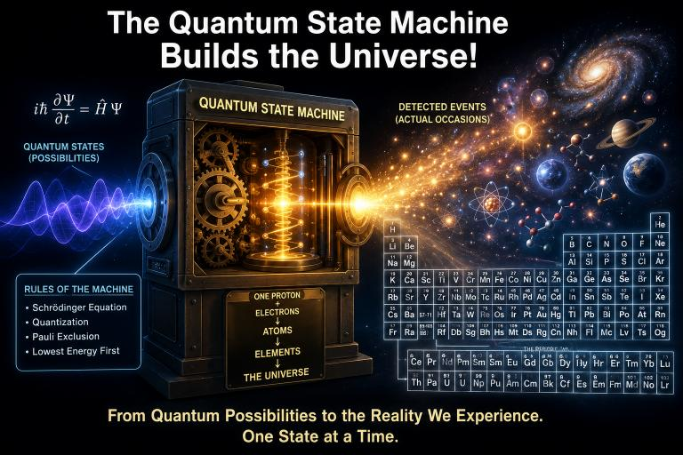
The Quantum State Machine Builds the Universe!
Looking Back
Over the past seven lectures we have discovered that
  Quantum mechanics predicts probabilities.
  The Quantum State Machine evolves quantum states.
  Detection events reveal actual outcomes.
  The Quantum State Machine built the hydrogen atom.
Today we ask one final question...

Slide 3
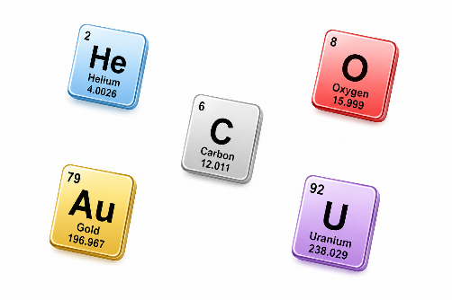
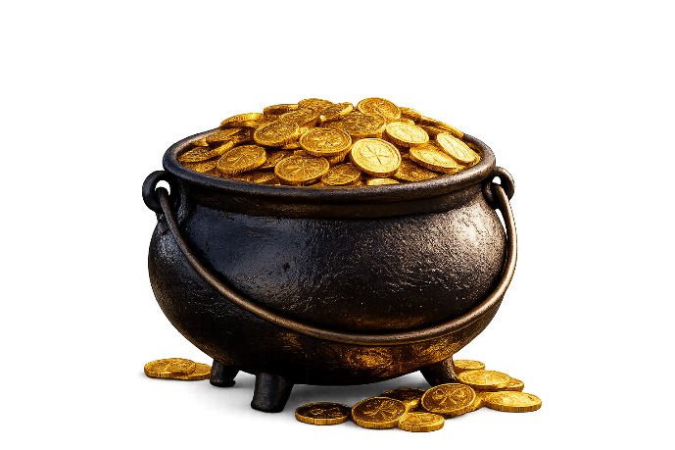
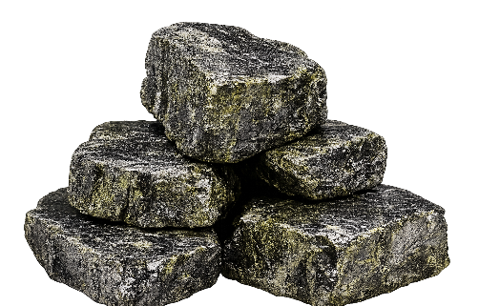
Can the Quantum State Machine Build Everything Else?
Hydrogen was only the beginning.
Can the same mathematics build:
  helium?
  carbon?
  oxygen?
  gold?
  uranium?

Slide 4
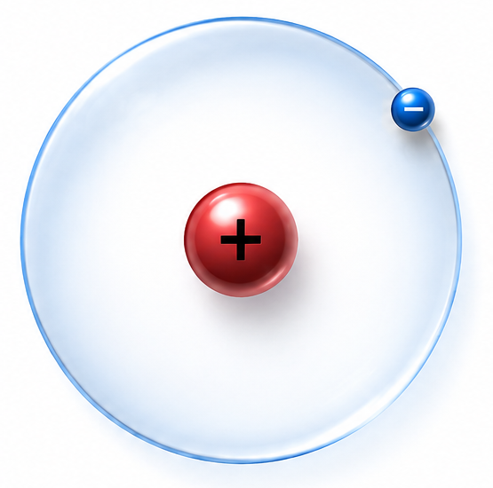
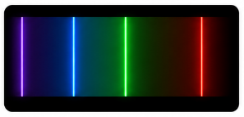
The Two-Electron Quantum State
We Began with Hydrogen in the last lecture
  One proton
  One electron
  The simplest atom.
The Quantum State Machine predicted
  An electron shell with its energy levels
  Its spectrum.

Slide 5
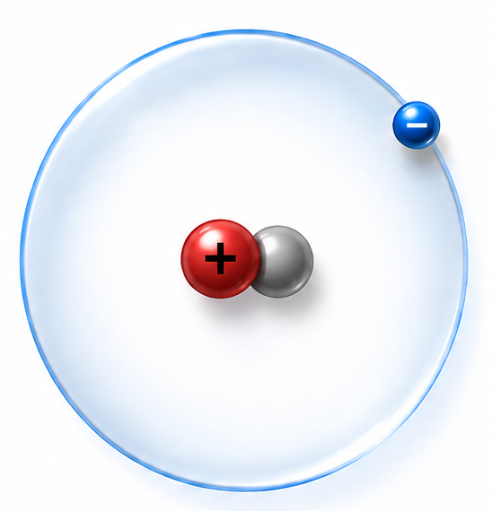
What If We Add One Neutron?
Then we let the Quantum State Machine predict Deuterium:
Deuterium
  One proton
  One neutron
  One electron
Chemically,
  it behaves almost exactly like hydrogen.

Slide 6
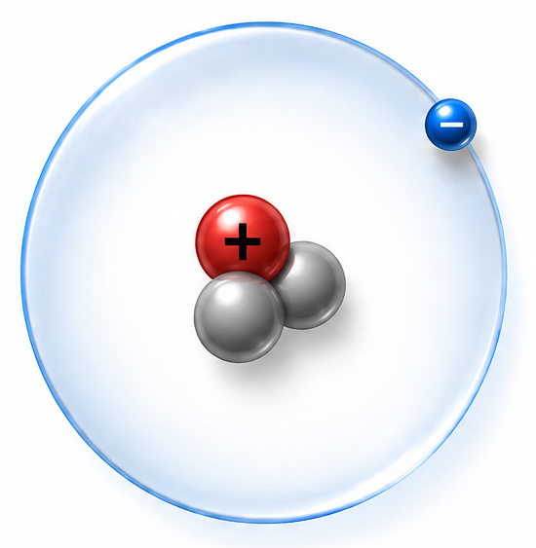
What If We Add Another Neutron?
And moved on to let the Quantum State Machine predict Tritium:
Tritium
  One proton
  Two neutrons
  One electron
  Still hydrogen.
The number of protons
  has not changed.
  It still acts chemically like hydrogen

Slide 7
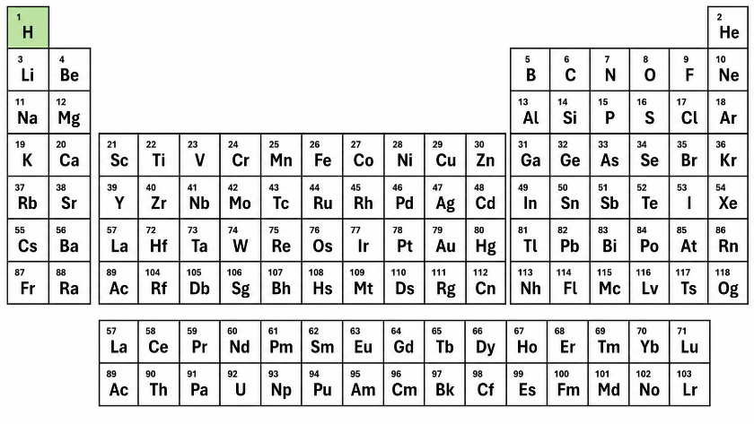
What Makes a Chemical Element?
The identity of a chemical element is determined by
  the number of protons.
  This number is called the atomic number.
  That is the number shown on the Periodic Table

Slide 8
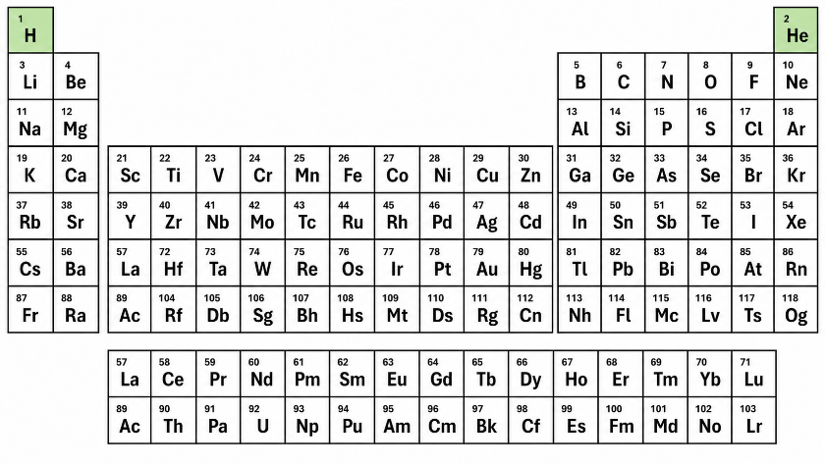
Let's Add One More Proton
Now the nucleus contains
  Two protons
To remain electrically neutral,
  the atom must also gain
  a second electron.
We have created

Slide 9
Let's Add One More Proton
Now the nucleus contains
  Two protons
To remain electrically neutral,
  the atom must also gain
  a second electron.
We have created
  helium.

Slide 10

The Quantum State Machine Has a New Problem
Where should the second electron go?
  The Answer:
    The electron exhibits free will within the probability constraints predicted by the Quantum State Machine.
    Physics cannot tell us where any individual electron will go
    Instead, physics will give us probability distributions.

Slide 11
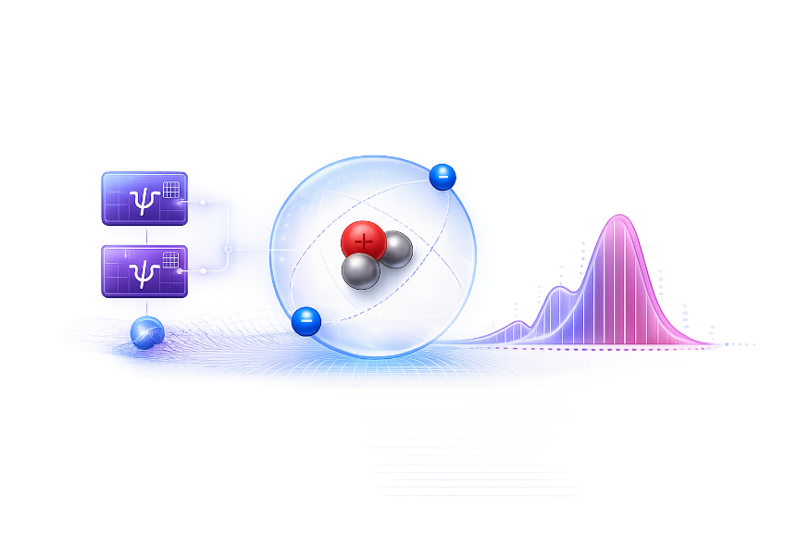
The Quantum State Machine is Perfect for Calculating those Probability Distributions
We have seen this before.
In the single-slit experiment the Quantum State Machine predicted
  regions of high probability
  regions of low probability
  even regions where detections were very unlikely.
  Many photons revealed the pattern.
  One photon at a time.
The Quantum State Machine predicts where detections are likely to occur.

Slide 12
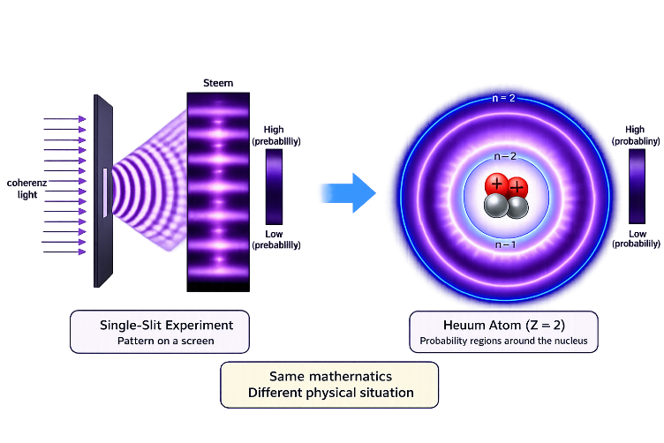
Around a Nucleus the Same Thing Happens
With a positively charged nucleus.
  The Quantum State Machine now predicts
  regions where an electron is likely to be detected
  regions where it is unlikely to be detected.
Instead of a pattern on a screen,
  The pattern surrounds the nucleus.
  Same mathematics
  Different physical situation

Slide 13
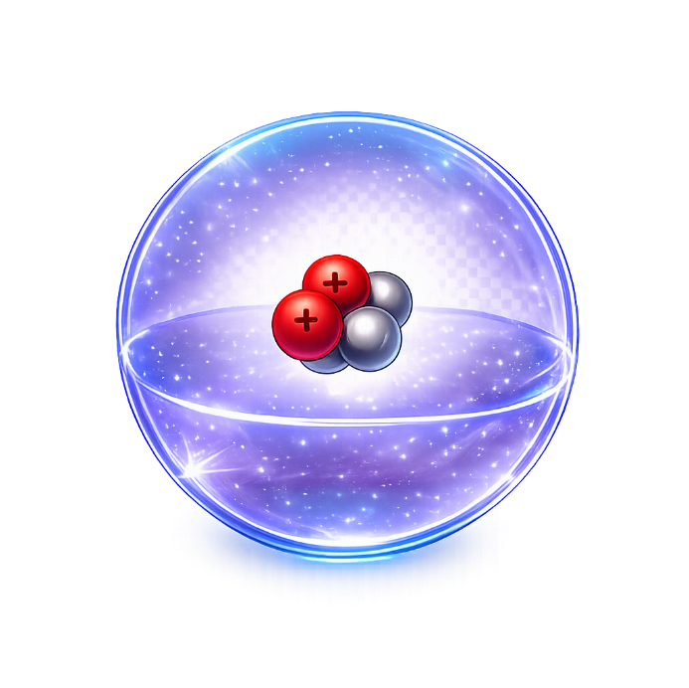
The First Shell Is a Probability Distribution
The first shell is not an orbit.
  It is the first stable probability distribution produced by the Quantum State Machine.
If we repeatedly detected the electron,
  The detections would gradually build this pattern.
  Exactly like the single-slit experiment.
  Thousands of tiny detection dots building the cloud.

Slide 14
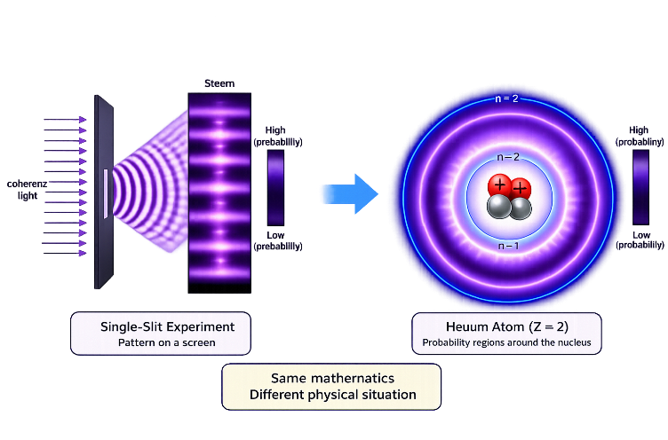
The Pattern Changes, But the Idea Does Not
In the single-slit experiment
the Quantum State Machine predicted alternating regions
  of high probability
  and low probability
  across a flat screen.
Around a nucleus
the Quantum State Machine predicts alternating regions (shells)
  of high probability
  and low probability
  surrounding the nucleus.
The mathematics is doing exactly what we have learned to expect.

Slide 15
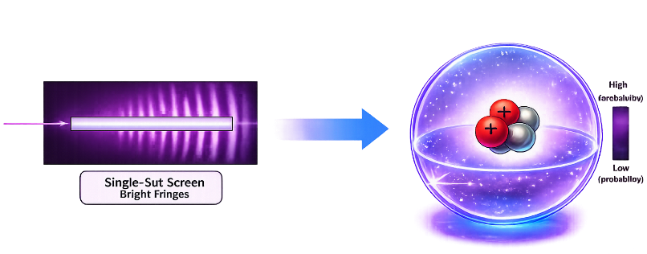
Key Concept:
The bright fringes on the single-slit screen and the electron shells around an atom are the same kind of thing.
Both are stable probability distributions produced by the Quantum State Machine under different physical conditions.
Both are examples of particle free-will within constraint.

Slide 16
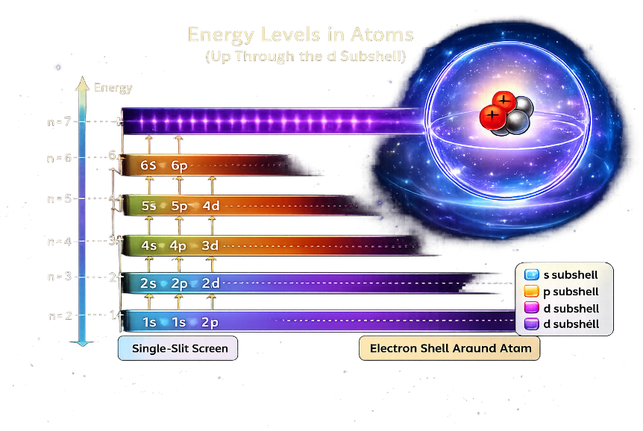
Different Probability Distributions Have Different Energies
Why?
Because each stable probability distribution is a different solution of the Quantum State Machine.
  Some probability distributions require more kinetic energy to maintain their shape.
  Others have lower potential energy because they are closer to the nucleus.
The Quantum State Machine balances these effects automatically.
  The result is a ladder of stable energy levels.

Slide 17
Organizing the Probability Distributions
The Quantum State Machine does not produce
just one stable probability distribution.
  It produces a whole family of them.
These probability distributions are organized by
  energy
  size
  shape
These become the electron shells and orbitals.

Slide 18
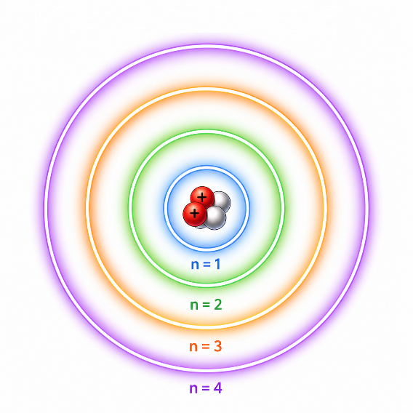
The Shell Numbers
Physicists give names to these shells and orbitals:
The shells are numbered
  1
  2
  3
  ...
The shell number tells us
  Approximately how far the probability distribution extends
  from the nucleus and
  Its energy level.
As the shell number increases,
  average distance increases
  energy increases.

Slide 19
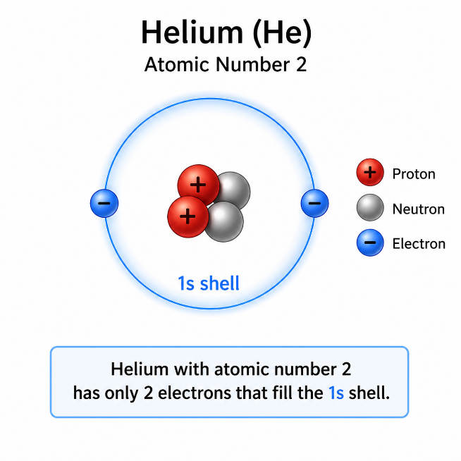
Every Shell Begins With an “s” Orbital
Each shell begins with
  one spherical probability distribution.
  It is called the “s” orbital.
  “s” stands for “sharp”, but it might be more useful to think of it as “spherical”.
Each orbital can hold
  two electrons.
Therefore
  Shell 1
  1s
  2 electrons
Helium with atomic number 2 has only 2 electrons that fill the 1s shell.

Slide 20
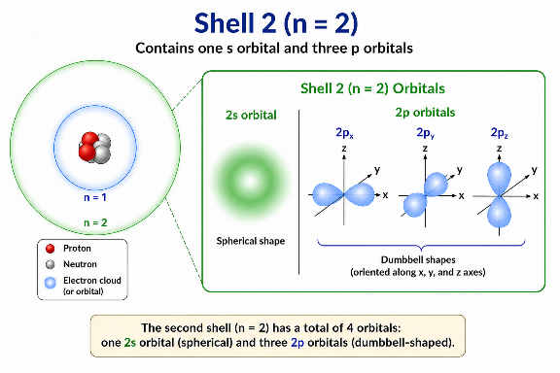

Shell 2 Introduces New Shapes
The second shell begins the same way. It has
  one spherical orbital
  2s
But now the Quantum State Machine also predicts
  three additional probability distributions with equally energetic orbitals.
These are called
  2px
  2py
  2pz
Each points in a different direction (“p” stands for “principle” but it might be more useful to think of it as “pointing”.
  Each has a dumbbell-shaped probability distribution.
  The p orbitals point in the x, y and z direction.

Slide 21
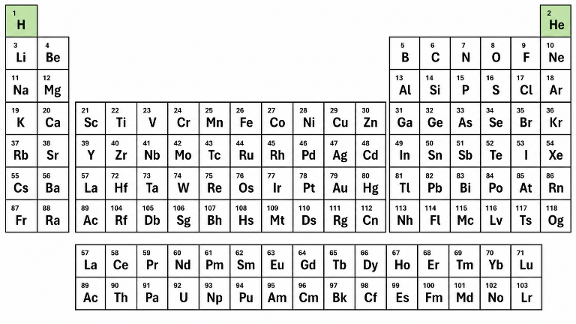
Filling the Second Shell
(From Helium to Neon)
Shell 2 contains
  2s
  2p_{x}
  2p_{y}
  2p_{z}
Each orbital holds two electrons, therefore:
  2s 1 orbital × 2 electrons
  2p 3 orbitals × 2 electrons
  8 electrons total

Slide 22
Filling the Second Shell
(From Helium to Neon)
We have 8 electrons from Shell 2
Also, in Shell 1:
  2 electrons
We now have 10 electrons total.

Slide 23
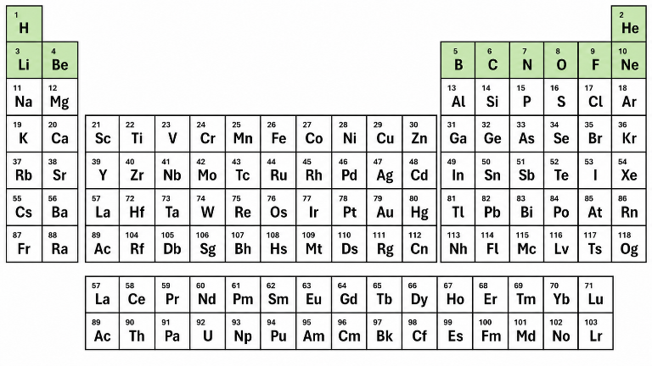
Filling the Second Shell
(From Helium to Neon)
Lithium through Neon fill in the entire second shell 2s, 2p_{x}, 2p_{y} and 2p_{z}
We have 8 electrons from Shell 2
Also, in Shell 1:
  2 electrons
We now have 10 electrons total.
  The first ten elements of the periodic table.

Slide 24
Filling the Second Shell
(From Helium to Neon)
Lithium through Neon fill in the entire second shell 2s, 2p_{x}, 2p_{y} and 2p_{z}
We have 8 electrons from Shell 2
Also, in Shell 1:
  2 electrons
We now have 10 electrons total.
  The first ten elements of the periodic table.

Slide 25
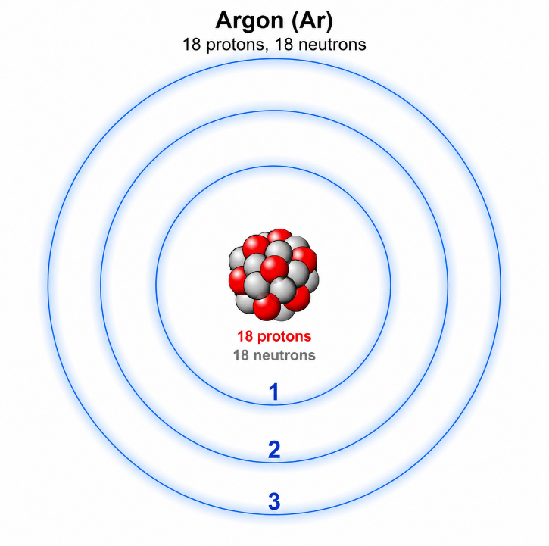
Shell 3
The pattern continues.
Shell 3 contains
  3s
  3p
  3d (This is a new set of orbitals called “diffuse”.)
More stable probability distributions.
More places for electrons.
More elements of the periodic table

Slide 26
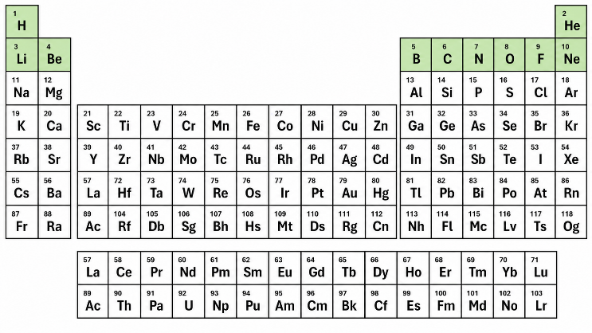
Filling the First Three Shells
The Quantum State Machine predicts stable probability distributions.
Electrons always occupy the lowest available energy first.
Shell 1
  1s → 2 electrons
Shell 2
  2s 2p → 8 electrons
Shell 3
  3s 3p → 8 electrons
Total
  2 + 8 + 8 = 18 electrons
This brings us to

Slide 27
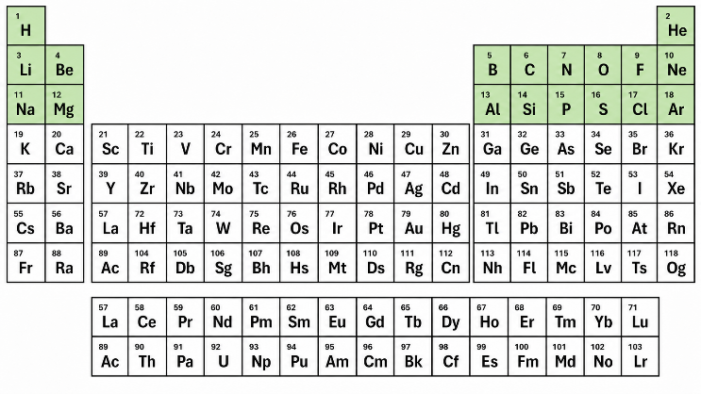
Filling the First Three Shells
Sodium (Z=11) through Argon (Z-18) filled in the 4 orbitals (8 electrons) in Shell 3.
The next element is Potassium (Z=19)
The Quantum State Machine predicts stable probability distributions.
Electrons always occupy the lowest available energy first.
Shell 1
  1s → 2 electrons
Shell 2
  2s 2p → 8 electrons
Shell 3
  3s 3p → 8 electrons
Total
  2 + 8 + 8 = 18 electrons
This brings us to
  Argon
  Atomic Number 18

Slide 28
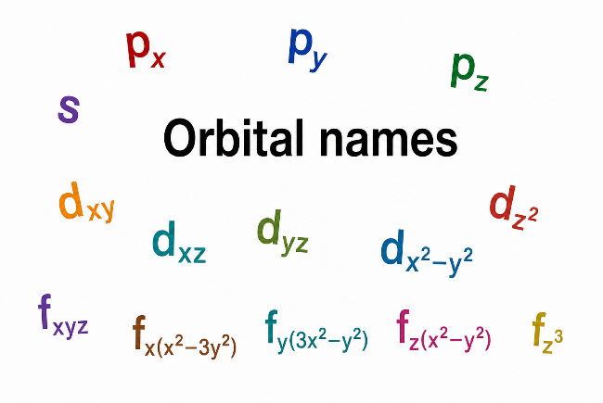
Before We Continue...
Let's pause for just a moment.
  We need to introduce the names physicists use for the different families of probability distributions.
  These names will appear throughout the rest of the lecture.
  We also want to look at the shape of these probability distributions.
Once we know the names and shapes,
  The rest of the periodic table becomes much easier to understand.

Slide 29
Four Families of Probability Distributions
The Quantum State Machine predicts four families of stable probability distributions.
These memory aids describe the probability distributions, not the historical origin of the letters.
Physics
Chemistry (Historical)
Our Memory Aid
s
sharp
spherical
p
principal
pointing
d
diffuse
directional
f
fundamental
fancy

Slide 30
Each Family Provides More Quantum States
Each family contains a different number of probability distributions.
As the shapes become more elaborate the Quantum State Machine provides more places for electrons.
Probability
Family
Electron States
Distributions
s = spherical
1
2
p = pointing
3
6
d = directional
5
10
f = fancy
7
14

Slide 31
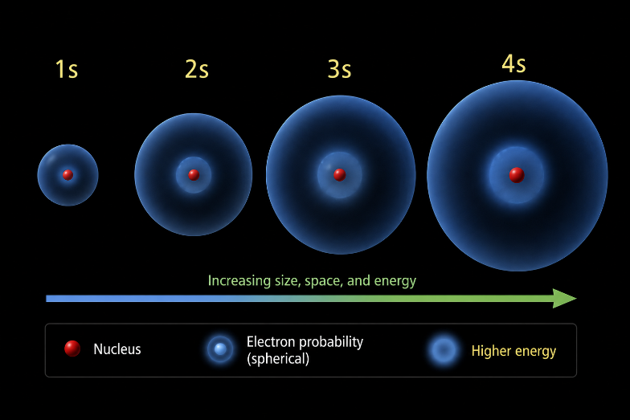
Higher Shells Extend Farther from the Nucleus
Within one family, each new shell is larger than the previous one.
For example,
  1s
  2s
  3s
  4s
“s” shells are all spherical probability distributions, but each new shell:
  extends farther from the nucleus,
  occupies more space,
  and has higher energy.

Slide 32
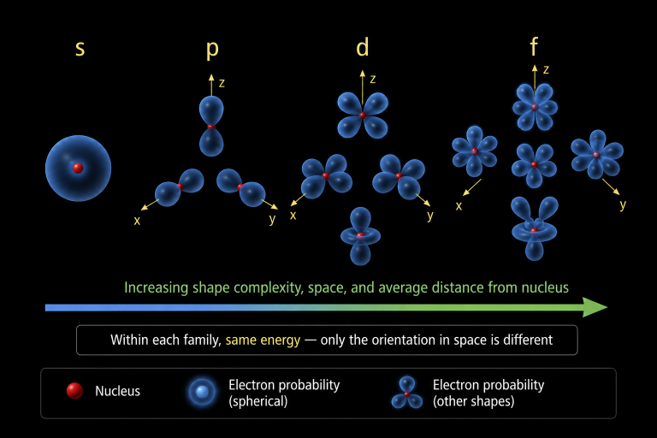
Within a Shell, New Families Become Larger.
The Quantum State Machine predicts four families of probability distributions.
As we move s → p → d → f
  the shapes become more elaborate,
  the probability distributions occupy more space,
  and the average electron distance from the nucleus increases.
Yet within each family,
  all p orbitals have the same energy,
  all d orbitals have the same energy,
  all f orbitals have the same energy.
Only their orientation in space is different.

Slide 33
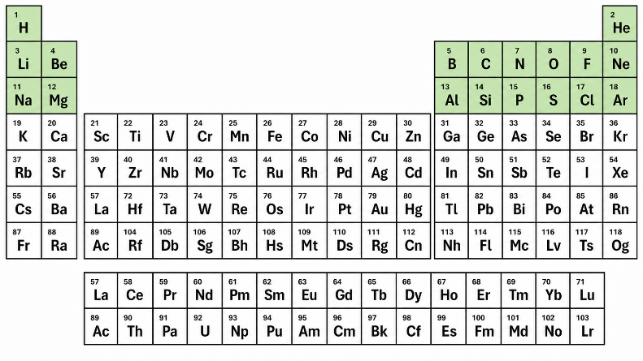
Now Let's Continue Building the Atom
We paused to learn the language. Now let's continue building the periodic table:
So far we have reached
  Argon (18)
The next two elements should be
  Potassium (19)
  Calcium (20)
So let’s continue to add protons and electrons one at a time?
What happens next?

Slide 34
The Quantum State Machine Predicts a Surprise!
Argon’s outer shell has 3s and 3p completely filled.
Physicists predicted 3d to fill next before moving to the next shell 4s.
But the Quantum State Machine predicts that:
  4s has slightly lower energy.
Therefore
  the next two electrons enter 4s (not 3d)
This produces

Slide 35
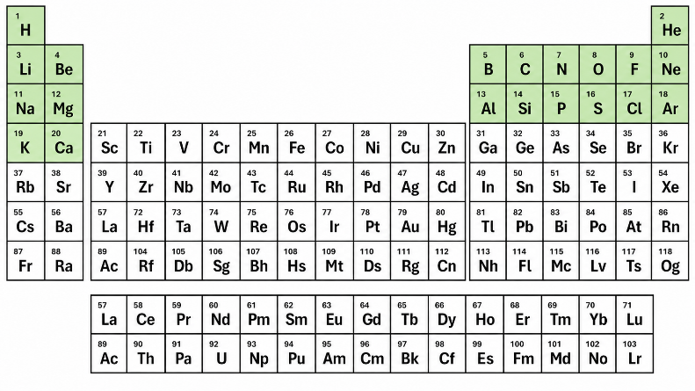
The Quantum State Machine Predicts a Surprise!
s (spherical)
d (directional)
p (pointing)
Argon’s outer shell has 3s and 3p completely filled.
Classical physics predicted 3d to fill next before moving to the next shell 4s.
But the Quantum State Machine predicts that:
  4s has slightly lower energy.
Therefore
  the next two electrons enter 4s (not 3d)
This produces
  Potassium (19)
  Calcium (20)
f (fancy)

Slide 36
The Quantum State Machine Predicts a Surprise!
Argon’s outer shell has 3s and 3p completely filled.
Classical physics predicted 3d to fill next before moving to the next shell 4s.
But the Quantum State Machine predicts that:
  4s has slightly lower energy.
Therefore
  the next two electrons enter 4s (not 3d)
This produces
  Potassium (19)
  Calcium (20)
The chemical properties of these elements are like Lanthanum
Lanthanum Series
4f (fancy)

Slide 37
The Quantum State Machine Predicts a Surprise!
Argon’s outer shell has 3s and 3p completely filled.
Classical physics predicted 3d to fill next before moving to the next shell 4s.
But the Quantum State Machine predicts that:
  4s has slightly lower energy.
Therefore
  the next two electrons enter 4s (not 3d)
This produces
  Potassium (19)
  Calcium (20)
The chemical properties of these elements are like Actinium
Actinium Series
5f (fancy)

Slide 38
The Transition Metals
Once 4s is filled, the Quantum State Machine returns to
  3d
Those five d orbitals hold 10 electrons
As they fill, we move across the transition metals:

Slide 39
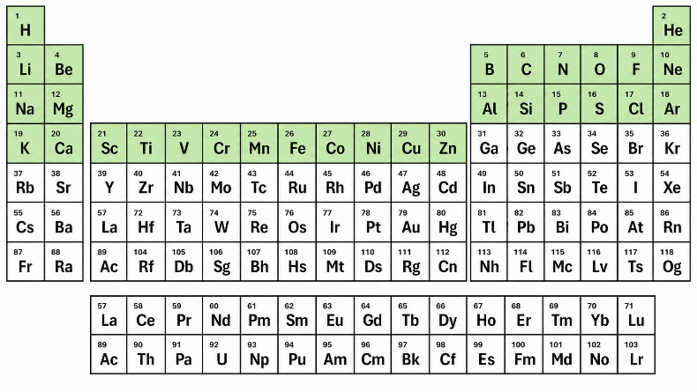
The Transition Metals
Once 4s is filled, the Quantum State Machine returns to
  3d
Those five d orbitals hold 10 electrons
As they fill, we move across the transition metals:
  Scandium (21)
  ↓
  ...
  ↓
  Zinc (30)

Slide 40
Completing the Fourth Shell
After 3d is full, the Quantum State Machine fills 4p
These six electrons carry us to

Slide 41
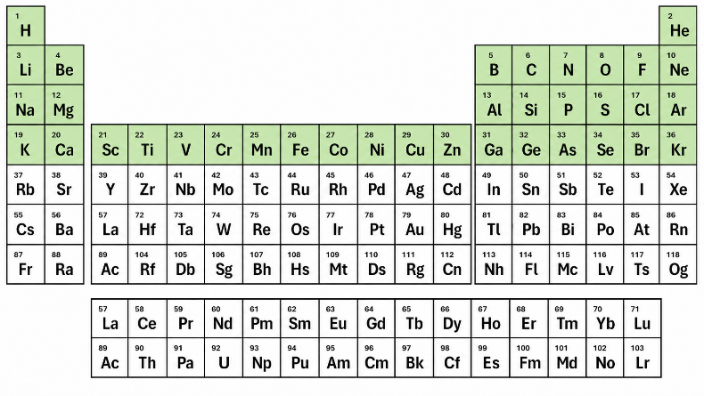
Completing the Fourth Shell
After 3d is full, the Quantum State Machine fills 4p
These six electrons carry us to
  Krypton
  Atomic Number 36

Slide 42
Completing the Fourth Shell
4s (spherical)
4p (pointing)
3d (directional)
IMPORTANT:
Starting with row 4
  The two 4s electrons are filled
  Then the 10 3d electrons are filled
  Finally the 6 4p electrons are filled
The s and p orbitals are from the current shell but the d orbitals are from the previous shell

Slide 43
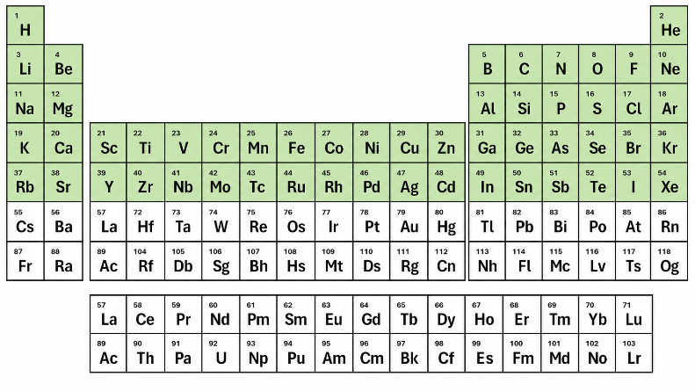
Completing the Fifth Shell
5p (pointing)
5s (spherical)
4d (directional)
The same filling order as the fourth shell:
Starting with row 5
  The two 5s electrons are filled
  Then the 10 4d electrons are filled
  Finally the 6 5p electrons are filled
The s and p orbitals are from the current shell but the d orbitals are from the previous shell

Slide 44
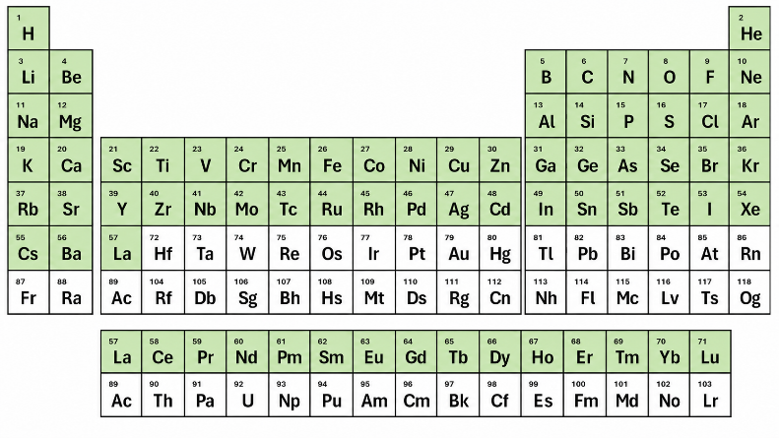
Filling the Sixth Shell
4f (fancy)
6s (spherical)
5d (directional)
This is where both d an f enter the picture:
Starting with row 6
  The two 6s electrons are filled.
  Then ONE 5d electron is filled.
  Then the 14 electrons of the 4f subshell are filled.
The s electrons are from the current shell, then one d electron from the previous shell, and then the 14 f electrons from two shells back!

Slide 45
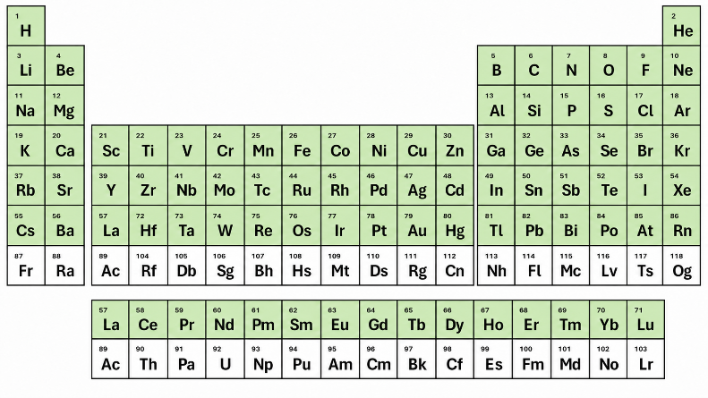
Completing the Sixth Shell
5d (directional)
6p (pointing)
This is where both d an f enter the picture:
Continuing with 5d and 6p
  The remaining 9 5d electrons are filled.
  Then the 6 6p electrons are filled.
The 2 s and 6 p electrons are from the current shell, then 10 d electrons are from the previous shell, and the the 14 f electrons from two shells back!

Slide 46
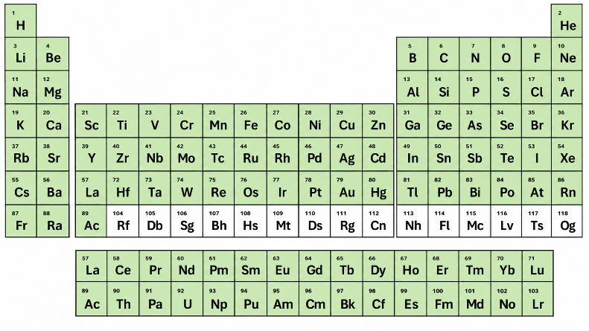
Filling the Seventh Shell
7s (spherical)
5f (fancy)
6d (directional)
This is where both d an f enter the picture:
Starting with row 7
  The two 7s electrons are filled.
  Then ONE 6d electron is filled.
  Then the 14 electrons of the 5f subshell are filled.
The s electrons are from the current shell, then one d electron from the previous shell, and then the 14 f electrons from two shells back!

Slide 47
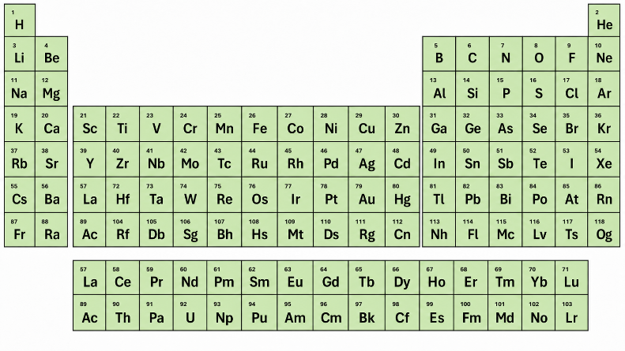
Completing the Seventh Shell
5f (fancy)
6d (directional)
This is where both d an f enter the picture:
Continuing with 6d and 7p
  The remaining 9 6d electrons are filled.
  Then the 6 6p electrons are filled.
The s electrons are from the current shell, then one d electron from the previous shell, and then the 14 f electrons from two shells back!

Slide 48
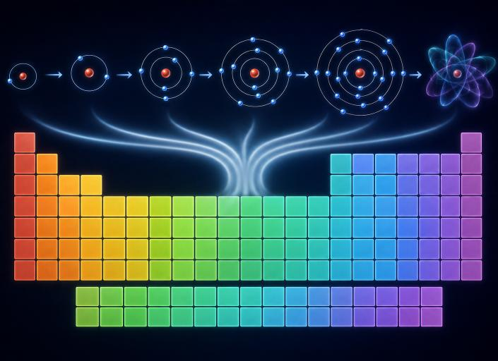
The Periodic Table Emerges Naturally
Every element is produced by adding one proton and one electron at a time.
  Each new electron occupies the lowest-energy probability distribution predicted by the Quantum State Machine.
  The periodic table is simply the record of that filling process.

Slide 49
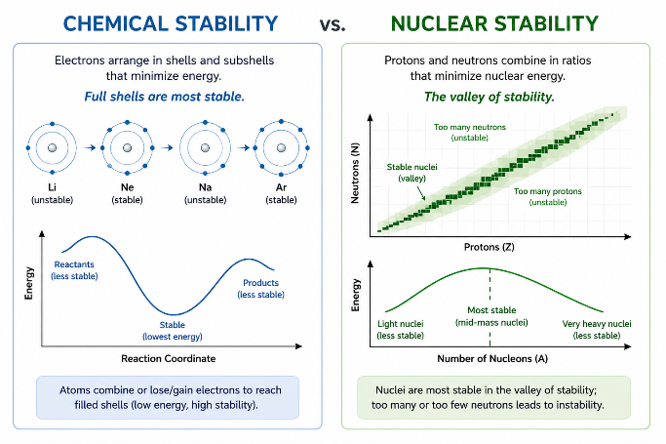
What are the Most Chemically Stable Elements?
Chemical Stability
Filled outer electron shells produce
  chemical stability.
Examples
  Helium
  Neon
  Argon
These atoms are the noble gases.

Slide 50
Two Different Concepts of Stability
Nuclear Stability Is Different
Do not confuse
  chemical stability
with
  nuclear stability.
They arise from completely different physics.

Slide 51
The Quantum State Machine Predicts Both
Nuclear Binding Energy
The most tightly bound nuclei are near
  Iron-56
and
  Nickel-62
Fusion in stars naturally moves toward this region.
  This is Nuclear Stability (refers to the nucleus)
  Chemical stability refers to the electrons and their shells

Slide 52
The Quantum State Machine Predicts Both
Why Lead Matters
  Lead is not the most tightly bound nucleus.
However,
  many radioactive decay chains eventually end
  at stable isotopes of lead.

Slide 53
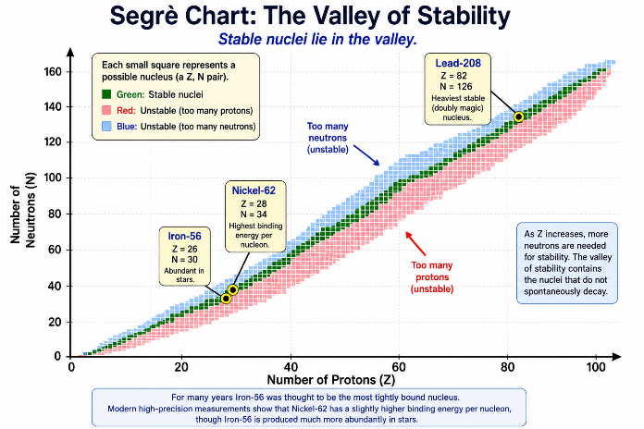
Lead-208 — A Doubly Magic Nucleus
Magic Numbers
The nucleus has shells, much like the electron shells surrounding the nucleus.
A filled nuclear shell is called a magic number.
Nuclei with filled proton and neutron shells are especially stable.
Five naturally occurring nuclei are doubly magic:
  Helium-4 (2 protons, 2 neutrons)
  Oxygen-16 (8 protons, 8 neutrons)
  Calcium-40 (20 protons, 20 neutrons)
  Calcium-48 (20 protons, 28 neutrons)
  Lead-208 (82 protons, 126 neutrons)

Slide 54
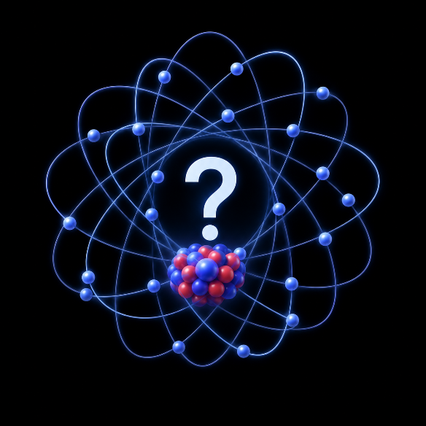
Naturally Occurring Chemical Elements
The Big Picture
The Quantum State Machine has now built
  Hydrogen
  Helium
  Every atom
  The Periodic Table
  Chemistry
The next question is...
  Where did all of these atoms come from?

Slide 55

Next Our Final Video from Nick Lucent
Video Introduction
  The Origin of the Chemical Elements
  Hydrogen and helium formed in the Big Bang.
  Stars forged heavier elements through nuclear fusion.
  Supernovae and neutron-star mergers created the heaviest elements.
Those elements eventually became
  planets,
  living organisms,
  and us.

Slide 56


Slide 57
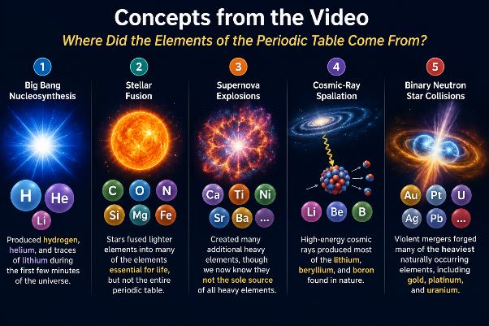
Concepts from the Video
Where Did the Elements of the Periodic Table Come From?
Big Bang Nucleosynthesis — Produced hydrogen, helium, and traces of lithium during the first few minutes of the universe.
Stellar Fusion — Stars fused lighter elements into many of the elements essential for life, but not the entire periodic table.
Supernova Explosions — Created many additional heavy elements, though we now know they are not the sole source of all heavy elements.
Cosmic-Ray Spallation — High-energy cosmic rays produced most of the lithium, beryllium, and boron found in nature.
Binary Neutron Star Collisions — Violent mergers forged many of the heaviest naturally occurring elements, including gold, platinum, and uranium.

Slide 58
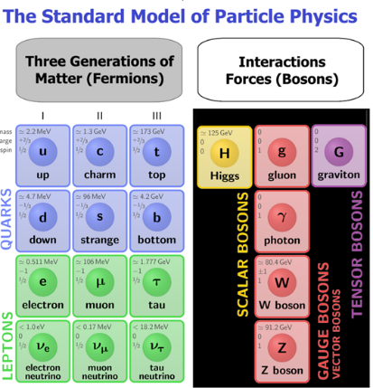
Beyond the Standard Model
Throughout this lecture series we have focused on the Standard Model of particle physics.
It explains:
  The elementary particles
  Three of the four fundamental forces
  Atoms
  Chemistry
  The periodic table
It is one of the most successful scientific theories ever developed.

Slide 59
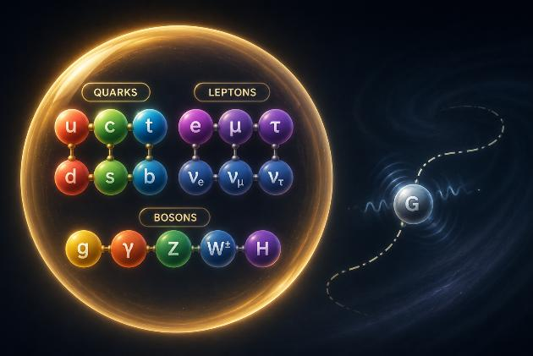

One Important Force Is Missing
There is one force we have intentionally left out.
  Gravity.
Gravity is described by Einstein's General Theory of Relativity,
not by the Standard Model.
Developing a quantum theory that successfully unifies gravity with the Standard Model remains one of the greatest challenges in modern physics.

Slide 60

Why I Didn't Cover Cosmology
Popular science books and videos often discuss
  quantum physics
  the Standard Model
  black holes
  dark matter
  dark energy
  the Big Bang
as though they are all part of one theory.
They are not.
  This lecture series has focused on the Standard Model of particle physics.
  Cosmology is a different field that studies the universe on its largest scales.

Slide 61
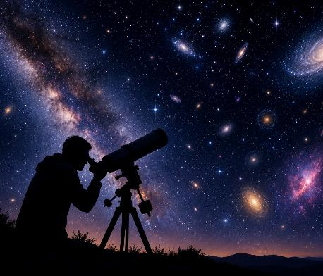
What Cosmologists Observe
Astronomers have discovered that
  galaxies rotate faster than expected
  the universe is expanding at an accelerating rate
These observations are well established.
The challenge is explaining why they occur.
Current leading explanations include
  dark matter
  dark energy
Their true physical nature remains unknown.

Slide 62

Open Questions
Many exciting questions remain.
  Can gravity be successfully unified with quantum physics?
  What are dark matter and dark energy?
  Will future discoveries connect these questions?
Today, no one knows.
  These remain active areas of scientific research.

Slide 63
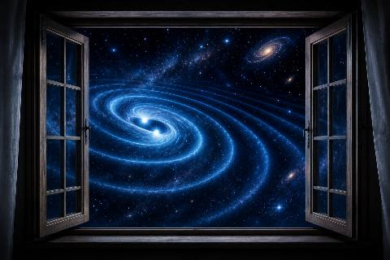
A New Window on the Universe
In recent years, scientists have opened an entirely new way of observing the universe.
  Instead of seeing only light,
  we can now detect gravitational waves produced by violent cosmic events.
  Nick Lucent mentioned in the video that new observations such as the collision of two neutron stars creates both gravitational waves and electromagnetic radiation.
  These observations allow scientists to test General Relativity with extraordinary precision and to explore some of the most extreme environments in nature.

Slide 64

The Journey Continues...
We have explored
  ✓ quantum states
  ✓ probability amplitudes
  ✓ quantum state machines
  ✓ atoms
  ✓ the periodic table
These ideas explain an enormous range of the physical world.
Yet one great challenge remains:
  bringing gravity and quantum physics together into a single coherent theory.

Slide 65

Thank You
Two Transformative Physics Models:
  The Standard Model has transformed our understanding of nature.
  General Relativity has transformed our understanding of gravity.
  Together they represent two of humanity's greatest intellectual achievements.
Yet they are still incomplete.
  The search for a deeper theory—and the continuing exploration of our universe—is one of the greatest scientific adventures of our time.
  Thank you for joining me on this journey.

Slide 66
Suggested Reading: Process Theology
Suggested Reading – Process Theology
1. Introduction to Process Theology
C. Robert Mesle
A friendly, non-technical introduction—the perfect place to begin.
2. Process Theology: An Introductory Exposition
John B. Cobb Jr. & David Ray Griffin
The classic introduction—a deeper and more systematic exploration of Process Theology.
3. God, Christ, Church: A Practical Guide to Process Theology
Marjorie Hewitt Suchocki
Discover how Process Theology reshapes traditional Christian beliefs and practices.
4. The Promise of Process Theology
Bruce G. Epperly
See how Process Theology is applied to contemporary spirituality and everyday life.
5. The Heart of Christianity
Marcus J. Borg
An inspiring bridge from Process Theology to Progressive Christianity.

Slide 67
Suggested Reading : Quantum Physics
1. Waves in an Impossible Sea
Matt Strassler
The best modern introduction to the Standard Model and quantum fields.
2. QED: The Strange Theory of Light and Matter
Richard P. Feynman
Discover how quantum probabilities successfully predict the behavior of light and matter.
3. In Search of Schrödinger's Cat
John Gribbin
Follow the remarkable history that led to the quantum revolution.
4. Fearful Symmetry
A. Zee
Explore why symmetry became the organizing principle of modern particle physics.
5. Reality Is Not What It Seems
Carlo Rovelli
Look beyond the Standard Model toward the frontier where quantum physics meets gravity.

Slide 68

Where Do We Go From Here?
We have spent eight weeks learning how quantum physics works.
The Standard Model
  Quantum states
  Time evolution
  Probability
  Atoms
  The Periodic Table
But one fascinating question still remains…
  What does quantum physics tell us about the nature of reality?

Slide 69
A Possible Future Lecture Series
Interpretations of Quantum Physics Using Process Theology as a Lens
Why are there so many interpretations of quantum physics?
  The Copenhagen Interpretation
  The Many-Worlds Interpretation
  Bohm's Hidden Variables
  Objective Collapse Theories
  Relational Quantum Mechanics
  Theological Perspectives on Quantum Reality
What have we learned?
  One mathematical theory... many different views of reality.

Slide 70


